Slide 1

ASSIGNMENT GUIDELINES
Make the changes in the PPT as you solve the parts
This file contains the template for the EDA part of the project.
Check the instructions added in the note section of every slide for clarity.
Don’t move around any image or text box
If you require more/lesser elements, be careful when you copy/delete the existing ones.

Slide 2
ASSIGNMENT Name: HARDIK MEHTA
Problem Statement
Bank of Corporate conducted a telemarketing campaign for one of its financial products, ‘Term deposits’, to build a long-term relationship with the existing customers. Your goal is to identify the target customers for the term deposits from the pool of the bank’s existing customers. You should also capture the key driving factors (or driver variables) behind the successful conversion of a customer, i.e., the customer opening a term deposit account with the bank.
Assignment Objective
To identify the target customers and the driving factors behind a successful customer conversion for future marketing campaigns.
Notes:
Problem Statement

Slide 3
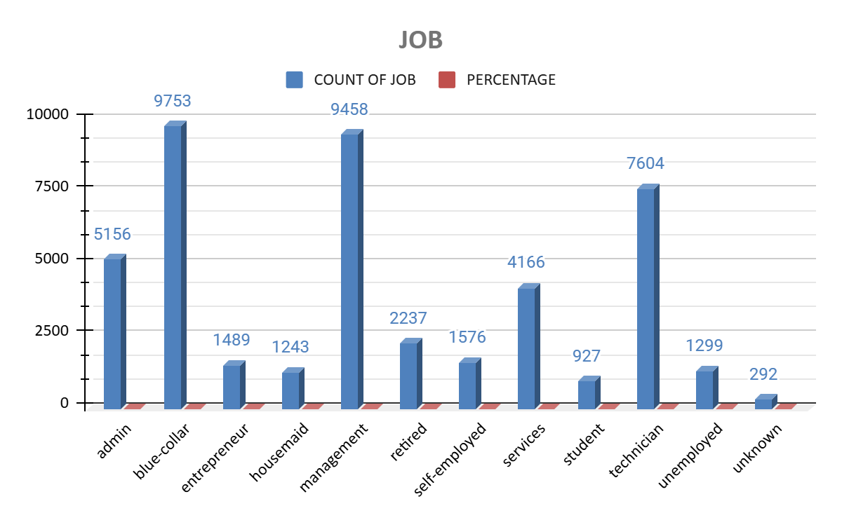
PART I : Univariate Analysis
Variable under consideration: (JOB)
Most customers are from the Blue-collar category which is- 9753 (21.58%) of the total job column.
The 2nd most customers are from the Management category- 9458 (20.92%) of the total job column.
The 3rd most customers are from the Technician category- 7604 (16.82%) of the total job column.
Lowest customers are from the unknown category- 292 (0.65%) of the total job column.
Notes:
Mention the results of the excel analysis and add the corresponding visualisations to the space provided above. Use copies of the above slide if necessary.

Slide 4
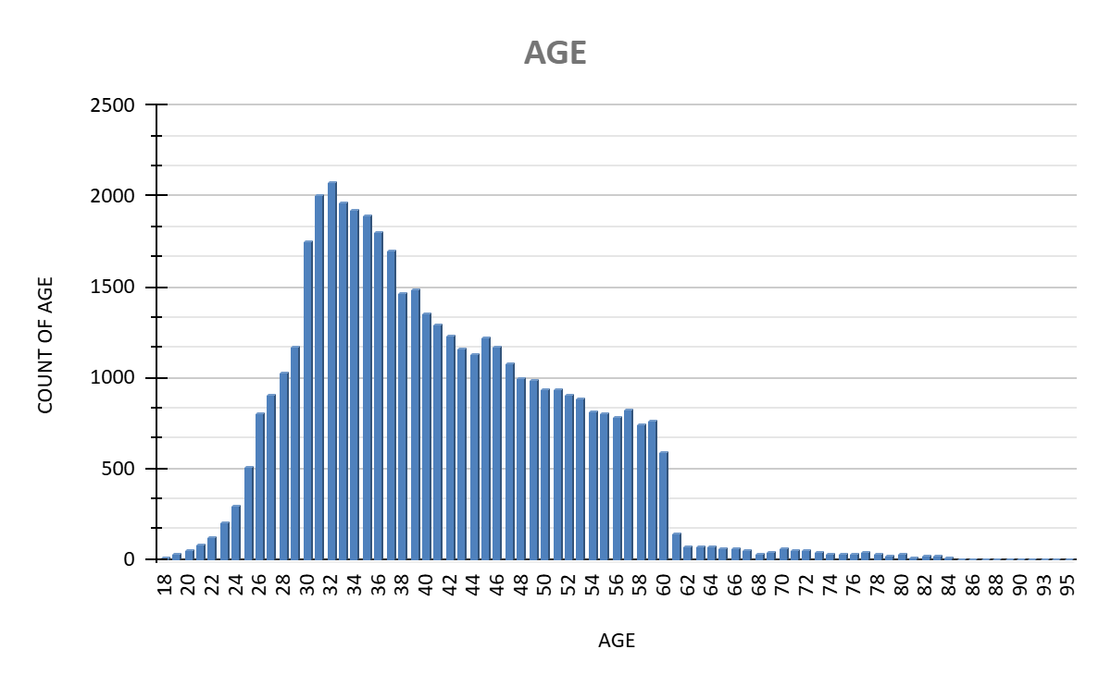
PART I : Univariate Analysis
Variable under consideration: (AGE)
Major group of people come from the age of 30-40.
Least group of people come from the age of 60 & above.
Notes:
Mention the results of the excel analysis and add the corresponding visualisations to the space provided above. Use copies of the above slide if necessary.

Slide 5
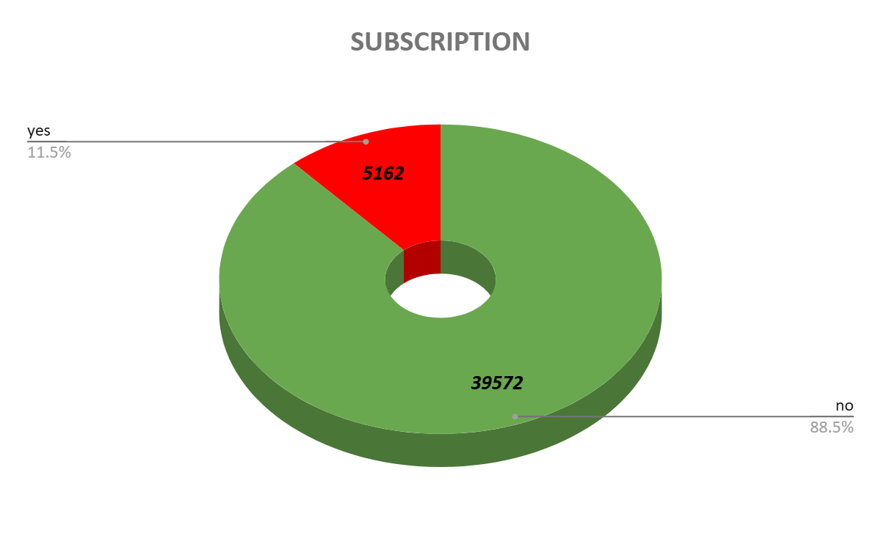
PART I : Univariate Analysis
Variable under consideration: (SUBSCRIPTION)
The frequency of YES is 5162 whereas the frequency of NO is 39572.
Therefore, successful conversion rate of subscription is 11.5% and failure conversion rate is 88.5%.
Notes:
Mention the results of the excel analysis and add the corresponding visualisations to the space provided above. Use copies of the above slide if necessary.

Slide 6
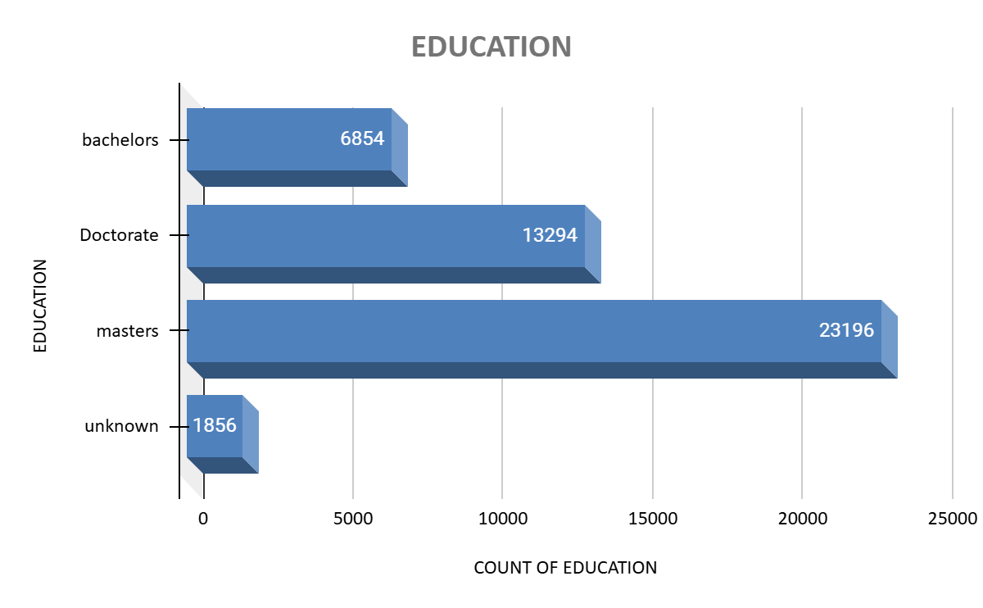
PART I : Univariate Analysis
Variable under consideration: (EDUCATION)
Most number of customers have qualification of Masters - 51.32% of the total education column.
The 2nd most number of customers have qualification of Doctorate - 29.41% of the total education column.
The 3rd most number of customers have qualification of Bachelors - 15.16% of the total education column.
Lowest number of customers have qualification of Unknown - 4.11% of the total education column.
Notes:
Mention the results of the excel analysis and add the corresponding visualisations to the space provided above. Use copies of the above slide if necessary.

Slide 7
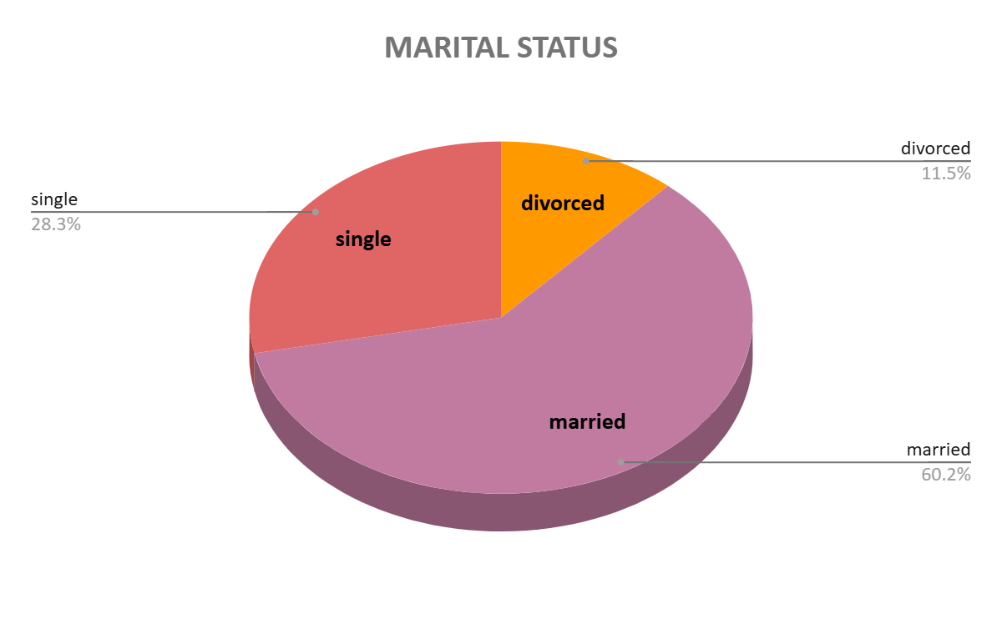
PART I : Univariate Analysis
Variable under consideration: (MARITAL STATUS)
The most number of customers marital status is Married - 60.2%.
The 2nd most number of customers marital status is Single - 28.3%.
The most number of customers marital status is Divorced - 11.5%.

Slide 8
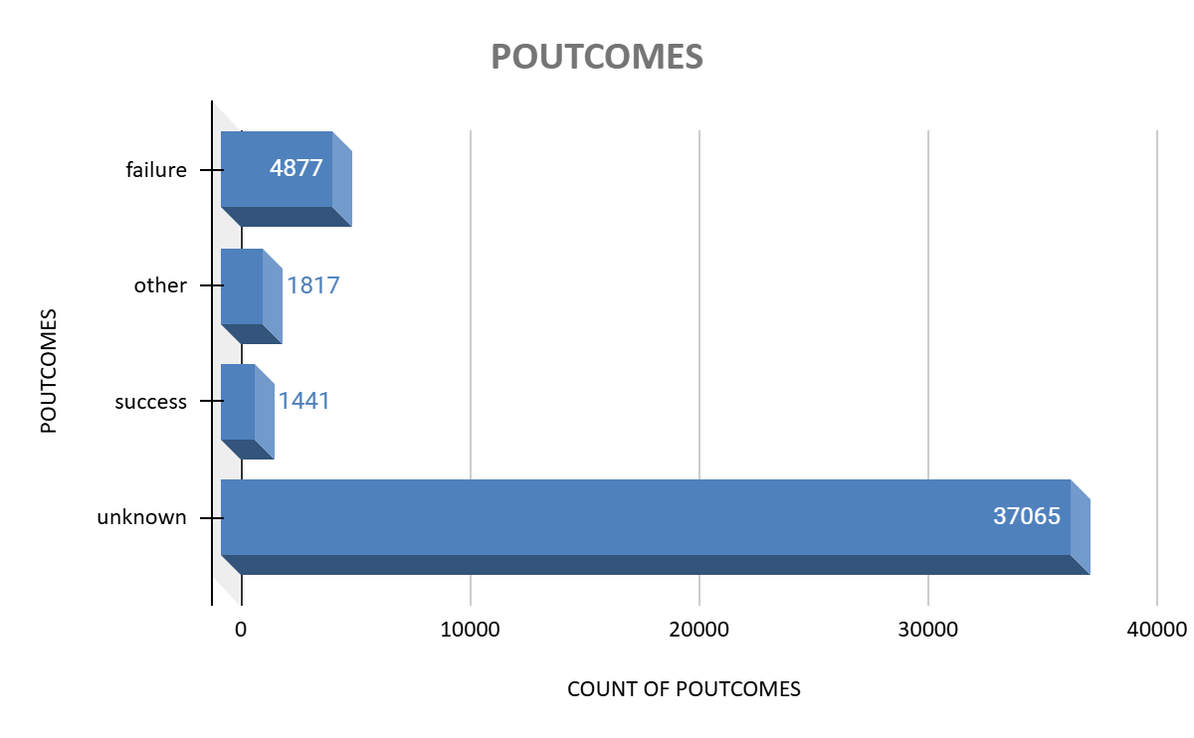
PART I : Univariate Analysis
Variable under consideration: (PREVIOUS OUTCOME)
Count of 37065 is denoted as 0 which represents that this number of customers have never bee reached for previous campaign which is a huge number.
Only count of 1441 is coming from the previous campaign.

Slide 9
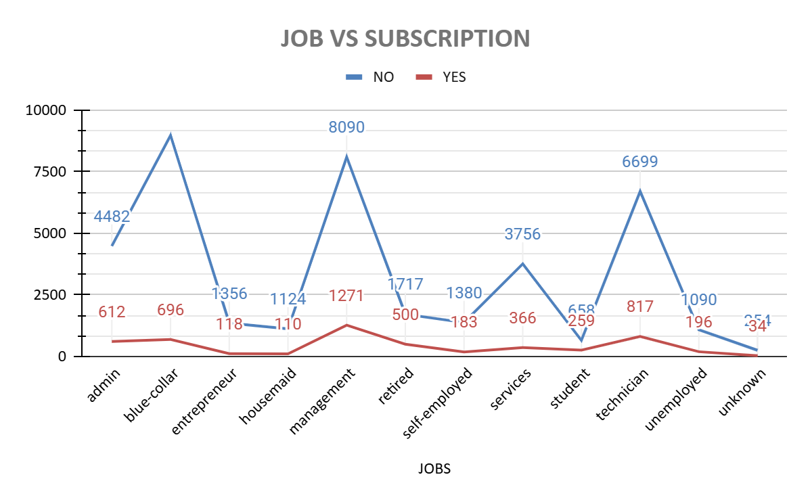
PART II : Bivariate Analysis
Variables under consideration: (JOB VS SUBSCRIPTION)
The highest number of YES is from management with 1271 counts.
The highest number of NO is from blue collar with 8966 counts.
Notes:
Mention the results of the excel analysis and add the corresponding visualisations to the space provided above. Use copies of the above slide if necessary.

Slide 10
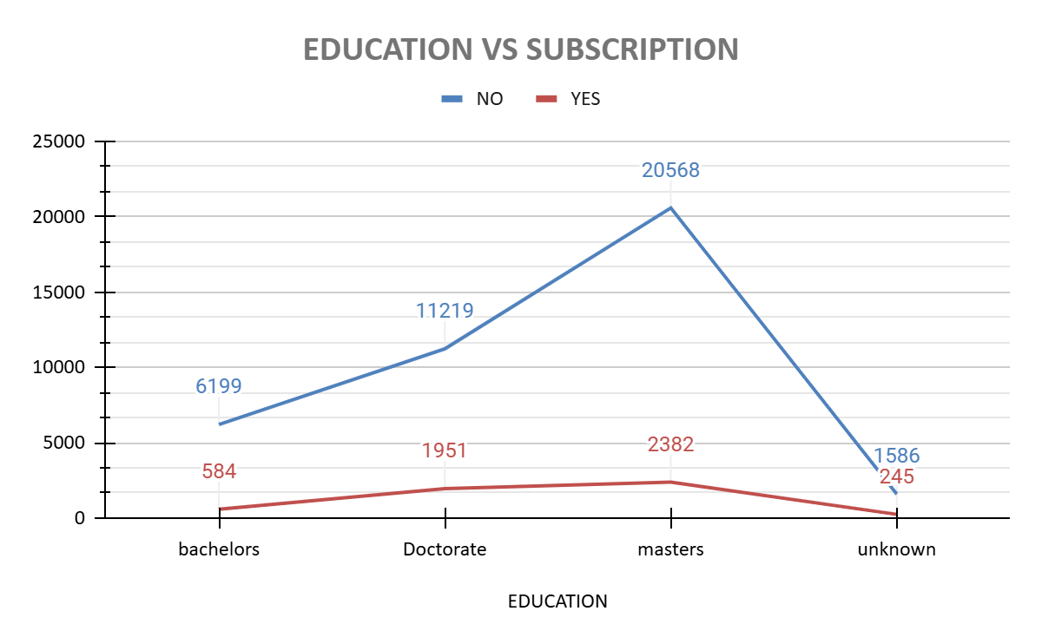
PART II : Bivariate Analysis
Variables under consideration: (EDUCATION VS SUBSCRIPTION)
Masters have highest rate of YES - 2382 and also have the highest rate of NO - 20568.
Unknown have the lowest rate of YES - 245 and also have the lowest rate of NO - 1586.
Notes:
Mention the results of the excel analysis and add the corresponding visualisations to the space provided above. Use copies of the above slide if necessary.

Slide 11
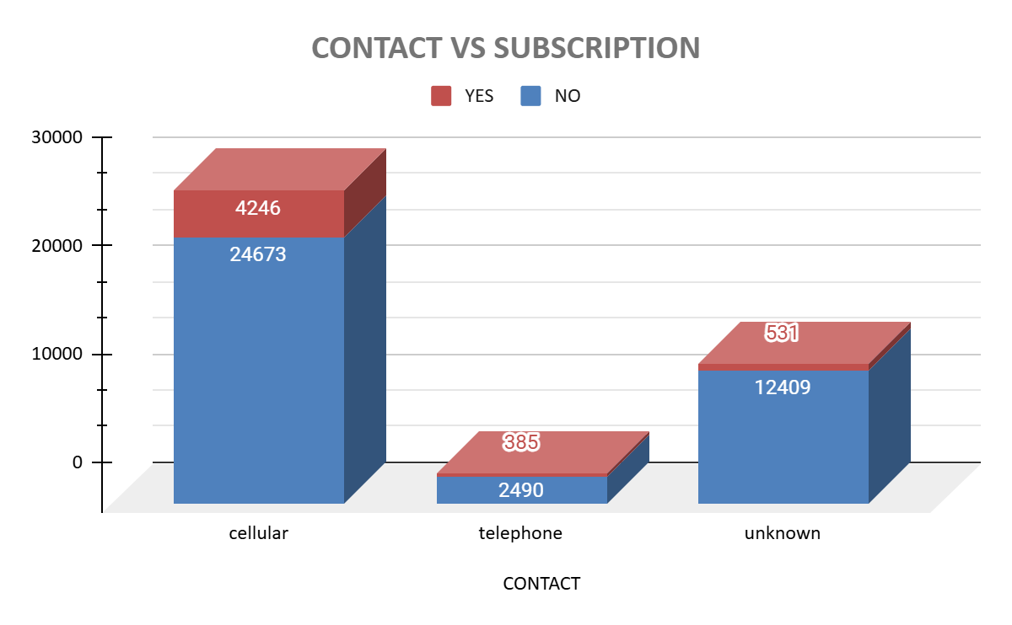
PART II : Bivariate Analysis
Variables under consideration: (CONTACT VS SUBSCRIPTION)
Cellular has the highest rate of YES-4246 and also highest rate of NO-24673.
Telephonic has the lowest rate of YES-385 and also the lowest rate of NO-2490.
Notes:
Mention the results of the excel analysis and add the corresponding visualisations to the space provided above. Use copies of the above slide if necessary.

Slide 12
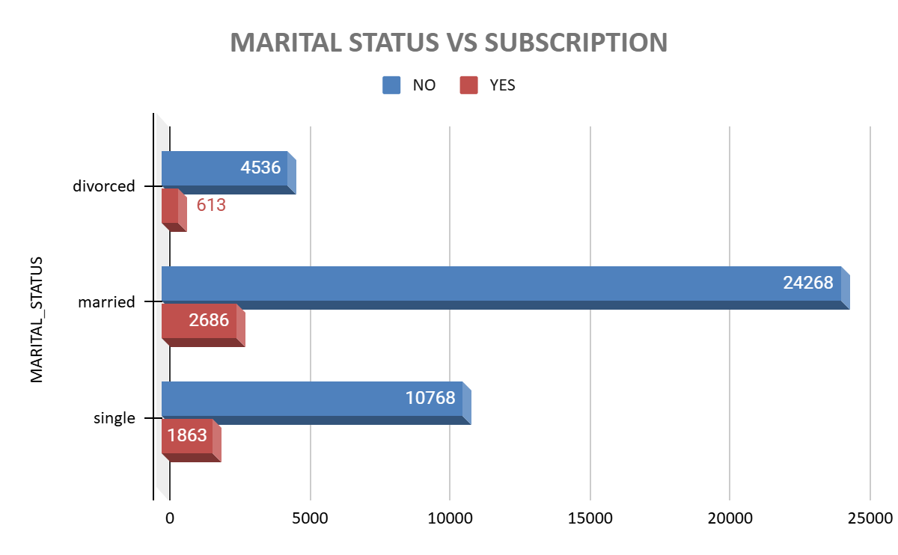
PART II : Bivariate Analysis
Variables under consideration: (MARITAL VS SUBSCRIPTION)
Married has the highest rate of YES - 2686 also married has the highest rate of NO - 24268.
Divorced has the lowest rate of YES - 613 and also has the lowest rate of NO - 10768.
Notes:
Mention the results of the excel analysis and add the corresponding visualisations to the space provided above. Use copies of the above slide if necessary.

Slide 13
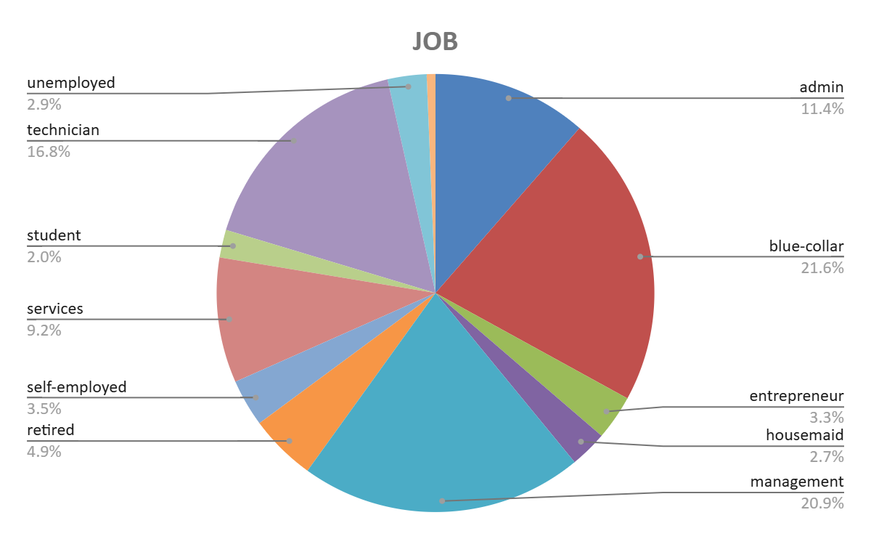
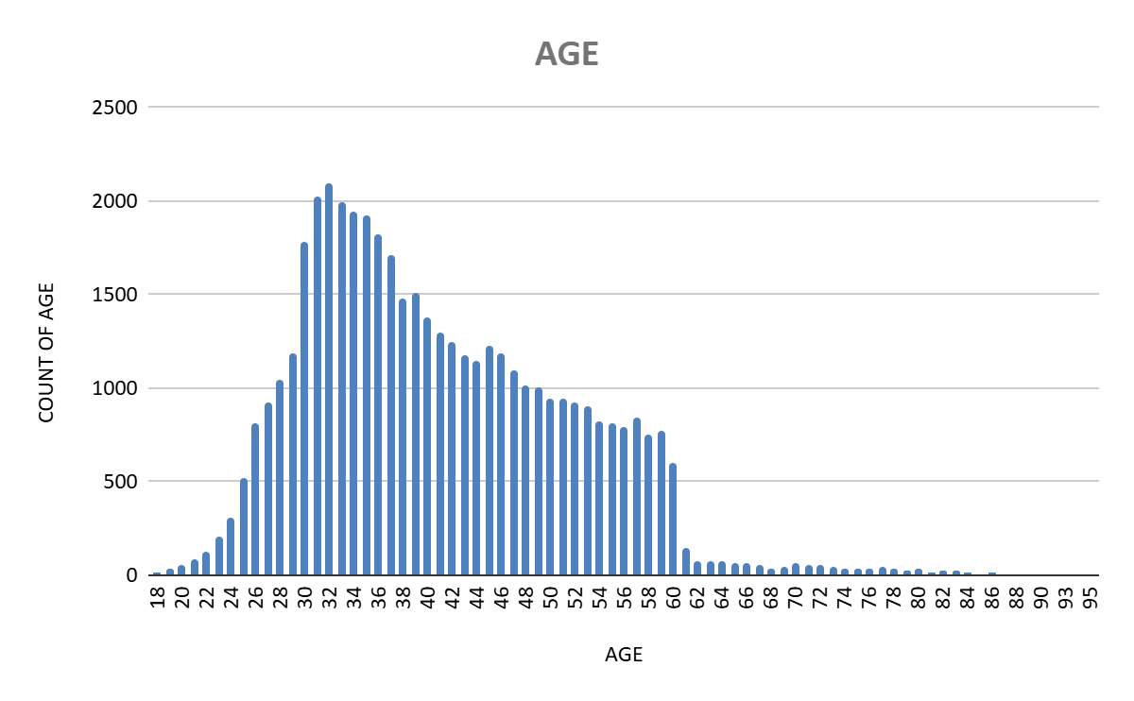
PART III: Major insights
Recommendations-
From the job segment we should target Blue Collar and Management as more than 40% of the customers are from this job category.
Age group between 30-40 should be targeted.

Slide 14
PART III: Major insights
The average call duration for YES is 800 second i.e. 12-15 mins it should not be less than this.
From the Marital - 60.2% segment we should target Married customers as it has the highest customer.
From the Education segment we should target the people who are qualified in Masters.

Slide 15
PART III: Major insights
The focus should be more on Cellular median because it has constituted for more than 65% and there should be an improvement as 50% of the customers who are contracted through Cellular are saying NO and we are losing a big chunk of customers and it affecting the conversion rate.

