Slide 1

ASSIGNMENT GUIDELINES
Make the changes in the PPT as you solve the parts
This file contains the template for all the parts of the project.
Check the instructions added in the note section of every slide for clarity.
Don’t move around any image or text box
If you require more/lesser elements, be careful when you copy/delete the existing ones.

Slide 2
ASSIGNMENT Name: HARDIK MEHTA
Problem Statement The sales pipeline conversion percentage at TechnoServe (a tech SaaS startup) has dropped from 35% at the end of last fiscal (FY 2017-18) to 25% at present.
Assignment Objective
Understand the problem, come up with a hypothesis for low conversions faced by TechnoServe, and analyse the dataset provided to arrive at possible solutions to increase it.
Notes:
Problem Statement

Slide 3
PART I : 1. Understanding the Problem Sales Pipeline Conversion at a SaaS Startup
Who?
Tech SaaS startup, TechnoServe
What?
Declining conversions across its sales funnel.
Sales has dropped from 35% to 25%.
When?
The company’s sales pipeline conversion percentage has dropped from 35% to 25% in FY 2017-18.
Where?
Among possible customers or the leads of the company
How?
The sales process was processed incorrectly.

Slide 4
PART I : 2. Understanding the Problem Sales Pipeline Conversion at a SaaS Startup
Situation
What is the strength of the company ?
How many client does TechnoServe have?
How many employees are there in the company?
Problem
Is the team skilled to develop the sales of product in market?
How many days it take to convert the lead to client>
How TechnoServe identify the lead in the market?
Implication
What is the impact of low sales on profit?
Does these sales hit target for future?
How does low pipeline conversion restrict your growth in the market?
Need-Payoff
What is the increase in revenue expected if the problem is solved?
How will the employees benefit?
Is there any change in increase in the market share of the company?
Notes:
Provide at least three questions under each branch.

Slide 5
PART II : Formulating Hypotheses Sales Pipeline Conversion at a SaaS Startup
Framework Used
The framework used in this is 5W framework.
Reason for using the selected framework
The 5W questions are important because they establish the framework of any project. Once you have established the answer the answer to the “WHO, WHAT, WHEN, WHERE, HOW”, you will have a clear picture of task in front of you.
How you have used the framework here
The problem has been divided into the five C’s in the framework.
Notes:
All the frameworks that are used should be mentioned.
A suitable reason is a must to provide here

Slide 6
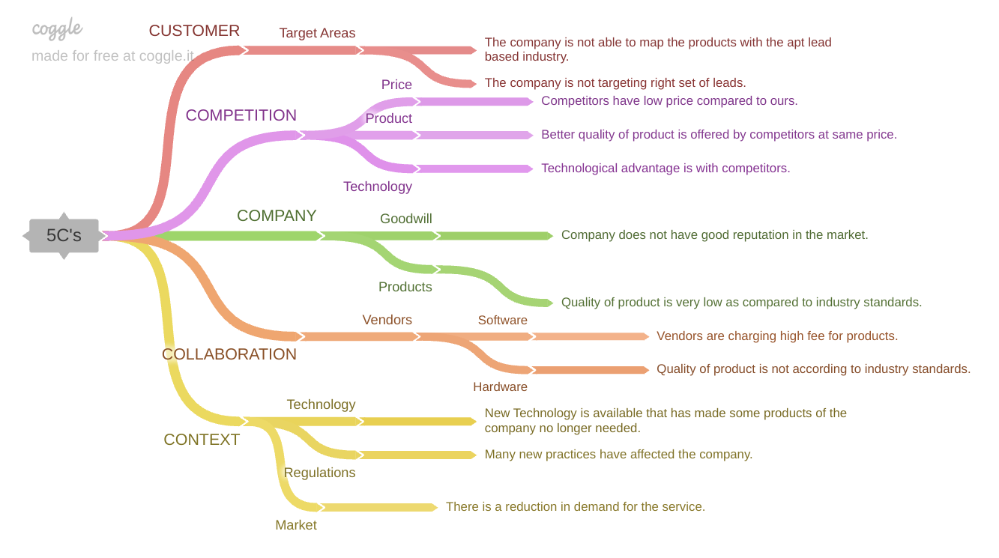
PART II : Formulating Hypotheses Sales Pipeline Conversion at a SaaS Startup
Notes:
Use the “download as” feature of Coggle if you are using the tool.
Provide one image with complete tree along with separate elements where the text is readable.
Copy the slide if you require more space

Slide 7
PART II : Formulating Hypotheses Sales Pipeline Conversion at a SaaS Startup
Branch 1: CUSTOMER- TARGET AREAS
The company is not able to map the products with the apt lead based industry. (P1)
The company is not targeting right set of leads. (P1)
Branch 2: COMPETITION- PRICE
Competitors have low price compared to ours. (P2)
Notes:
Each branch must follow this naming pattern: Problem – Branch 1 – Sub-branch 1 – Sub-branch 2 – …… – Hypotheses
There must be minimum 10 hypotheses in total and at least 1 in each branch.

Slide 8
PART II : Formulating Hypotheses Sales Pipeline Conversion at a SaaS Startup
Branch 3: COMPETITION- PRODUCT
Better quality of product is offered by competitors at same price. (P2)
Branch 4: COMPETITION- TECHNOLOGY
Technological advantage is with competitors. (P1)
Notes:
Each branch must follow this naming pattern: Problem – Branch 1 – Sub-branch 1 – Sub-branch 2 – …… – Hypotheses
There must be minimum 10 hypotheses in total and at least 1 in each branch.

Slide 9
PART II : Formulating Hypotheses Sales Pipeline Conversion at a SaaS Startup
Branch 5: COMPANY- GOODWILL
Company does not have good reputation in the market. (P2)
Branch 6: COMPANY- PRODUCTS
Quality of product is very low as compared to industry standards. (P1)
Notes:
Each branch must follow this naming pattern: Problem – Branch 1 – Sub-branch 1 – Sub-branch 2 – …… – Hypotheses
There must be minimum 10 hypotheses in total and at least 1 in each branch.

Slide 10
PART II : Formulating Hypotheses Sales Pipeline Conversion at a SaaS Startup
Branch 7: COLLABORATION- VENDORS- SOFTWARE
Vendors are charging high fee for products. (P2)
Branch 8: COLLABORATION- VENDORS- HARDWARE
Quality of product is not according to industry standards. (P3)
Notes:
Each branch must follow this naming pattern: Problem – Branch 1 – Sub-branch 1 – Sub-branch 2 – …… – Hypotheses
There must be minimum 10 hypotheses in total and at least 1 in each branch.

Slide 11
PART II : Formulating Hypotheses Sales Pipeline Conversion at a SaaS Startup
Branch 9: CONTEXT- TECHNOLOGY
New Technology is available that has made some products of the company no longer needed. (P2)
Branch 10: CONTEXT- MARKET
There is a reduction in demand for the service. (P2)
Notes:
Each branch must follow this naming pattern: Problem – Branch 1 – Sub-branch 1 – Sub-branch 2 – …… – Hypotheses
There must be minimum 10 hypotheses in total and at least 1 in each branch.

Slide 12
PART III A : Generating Insights Sales Pipeline Conversion at a SaaS Startup
Variable
Technology Primary
B2B Sales Medium
Client Revenue Sizing
Opportunity Sizing
Business from Client Last Year
Insights if any
A large number of opportunities come from ERP Implementation and they have better than average opportunity conversation rate.
Most Opportunities are from marketing and enterprise sellers with the enterprise seller having a better than average opportunity conversation rate.
A large number of opportunities come from clients who are less in revenue size 100K or less.
The opportunity conversation rate is significantly higher for clients with potential revenue in 0-30K range.
The conversation rate is higher for existing customer despite the number of opportunities unusually large from newer customers.
Pattern of Insight
Significant Outliers
Significant Outliers
Significant Outliers
Surprising Comparison
Significant Outliers/ Surprising Comparison
Notes:
Analyse the variables in the dataset, find the insights and mention the pattern of insights in the data. Make more copies of this slide if needed.

Slide 13
PART III A : Generating Insights Sales Pipeline Conversion at a SaaS Startup
Variable under consideration: Technology Primary
A large number of opportunities come from ERP Implementation category and they have a better than average opportunity conversion rate.
Notes:
For each variable that produced an interesting insight, explain you analysis bit here – the results you got from excel and the necessary visualisations. Note: it is compulsory for you to mention the results of the analysis on these variables - 'Technology Primary', 'B2B Sales Medium', 'Client Revenue Sizing', 'Opportunity Sizing' and 'Business from Client last year’.

Slide 14
PART III A : Generating Insights Sales Pipeline Conversion at a SaaS Startup
Variable under consideration: B2B Sales Medium
Most Opportunities are from Marketing Enterprise sellers with the enterprise sellers having a better than average opportunity conversation rate.
Notes:
For each variable that produced an interesting insight, explain you analysis bit here – the results you got from excel and the necessary visualisations. Note: it is compulsory for you to mention the results of the analysis on these variables - 'Technology Primary', 'B2B Sales Medium', 'Client Revenue Sizing', 'Opportunity Sizing' and 'Business from Client last year’.

Slide 15
PART III A : Generating Insights Sales Pipeline Conversion at a SaaS Startup
Variable under consideration: Client Revenue Sizing
A large number of opportunities come from clients who are less in revenue size (100K or less)
Notes:
For each variable that produced an interesting insight, explain you analysis bit here – the results you got from excel and the necessary visualisations. Note: it is compulsory for you to mention the results of the analysis on these variables - 'Technology Primary', 'B2B Sales Medium', 'Client Revenue Sizing', 'Opportunity Sizing' and 'Business from Client last year’.

Slide 16
PART III A : Generating Insights Sales Pipeline Conversion at a SaaS Startup
Variable under consideration: Opportunity Sizing
The Opportunity conversation rate is significantly higher in 0-30K range.
Notes:
For each variable that produced an interesting insight, explain you analysis bit here – the results you got from excel and the necessary visualisations. Note: it is compulsory for you to mention the results of the analysis on these variables - 'Technology Primary', 'B2B Sales Medium', 'Client Revenue Sizing', 'Opportunity Sizing' and 'Business from Client last year’.

Slide 17
PART III A : Generating Insights Sales Pipeline Conversion at a SaaS Startup
Variable under consideration: Business from client last year
The conversation rate is higher for existing customers despite the number of opportunities larger from newer customer.
Notes:
For each variable that produced an interesting insight, explain you analysis bit here – the results you got from excel and the necessary visualisations. Note: it is compulsory for you to mention the results of the analysis on these variables - 'Technology Primary', 'B2B Sales Medium', 'Client Revenue Sizing', 'Opportunity Sizing' and 'Business from Client last year’. Make more copies of this slide if needed.

Slide 18
PART III A : Generating Insights Sales Pipeline Conversion at a SaaS Startup
Recommendations
Company should focus on new leads for ensuring high conversation rate:
ERP Implementation as the type of solution offered to the customer
Enterprise Sellers as the B2B Sales Medium
Client Revenue Sizing 100K or Less
Opportunity Sizing 0-30K
Existing Customers
Corresponding Insights
An unusually large number of opportunities come from ERP Implementation category and they have a better than average opportunity conversation rate.
Most opportunities are from Marketing and Enterprise sellers with the enterprise sellers having a better than average opportunity conversation rate.
A large number of opportunities come from clients who are less in revenue size (100k or less)
The opportunity conversation rate is significant higher for clients with potential revenue in 0-30K range.
The conversation rate is higher for existing customer despite the number of opportunities larger from newer customer.
Notes:
For each recommendation explain the insights that form the reasoning for giving that recommendation. Make more copies of this slide if necessary.

Slide 19
PART III B : Presenting Findings Sales Pipeline Conversion at a SaaS Startup
Recommendations:
For higher conversation rate company should follow-
ERP Implementation category of solution offered to the customers
Enterprise sellers as the B2B Sales Medium
Client Revenue Sizing (100K or less)
Opportunity Sizing (0-30K)
Existing Customers
Notes:
You are free to use the elements and boxes mentioned previously. Make sure you’re using the pyramid principle, data visualization, visual design principle and storyboarding concepts to design these slides.

Slide 20
PART III B : Presenting Findings Sales Pipeline Conversion at a SaaS Startup
Notes:
You are free to use the elements and boxes mentioned previously. Make sure you’re using the pyramid principle, data visualization, visual design principle and storyboarding concepts to design these slides.

