Slide 1
Compound Interest Calculator
2022-02-15
Adam Pettman, Stephen Fearnley, Liam Meagher
3

Slide 2
What You’ll Be Making
Compound interest calculator in Python
User enters Starting Amount, Interest Rate, and Time
Tells user how much money they’ll have at the end

Slide 3
What You’ll Learn
Variables
Printing
For loops
Functions

Slide 4

Variables
A reference to a piece of information for future use
Variables must be declared before they can be used
A Variable can be set or updated by user input or other code
Variables can be a String (“Hello”), Integer (10), or a Float (5.5)

Slide 5
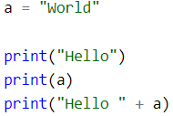

Printing
Used to output information in a human-readable format
Can be used to display variables

Slide 6

For Loops
A way of repeating execution of code a given number of times
A variable, called an Iterator, counts from 0 to the number of loops
A For Loop can iterate over a group of data, applying the same code to each value in the file

Slide 7
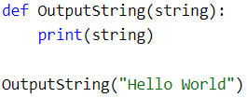
Function
Wraps a chunk of code into a reusable block
A Function can be “called” to execute that code
Can take in Arguments, which is the way to pass in information
Can Return a value

