Slide 1
Gear5 UI Review Deck
Generated from http://127.0.0.1:5173 on 2026-05-16 20:15
How to edit: - Move, resize, draw over, or annotate anything directly on the slide. - Add arrows/comments for spacing, copy, color, or hierarchy changes. - Keep the route label on each slide so Codex knows which screen to update. - Save the edited PPTX into mockups/inbox and ask Codex to apply it. Tip: if a slide should be very precise, export it as PNG too and place it next to the PPTX.
Editable notes area is included on every screen slide.

Slide 2
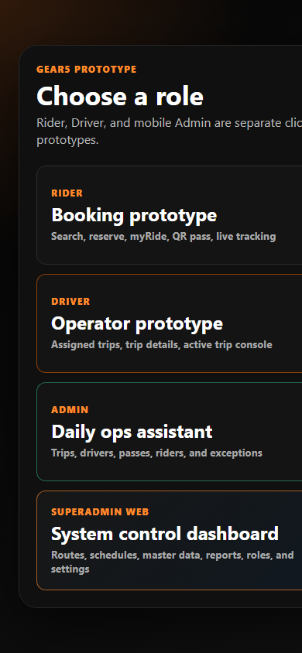
Role Switch | /
Edit / annotate here
Layout
Type notes here or draw directly on the screenshot.
Spacing
Type notes here or draw directly on the screenshot.
Copy / labels
Type notes here or draw directly on the screenshot.
Behavior notes
Type notes here or draw directly on the screenshot.

Slide 3
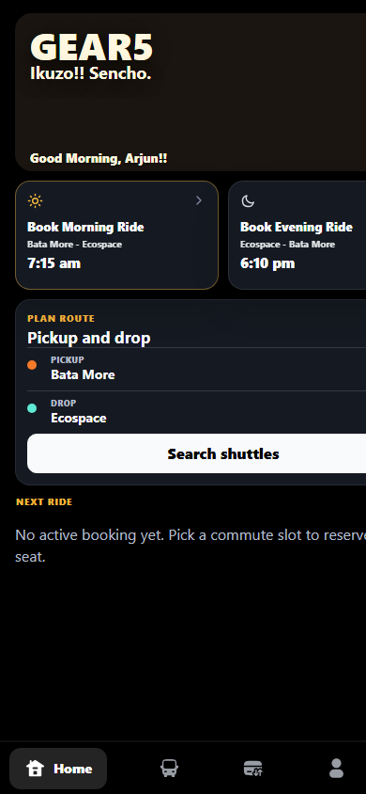
Rider Home | /rider
Edit / annotate here
Layout
Type notes here or draw directly on the screenshot.
Spacing
Type notes here or draw directly on the screenshot.
Copy / labels
Type notes here or draw directly on the screenshot.
Behavior notes
Type notes here or draw directly on the screenshot.

Slide 4
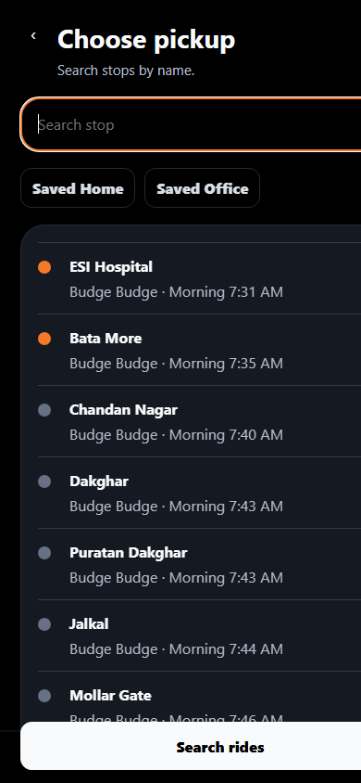
Search | /search
Edit / annotate here
Layout
Type notes here or draw directly on the screenshot.
Spacing
Type notes here or draw directly on the screenshot.
Copy / labels
Type notes here or draw directly on the screenshot.
Behavior notes
Type notes here or draw directly on the screenshot.

Slide 5
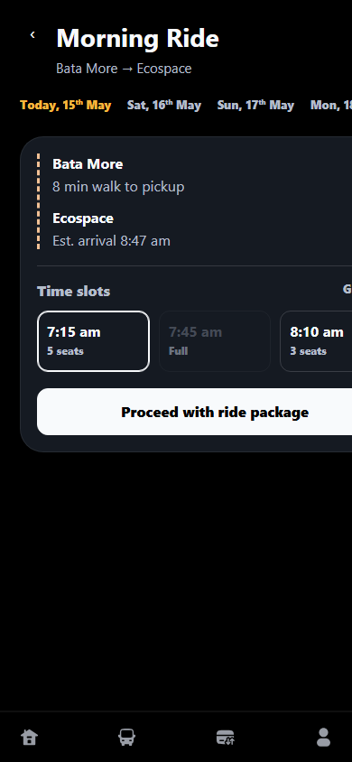
Ride Options | /rides
Edit / annotate here
Layout
Type notes here or draw directly on the screenshot.
Spacing
Type notes here or draw directly on the screenshot.
Copy / labels
Type notes here or draw directly on the screenshot.
Behavior notes
Type notes here or draw directly on the screenshot.

Slide 6
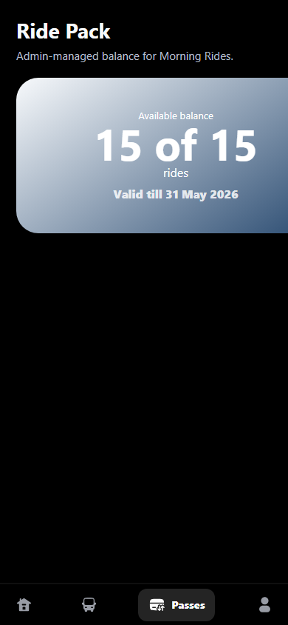
Ride Pack | /ride-pack
Edit / annotate here
Layout
Type notes here or draw directly on the screenshot.
Spacing
Type notes here or draw directly on the screenshot.
Copy / labels
Type notes here or draw directly on the screenshot.
Behavior notes
Type notes here or draw directly on the screenshot.

Slide 7
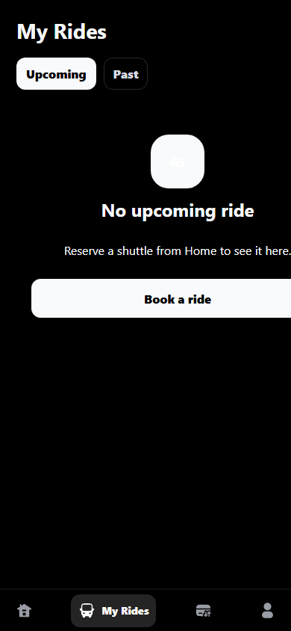
My Ride | /myride
Edit / annotate here
Layout
Type notes here or draw directly on the screenshot.
Spacing
Type notes here or draw directly on the screenshot.
Copy / labels
Type notes here or draw directly on the screenshot.
Behavior notes
Type notes here or draw directly on the screenshot.

Slide 8
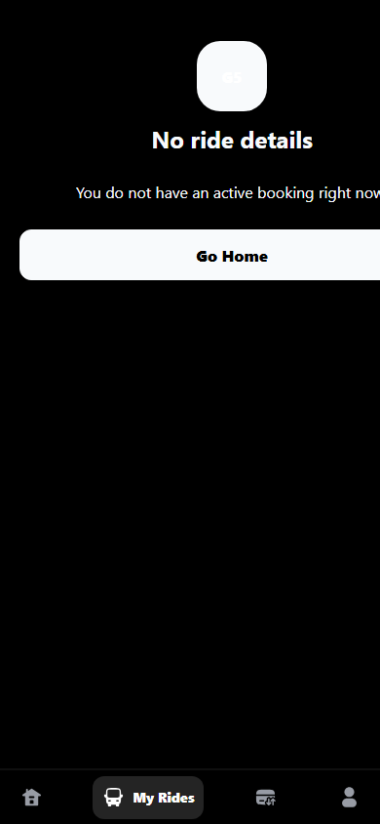
My Ride Details | /myride/details
Edit / annotate here
Layout
Type notes here or draw directly on the screenshot.
Spacing
Type notes here or draw directly on the screenshot.
Copy / labels
Type notes here or draw directly on the screenshot.
Behavior notes
Type notes here or draw directly on the screenshot.

Slide 9
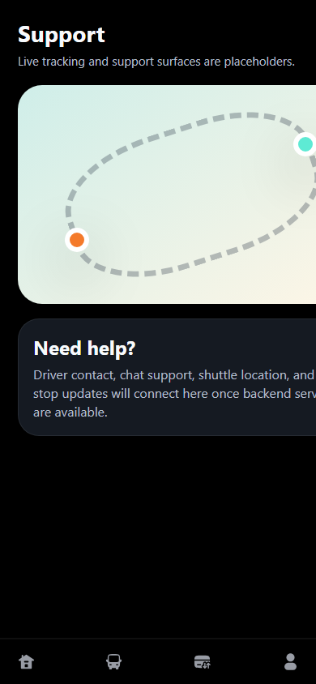
Live Ride | /live
Edit / annotate here
Layout
Type notes here or draw directly on the screenshot.
Spacing
Type notes here or draw directly on the screenshot.
Copy / labels
Type notes here or draw directly on the screenshot.
Behavior notes
Type notes here or draw directly on the screenshot.

Slide 10
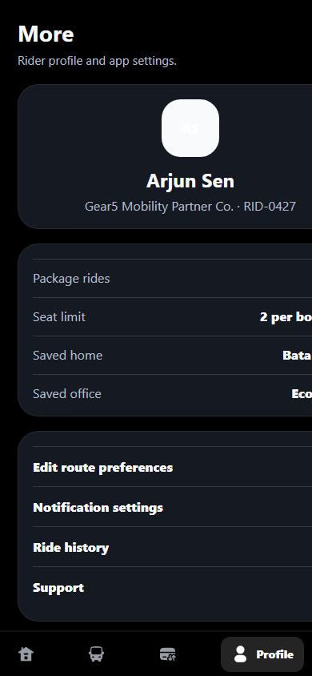
Profile | /profile
Edit / annotate here
Layout
Type notes here or draw directly on the screenshot.
Spacing
Type notes here or draw directly on the screenshot.
Copy / labels
Type notes here or draw directly on the screenshot.
Behavior notes
Type notes here or draw directly on the screenshot.

Slide 11
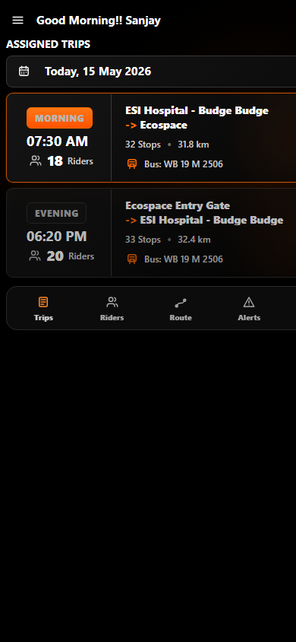
Driver | /driver
Edit / annotate here
Layout
Type notes here or draw directly on the screenshot.
Spacing
Type notes here or draw directly on the screenshot.
Copy / labels
Type notes here or draw directly on the screenshot.
Behavior notes
Type notes here or draw directly on the screenshot.

Slide 12
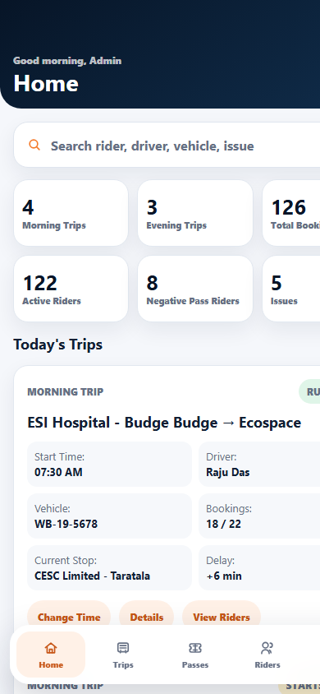
Admin | /admin
Edit / annotate here
Layout
Type notes here or draw directly on the screenshot.
Spacing
Type notes here or draw directly on the screenshot.
Copy / labels
Type notes here or draw directly on the screenshot.
Behavior notes
Type notes here or draw directly on the screenshot.

Slide 13
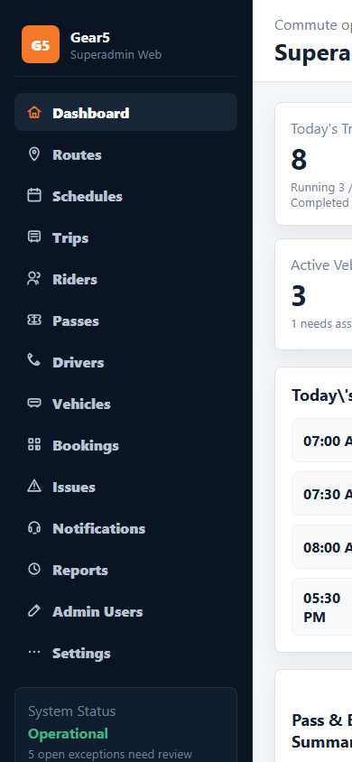
Superadmin | /superadmin
Edit / annotate here
Layout
Type notes here or draw directly on the screenshot.
Spacing
Type notes here or draw directly on the screenshot.
Copy / labels
Type notes here or draw directly on the screenshot.
Behavior notes
Type notes here or draw directly on the screenshot.

