Slide 1

Static binary analysis: the essentials
Igor Kuznetsov
Kaspersky

Slide 2

About me – Igor Kuznetsov
Principal Security Researcher, GReAT
18 years at Kaspersky
Reverse engineering is my daily job.
Also, I teach static malware analysis.
Guinea pigs: old-school “real” viruses and worms, Flame, Gauss, Duqu, Red October, Miniduke, Careto, Equation, Grayfish, Regin, Remsec, Duqu2, Shadowpad, …

Slide 3
The boring disclaimer
There is no “right” or “correct” way to do reverse engineering
This is not a review or endorsement of any particular software product
Your mileage may vary
Screenshots of assembly code ahead!

Slide 4
A few definitions
Static analysis is the analysis of a program without executing it.
It is the opposite of dynamic analysis that is done through observation of the program’s behavior.
The primary tools used are :
Hex / binary editors – hexedit, 010 editor, HxD
Disassemblers – IDA Pro, Binary Ninja, Radare2, Ghidra
Decompilers – Hex-Rays, Ghidra

Slide 5
Why bother?
Static analysis is more comprehensive than dynamic analysis.
No dependency on the live environment that the program requires.
It can be automated and scaled.
The results can be saved, versioned, reproduced and shared.

Slide 6
The
practical introduction
A look into the binary

Slide 7
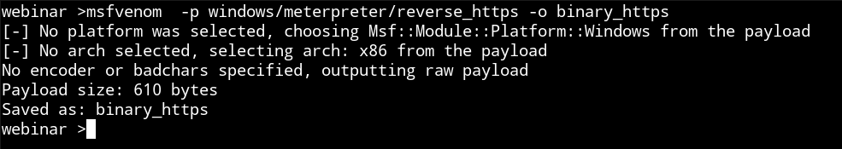
The sample
Available on Github, used everywhere
The metasploit reverse https shell

Slide 8
Stage 1 : The checklist
The context: where did you get it?
Validation points: what should be inside?
Basic knowledge about the layout of the input data
CPU architecture, the visual appearance of the code
Knowledge about the OS, what are the system function names if any, how does the OS invoke the code?

Slide 9
Stage 1 : visual inspection
Check if:
the format is known (PE/ELF/Mach-O/raw shellcode/etc.)
the file requires unpacking or removing encryption/protection layers
the strings are clear text or encrypted
the file contains high-entropy items and their size
there is embedded executable code
The next step may be decryption or unpacking

Slide 10
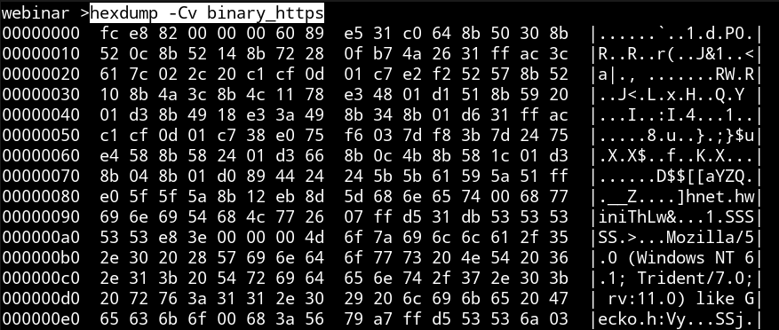
Stage 1 : visual inspection
Use your favourite hex editor to take a look at the file
“hexdump”, “xxd”, “less”, even “strings” and “file” – anything goes
Notes:
Raw shellcode-like structure
Shellcode frequently begins with EB ?? (jmp short) or E8 ?? ?? 00 00 (call)
Easily readable ASCII strings
Low entropy - may be code
Let’s load in the disassembler!
(use IDA Pro or Ghidra)
Initial assumptions: Intel x86, 32 bit, Windows (usually there is more context)

Slide 11
Stage 1 : visual inspection
Raw shellcode-like structure
Shellcode frequently begins with EB ?? (jmp short) or E8 ?? ?? 00 00 (call)
Easily readable ASCII strings
Low entropy - may be code
Let’s load it in the disassembler!
(use IDA Pro or Ghidra)
Initial assumptions: Intel x86, 32 bit, Windows (usually there is more context)

Slide 12
The
disassembly
line

Slide 13
Stage 2 : The checklist
The assembly language of the target code
CPU features: stack, registers, memory layout
OS features: system calls, calling conventions, callbacks
OS API documentation: MSDN, *nix man pages
Compiler features: standard runtime functions and classes
Programming language features: classes, “main” functions, static constructors, multiple return values (say hello to Go!)

Slide 14
Tools of the trade
IDA Pro (“Interactive Disassembler”) – proprietary, C++/Python API
Binary Ninja – proprietary, C / Python API
Ghidra – free, open-source, written in Java, has Java/Python API
Radare2– free, open-source, C, API via SWIG

Slide 15
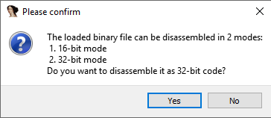
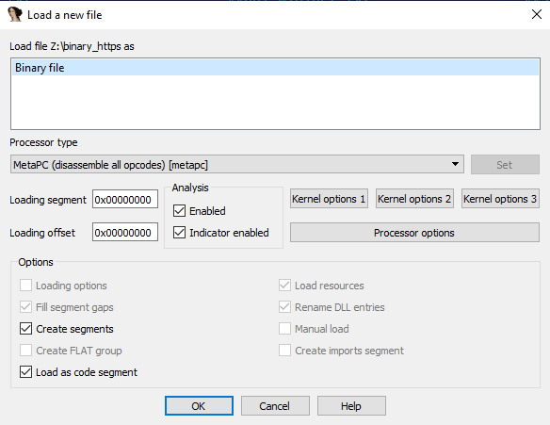
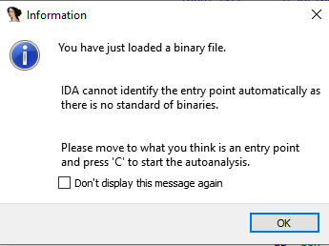
Stage 2: disassembly, IDA Pro
Use the knowledge acquired from stage 1 to choose the proper loading options.

Slide 16
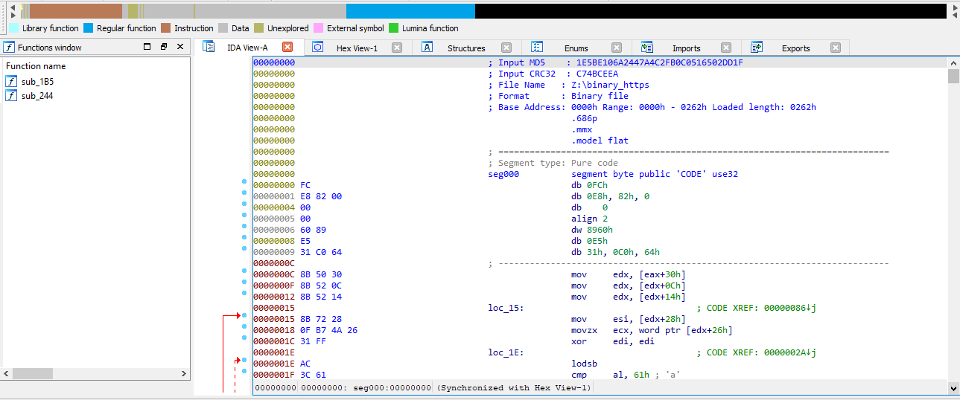
Stage 2: disassembly, IDA Pro
Use the knowledge acquired from step 1 to choose the proper load options.

Slide 17
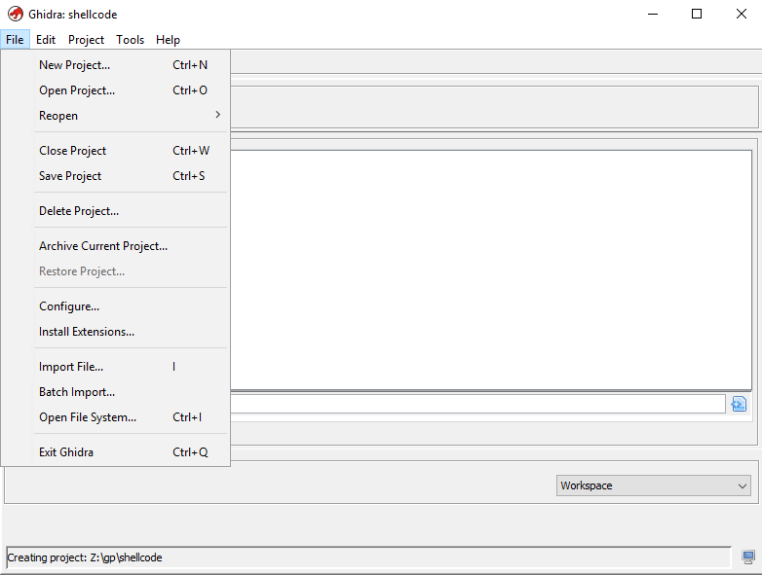
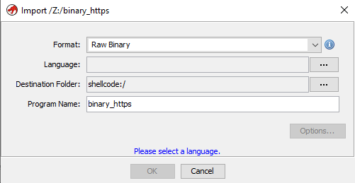
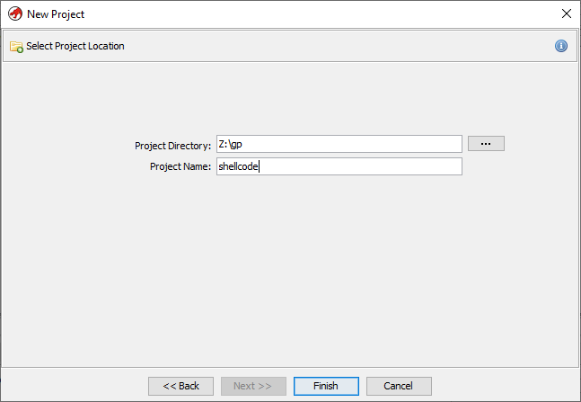
Stage 2: disassembly, Ghidra
Ghidra has workspaces for analyzing many files called “projects”
Create a new project, then “import” the file you need to analyze
The “CodeBrowser” tool is the GUI for the task

Slide 18
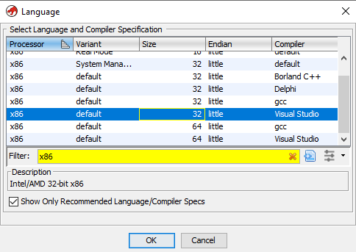
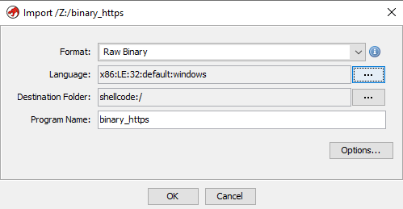
Stage 2: disassembly, Ghidra
The “language” used for loading is the term for the processor architecture, memory model, OS all together

Slide 19
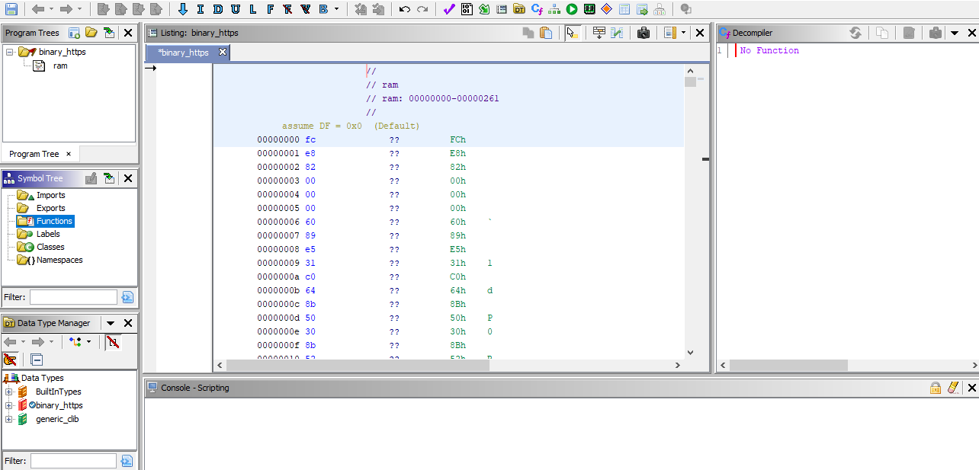
Stage 2: disassembly, Ghidra

Slide 20
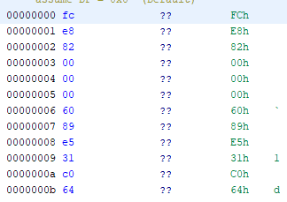
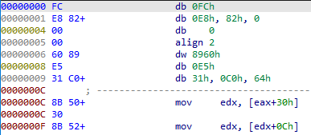
Stage 2: disassembly
“Smart disassemblers” try to make their own assumptions
IDA guesses some of the instructions, Ghidra needs more input
Ghidra
IDA

Slide 21
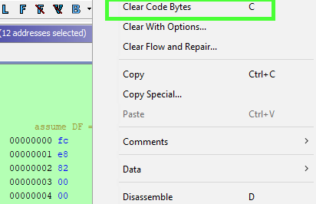
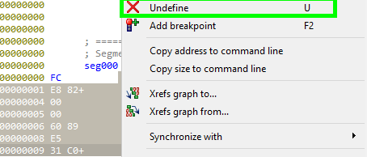
Stage 2: disassembly
Let them know where the actual code and data is!
IDA: “undefine”, “edit->code”, “edit->data”
Ghidra: “clear code bytes”, “disassemble”, “data->*”
Ghidra
IDA

Slide 22
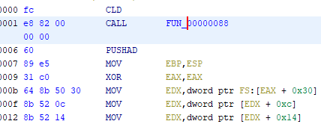
Stage 2: disassembly
Follow references and use back-references (XREFs) to code and data to track data and code flow
Double-click / press Enter to navigate to functions, stack variables, data
Use forward references with “back” navigation commands to move around

Slide 23
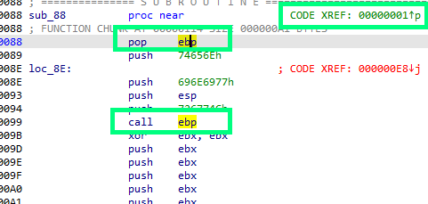
Stage 2: disassembly
Pay attention to data access, both direct and indirect
CALL also modifies the stack by pushing the return address on top of it
Also happens to the ECX with the LOOP command, EDX with DIV, etc.
Highlight the registers (IDA: click, Ghidra: middle click) to track data

Slide 24
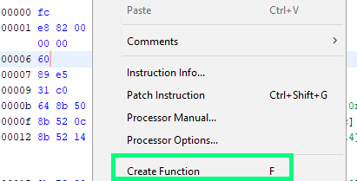
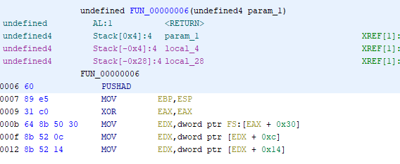
Stage 2: disassembly
Create functions if they are not detected automatically
Result: stack frame access and the stack variables with all the back references (data flow!)

Slide 25
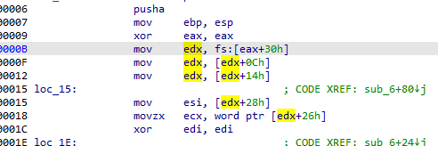
Stage 2: disassembly
Let’s analyze the code
DWORD PTR [fs:0x30] is a pointer to the PEB, a system structure
We can’t analyze further until we discover the meaning of these memory reads

Slide 26
Stage 2: Structures!
The single most important feature of modern disassemblers
If data is not a string or an integer, most likely it is a structure. Structures bring order to life!
C++ classes are also structures (fields! virtual tables!)
Can be used by the decompilers to produce fantastic output!
but:
Someone has to provide the information about the types
IDA Pro and Ghidra ship with built-in type libraries

Slide 27
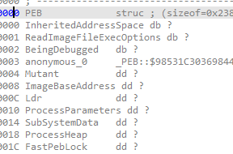
Stage 2: Structures. This is the IDA way.
Structures and enumerations are stored in “Type libraries”
Open the subview “type libraries”
Load the required type library – “ntapi”
Open the subview “structures”
“Add struct type…”
“Add standard structure”
Locate the structure by name. Done. Easy, huh?

Slide 28
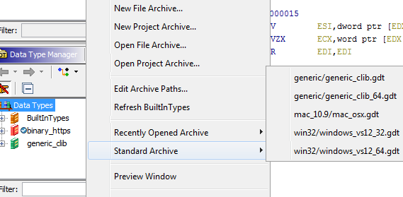
Stage 2: Structures. The Ghidra way.
Structures and enumerations managed with the “Data Type Manager”
There is a “Standard Archive” for windows_vs12_32, but there is no PEB!
Many standard Windows structures are missing

Slide 29
Stage 2: Structures. The hard way.
When there is no type, we import it from the C header files
IDA Pro: “File->Load->Parse C header file”
Preprocessor definition and paths are set up in “Option->Compiler”
Also, there is a tool named “tilib” to produce persistent type databases
Ghidra: “File->Parse C source”
All options are in the same dialog
Yes, we download the Windows SDK and tinker with the options to get the headers compiled.

Slide 30
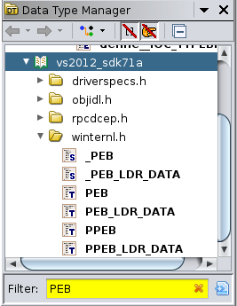
Stage 2: Structures. The hard way, in Ghidra
What worked for me:
Visual Studio 2012 crt/include
Windows SDK 7.1A
Cloned the profile “VisualStudio12_32”
Modified the –I /include/directories
Source files from the SDK: “windows.h”, “winternl.h”
Saved in the new data archive.
Do it once, then reuse the library in other projects.

Slide 31
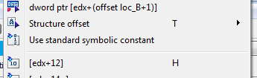

Stage 2: Applying structures, IDA Pro
Apply to the operand:
“Edit->Operand Type->Offset->Offset (struct)”
Less options in the context menu “Structure offset”
Now, how do you discover the type of the field PEB.Ldr?

Slide 32
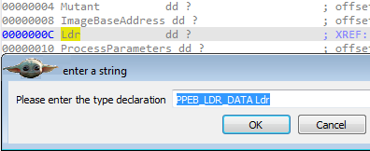
Stage 2: Fields of structures
Double click/Enter on the field to go to the definition of the structure
Select the field of interest (“Ldr”) and use the command “Set type”
Now look for this new type in the “Structures”, add it if required
Rinse and repeat for the next pointer

Slide 33
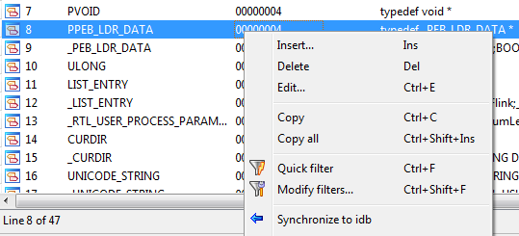
Stage 2: Local types
The subview called “Local types” displays the currently loaded type definitions
It contains more types, i.e. pointers to structures (PPEB_LDR_DATA..)
It requires “synchronizing to the IDB”

Slide 34
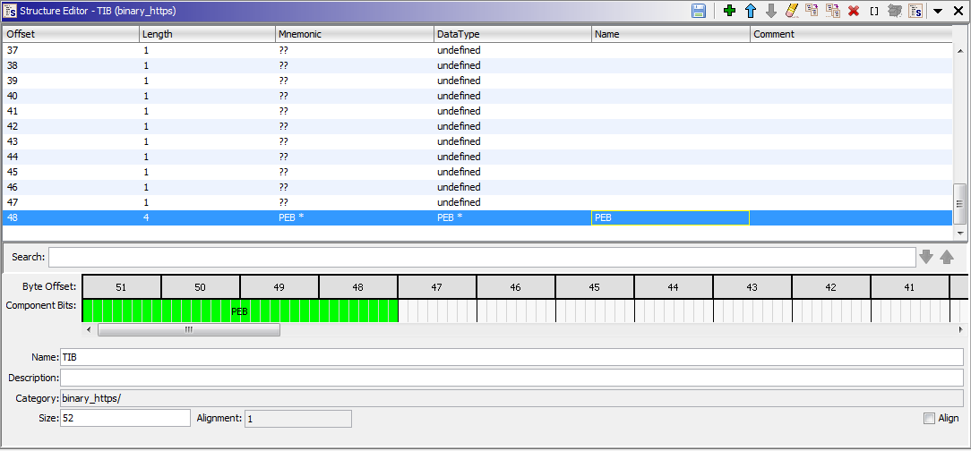
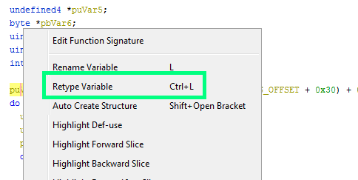
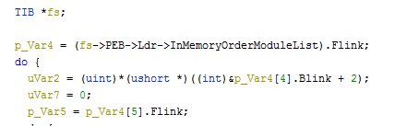
Stage 2: Applying structures, Ghidra
No such feature as the “field offset” in the vanilla Ghidra
Can be applied in the decompiler, “Retype variable”
Create a structure “TIB” with “PEB*” at 0x30

Slide 35

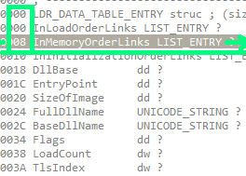
Stage 2: Next pointer
Flink is a pointer within a standard linked list structure, “LIST_ENTRY”
It is placed in the bigger structure “LDR_DATA_TABLE_ENTRY”
It points to the same field in the next structure’s instance, not to the head of it

Slide 36
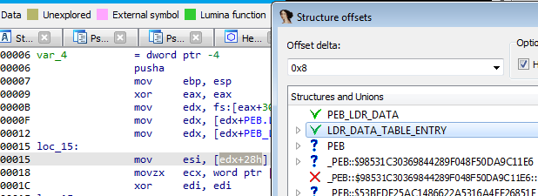
Stage 2: Next pointer
Ghidra has no native support to shifted pointers, need a workaround
IDA Pro supports shifted pointers in both the disassembler and the decompiler
Hidden feature: select the operand, then use the “Struct offset” command, use the offset delta to correct the pointer

Slide 37
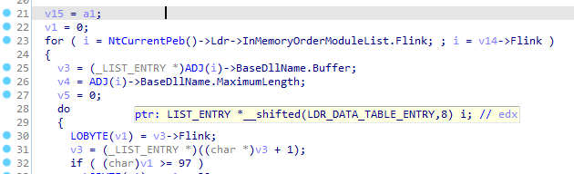
Stage 2: Next pointer
In the decompiler, “set lvar type” of the variable i to a “shifted pointer”:
LIST_ENTRY *__shifted(LDR_DATA_TABLE_ENTRY,8) i

Slide 38
Stage 2: Next steps
Apply the structure offsets throughout the function
LDR_DATA_TABLE_ENTRY::DllBase is the pointer to the IMAGE_DOS_HEADER
Its e_lfanew field is the offset of the IMAGE_NT_HEADERS
The first directory of the header is the RVA of the IMAGE_EXPORT_DIRECTORY
Prerequisites: MZ, PE formats, PE RVA and VA and their relations.

Slide 39
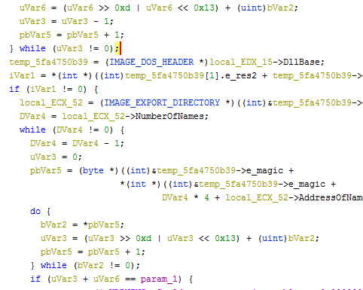
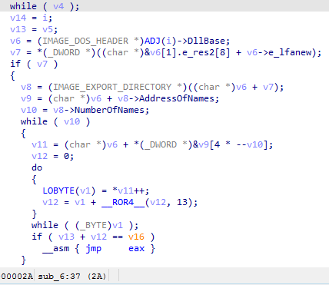
Stage 2: Later that day…
Ghidra
IDA

Slide 40
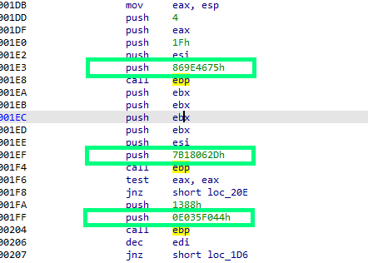
Stage 2: Where to next?
That’s the famous “ROR 13” hash function.
First: rename the function. Rename everything!
Then: convert all the hashes
into actual function names.
Pre-calculate the hashes and then search
for every operand that matches

Slide 41
The obvious
next step
We write some code

Slide 42
Stage 3 : The checklist
Python is just barely enough
Basic (better: advanced) programming skills in C++ or Java
The understanding of the disassembler’s workflow. Take the Capstone framework and try it yourself.
Bitwise operations (OR,XOR,AND,ROR/ROL,SHR/SHL) in both Assembly and C++/Java
The format of the machine code itself, opcode values and the encoding of operand values

Slide 43
Stage 3: Now you make the tools
The reverse engineering tools have APIs for a reason
One day or another, you will end up writing code
IDA calls the external code “plugins” and provides a native C++ API and Python bindings
Ghidra calls them “scripts” and provides a native Java API and a way to execute Python code via Jython
Both are bundled with working examples

Slide 44
Stage 3: The task
Let’s create extensions for both frameworks.
The task:
Load a list of exported API names
Pre-calculate the Ror 13 hash for each name
Enumerate all decoded instructions
Check if the operands match one of the hashes
If any of them matches, make a comment in the listing

Slide 45
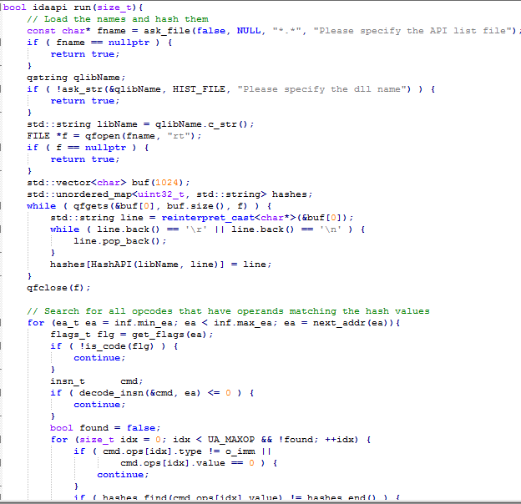
Stage 3: IDA plugin
Use Visual Studio
Need the IDA SDK
124 lines

Slide 46
Stage 3: IDA plugin
The plugin exports a structure with several function pointers: “init”, “run”, “term”, “comment”. The main one is “run”.
Iterate over all addresses with:
for (ea_tea=inf.min_ea; ea<inf.max_ea; ea=next_addr(ea))
Check if the address is marked as code using flags:
is_code(get_flags(ea))
Decode the instruction and get the operands:
insn_t cmd; decode_insn(&cmd, ea)

Slide 47
Stage 3: IDA plugin
Compile the source code
Copy to %IDADIR%/plugins/
Reload IDA
Start the plugin using the menu
“Edit->Plugins”

Slide 48
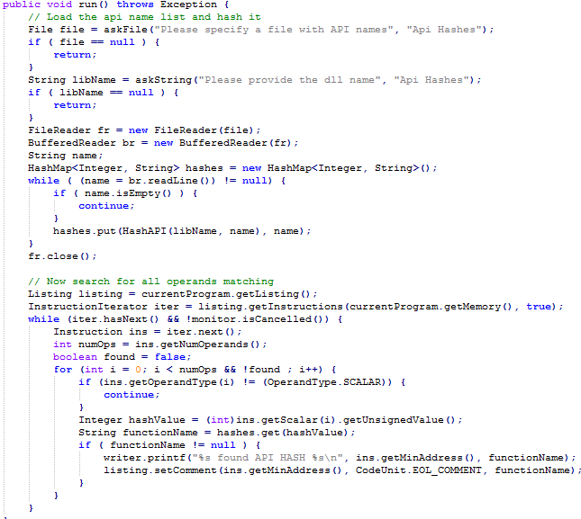
Stage 3: Ghidra script
Copy the .java file to Ghidra/Features/Base/ghidra_scripts
85 lines
No need to
compile
Start with the
“Script manager”

Slide 49
Stage 3: Ghidra script
The script implements a class inheriting from the “GhidraScript”
The main function is called… “run”
There is a “listing” that allows to enumerate all instructions:
currentProgram.getListing();
InstructionIterator iter = listing.getInstructions(currentProgram.getMemory(), true);
There is no need to implicitly decode the instructions, just iterate:
while (iter.hasNext) { Instruction ins = iter.next();

Slide 50
Stage 3: Common parts
The frameworks are based on similar concepts and implemented with similar atomic elements:
Addresses
Instructions
Data types
Functions
Cross-references

Slide 51
Stage 3: The data
We need the list of API names!
Use the DLLs from the System32 folder
Many ways to extract the exported names, i.e. :
dumpbin /exports filename.dll
objdump -p filename.dll | cut -d ']' -f 2 | cut -d ' ' -f 2 | sort | uniq

Slide 52
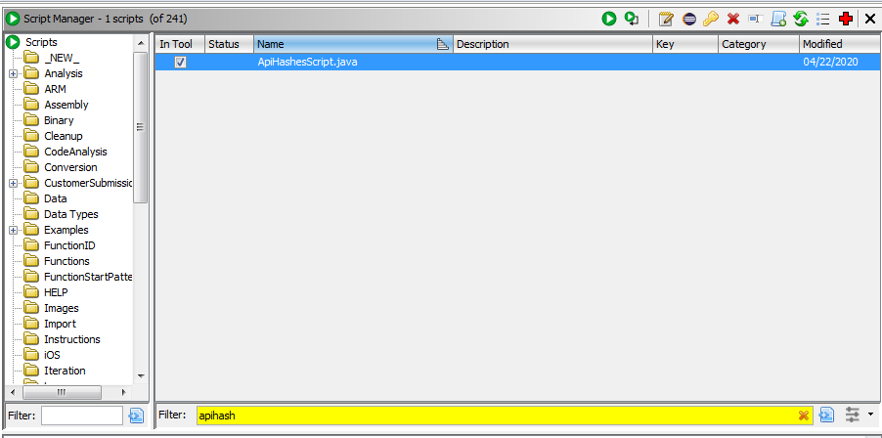
Stage 3: Action!

Slide 53
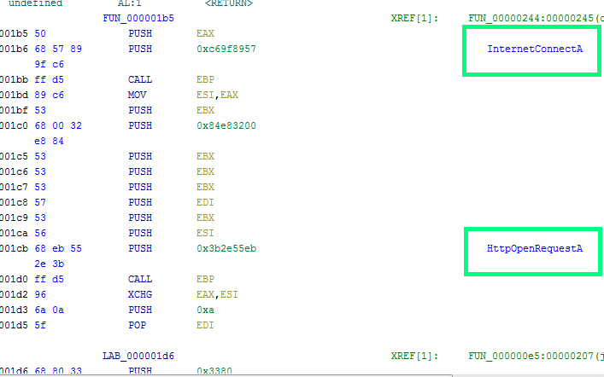
Stage 3: Action!

Slide 54
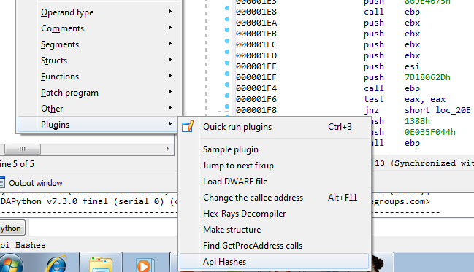
Stage 3: Action!

Slide 55
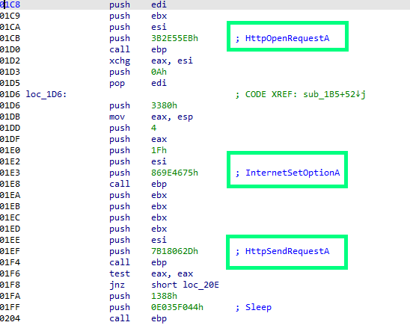
Stage 3: Action!

Slide 56
Stage 3: The source code
The source code for both plugins is available on Github:
https://github.com/2igosha/apihashes
API for IDA Pro and Ghidra is well-documented, read the headers and the docs
Start by modifying the existing examples

Slide 57
The next
frontier
Because it’s definitely not the last one

Slide 58
Areas for development
Study the architectures
Learn the assembly languages, better to create a program in the assembler of your choice
Create your own parsers for the binary formats (PE, ELF, Mach-O)
Create a reversing framework (no, seriously)
C++ classes : compile your own, reverse, improve
Function signatures : compile Zlib, cURL, OpenSSL with different options, apply to the existing code
Learn the shortcuts!

Slide 59
XREFS
IDA Pro: https://www.hex-rays.com/products/ida/
Ghidra: https://ghidra-sre.org/
Metasploit: https://github.com/rapid7/metasploit-framework
API hashes: https://github.com/2igosha/apihashes

Slide 60
#SASatHome | #TheSAS2020
Let’s Talk?
@2igosha
Igor Kuznetsov
Kaspersky

