Slide 1
SHOPAA PROJECT
GROUP 10 - SHOPAA WEBSITE
20127274 - NGUYỄN THANH PHONG
20127251 - LÊ THU NGÂN
20127390 - LÊ ANH VINH
20127589 - VÕ TẤN PHÁT

Slide 2
TABLE OF CONTENT
1.
4.
Preamble
Analysis and design.
2.
5.
Project management.
Software testing.
3.
6.
Software requirements.
Demo.

Slide 3
1. Preamble
Problem statement, product position statement (from the Vision document), users/market.

Slide 4
PROBLEM STATEMENTS
the problem of | Some people need for a website that only sells typical local food, Need a website selling Vietnamese food
affects | Satisfy the taste of those who love typical local food in VietNam, specifically, Ho Chi Minh City People’s Health because the food will be checked for food hygiene and safety before reaching consumers
the impact of which is | Local food lovers can enjoy the food without fussy cooking but still ensure food hygiene and safety.
a successful solution would be | Helping people that don't know how to cook local food can enjoy the food they want. Provide a place where people can sell and enjoy local food Make the typical local food accessible to everyone

Slide 5
PRODUCT POSITION STATEMENT
For | everyone in Ho Chi Minh ‘s City
who | Sell and buy typical local food
The (product name) | Shopaa
That | A website can sell and buy typical local food, quality assurance, food hygiene and safety
Unlike | The website recommends dishes so that users do not need to think about what to eat for today's meal, the dishes displayed on the interface are different, and the user selects dishes to display the names of restaurants that sell that dish, avoiding food suggestions overlap
Our product | Provide a place can sell and buy typical local food All users from any PC connected with the internet

Slide 6
USER SUMMARY
Name | Description | Responsibilities | Stakeholder
Buyer | Registers for oder food, select food on website to buy | Register; Login; Select food to cart; Payment for food; Review of product | self - represented
Seller | Registers for selling food, post product to website | Register; Login; Add or delete selling post; Manage activity log | self - represented
Administrator | Manage posts and user | Logi; Delete comments, posts; Delete account; create voucher, approve to sell | self - represented
Shipper | Delivery | Login; Receive, view purchase order | self - represented

Slide 7
2. Project management.
Team structure and responsibilities of team members.

Slide 8
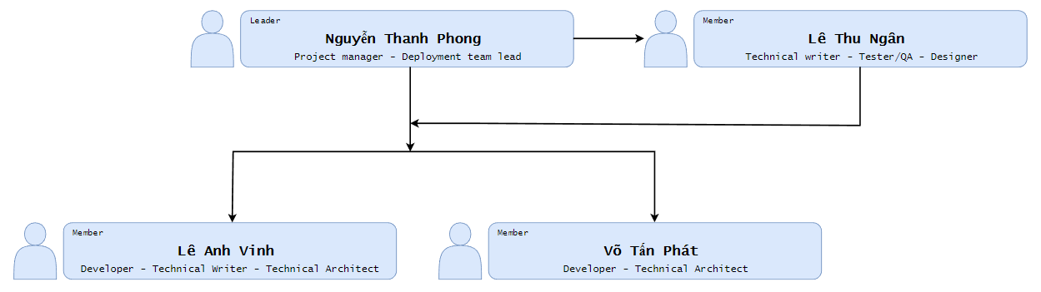
ORGANIZATIONAL STRUCTURE

Slide 9
ROLES AND RESPONSIBILITIES
Role | Responsibility
Phong | - Responsible for managing the overall Project Management discipline. - Organizing and motivating a project team Monitor Project Progress and Set Deadlines - Work with customers to define the requirements. - Plan and develop the project idea
Vinh, Phát | - Determine organization needs and identify system specifications. - Analyze the needs of large systems and break them down into smaller manageable parts. - Plan and design the structure of technology systems, discuss these with the client. - Communicate system requirements to developers; explain system structure and provide assistance throughout the assembly process.
Phong | - Leading the team responsible for installation activities. - Managing the resource of time - Managing the deployment deliverables - Keeping the team close-knit

Slide 10
ROLES AND RESPONSIBILITIES
Role | Responsibility
Ngân | - The Tester is responsible for executing testing, including test set-up and execution, evaluation of test execution and recovery from errors, and assessing the results of test and logging identified defects
Ngân, Vinh | - Writes and edits technical documents including reference manuals and product manuals. Writes and edits procedural documentation such as user guides and manuals. Meets with engineers, programmers, and project managers to learn about specific products or processes.

Slide 11
ROLES AND RESPONSIBILITIES
Role | Responsibility
Ngân | - Develop illustrations, logos and other designs using software or by hand. - Prepare rough drafts and present ideas. - Conceptualize visuals based on requirements. - Amend designs after feedback
Vinh, Phát | - Researching, designing, implementing, and managing software programs - Work with other developers to design algorithms and flowcharts Produce clean, efficient code based on specifications - Troubleshoot, debug and upgrade existing software - Configuration Manager Create technical documentation for reference and reporting

Slide 12
3. Project management.
use-case model, non-functional requirements.

Slide 13
USE - CASE MODEL

Slide 14
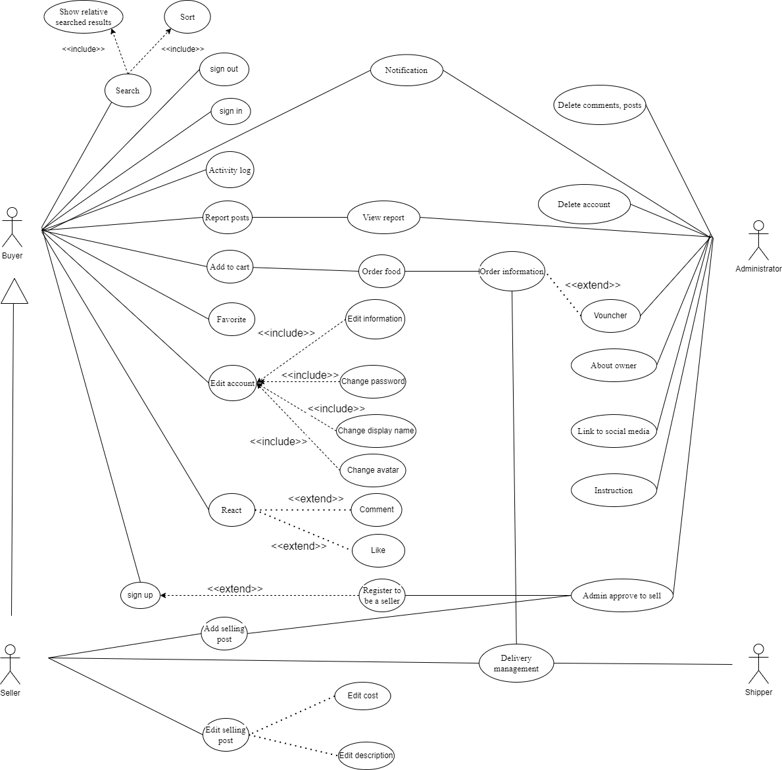

Slide 15
NON - FUNCTIONAL REQUIREMENT
Performance: The web should reply to the commands of clients in less than 1 seconds.
Security: The web must protect the information of users.
Availability: The web shall be available 24 hours a day, 7 days a week.
Usability: The web shall be easy-to-use and appropriate for all people.
Maintainability: The system shall be designed for ease of maintenance.
Fault tolerance: Use load balancing or failover solutions to ensure availability through rapid redundancy and troubleshooting.

Slide 16
4. Analysis and design
Architecture and technologies used

Slide 17
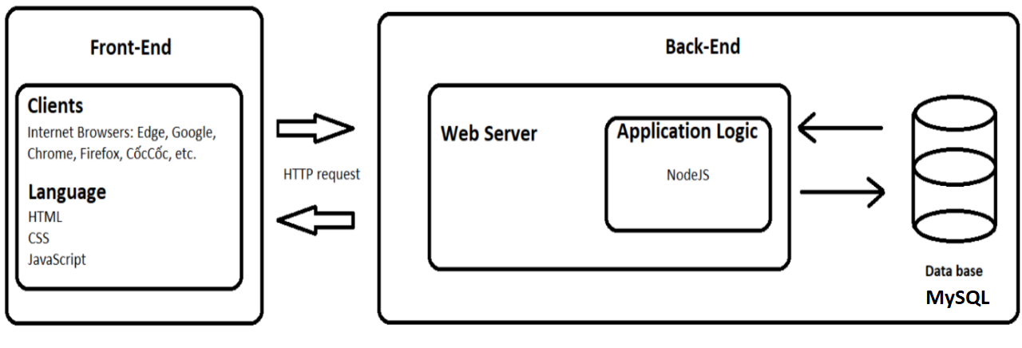
LOGICAL VIEW
3-tier architecture models

Slide 18
COMPONENT
GUI COMPONENTS:
Authentication GUI
Admin GUI
Post GUI
Searching Result GUI
Homepage GUI
Order GUI
Store page GUI
CONTROLLER COMPONENTS:
Authentication Controller
Admin Action Controller
Post Controller
Searching Controller
Homepage Controller
Order Controller
Store page Controller
User Management
Service Integration

Slide 19
SERVICE INTEGRATION
The Service Integration is constructed to communicate between client and server side. From the client, the Integration will receive the commands from the Controllers, send them to the server (by using GET and POST methods) to request the server to access the database. Then, the accessed data will be sent back to the client side to display on the GUIs.

Slide 20
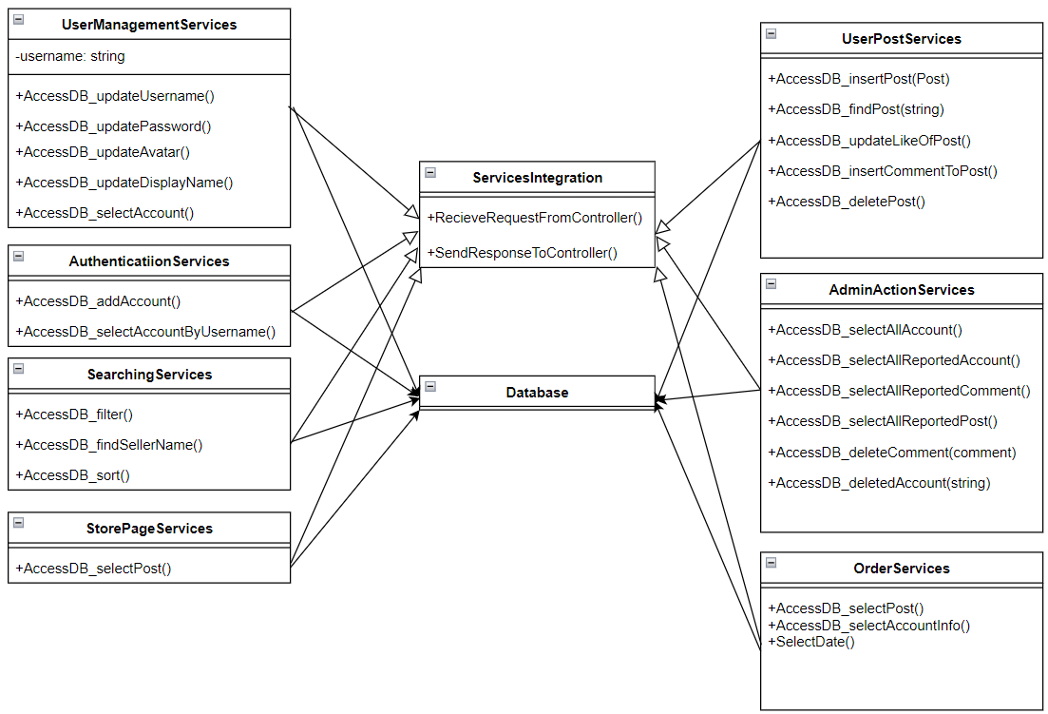

Slide 21
IMPLEMENTATION VIEW
Using the implementation view, we will create a folder structure that will be utilized in this project, similar to the package diagram shown below.

Slide 22
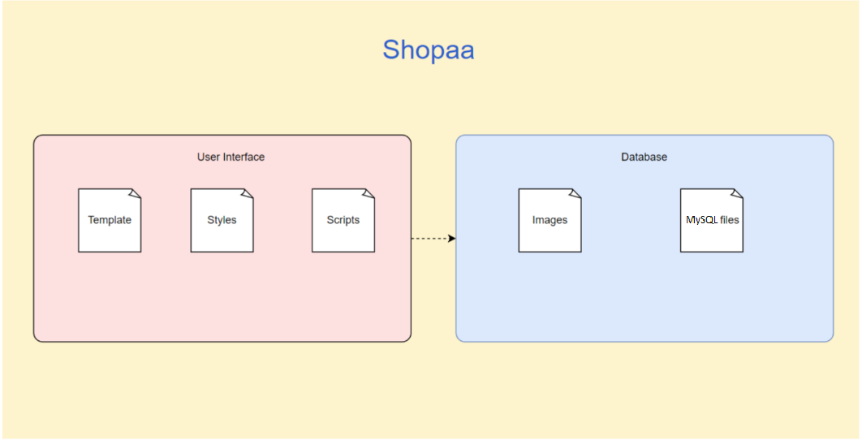

Slide 23
IMPLEMENTATION
User interface:
Template: Save HTML files
Scripts: Save external Javascript files
Style: Save external CSS file
Database:
Image: Save image
Contain MySql files of data
There are folders called Templates, Styles, and Scripts on the client side. There are numerous HTML files in the Templates folder that describe the webpages; in addition, the Styles and Scripts folders contain external CSS and JavaScript files that enhance and add sophisticated functionality to these pages.
The database Mysql files will store and load the data to the browser (The device which runs the database must have Node.js, Node.js module, Mysql database file).

Slide 24
5. SOFTWARE TESTING
Test environments, test plan, and test results

Slide 25
REQUIREMENTS NEEDS
Hardware Requirements:
Operating system: Windows 10, Windows 11 (recommended)
Ram: 2gb or more
Productivity and Support Tools:
Tool Category or Type | Tool Brand Name | Vendor or In-house | Version
Defect Tracking | MS Excel 2010 | MS | 2016 or later

Slide 26
REQUIREMENTS NEEDS
Software in the Test Environment:
Software Name | Purpose | Version | Type and Other Notes
Firefox | test ability to run on the web platform | Newest | Internet Browser
Google Chrome | test ability to run on the web platform | Newest | Internet Browser
Microsoft Edge | test ability to run on the web platform | Newest | Internet Browser
Windows 10, 64 bit | Compatibility check | 21H2 | Operating System

Slide 27
TARGET TEST ITEMS
Sign in
Add to cart
Search store
Sort store
Order food

Slide 28
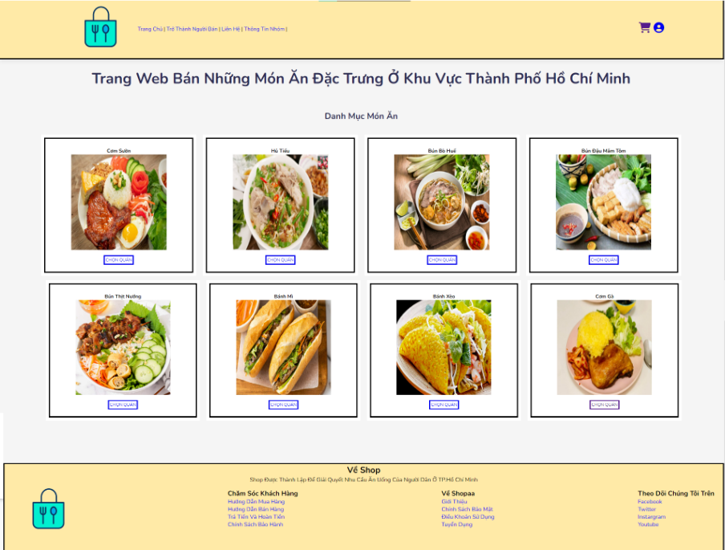
6.DEMO

Slide 29
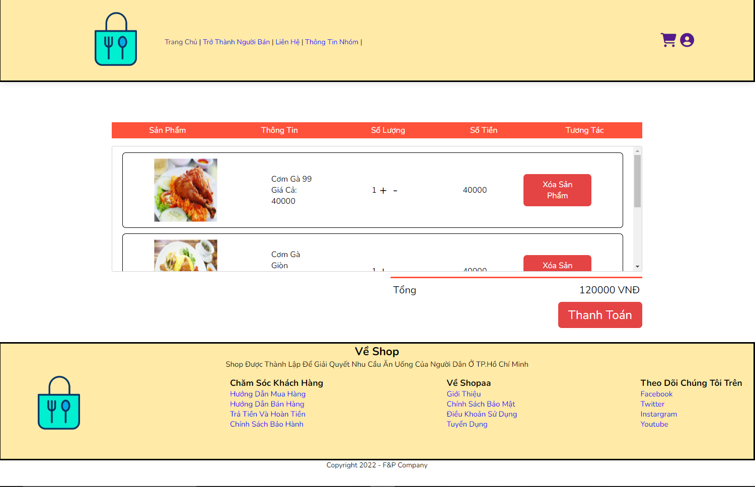
6.DEMO

Slide 30

INSTRUCTORS:
NGUYỄN LÊ HOÀNG DŨNG
NGUYỄN MINH HUY
HỒ TUẤN THANH

