Slide 1
Hardware
Jamie Zhang

Slide 2
CPU
The central processing unit (CPU) (also known as a microprocessor or processor) is central to all modern computer systems (including tablets and smartphones), which is installed as an IC(Integrated Circuit) inside the microchips.
The CPU includes:
-ALU
-CU
-registers and buses

Slide 3
ALU
As the name tells, ALU is in charge of Arithmetic and Logic calculations.
For example: 1+2, True & False

Slide 4
CU
CU ensures synchronisation of data flow and programs throughout the computer by sending out control signals along the control bus.

Slide 5
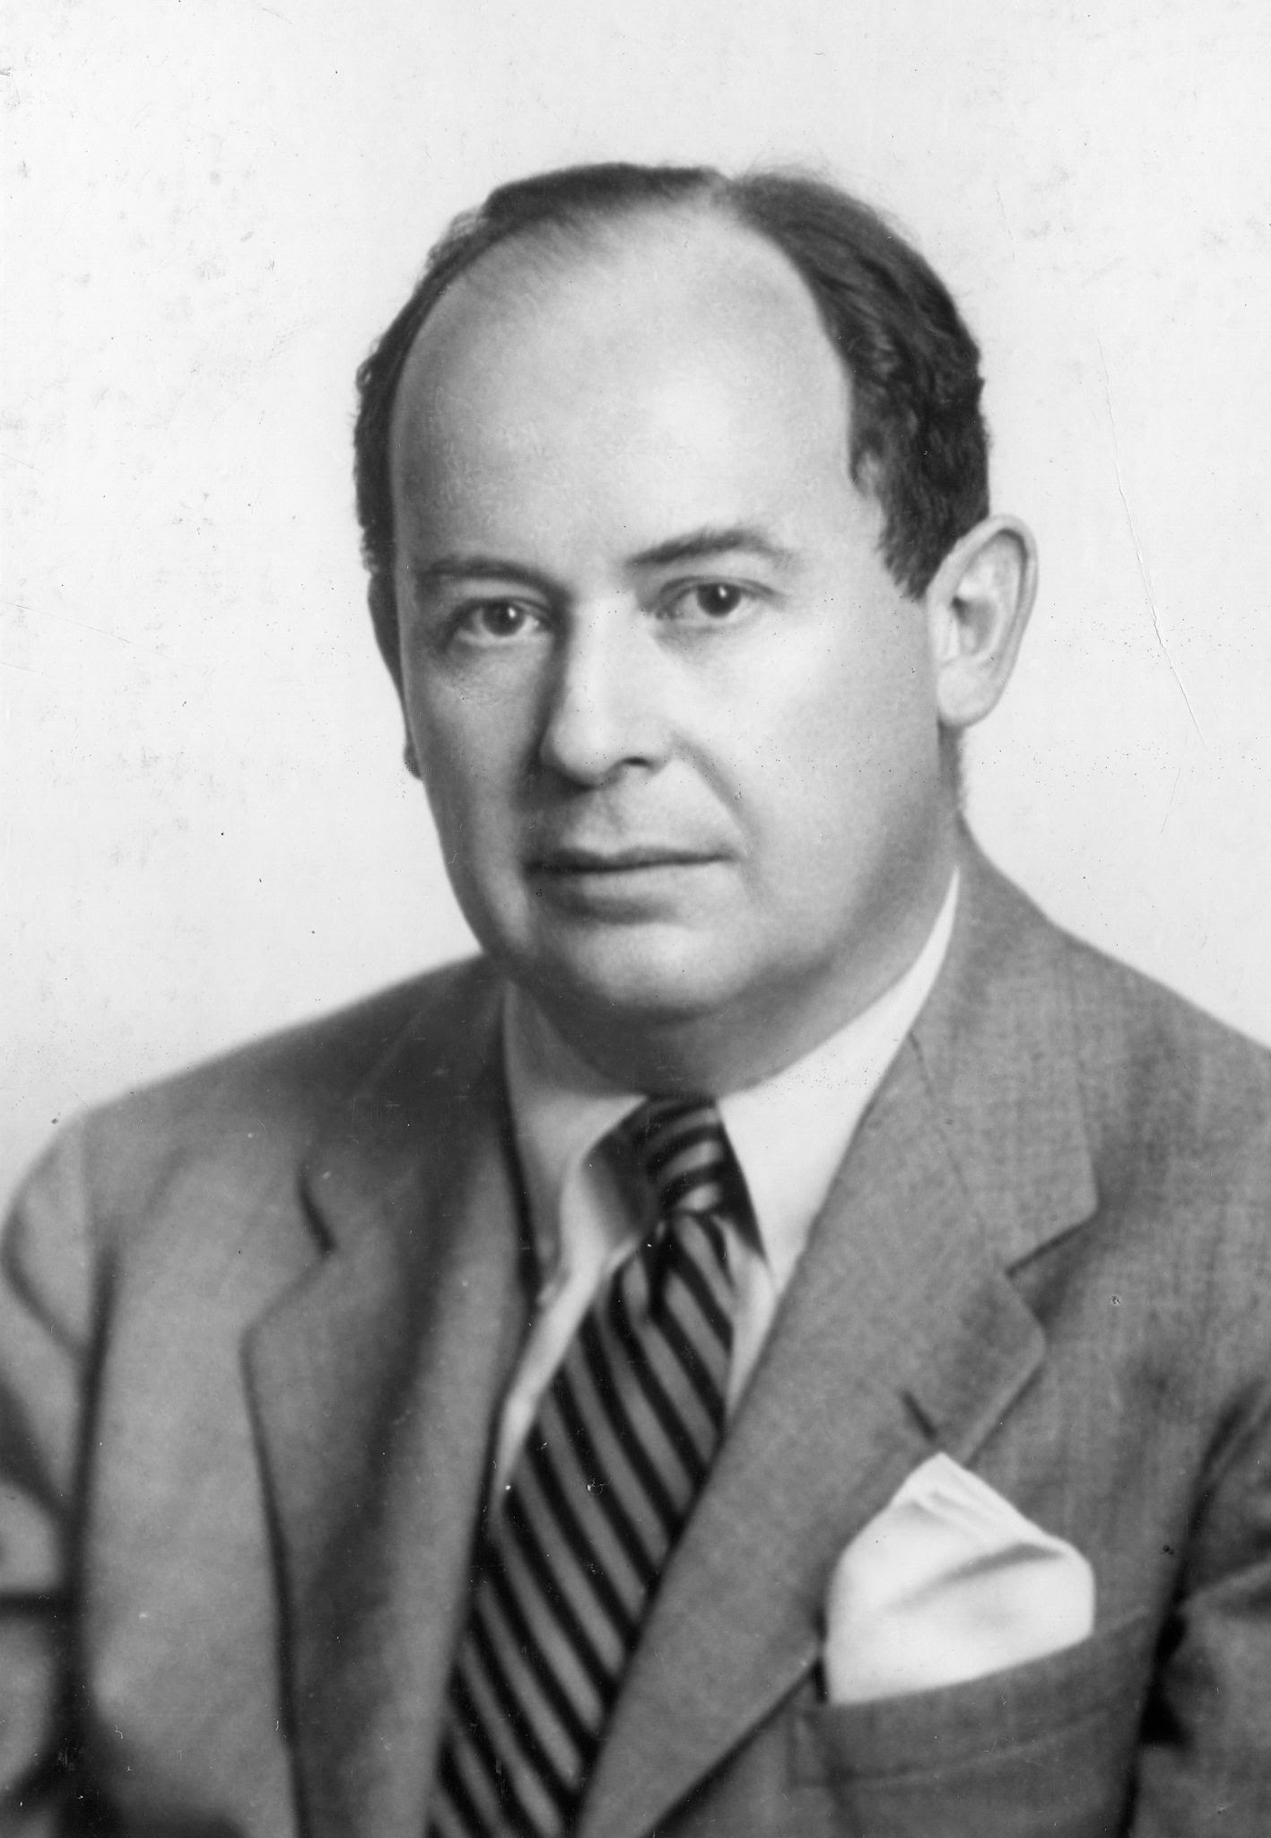
Von Neumann Architecture
There are two famous people in the CS history that you cannot forget: Von Neumann and Alan Turing
John von Neumann developed the concept of the ‘stored program computer’, which has been the basis of computer architecture ever since.

Slide 6
Von Neumann Architecture
The concept of a central processing unit (CPU or processor)
The CPU was able to access the memory directly
Computer memories could store programs as well as data
Stored programs were made up of instructions which could be executed in sequential order.

Slide 7
Registers and buses
PC: Program Counter(the address where the next instruction to be read).
MAR: Memory Address Register(the address of the location currently being used)
MDR: Memory Data Register(the data which has just been read)
CIR: Current Instruction Register(the current instruction that is being decoded and executed)
ACC: Accumulator(Used when carrying ALU calculations. Temporarily stores the data during calculation)

Slide 8
Registers and buses
Address buses: Unidirectional, carries the address.
Control buses: Bi-directional, carries the control signals for CU, 8 bits.
Data buses: Bi-directional, carries the data. Wider data bus could allow several bit blocks(or we call it word) to be transported at the same time(or we call it higher word length).

Slide 9
Fetch-decode-execute cycle
Address Bus
FETCH
PC
MAR
Address Bus
Map
Address | Instructions/data
MDR
Data Bus
CIR
Data Bus

Slide 10
Fetch-decode-execute cycle
The CIR is in charge of the DECODE process.
In a computer system, instructions are a set of operations which are decoded in sequence. An operation is made up of an opcode(what operation needs to be done) and an operand(the data which needs to be acted).
A limited number of opcodes that can be used; this is known as the instruction set.

Slide 11
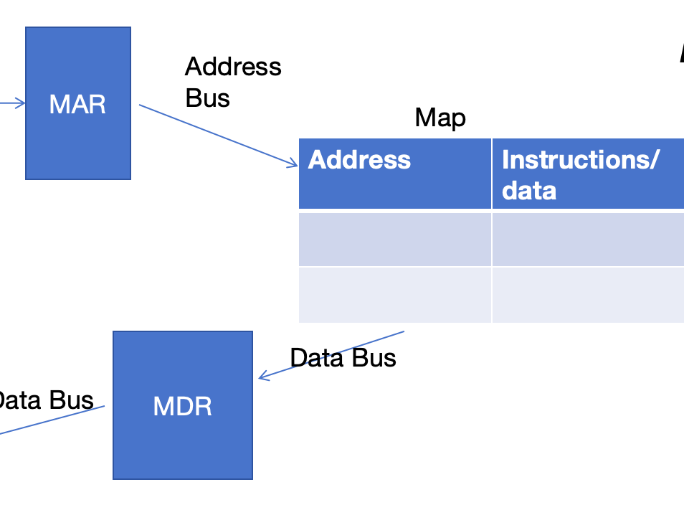
Fetch-decode-execute cycle
After the decode process, there’re two types of situation in EXECUTE.
If it’s an addressing instruction, then we’ll go back to MAR and follow this part of the process to get the data:
If it’s a calculation instruction, then the ALU and AC will cooperate to finish the task.

Slide 12
System Clocks
Like a clock, the computer needs to follow some time rules to do the FE cycle, in order to synchronize computer operations.

Slide 13
CPU performance
Increase the width of address and data buses.
Multi-cores
Increase clock speed
Use of cache memory

Slide 14
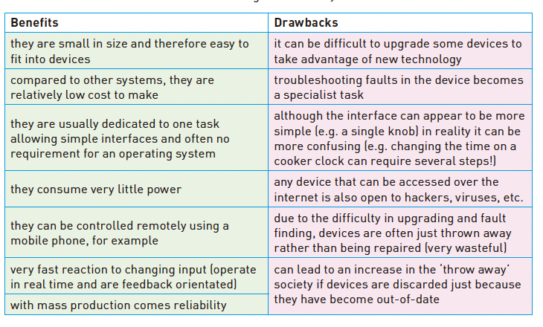
Embedded system
An embedded system is a combination of hardware and software which is designed to carry out a specific set of functions.

Slide 15
Examples of embedded systems
Set-top box
GPS system
Airbags

Slide 16
Input and output devices
Scanner
Monitor
Touchscreen
Earphone with a microphone

Slide 17
Barcode Scanner
A barcode is a series of dark and light parallel lines of varying thickness.
The pattern on the left/right of the guard bar is different, in order to allow the barcode to be scanned in all directions.
the barcode is known as the key field in the stock item record.

Slide 18
QR code
It’s a matrix of filled-in dark squares on a light background.
A QR code consists of a block of small squares (light and dark) known as pixels.
The three large squares at the corners of the code function as a form of alignment; the remaining small corner square is used to ensure the correct size and correct angle of the camera shot when the QR code is read.

Slide 19
QR code
the app will now process the image taken by the camera, converting the squares into readable data
the browser software on the mobile phone or tablet automatically reads the data generated by the app; it will also decode any web addresses contained within the QR code
the user will then be sent to a website automatically

Slide 20
Barcode VS QR code
Advantages of QR codes compared to traditional barcodes
- They can hold much more information
- There will be fewer errors; the higher capacity of the QR code allows the use of built-in error-checking systems . normal barcodes contain almost no data redundancy (data which is duplicated) therefore it isn’t possible to guard against badly printed or damaged barcodes
- QR codes are easier to read
- It is easy to transmit QR codes either as text messages or images
- It is also possible to encrypt QR codes which gives them greater protection than traditional barcodes.
Disadvantages of QR codes compared to traditional barcodes
- More than one QR format is available
- QR codes can be used to transmit malicious codes . known as attagging. Since there are a large number of free apps available to a user for generating QR codes, that means anyone can do this. It is relatively easy to write malicious code and embed this within the QR code. When the code is scanned, it is possible the creator of the malicious code could gain access to everything on the user’s phone (for example, photographs, address book, stored passwords, and so on). The user could also be sent to a fake website or it is even possible for a virus to be downloaded.

Slide 21
Digital Camera
the image is captured when light passes through the lens onto a light-sensitive cell. Each cell is a pixel which contains a sensor. The light is transfered to digital signals by ADC
the ADC converts the electric charges from each pixel into levels of brightness and RGB color code
Light-> Sensor-> ADC-> Store and show the image

Slide 22
Keyboards
There is a membrane or circuit board at the base of the keys
The CPU in the computer can then determine which key has been pressed
The CPU refers to an index file to identify which character the key press represents

Slide 23
Microphone
When sound is created, it causes the air to vibrate.
When a diaphragm in the microphone picks up the air vibrations, the diaphragm also begins to vibrate.
A copper coil is wrapped around the cone which is connected to the diaphragm. As the diaphragm vibrates, the cone moves in and out causing the copper coil to move backwards and forwards.
This forwards and backwards motion causes the coil to cut through the magnetic field around the permanent magnet, inducing an electric current.
The electric current is then either amplified or sent to a recording device. The electric current is analogue in nature.

Slide 24
Optical Mouse
The red light is bounced off the surface and the reflection is picked up by CMOS
The processor can now work out the coordinates of the mouse based on the changing image patterns as it is moved about on the surface.
The computer can then move the on-screen cursor to the coordinates sent by the mouse.

Slide 25
2D-scanner
Computers equipped with optical character recognition (OCR) software allow the scanned text from the document to be converted into a text file format.
And then the scanned image is edited and manipulated in a word processor.
An example is the airport passport scanner

Slide 26
3D-scanner
Since solid objects have x, y and z coordinates, these scanners take images at several points along these three coordinates.
A digital image which represents the solid object is formed.
An example is the tomography

Slide 27
Touchscreens
Capacitive touch screens are composed of a layer of glass (protective layer), a transparent electrode (conductive) layer and a glass substrate. Human touch will change the electric field in the glass surface.
Infrared touch screens use a glass screen with an array of sensors and infrared transmitters.
Resistive touch screens are made up of two layers of electrically resistive material with a voltage applied across them.

Slide 28
Acutator
Converts an electrical signal into a magnetic field producing linear motion. If a plunger (for example, a magnetised metal bar) is placed inside the coil, it will move.

Slide 29
Light Projector-DLP
Use micro mirrors.
The ON/OFF state of the micromirrors determines the pixel brightness.
It can generate over 16 million colors using RGB system.
It utilizes Micro-Opto-Electro-Mechanical Systems (MOEMS) technology.

Slide 30
Light Projector-LCD
The light first passes through the LCD screens before being projected to form an image.
Three LCD panels are used to separately process red, green, and blue.
A prism is used to combine the colors into a full-color image.

Slide 31
Light Projector
DLP: last longer, more colors, but might have blinkness, and the energy consumption is higher.
LCD: more stable, cheaper, but larger, and might have LCD screen problems.

Slide 32
Printer
Inkjet: Use liquid ink, including Thermal bubble and Piezoelectric tech.
Laser: Use powder ink and rotating drum.
3D: Use solid materials like plastic and resin.

Slide 33
Screen
LED
Brightness control achieved by varying electric current.
Composed of tiny red, green, and blue LEDs that emit light.
Mainly used for large outdoor displays due to high brightness.
Faster brightness adjustment, Sharper colors, higher contrast, Longer lifespan & lower power consumption
LCD
Made up of liquid crystal pixels that require backlighting.
Mainly used for large outdoor displays due to high brightness.

Slide 34
Loudspeaker
DAC
Amplifier
Lorentz Force

