Slide 1
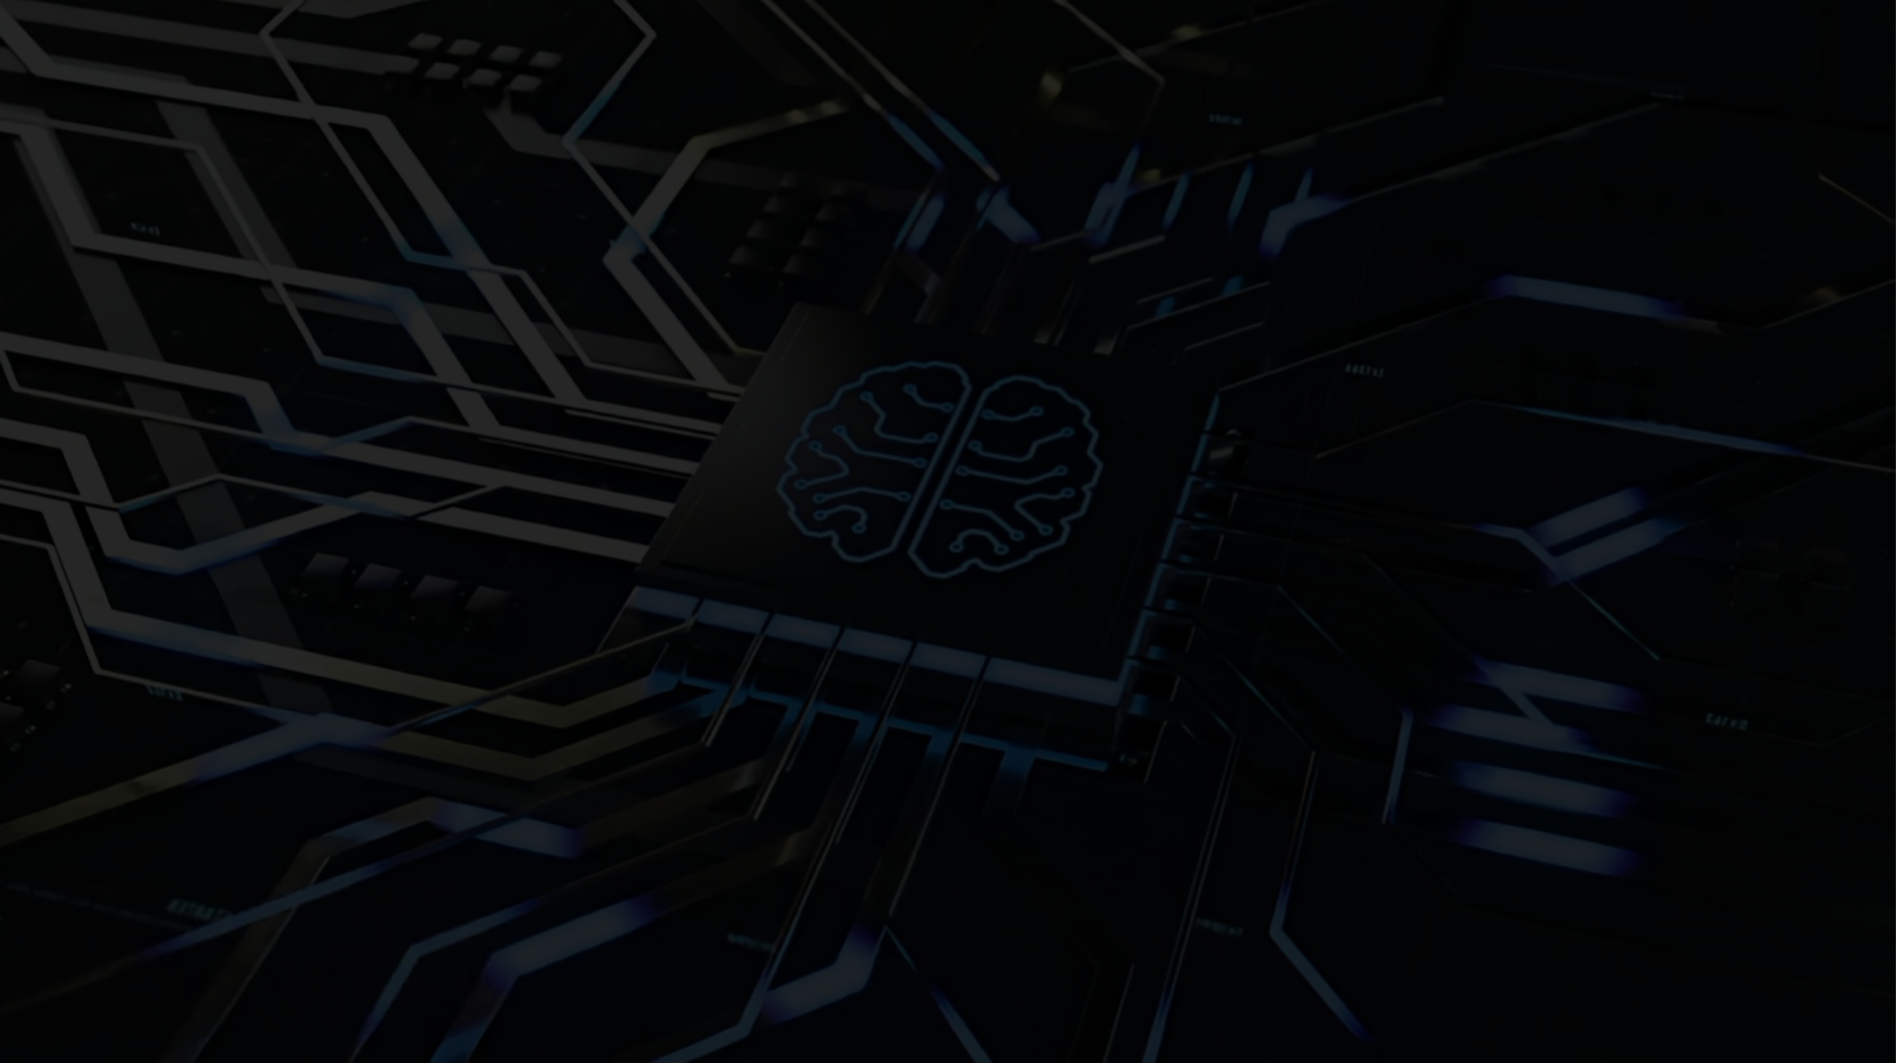



NEXT SLIDE
COMPUTER
SCIENCE
The foundation of modern innovation, connecting the world through digital systems.

Slide 2

NEXT SLIDE
What do you know about Computer Science?

Slide 3
NEXT SLIDE
ABOUT
CS
The study of computers, computing systems, and computational processes. It involves the theory, design, development, and application of software and systems to solve problems and perform tasks

Slide 4

NEXT SLIDE
What’s Computer Science?
Algorithms& Data Structures
Programming
Software
Hardware
AI& ML
Database
Human-computer Interaction
Embedded System
Distributed System
Theory of Computation, Computer Network, Operating System...

Slide 5
NEXT SLIDE
What could you do in the future?
Theory Computer Scientist
Software Engineer
Data& Research Scientist
Machine Learning Engineer
Tech Staff
Game Developer

Slide 6
NEXT SLIDE
Your first HW
Try to search for P=NP
problem.
Next time please explain
to me what’s that.

Slide 7

NEXT SLIDE
What will you learn in IGCSE CS
- Data Systems, Data Compression, Data Storage, Database, Logic Gate
- Data Transmission, Encryption
- Hardware& Software
- Internet, Cyber security
- Emerging Tech
- Pseudocode
- Programming

Slide 8
NEXT SLIDE
IGCSE CS
Paper I: 75 points, 105 mins
Paper II: 75 points, 105 mins
Mostly theory, some calculation.
Mostly coding, some theory

Slide 9

NEXT SLIDE
Any questions?
Or which part do you find interesting?

Slide 10

BACK
THANK YOU!

