Slide 1


QA Project 1
By James Long
Notes:
To start of with hi, im james how are you doing today.
so to start of with im going to be going throo the process I took at completing the project that was given to myself along with the screenshots
Ive taken throughout developing it.
then after we’ve finished that I’ll give you a quick demo of the application at its current stage.
Everyone happy with that ?
Ill give you moments for question throughout but if you really have a urgent question please feel free to just interrupt me and ask.

Slide 2
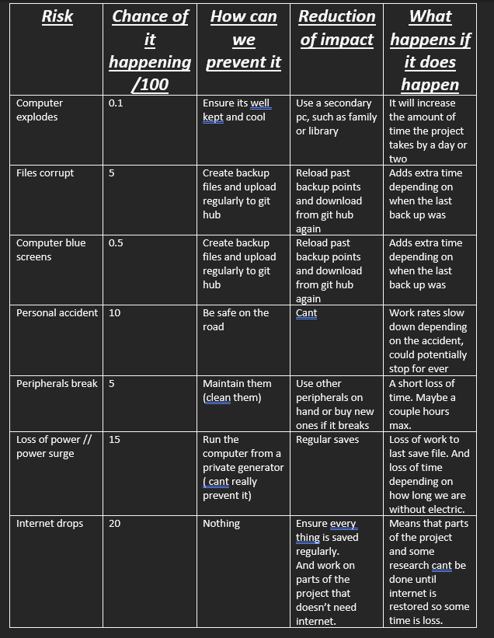
Risk assessment
Notes:
Now being a small project with just myself, the risks to this project were minimal and I ensured that they were reduced as much as I could so that there wernt any issues while developing the project which was defiantly the case as files did crossed over due to my error but nothing was lost and it took me all of about 5 minuets to fix thanks to making private copies while working. and im aware when working with a team this isn’t really a option but as it was just myself it was definatly the better way to go about a little bit of a extra security net.

Slide 3
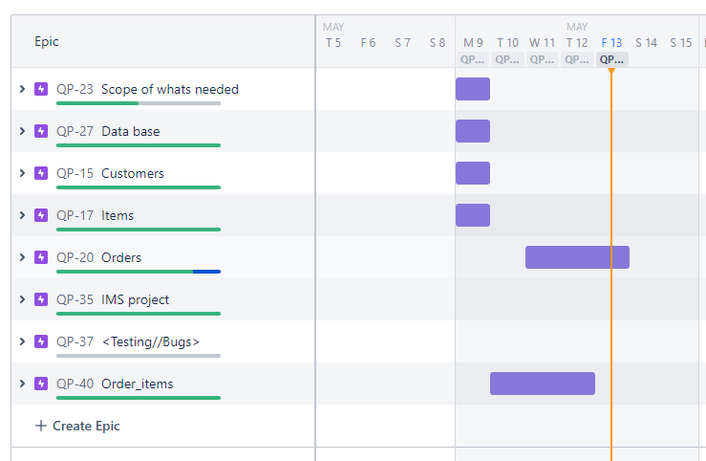
Jira
Notes:
Infront of you now is the most up to date snapshot of my jira roadmap showing you how far along I was and when each part was complete. The first thing I did after getting the brief and learning about jira was make my user stories and tasks. Now admittedly after using jira for a working week I’ve realised that I was defiantly using it differently, in a manor that worked for me at the time, although I will be using it the proper way now I understand how to and why we do use it a certain way.

Slide 4

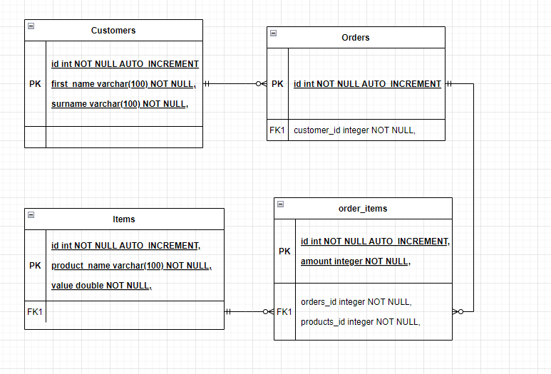
The ERD board
Notes:
So after my Jira the first step was the ERD, As advised by my cohort leader I after reading throo the Word document It was the next item on my list to be done.
I had a good idea of what was needed for the basics of this project because of the brief and the word document ofcourse and ended with this ERD board infront of you now Showing the relationships between the tables and what they contain.

Slide 5
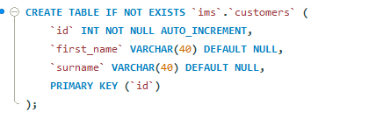
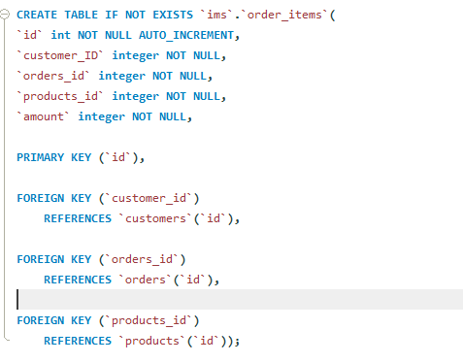
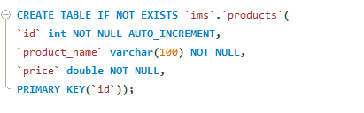
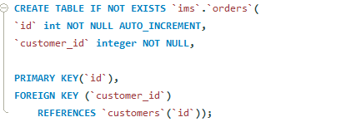
My SQL
Notes:
Now since the ERD was already created and made it allowed me to generate and set out the database and all the variables included rather quickly.
Is there any questions so far ?

Slide 6
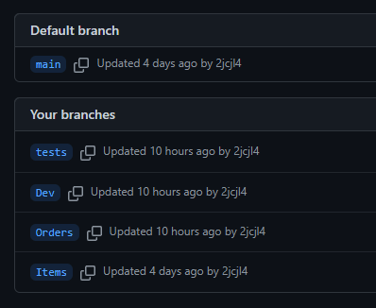
Branches
Notes:
After making my SQL database I made my git hub repository and the necessary branches to begin, being the main and Dev branch, and although I knew the project and the requirements outlined I decided to make the branches I felt appropriate at the time of developing that feature of the project

Slide 7
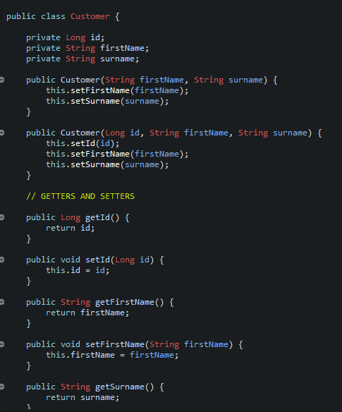
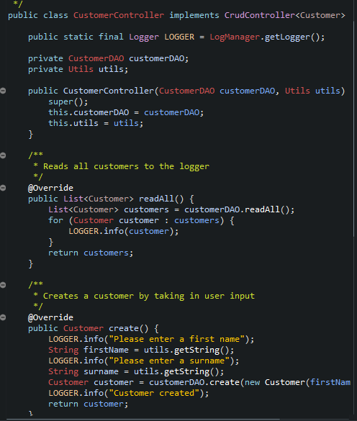
First steps of developing the application
Notes:
So after getting the starter code generously given to us to use as a base I spent a little while skimming throo the code and seeing what there was and what could be re used for ease of developing. I ran the application and

Slide 8
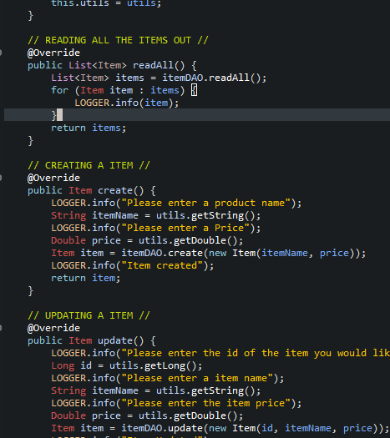
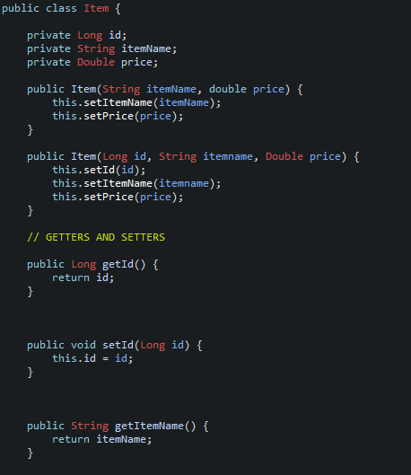
Second part Items
Notes:
So we can go throo this in more detail if you like when we do the demo of the application later if you like but as a basic gist my items class was very similar and quick to understand like the customer class with a few variations in the variables obviously and at this stage everything was going smoothly and I had no altercations making this application. So I pushed it to my dev branch and moved onto my order class.

Slide 9
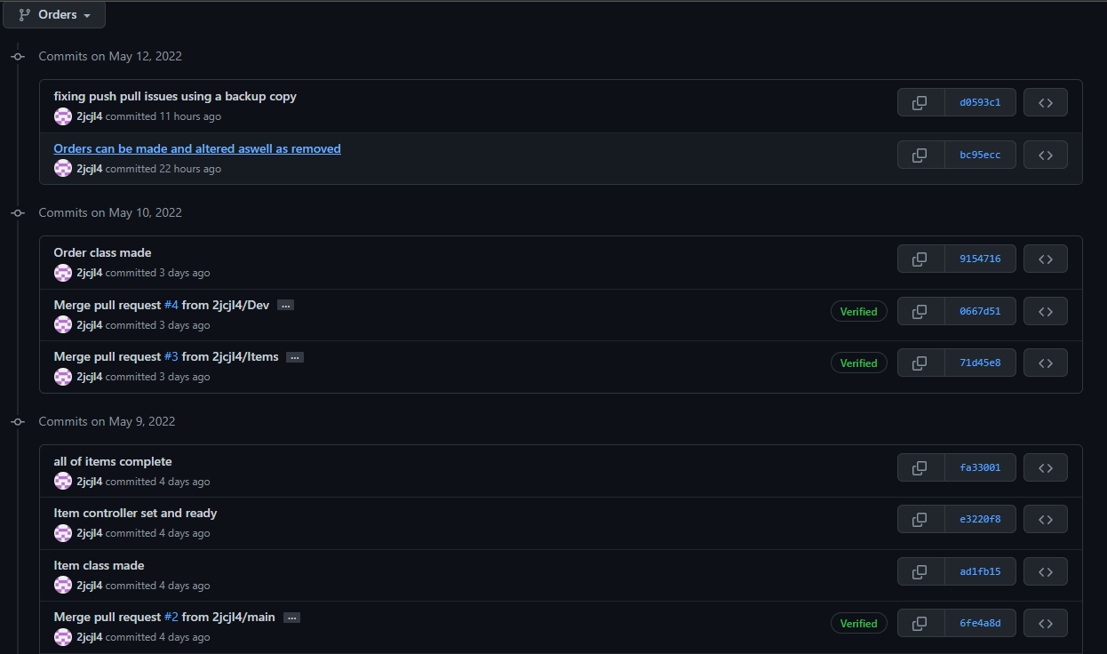
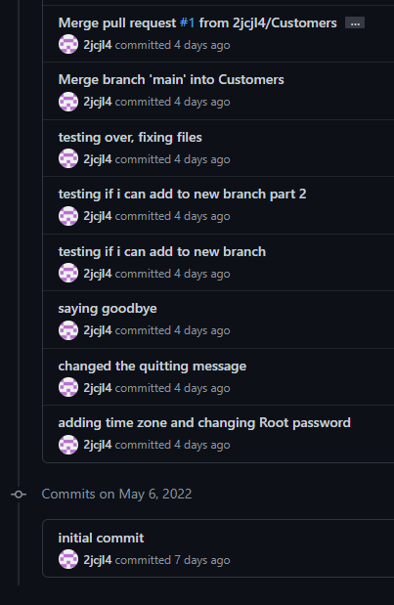
Third stage Order Class
There was 18 commits for Orders branch alone
Notes:
Now my Order class I thought would be simple and easy to make, the commits on the screen now show, it wasnts quite the walk in the park I hoped for as I remembered the fact that I have to fit order items inside of it aswell.
Before I get into it any further I will say that I most likely will never be doing it this way again as the hassle it was and the other ways of making this application would have been suited and easier to do, such as putting everything into lists. But as a first project I wanted to push my self and learn more about SQL and java linking together so I decided to run all my operations throo sql instead of a inbuilt list.

Slide 10

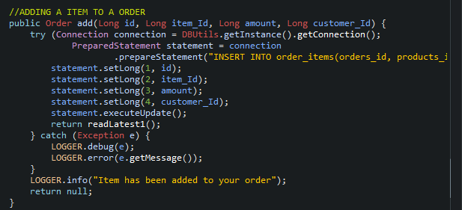
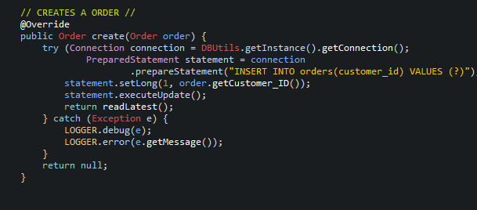
Orders and the solutions
Notes:
so heres the part that’s interesting and how I managed to create the application using new methods in the DAO and switch statement in the controller part. Now in front of you is a small example of the create method taken from customers which has been altered to make a order, but instead of using the same method to create a item and put it into a list, which would of made everything easier I admit I made a new method that put all the data into my SQL and called on that part of the database throo out the application.
Any questions so far ?

Slide 11
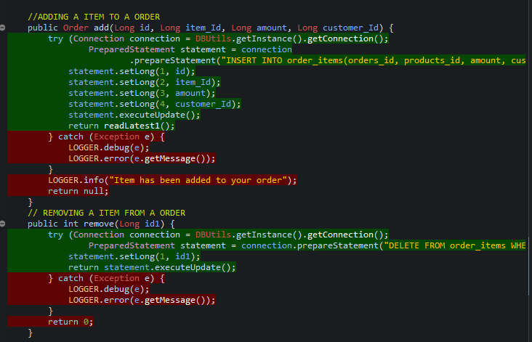
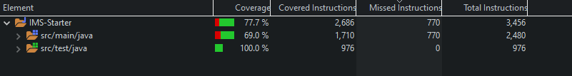
Testing
Notes:
Okay so recently I did the testing for the application so far and have reached a over all coverage of 77.7% with the main being at 69%. But every method and part of the application has been tested other than catching exceptions and the runner. So in terms of coverage of whats being used I feel as though the coverage is very adequate

Slide 12
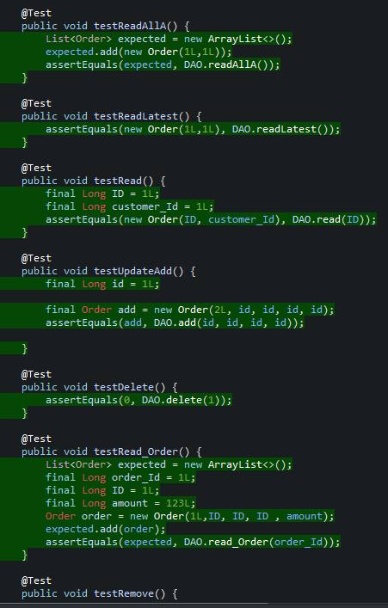
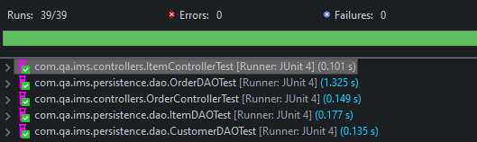
Tests
Notes:
Just infront of you now is a couple of the tests that I ran on the application along with the amount of tests done, and as it shows so far we have 0 failures meaning that the application is working perfectly as intented.

Slide 13
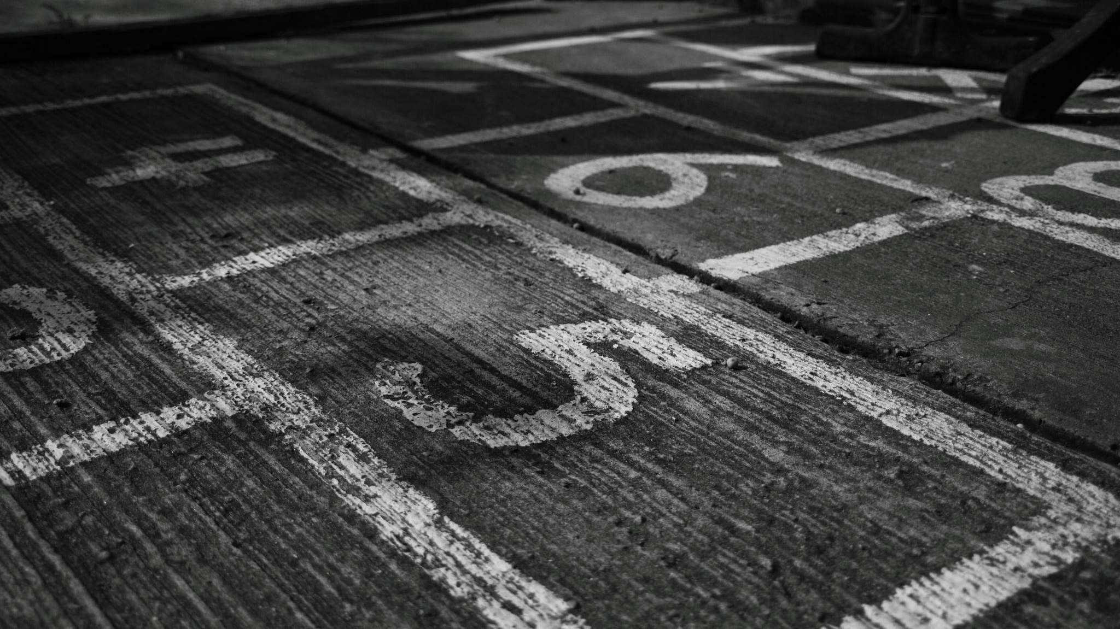
The end
Notes:
So that concludes my presentation. I will say that the application isn’t quite finished just yet as im still yet to add the total price method which will be implemented before the end of today.
Do you have any questions or would you like a short demonstration

