Slide 1
DESIGN AND IMPLEMENTATION OF A MICROPROCESSOR BASED TEMPERATURE CONTROLLER WITH REAL TIME DISPLAY
By:
Angad Singh Nagi (2K18/EE/026)

Slide 2
ABSTRACT
This project is a standalone automatic fan speed controller that controls the speed of an electric fan according to our requirement. Use of embedded technology makes this closed loop feedback control system efficient and reliable. Microcontroller (ATMega8 / 168 / 328) allows dynamic and faster control. Liquid crystal display (LCD) makes the system user-friendly. The sensed temperature and fan speed level values are simultaneously displayed on the LCD panel.
It is very compact using few components and can be implemented for several applications including air-conditioners, water- heaters, snow-melters, ovens, heat-exchangers, mixers, furnaces, incubators, thermal baths and veterinary operating tables. ARDUINO micro controller is the heart of the circuit as it controls all the functions.
The temperature sensor LM35 senses the temperature and converts it into an electrical (analog) signal, which is applied to the microcontroller. The sensed and set values of the temperature are displayed on the 16x2-line LCD. The micro controller drives Transistor to control the fan speed. This project uses regulated 12V, 2A power supply. This project is useful in process industries for maintenance and controlling of Boilers temperature.

Slide 3
INTRODUCTION
With the advancement in technology, intelligent systems are introduced every day. Everything is getting more sophisticated and intelligible. There is an increase in the demand of cutting edge technology and smart electronic systems. Microcontrollers play a very important role in the development of the smart systems as brain is given to the system. Microcontrollers have become the heart of the new technologies that are being introduced daily.
A microcontroller is mainly a single chip microprocessor suited for control and automation of machines and processes. Today, microcontrollers are used in many disciplines of life for carrying out automated tasks in a more accurate manner. Almost every modern day device including air conditioners, power tools, toys, office machines employ microcontrollers for their operation. Microcontroller essentially consists of Central Processing Unit (CPU), timers and counters, interrupts, memory, input/output ports, analog to digital converters (ADC) on a single chip. With this single chip integrated circuit design of the microcontroller the size of control board is reduced and power consumption is low.

Slide 4
DESCRIPTION
The temperature-based fan speed control system can be done by using an electronic circuit using an Arduino board. Now Arduino board is very progressive among all electronic circuits, thus we employed Arduino board for fan speed control. The proposed system is designed to detect the temperature of the room and send that information to the Arduino board. Then the Arduino board executes the contrast of current temperature and set temperature based on the inbuilt program of the Arduino.
The outcome obtained from the operation is given through the o/p port of an Arduino board to the LCD display of related data. The generated pulses from the board which is further fed to the driver circuit to get the preferred output to the fan.

Slide 5
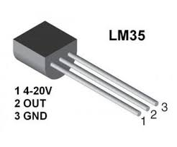
Temperature Sensor
We are using LM 35 as temperature sensor. LM 35 is a precision temperature sensor whose output is linearly proportional to celsius temperature. The LM35 is rated to operate from -55° centigrade to 150° centigrade with a linear scale factor of
+10mv/° c
Features:
Calibrated directly in degree Celsius (centigrade)
Linear +10.0 mV/ degree Celsius
0.5 degree Celsius accuracy (at +25degree Celsius)
Rated for full -55 to +150 degree Celsius range
Suitable for remote applications
Low cost due to wafer-level trimming
Operates from 4 to 30 volts
Less than 60 Micro ampere current drains
Low self-heating, 0.08 degree Celsius in still air
Nonlinearity only +/- 1/4 degree Celsius typical
Low impedance output, 0.1 Ohm for 1mA load

Slide 6
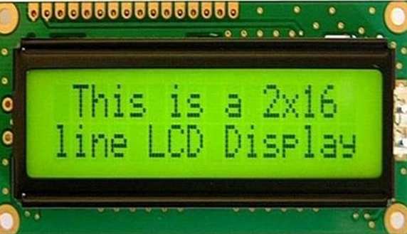
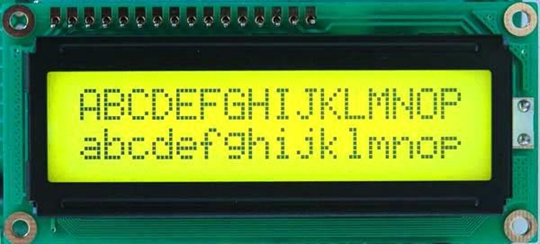
Liquid Crystal Display
The LCD is a dot matrix liquid crystal display that displays alphanumeric characters and symbols. 16X2 LCD digital display has been used in the system to show the room temperature. Liquid Crystal Display screen is an electronic display module and find a wide range of applications. A 16x2 LCD display is very basic module and is very commonly used in various devices and circuits. These modules are preferred over seven segments and other multi segment LEDs. The reasons being: LCDs are economical; easily programmable; have no limitation of displaying special & even custom characters (unlike in seven segments), animations and so on.
A 16x2 LCD means it can display 16 characters per line and there are 2 such lines. In this LCD each character is displayed in 5x7 pixel matrix. This LCD has two registers, namely, Command and Data. The command register stores the command instructions given to the LCD. A command is an instruction given to LCD to do a predefined task like initializing it, clearing its screen, setting the cursor position, controlling display etc. The data register stores the data to be displayed on the LCD. The data is the ASCII value of the character to be displayed on the LCD.

Slide 7
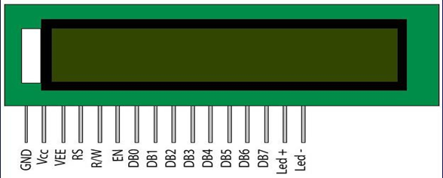
Pin Description:
Pin No | Function | Name
1 | Ground (0V) | Ground
2 | Supply voltage; 5V (4.7V – 5.3V) | Vcc
3 | Contrast adjustment; through a variable resistor | VEE
4 | Selects command register when low; and data register when high | Register Select
5 | Low to write to the register; High to read from the register | Read/write
6 | Sends data to data pins when a high to low pulse is given | Enable
7 | 8-bit data pins | DB0
8 |  | DB1
9 |  | DB2
10 |  | DB3
11 |  | DB4
12 |  | DB5
13 |  | DB6
14 |  | DB7
15 | Backlight V_{CC} (5V) | Led+
16 | Backlight Ground (0V) | Led-

Slide 8
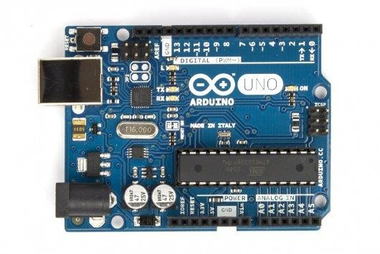
Arduino UNO
SPECIFICATIONS
Microcontroller : ATmega328
Operating Voltage : 5V Input Voltage (recommended) : 7-12V Input Voltage (limits) : 6-20V
Digital I/O Pins : 14 (of which 6 provide PWM output)
Analog Input Pins :6
DC Current per I/O Pin :40 mA
DC Current for 3.3V Pin :50 mA
Flash Memory :32 KB of which 0.5 KB used by
: Bootloader
SRAM :2 KB
EEPROM :1 KB
Clock Speed :16 MHz

Slide 9
General Pin functions:
LED: There is a built-in LED driven by digital pin 13. When the pin is HIGH value, the LED is on, when the pin is LOW, it's off.
VIN: The input voltage to the Arduino/Genuino board when it's using an external power source (as opposed to 5 volts from the USB connection or other regulated power source). You can supply voltage through this pin, or, if supplying voltage via the power jack, access it through this pin.
5V: This pin outputs a regulated 5V from the regulator on the board. The board can be supplied with power either from the DC power jack (7 - 20V), the USB connector (5V), or the VIN pin of the board (7-20V). Supplying voltage via the 5V or 3.3V pins bypasses the regulator, and can damage the board.
3V3: A 3.3 volt supply generated by the on-board regulator. Maximum current draw is 50 mA.
GND: Ground pins.
IOREF: This pin on the Arduino/Genuino board provides the voltage reference with which the microcontroller operates. A properly configured shield can read the IOREF pin voltage and select the appropriate power source or enable voltage translators on the outputs to work with the 5V or 3.3V.
Reset: Typically used to add a reset button to shields which block the one on the board.
Special Pin Functions:
Each of the 14 digital pins and 6 Analog pins on the Uno can be used as an input or output, using pinMode(),digitalWrite(), and digital Read() functions. They operate at 5 volts. Each pin can provide or receive 20 mA as recommended operating condition and has an internal pull-up resistor (disconnected by default) of 20-50k ohm. A maximum of 40mA is the value that must not be exceeded on any I/O pin to avoid permanent damage to the microcontroller. The Uno has 6 analog inputs, labeled A0 through A5, each of which provide 10 bits of resolution (i.e. 1024 different values). By default they measure from ground to 5 volts, though is it possible to change the upper end of their range using the AREF pin and the analog Reference() function.

Slide 10
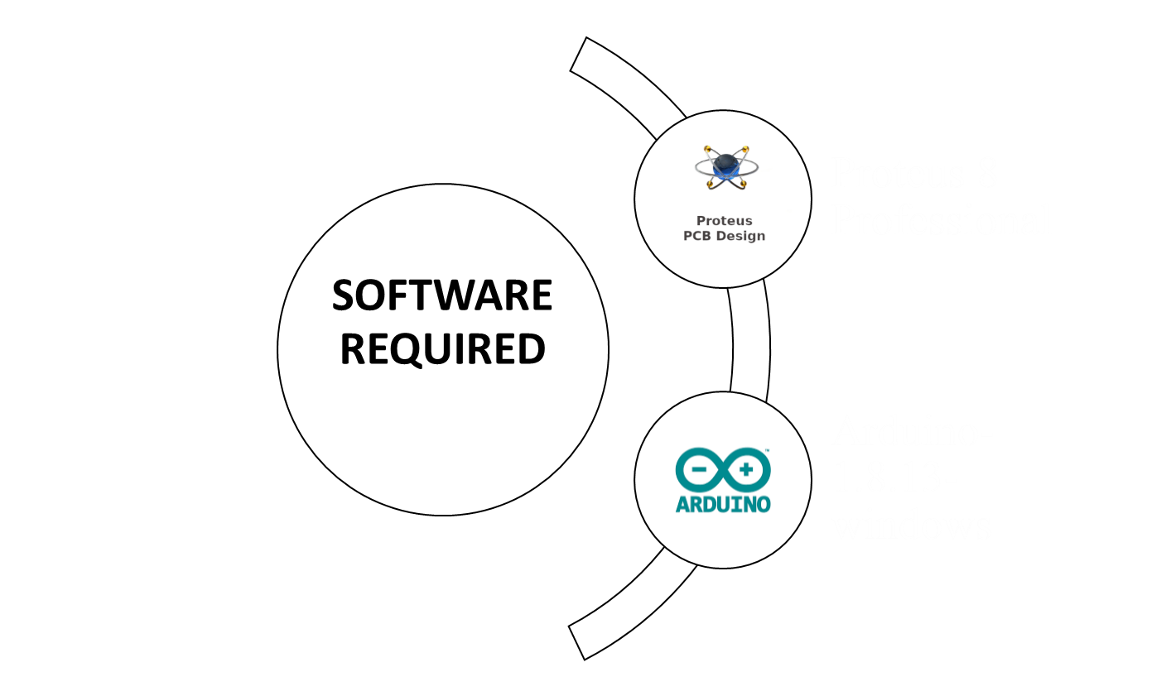

Slide 11
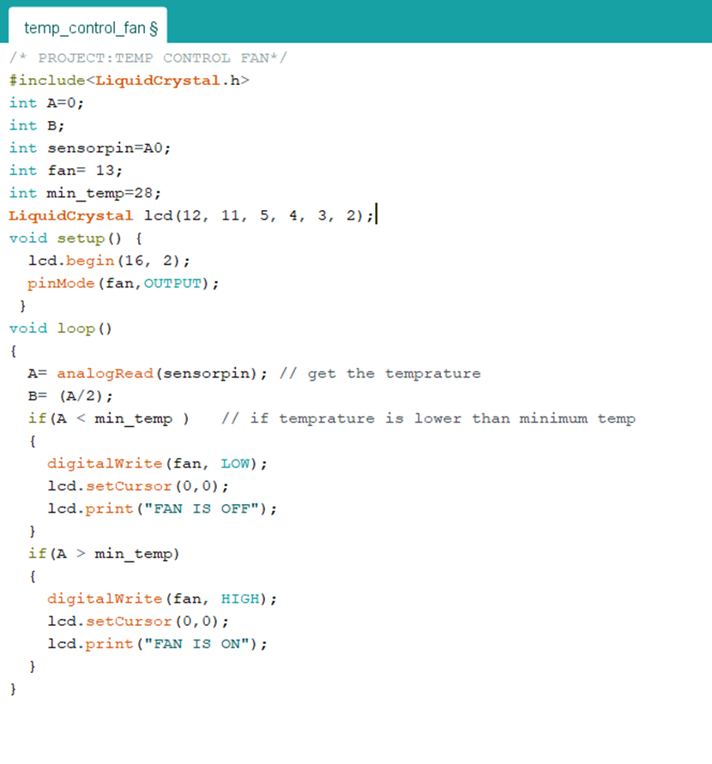
CODE:

Slide 12
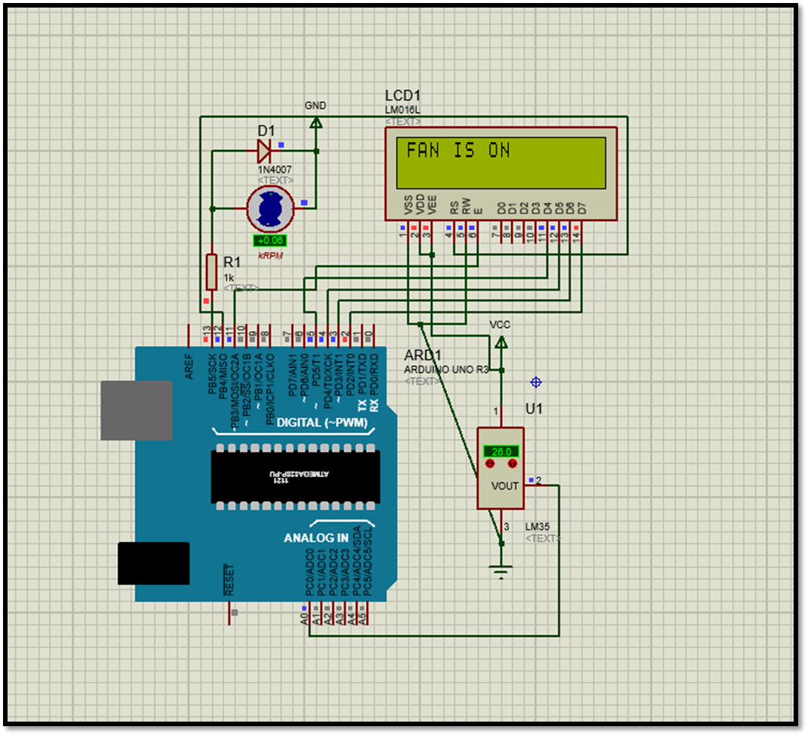
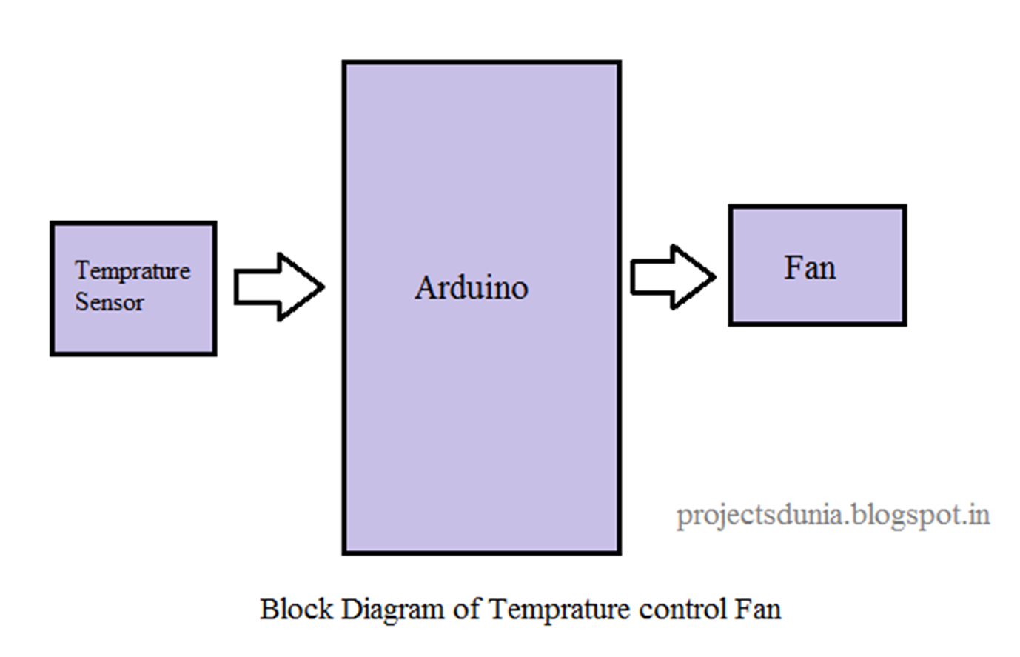
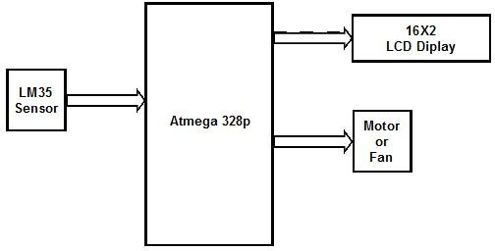
Circuit Diagram
Block Diagram

Slide 13
Application:
Temperature based fan speed controller is useful for cooling the processor in the laptops and personal computers “more efficiently”. Generally fan in laptop comes with only two or three possible speeds. So it results in more power consumption.
The fan designed in this project, has different values of speed according to temperature change. This can be also used in small scale industries for cooling the electrical/mechanical equipment. The whole circuit except motor and fan can be manufactured on a single PCB, and it can be used for temperature based control operations.

Slide 14
Advantages:
Disadvantages:
This project can be used in Home.
This project can be used in Industry.
This will help in saving the energy / electricity.
To monitor the environments that is not comfortable, or possible, for humans to monitor, especially for extended periods of time.
Prevents waste of energy when it’s not hot enough for a fan to be needed.
To assist people who are disabled to adjust the fan speed automatically.
It can only be maintained by technical person. Thus, it becomes difficult to be maintained.
Due to temperature variation, after sometimes its efficiency may decrease.
FUTURE SCOPES:
REDUCING ERROR AND IMPROVING THE CODE

Slide 15
THANK YOU

