Slide 1
DOMAIN-SALESFORCE DEVELOPER UsECASE-RETAIL MANAGEMENT APPLICATION
TEAM MEMBERS
GIRIHARAN S
HARI PRASANNA S
NANDHAKUMAR S
NITHISH S
MURALIDHARAN S
MENTOR-RAKESH
GUIDE-VEKATA RAMANEN EVALUATOR-

Slide 2
WHAT Is SALESFORCE?
>Salesforce a CRM platform and its an Saas Cloud . apart from this ,It is game-changing technology, with a host of productivity- boosting features, that will help you sell smarter and faster.
>Salesforce has everything you need to run your business from anywhere. Using standard products and features, you can manage relationships with prospects and customers, collaborate and engage with employees and partners, and store your data securely in the cloud.
>Salesforce is your customer success platform, designed to help you sell, service, market, analyze, and connect with your customers.

Slide 3
RETAIL MANAGEMENT APPLICATION
>In this project a CRM product has to create two applications, one is a sales app for sales reps to use this application and store customers data, and the second application is a service app for service reps/agents to provide support to customers in dealing cases. To generate business on top of the customers.
>Retailing encompasses the business activities involved in selling goods and services to consumers for their personal, family, or household etc.

Slide 4
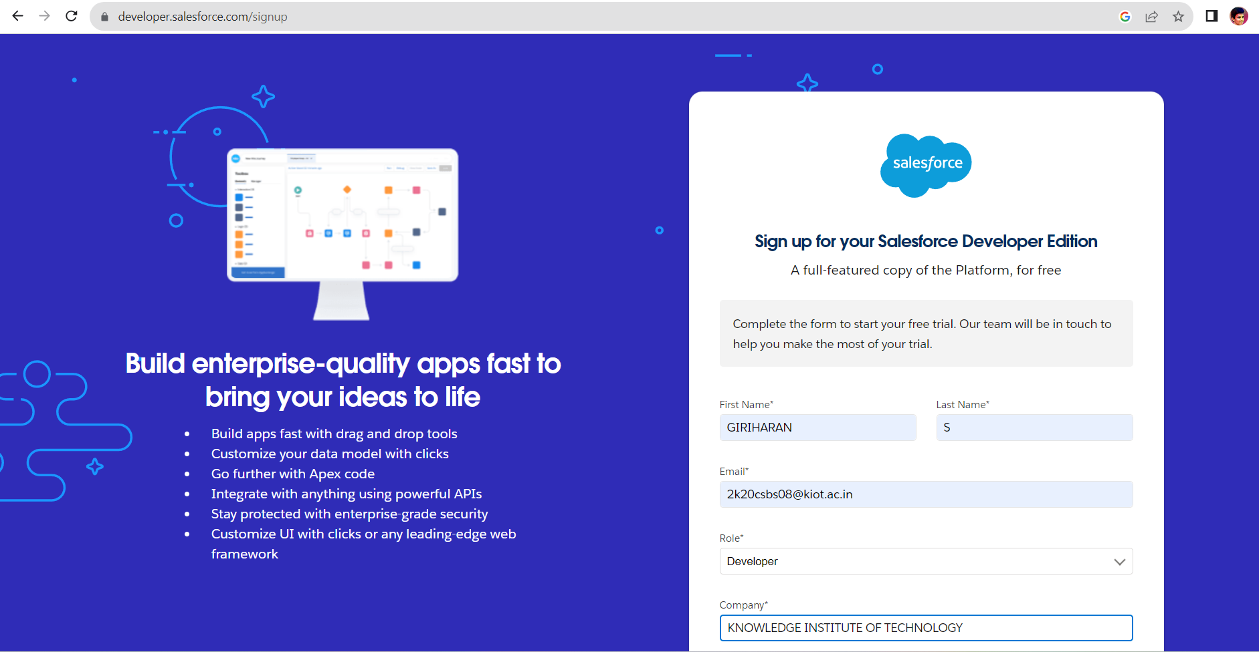
CREATION OF DEVELOPER ACCOUNT
A Developer org has all the features and licenses you need to get started with Salesforce.1.Search Developer.salesforce.com/signup

Slide 5
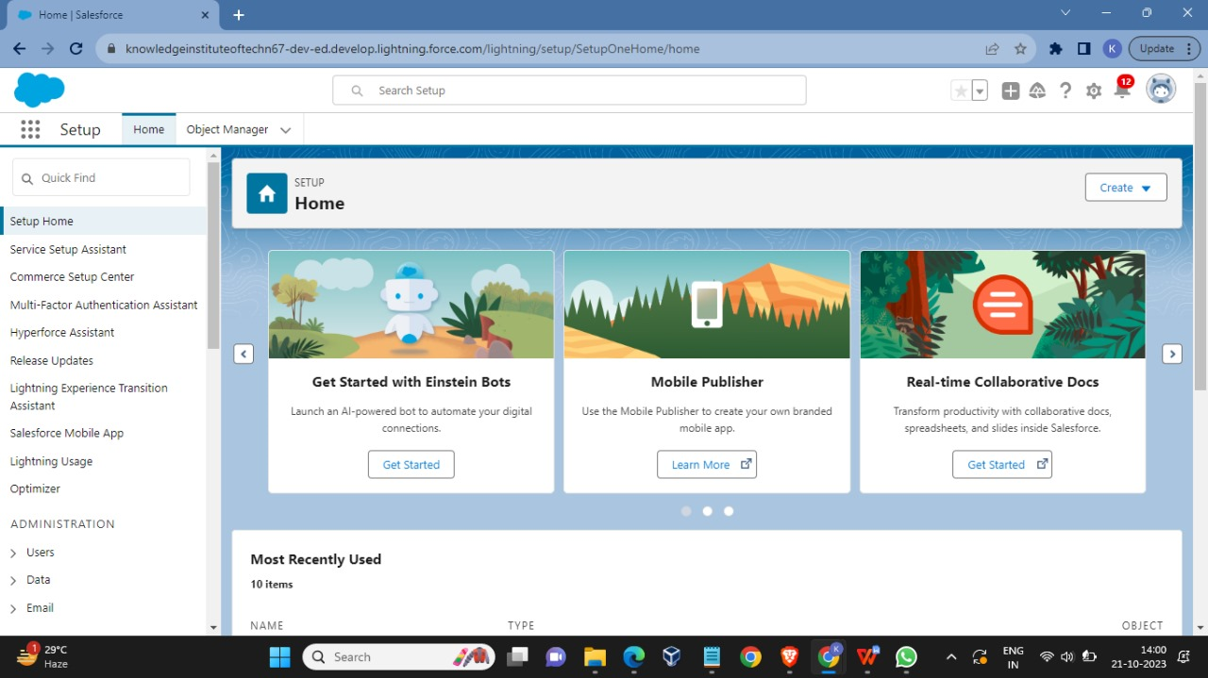
HOME PAGE

Slide 6
OBJECTS
>WHAT IS AN OBJECT?
Salesforce objects are database tables that permit you to store data that is specific to an organization. It consists of fields (columns) and records (rows).
>SALESFORCE OBJECTS ARE OF 2 TYPES
1.Standard Objects: Standard objects are the kind of objects that are provided by salesforce.com such as users, contracts, reports, dashboards, etc.
2.Custom Objects: Custom objects are those objects that are created by users. They supply information that is unique and essential to their organization. They are the heart of any application and provide a structure for sharing data.

Slide 7
In This Application We Use 4 Custom Objects:
>Warehouse
>Sales order
>Dispatch/Tracking
>Dispatch/Delivery

Slide 8
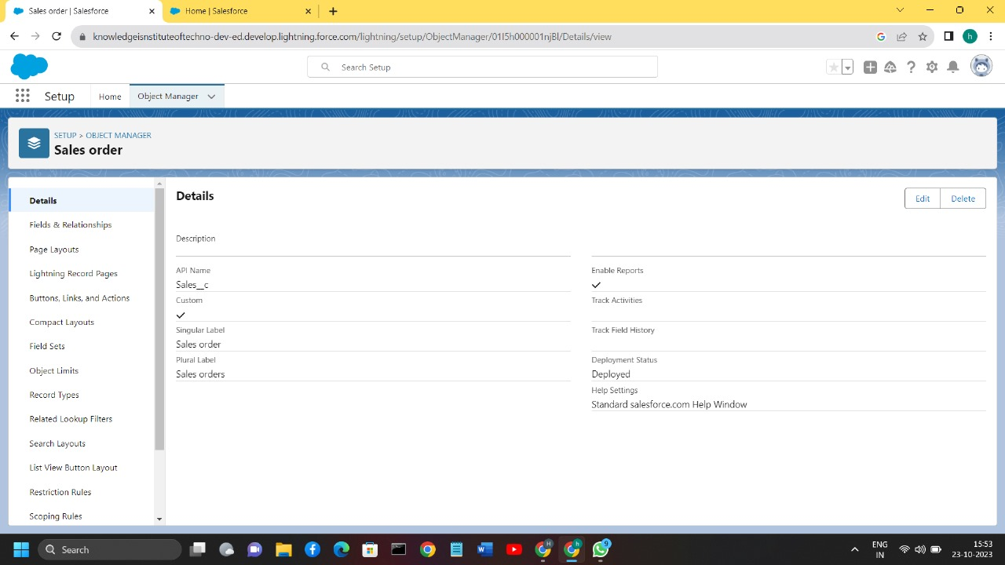
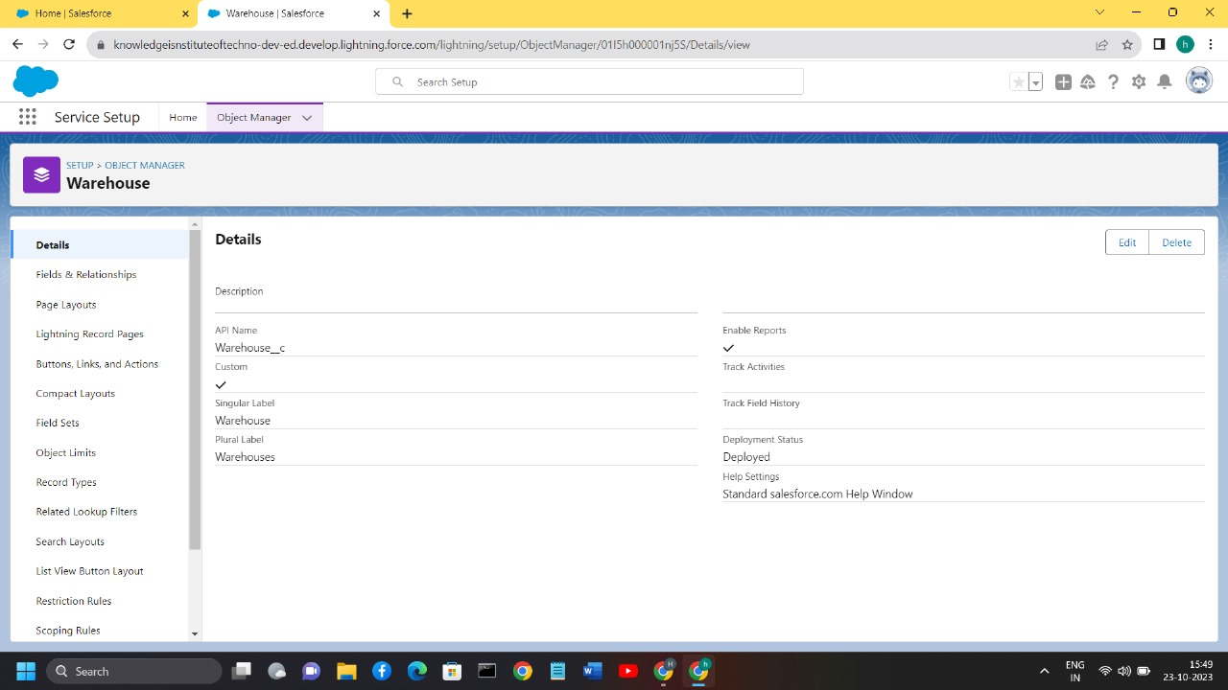

Slide 9
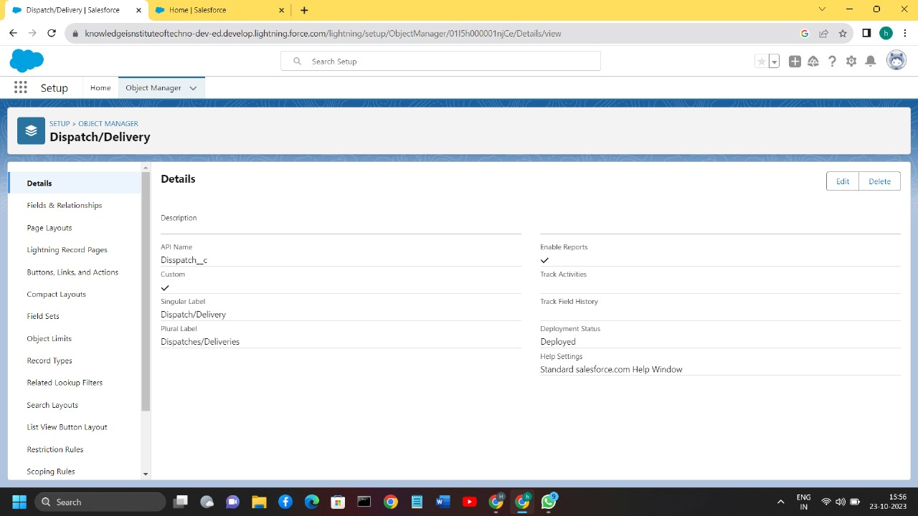


Slide 10
TABS
Tabs in Salesforce help users view the information at a glance. It displays the data of objects and other web content in the application.
There are mainly 4 types of tabs:
Standard Object Tabs:
Standard object tabs display data related to standard objects.
Custom Object Tabs:
Custom object tabs display data related to custom objects. These tabs look and function just like standard tabs.
Web Tabs:
Web Tabs display any external Web-based application or Web page in a Salesforce tab.
Visualforce Tabs:
Visualforce Tabs display data from a Visualforce Page.

Slide 11
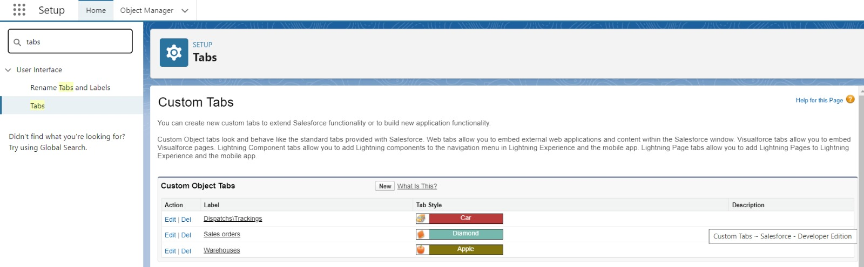

Slide 12
FIELDS AND RELATIONSHIP
Fields And Relationship
Fields - Fields store data values that are required for a particular object in a record.
An object relationship in Salesforce is a two-way association between two objects. Relationships are created by creating custom relationship fields on an object. This is done so that when users view records, they can also see and access related data.

Slide 13
USER
>What is a user?
A user is anyone who logs in to Salesforce. Users are employees at your company, such as sales reps, managers, and IT specialists, who need access to the company's records. Every user in Salesforce has a user account. The user account identifies the user, and the user account settings determine what features and records the user can access.

Slide 14
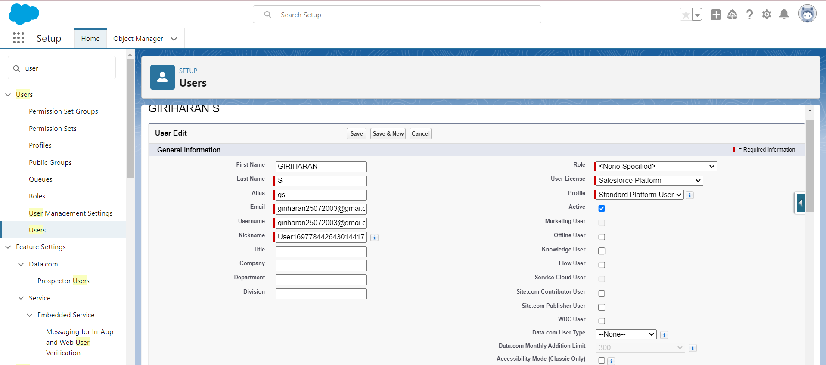

Slide 15
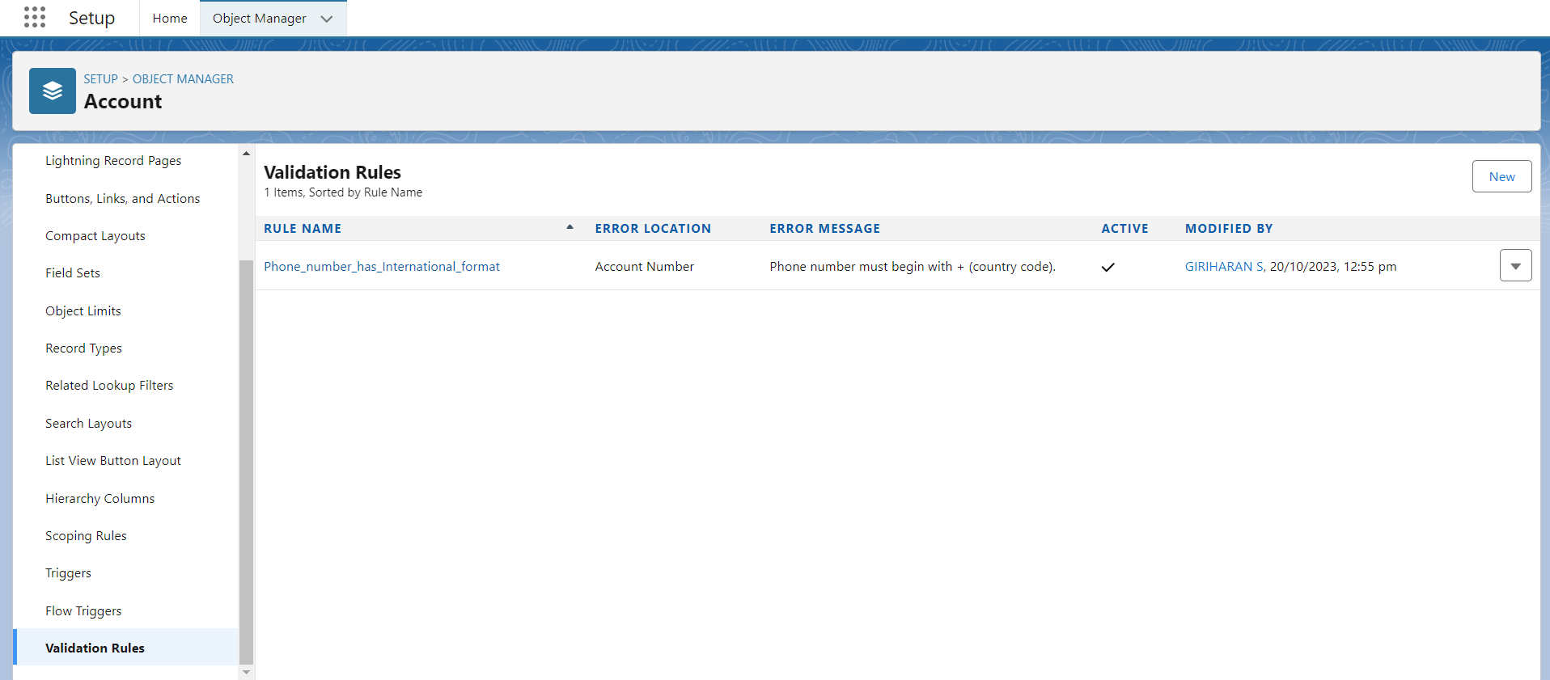
VALIDATION RULES
Validation rules verify that the data a user enters in a record meets the standards you specify before the user can save the record. As a crm product owner they requested to create a validation rule on account object on the phone field.

Slide 16
REPORT
>Tabular representation(with the option to display charts) of the list of records that meet a particular criterion that gives an answer to question(s). This list of records in reports can be filtered or grouped based on any field.
>TO Create the Report and View the Report.

Slide 17
DASHBOARDS
Dashboards provide more insights than reports as they combine the data from many reports and show a summarized result. Looking at many reports at a time gives the flexibility of combining the results from them quickly. Also summaries in dashboards help us decide on action plans quicker. The dashboards can contain charts, graphs and Tabular data.

Slide 18
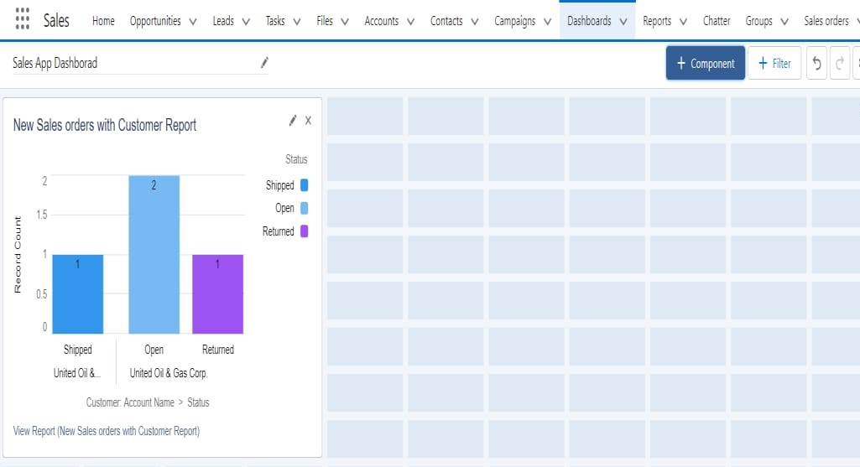
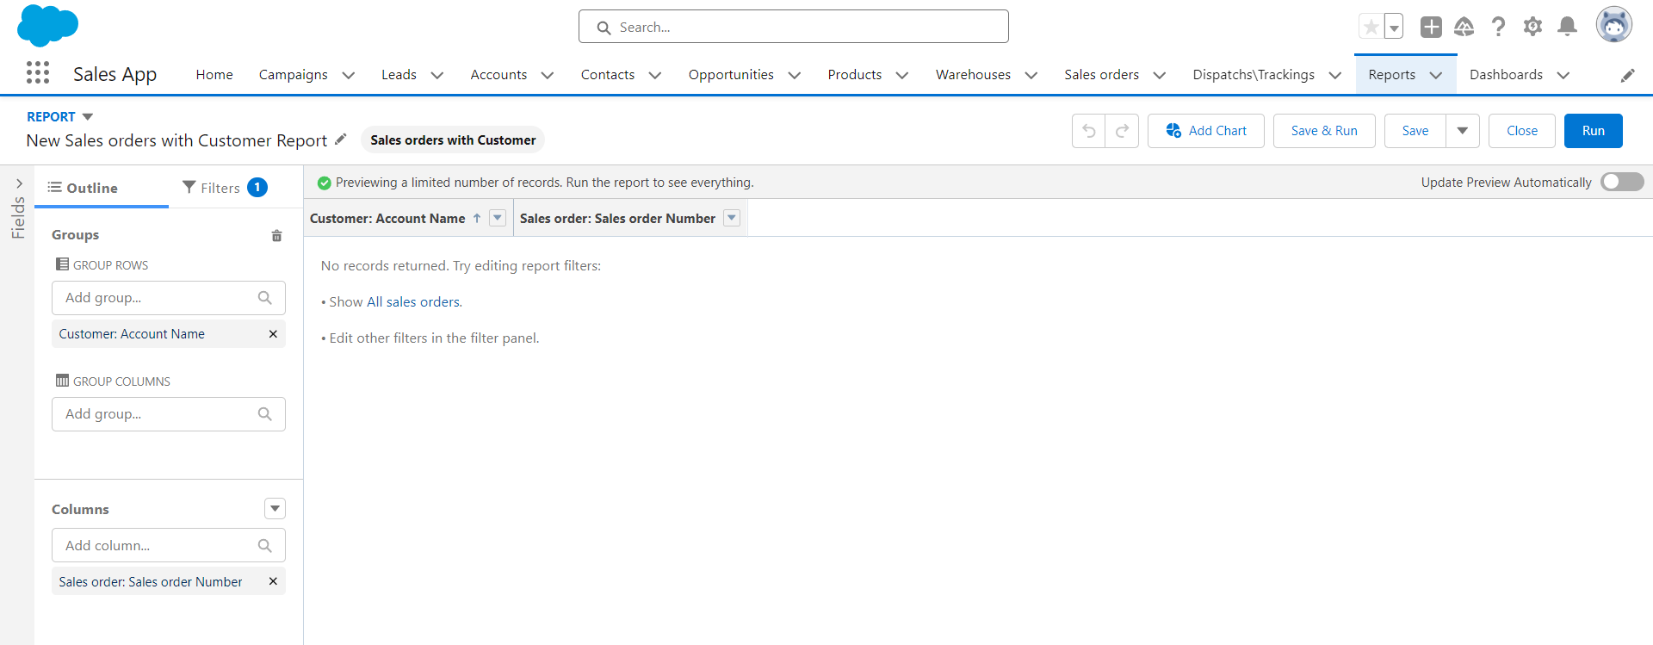

Slide 19
Flows
Flows In Salesforce, a flow is a tool that automates complex business processes. Simply put, it collects data and then does something with that data. Flow Builder is the declarative interface used to build individual flows. Flow Builder can be used to build code-like logic without using a programming language. Flows fall into five categories: Screen Flows Schedule-Triggered Flows Autolaunched Flows Record-Triggered Flows Platform Event-Triggered Flows.

Slide 20
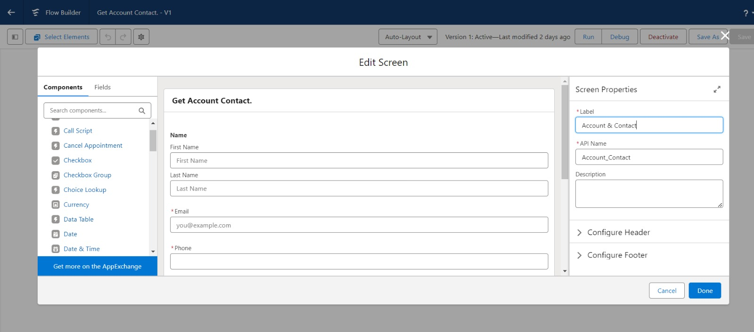

Slide 21
LIGHTNING APP
>What is an App?
Apps in Salesforce are a group of tabs that help the application function by working together asa unit. It has a name, a logo, and a particular set of tabs. The simplest app usually has just two tabs.
To create new Lightning app of Home page and select the components of flow and select the flow .

Slide 22
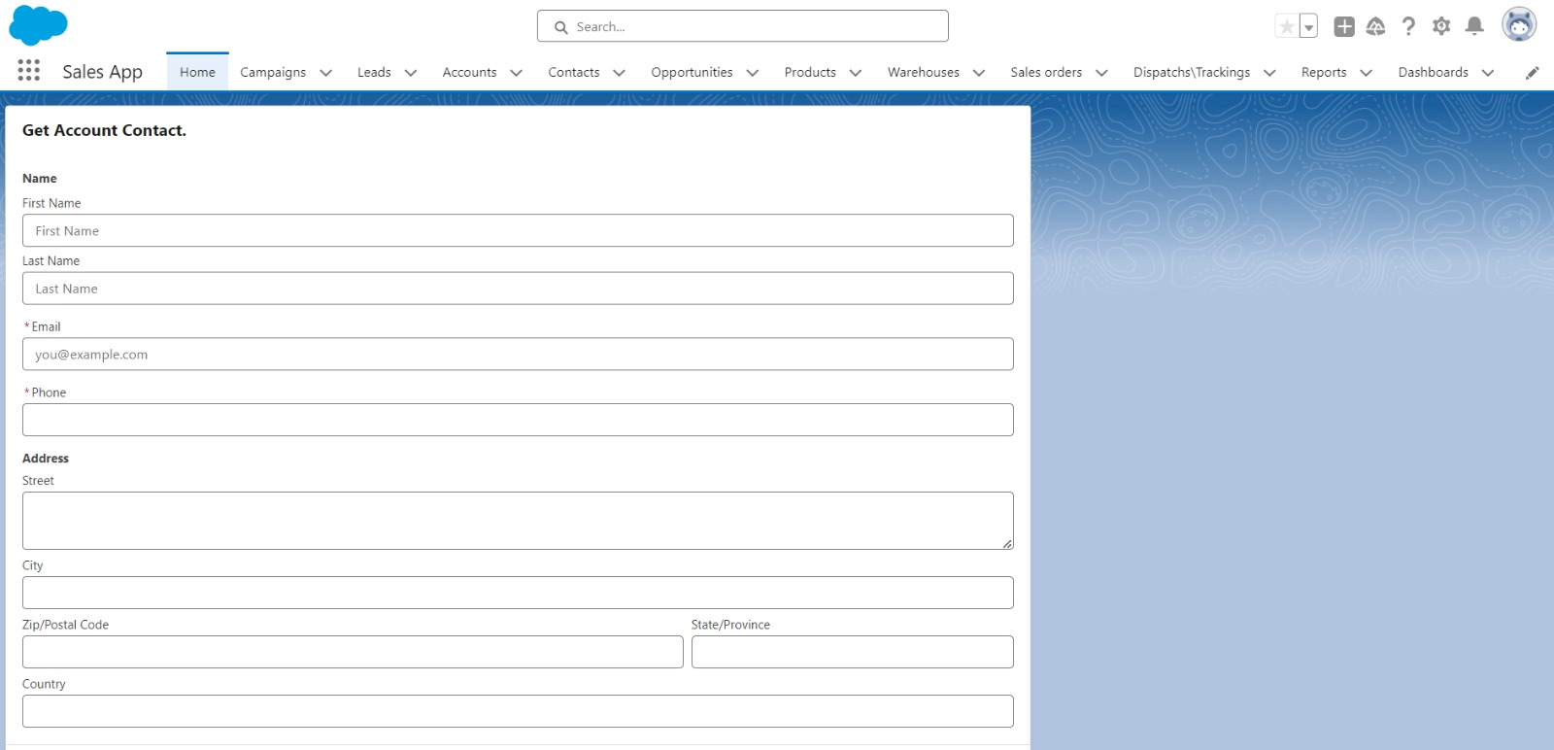

Slide 23
Apex trigger
Apex triggers-Apex can be invoked by using triggers. Apex triggers enable you to perform custom actions before or after changes to Salesforce records, such as insertions, updates, or deletions.
To create apex trigger with the code
trigger PreventDuplicateAccounts on Account (before insert){ Set<String> accountNames = new Set<String>();
for (Account acc : Trigger.new) {
if (accountNames.contains(acc.Name)) {
acc.addError('A duplicate account with this name already exists.');} else {
accountNames.add(acc.Name);
}
}
}

Slide 24
THANK YOU

