Slide 1


3 DAYS ON JANUARY 16th, 17th & 18th 2015
Santa Clara Convention Center, 5001 Great America Parkway,
Santa Clara, CA 95054, United States

Slide 2
Hadoop Performance Tuning
Tips and Techniques

Slide 3
Agenda
Cluster Capacity Planning
Developing Map Reduce application
Running the jobs
Interpret Counters
Understanding Performance tuning criteria
Split Size
Number of Reducers
Addressing skew
Custom partitioners
Combiners
Distributed Cache
Hive Map Side Joins
Compression
Combine File Input Format
Filtering
Sorting (Global Sorting and key based sorting)
Order by vs. Sort by
Hive Partitioning
JVM Reuse
Memory tuning

Slide 4
Cluster
Masters
Cloudera Manager
MySQL Database
Gateway
Hue
Hive Servers
Gateway
Slaves
Datanode
Nodemanager
On every node
Network Switch
Namenode
Secondary Namenode
Other Masters
(if required)
Resource Manager

Slide 5
Cluster Capacity Planning
Identify Gateways between users and cluster
Submit jobs from Gateways
Identify masters and slaves (masters will be less than 10 irrespective of the size of the cluster)
Understand pros and cons of different hardware configuration of masters (Namenode, Resource Manager/Job Tracker, HBase Master etc). They need not use same hardware configuration.
Understand important settings for resources like memory and CPU
Keep in mind all Hadoop based tools as well as non Hadoop based tools, eg: data encryption tools which will take up some resources
Do not follow thumb rules by the vendors blindly, eg: Some vendors recommend 150% of mappers and reducers to number of CPUs/cores
Use compression for the data stored for compliance purposes

Slide 6
Developing Map Reduce application
Parsing the data
Develop POJO with private variables and getter setter methods
Filtering or row level transformations or data cleansing
Develop map function
Extend Mapper and override map function
Sorting or distribution the data with out skew
Use or customize shuffle and sort (partitioner, sort comparator, grouping comparator etc)
Aggregations or Joins
Develop reduce function
Extend Reducer and override reduce function
Customizing framework (advanced)
Developing custom input/output formats
Developing custom key/value types (Writable or WritableComparable)
Job Configuration
Implement Tool and use Job class to configure the map reduce job

Slide 7
Map Reduce lifecycle
HDFS
Mapper
Shuffle/Sort
Reducer
HDFS

Slide 8
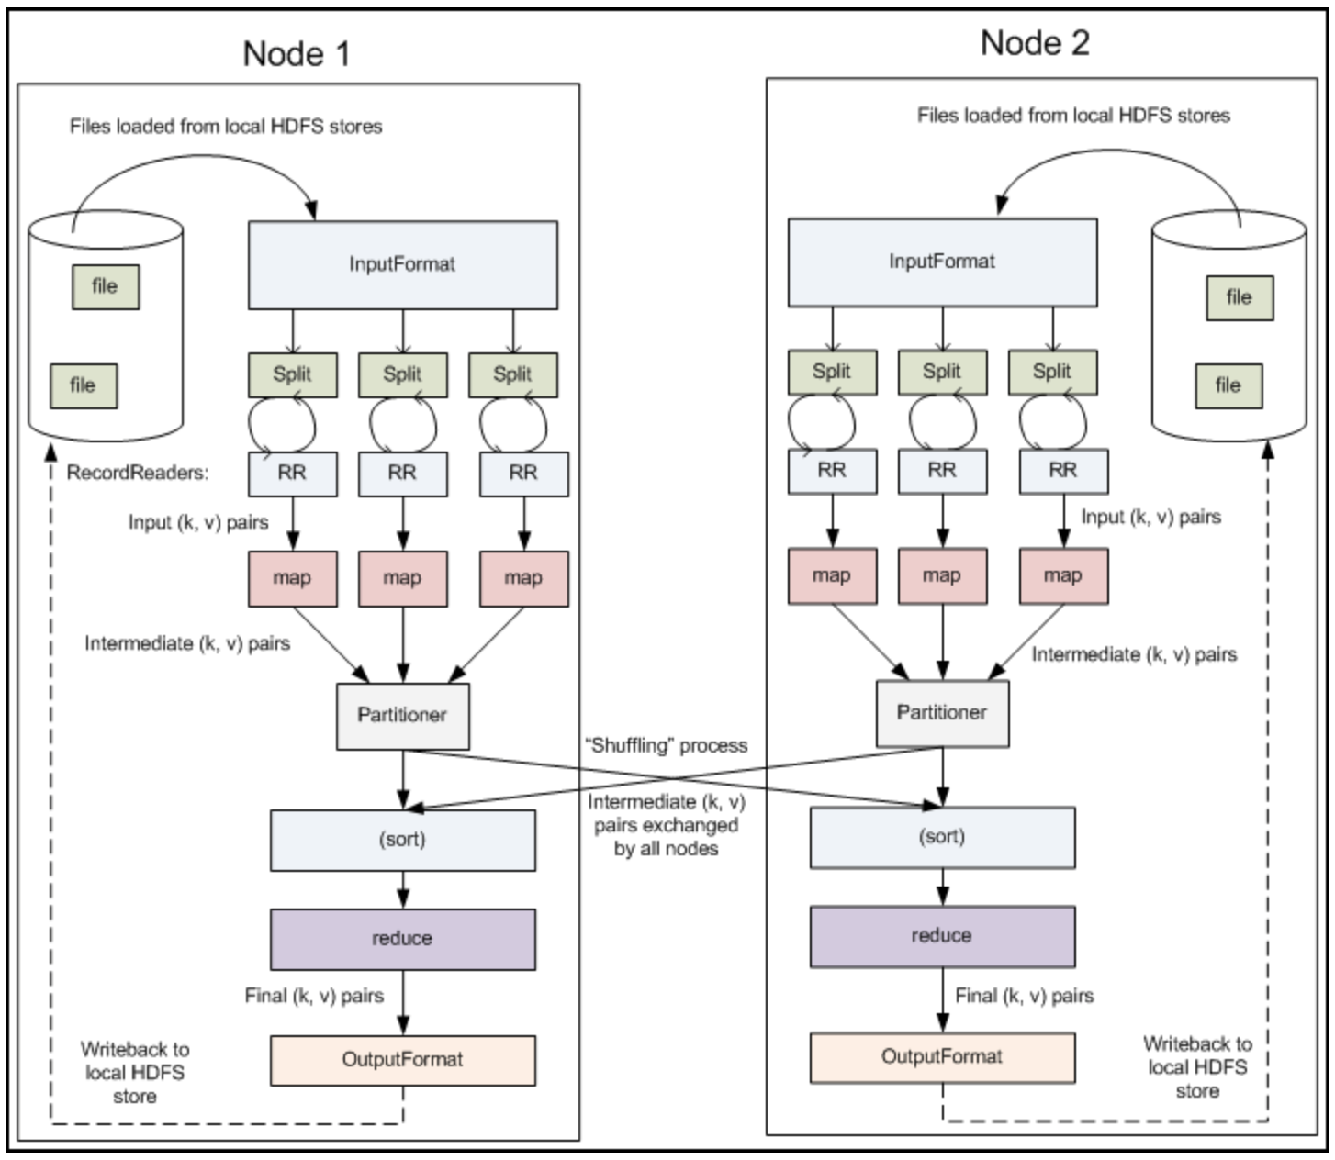
Map Reduce lifecycle

Slide 9
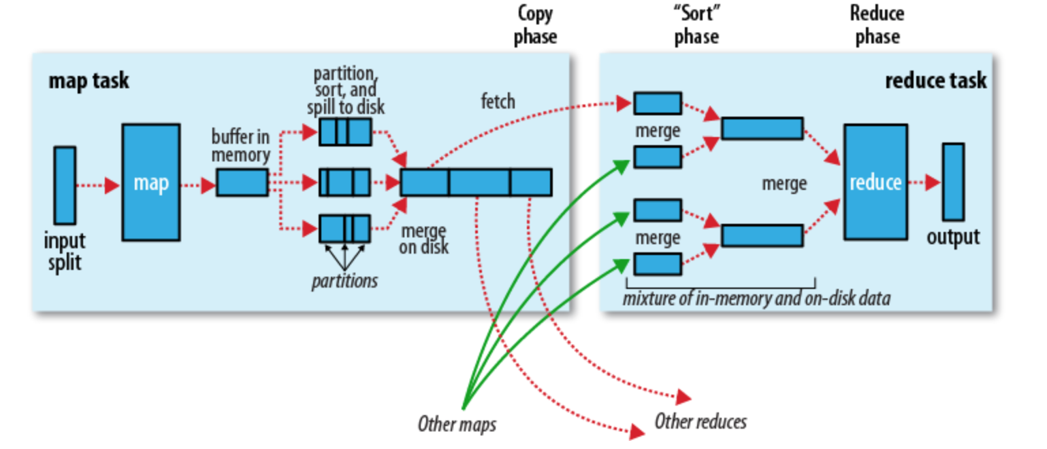
Map Reduce lifecycle

Slide 10
Map Reduce lifecycle
Partition
Sorting Comparator
Grouping Comparator
Combiner
Intermediary file

Slide 11
Running the jobs
We typically run jobs using
hadoop jar command
-D can be used to override a parameter
-conf can be used to override bunch of parameters
Input path and output path are either passed as part of the program or hard coded in the program

Slide 12
Interpret Counters
File System counters
Job Counters
Map Reduce Framework
* Run job and explain above counters in detail

Slide 13
Understanding Performance tuning criteria
Number of mappers and reducers
I/O
CPU
Sharing resources
Memory Configuration
Data Modeling
Understand Map Reduce life cycle
Design and develop Map functions
Setup method
Partitioners
Comparators (Grouping and Sorting)
Combiners
Design and develop Reducer functions
Changing configurations at run time
* Each of the performance tip will address more than one of the above topics

Slide 14
Split Size
What is split size?
Typically equal to block size
Lowest chunk of a given file that will be processed by mapper
Can be used to increase or decrease the number of mappers
Typical behavior: It cannot be less than block size
Setting split size in map reduce
Setting split size in hive

Slide 15
Split Size
Single node datanode
PROCESSING
STORAGE
Split Size 128 MB
map_task_0
blk_xxxx0
File size: 1 GB
Block Size: 128 MB
Blocks: 8
Replication: 1
map_task_1
blk_xxxx1
map_task_2
blk_xxxx2
map_task_3
blk_xxxx3
map_task_4
blk_xxxx4
Mappers 8
map_task_5
blk_xxxx5
map_task_6
blk_xxxx6
map_task_7
blk_xxxx7

Slide 16
Split Size
Single node datanode
Split Size 256 MB
map_task_0
blk_xxxx0
File size: 1 GB
Block Size: 128 MB
Blocks: 8
Replication: 1
blk_xxxx1
map_task_1
blk_xxxx2
blk_xxxx3
map_task_2
blk_xxxx4
Mappers 4
blk_xxxx5
map_task_3
blk_xxxx6
blk_xxxx7

Slide 17
Split Size
Setting in Map Reduce
Updating mapred-site.xml
Setting as part of Job configuration in Map Reduce application
Run time using hadoop jar command
-Dmapred.max.split.size
Custom configuration file and then -conf

Slide 18
Split size
Setting in Hive
Using hive-site.xml
Using .hiverc
Using set
set mapred.max.split.size=<IN_BYTES>
Using hiveconf
-hiveconf mapred.max.split.size=<IN_BYTES>

Slide 19
Number of Reducers
Number of mappers are determined by Hadoop framework based on split size.
Number of reducers cannot be determined accurately by framework
As part of map logic data might have
Transformed
Filtered
Exploded

Slide 20
Number of Reducers
Default Values
1 apache distribution
Cloudera Distribution overrides to number of slaves
Relationship between number of reducers, hash algorithm on map output key and partitioner
Determining Number of Reducers
Understand data and requirement to determine number of Reducers
Addressing skew by using custom partitioners
Develop custom partitioners to address skew
Setting Number of Reducers while running map reduce programs
Hive algorithm for determining Number of Reducers
Issues with Hive algorithm and working around it
Setting number of reducers for hive queries

Slide 21
Number of Reducers
Relationship between number of reducers, hash algorithm on map output key and partitioner
hashmod = Hash(map output key) % (number of reducers)
Eg: Distribute data by pip of a file with 2 GB data
If it uses only one reducer then for each pip (2-10 and J, Q, K, A) hashmod function will return 0, hence only one reducer have to process entire data set
By increasing the number of reducers hashmod will result in 0 to number of reducers – 1, hence more reducers will process data (scalability)

Slide 22
Number of Reducers
Determining Number of Reducers
Understand data and requirement to determine number of Reducers
One should avoid setting number of reducers to a higher value than number of unique keys (for pip, it can be up to 13)
Try to reduce skew
If you want to generate sales report by state for a retail store and if you set 51 as number of reducers, what will happen?

Slide 23
Number of Reducers
Addressing skew by using custom partitioners
Develop custom partitioners to address skew
Eg: CardCountByPip

Slide 24
Number of Reducers
Setting Number of Reducers in Map Reduce Program
Setting in mapred-site.xml
Using job.setNumReduceTasks as part of job configuration
Passing run time using -D or -conf

Slide 25
Number of reducers
In hive, we can mitigate the skew but cannot completely eliminate it
Setting Number of reducers for hive queries
Using set
set mapred.reduce.tasks=<NO_OF_REDUCERS>
Using hiveconf
-hiveconf mapred.max.split.size=<NO_OF_REDUCERS>

Slide 26
Combiners
What is combiner?
Can move aggregation which is typically in reducer to leverage data locality
If appropriately used
It will reduce network traffic considerably
It runs arbitrary number of times
When to use and when not to use?
Use only when there is considerable amount of aggregation
Aggregation needs to be additive
When it will run?
It runs as part of auxiliary service on the output of map function
Combiners in Hive
Combiners in Map Reduce
Demo

Slide 27
Map Reduce lifecycle
Combiner runs here

Slide 28
Distributed Cache
What is Distributed Cache?
Using setup method
Using Distributed Cache in Map Reduce
Role of Distributed Cache in Hive
Map Side Joins

Slide 29
Distributed Cache
It is used for copying files and archives to the task nodes in time for the tasks to use them when they run.
Files that are passed using -files, -archives, -libjars will be copied to the node once task is started. They will be stored locally and will be recycled once threshold set by local.cache.size (default 10 GB) is reached
It can be used effectively to join smaller data sets

Slide 30
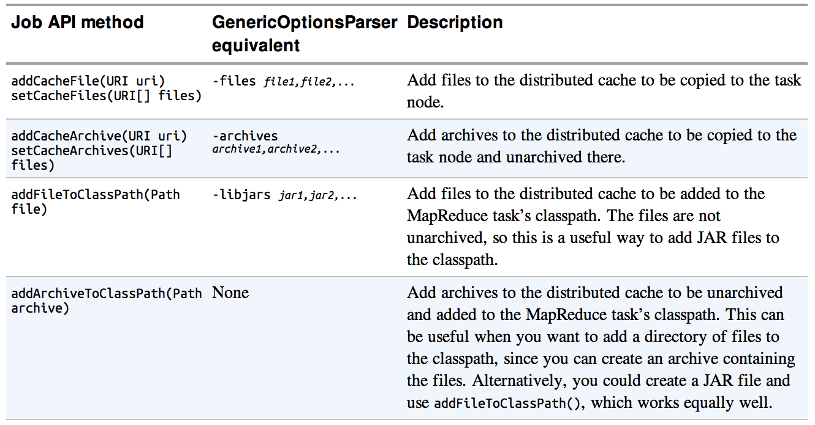
Distributed Cache

Slide 31
Distributed Cache
Details about Distributed Cache
Files can be pushed to map reduce framework using -files option from command line
These files can be local to client, can live on HDFS or Hadoop readable file system like S3
When job is launched, these files will be pushed to HDFS and task tracker will load these files to its local directory before starting mappers/reducers.
Size of the cache on each data node is determined by local.cache.dir which is defaulted to 10 GB. This cache is also used to store libjars passed through hadoop jar command.
Steps to implement Distributed Cache
Prepare metadata set that needs to be passed as distributed cache
Write a parser class for the metadata (optional)
Run hadoop jar command using -files option
In the run function, use GenericOptionsParser to parse options passed using built-in options like -files
In Mapper or Reducer override setup method (from built-in Mapper/Reducer class)
Write logic to build HashMap so that you can look up using key

Slide 32
Hive Map Side Joins
Hive Map Side joins leverages Distributed Cache concept
set hive.auto.convert.join=true;
set hive.mapjoin.smalltable.filesize=400000000;

Slide 33
Compression
Compression Types
Splittable vs. non-splittable
Compression Codecs
Compression Configuration
Compressing both map output as well as reduce output
Compression map output/intermediate files
Can use configuration or set methods

Slide 34
Splittable vs. Non-splittable (HDFS)
Size: 20 GB
Between uncompressed, splittable and non splittable
Size of the file will differ
But files will be stored in similar manner
If the file is greater than 128 MB, number of blocks will be generated using file size divided by block size
Splittable
(2 GB)
Non Splittable
(2 GB)
160 blocks distributed across cluster
16 Blocks
Distributed across cluster
HDFS
Cluster size: 10
Block size: 128 MB
Replication Factor: 1

Slide 35
Splittable vs. Non-splittable (Map Reduce)
Size: 20 GB
160 mappers
Between uncompressed, splittable and non splittable
Will differ in number of mappers and data locality
Uncompressed and splittable compression – number of mappers will differ, but both leverage data locality using split/block size
Non splittable compression will use only one mapper (no data locality)
Splittable
(2 GB)
Non Splittable
(2 GB)
16 mappers
1 mapper
(no data locality)
160 blocks distributed across cluster
16 Blocks
Distributed across cluster
HDFS
Cluster size: 10
Block size: 128 MB
Replication Factor: 1
Split size: 128 MB

Slide 36
Compression (Types)
A summary of compression formats
Compression format | Tool | Algorithm | Filename extension | Splittable?
DEFLATE[a] | N/A | DEFLATE | .deflate | No
gzip | gzip | DEFLATE | .gz | No
bzip2 | bzip2 | bzip2 | .bz2 | Yes
LZO | lzop | LZO | .lzo | No[b]
LZ4 | N/A | LZ4 | .lz4 | No
Snappy | N/A | Snappy | .snappy | No
[a] DEFLATE is a compression algorithm whose standard implementation is zlib. There is no commonly available command-line tool for producing files in DEFLATE format, as gzip is normally used. (Note that the gzip file format is DEFLATE with extra headers and a footer.) The .deflate filename extension is a Hadoop convention.
[b] However, LZO files are splittable if they have been indexed in a preprocessing step. See page .
[c] Splittable - Block of compressed file cannot be splitted

Slide 37
Compression (Codecs)
Compression format | Hadoop CompressionCodec
DEFLATE | org.apache.hadoop.io.compress.DefaultCodec
gzip | org.apache.hadoop.io.compress.GzipCodec
bzip2 | org.apache.hadoop.io.compress.BZip2Codec
LZO | com.hadoop.compression.lzo.LzopCodec
LZ4 | org.apache.hadoop.io.compress.Lz4Codec
Snappy | org.apache.hadoop.io.compress.SnappyCodec
Compression format | Java implementation? | Native implementation?
DEFLATE | Yes | Yes
gzip | Yes | Yes
bzip2 | Yes | No
LZO | No | Yes
LZ4 | No | Yes
Snappy | No | Yes

Slide 38
Compression (Map Reduce configuration)
MapReduce Compression Properties
Property name | Type | Default value | Description
mapred.output.compress | boolean | FALSE | Compress outputs
mapred.output.compression.codec | Class name | org.apache.hadoop.io.compress.DefaultCodec | The compression codec to use for outputs
mapred.output.compression.type | String | RECORD | The type of compression to use for SequenceFile outputs: NONE, RECORD, or BLOCK
Map Output Compression Properties
Property name | Type | Default value | Description
mapred.compress.map. output | boolean | FALSE | Compress map outputs
mapred.map.output.compression.codec | Class | org.apache.hadoop.io.compress.DefaultCodec | The compression codec to use for map outputs

Slide 39
Combine File Input Format
Ideally file size should not be less than block size (default 128 MB).
But we will see many small files starting from few mega bytes, especially loading deltas.
Combine File Input format is used
To use efficient number of mappers when we have too many small files
To give more horse power by reducing split size on large files

Slide 40
Combine File Input Format
In recent versions (class hierarchy)
org.apache.hadoop.mapreduce.lib.input.CombineFileInputFormat
org.apache.hadoop.mapreduce.lib.input.CombineTextInputFormat
org.apache.hadoop.mapreduce.lib.input.CombineSequenceFileInputFormat

Slide 41
Combine File Input Format
Job configuration for Combine File Input Format
Setting split size to get desired number of mappers to process the data

Slide 42
Filtering
Design Considerations
Coming up with proper naming conventions for directories and/or files
Partition pruning/Directory pruning – to filter out partitions or directories that are not required
Pass the parameters to mapper and filter as much as you can in mapper

Slide 43
Filtering
Query: select suit, count(1) from deck where pip='J' and color='RED' group by suit;
Class: demo.cards.drivers. CardCountBySuitFilteredByPipAndColor.java
Running program: hadoop jar performance_tuning.jar demo.cards.drivers.CardCountBySuitFilteredByPipAndColor /user/hduser/cards /user/hduser/output.cards J RED

Slide 44
Sorting (Global vs. Key based)
Global sorting is typically done using 1 reducer
Sorting does not scale linearly
For most of the use cases sorting with in leading key is enough
Eg: Trend sales of each of the retail store of leading enterprise for last 5 years.
There is no need to sort by store, sorting by year with in each store is more than enough

Slide 45
Sorting (Global vs. Key based)
In Map Reduce, we need to implement secondary sorting
Key will contain both store and year
Need to implement custom partitioner where data is partitioned on only by store
It will ensure that all the data for a given store goes to same reducer

Slide 46
Sorting (Global vs. Key based)
In Hive
We have to use order by for global sorting. Queries using "ordery by" will use only one reducer.
We have to use "sort by" in conjunction with "distribute by" for key based sorting
distribute by store sort by store, year

Slide 47
Hive Partitioning
Too much vs. too little partitioning
Too much partitioning will lead into too many small files issue
Too little partitioning will unnecessarily read the data

Slide 48
JVM Reuse
What is JVM Reuse?
By default JVM Reuse is set to 1 and all mappers and reducers will run in their own JVM
Forking and cleaning up will become overhead for jobs that require mappers and reducers significantly larger than the capacity
JVM Reuse will facilitate mappers of same job or reducers of same job use JVM more than once
Parameters at job level
mapred.job.reuse.jvm.num.tasks (default 1 – each task will run in its own JVM)

Slide 49
JVM Reuse
When to enable jvm reuse (mapred.job.reuse.jvm.num.tasks to set greater than 1)?
If job have large number of small and short lived tasks
Lengthy initialization process (distributed cache)
HotSpot JVM (builds up enough information to detect performance-critical sections in the code and dynamically translates the Java byte codes of these hot spots into native machine code. This works well for long-running processes, but JVMs that run for seconds or a few minutes may not gain the full benefit of HotSpot.)

Slide 50
Memory Tuning
JVM heap size
Spills and io.sort.mb
Capacity planning for whole Hadoop eco system.
Analyze impact on resources for each non map reduce based tool deployed in the cluster
YARN - Node Manager and Resource Manager memory parameters
Classic – Memory parameters, Mappers and Reducers

Slide 51
Important parameters in MRv2/YARN
File Name | Parameter Name | Parameter value | Description
mapred-site.xml | mapreduce.framework.name | yarn
mapred-site.xml | mapreduce.jobhistory.webapp.address | <ip_address>:<port> | Job history server Web UI IP address and port number
mapred-site.xml | yarn.app.mapreduce.am.* |  | Parameters related to application master
mapred-site.xml | mapreduce.map.java.opts |  | JVM Heap size for child task of map container
mapred-site.xml | mapreduce.reduce.java.opts |  | JVM Heap size for child task of reduce container
mapred-site.xml | mapreduce.map.memory.mb |  | Size of container for map task
mapred-site.xml | mapreduce.map.cpu.vcores | 1 | Number of virtual cores required to run each map task
mapred-site.xml | mapreduce.reduce.memory.mb |  | Size of container for reduce task
mapred-site.xml | mapreduce.reduce.cpu.vcores | 1 | Number of virtual cores required to run each reduce task
mapred-site.xml

Slide 52
Important parameters in MRv2/YARN
File Name | Parameter Name | Parameter value | Description
yarn-site.xml | yarn.resourcemanager.address | <ip_address>:<port> | Resource Manager ip and port
yarn-site.xml | yarn.resourcemanager.webapp.address | <ip_address>:<port> | Resource Manager web UI ip and port
yarn-site.xml | yarn.nodemanager.resource.memory-mb |  | maximum memory YARN can utilize on the node
yarn-site.xml | yarn.scheduler.minimum-allocation-mb | 1024 | Minimum total memory for containers on each of the nodes
yarn-site.xml | yarn.scheduler.maximum-allocation-mb | 4096 | Maximum total memory for containers on each of the nodes. Same as yarn.nodemanager.resource.memory.mb
yarn-site.xml | yarn.scheduler.minimum-allocation-vcores | 1 | Minimum number of virtual cores on each of the nodes
yarn-site.xml | yarn.scheduler.maximum-allocation-vcores | 4 | Maximum number of virtual cores on each of the nodes
yarn-site.xml | yarn.resourcemanager.scheduler.class |  | Class which determines scheduler – Fair or capacity
yarn-site.xml
yarn-site.xml

