Slide 1
Software Engineering Laboratory CS29006
Abir Das, Sourangshu Bhattacharya
Computer Science and Engineering Department
Indian Institute of Technology Kharagpur

Slide 2
Agenda
Course Name and code:
https://www.anaconda.com/products/individual#Downloads

Slide 3
Getting Started
Running Python:
There are many ways to install Python on your laptop/PC/server etc.
https://www.python.org/downloads/
https://www.anaconda.com/download/
There are many editors as well
Eclipse
Jupyter notebook/lab
Spyder
PyCharm
VSCode
Text editors like Sublime Text

Slide 4
Our Choice is Popular
Anaconda:
Anaconda is a distribution of programs in Python (and R) language and includes a huge number of libraries and several tools.
These include the Spyder development environment and Jupyter notebooks.
You can create your own customized environment which independent of what you have in your PC/Laptop/Server already.

Slide 5
Installing Anaconda
Download and install Anaconda for your OS -- https://www.anaconda.com/products/individual#Downloads -- Note that the most recent python version is 3.8 here. There are two versions of the installer – Graphical and Commandline. Graphical works on windows/mac while Commandline works on mac/Linux [In the above link the linux specific installer is called just ‘installer’ [i.e., without the word ‘commandline’ in it]]. If you have the option, use Commandline installation [that will be my choice].
Depending on your OS please follow the steps as listed in the following links.
Installing on Windows
Installing on macOS
Installing on Linux

Slide 6
Installing Anaconda
Straightaway after installing, you can use spyder and jupyter notebook ides. Get started from -- https://docs.anaconda.com/anaconda/user-guide/getting-started/
If you can run till this, you are ready for the lab! However I shall continue to use eclipse editor [Sorry – comfort zone]. In eclipse you need to add PyDev plugin -- https://docs.anaconda.com/anaconda/user-guide/tasks/integration/eclipse-pydev/

Slide 7
Iterables
An iterable is any Python object capable of returning its members one at a time, permitting it to be iterated over a loop.
Examples:- lists, tuples, and strings etc.
Iterables help to write efficient codes using the concept of ‘generators’ – which we we will come at a later slide.
Some useful built-in functions that accept iterables as arguments:
list, tuple, sum, sorted etc.
Demo [PROVIDE GITHUB LINK]

Slide 8
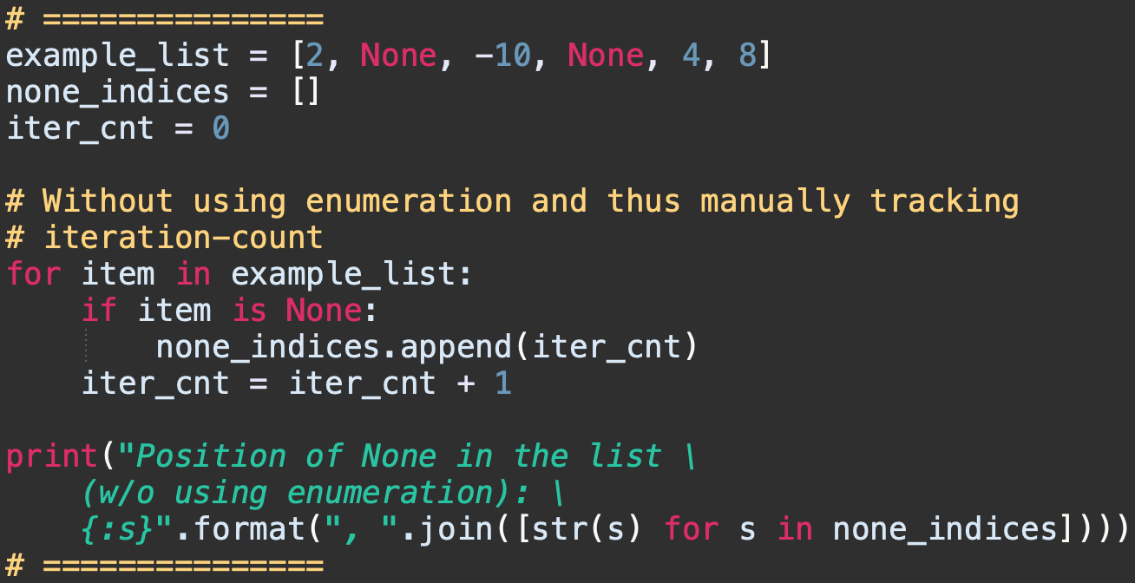
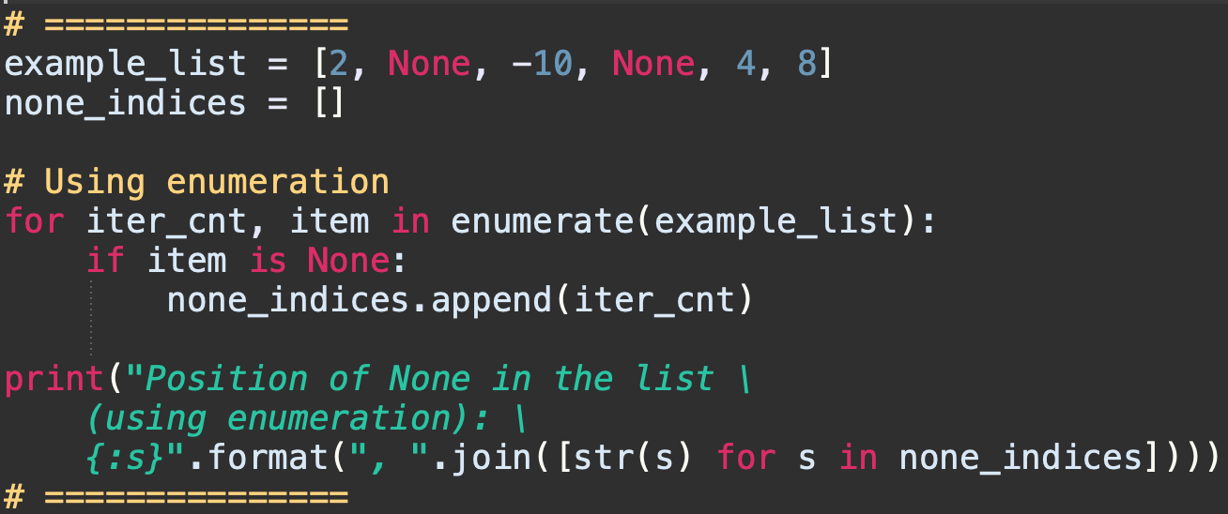
Enumerating Iterables
The built-in enumerate function allows to iterate over an iterable, while keeping track of the iteration count.
The enumerate function accepts an iterable as an input and the items in the iterable are enumerated.
Example code illustrating simplification of code. Problem statement is – to record all the positions in a list where the value None is stored.

Slide 9
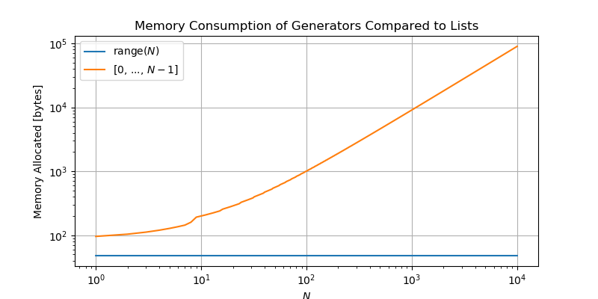
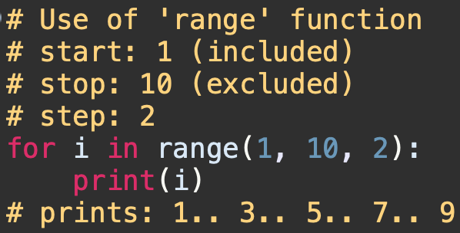
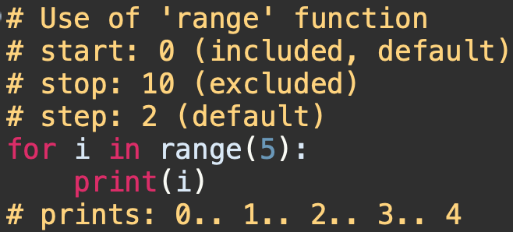
Generators
Generators allow us to generate arbitrarily-many items in a series, without having to store them all in memory at once.
Recall that a list readily stores all of its members. A generator, on the other hand, stores the instructions for generating each of its members, and stores its iteration state; this means that the generator will know if it has generated its second member, and will thus generate its third member the next time it is iterated on.

Slide 10
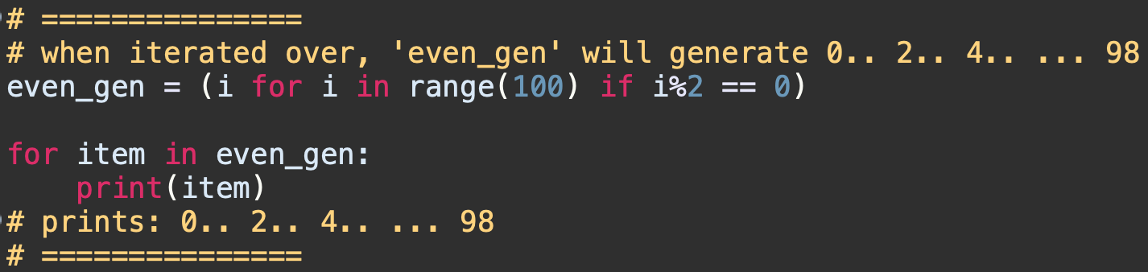
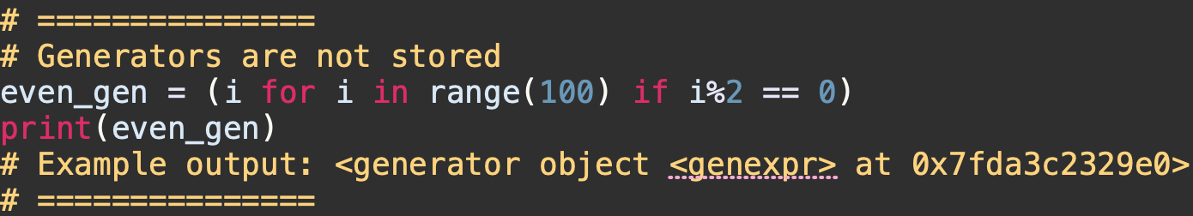
Generator Comprehensions
Python provides a sleek syntax for defining a simple generator in a single line of code – known as Generator Comprehension
The syntax is - (<expression> for <var> in <iterable> [if <condition>])
(<expression> can be any valid single-line of Python code that returns an object:
Generator comprehensions do not store values.

Slide 11
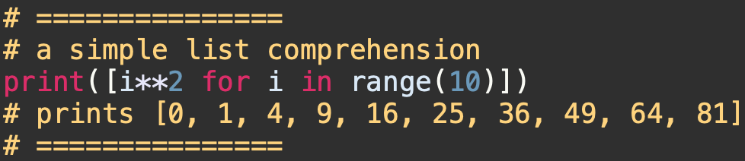
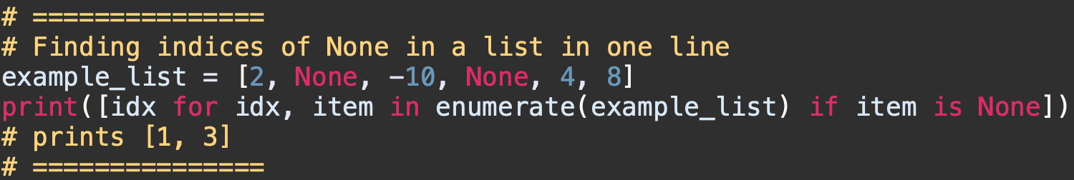
List (and Tuple) Comprehensions
Using generator comprehensions to initialize lists is so useful that Python actually reserves a specialized syntax for it, known as the list comprehension
The syntax is: [<expression> for <var> in <iterable> {if <condition}]
Revisiting the example of finding index of ‘None’ in a list

Slide 12
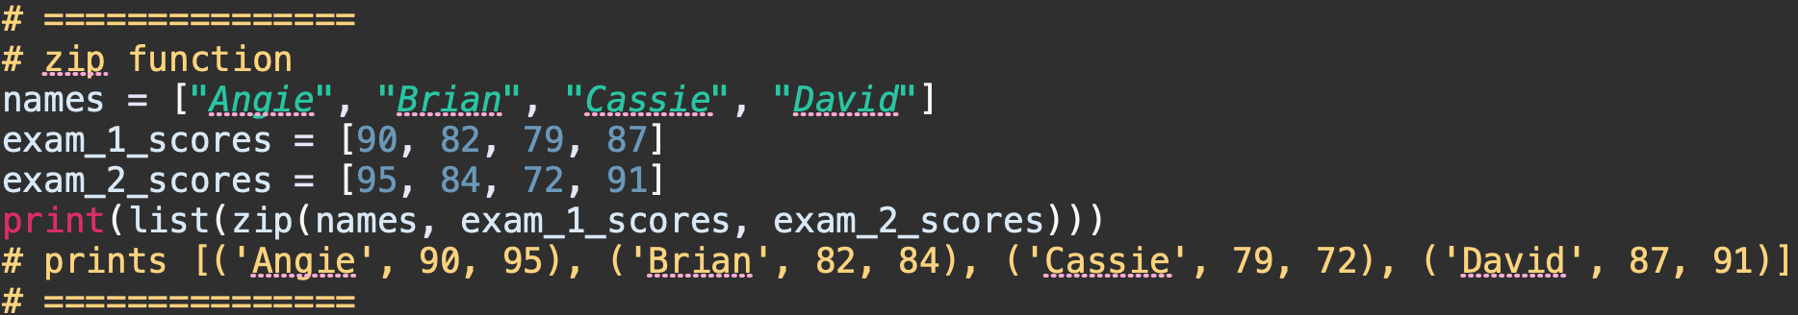
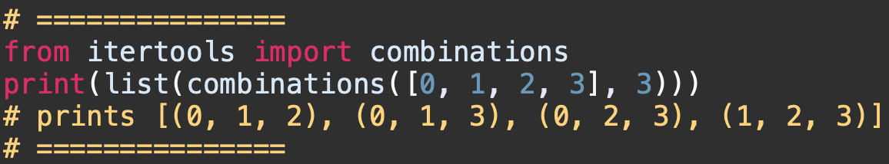
Itertools
Python has an itertools module, which provides a core set of fast, memory-efficient tools for creating iterators. The majority of these functions create generators, thus we will have to iterate over them in order to show the use of them.
zip: Zips together the corresponding elements of several iterables into tuples.
itertools.combinations: Generate all length-n tuples storing “combinations” of items from an iterable:

Slide 13
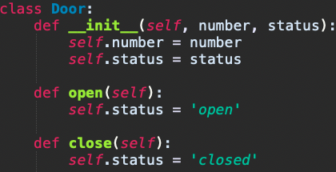
Object Oriented Programing in Python
We will discuss some key terminology for object-oriented programming in python. Most references will be made along the topics getting covered in the theory class.
The class keyword is reserved for defining a class.
The following defines a new class of object, named Door, specifying two attributes number and status, and two member functions open and close.

Slide 14
Creating Objects
Methods of a class must accept as first argument a special value called self (the name is a convention but please never break it).
The special method __init__() works as the constructor.
door1 = Door(1, 'closed’)
print(door1.number) # gives 1
print(door1.status) # gives closed
door1.open()
No arguments have been passed. But, it was declared to accept an argument (self). When you call a method of an instance, the instance is passed to the method as first argument automatically.
print(door1.status) # gives open
print(type(door1)) # gives <class '__main__.Door’>
type() returns the class as __main__.Door since the class was defined directly in the interactive shell, that is in the current main module.

Slide 15
Playing with Addresses
Create one more Door object with same attributes
door2 = Door(1, 'closed’)
print(hex(id(door1))) # gives 0x7faebb2c1310
print(hex(id(door2))) # gives 0x7faebb29e1c0
print(hex(id(door1.__class__))) # gives 0x7faeb9d1de40
print(hex(id(door2.__class__))) # gives 0x7faeb9d1de40
Any Python object is automatically given a __dict__ attribute, which contains its list of attributes. Try both – “Door.__dict__” and “door1.__dict__”
You can also get the attribute value by “door1.__dict__[‘status’]” [try it]

Slide 16
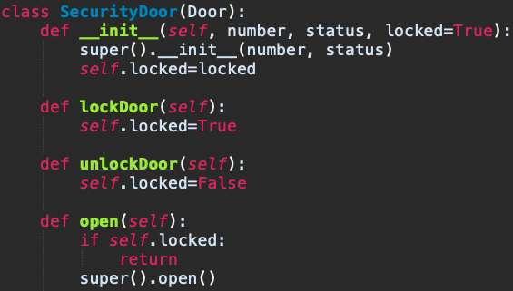
Inheritance and Overriding
Let us try to create a subclass of Door called SecurityDoor which has an additional attribute that provides the information whether the door is locked.
Instead of ‘super’ you could have used ‘Door’ [e.g., Door.__init__() or Door.open() etc]. However, using ‘super’ is encouraged as this lets python do the hierarchy resolution for multiple inheritance.
Subclass constructor
Calling superclass constructor
Override: In Python you can override a parent class member simply by redefining it in the child class.

Slide 17
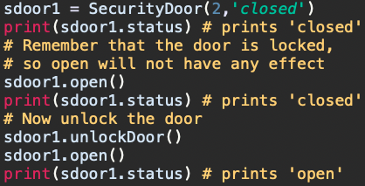
Inheritance and Overriding
Behavior of an object of type SecurityDoor.
Try the following methods.
SecurityDoor.__bases__
Print(help(SecurityDoor))

