Slide 1

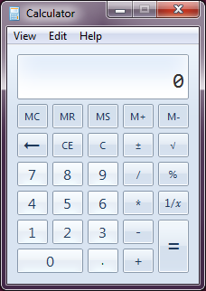

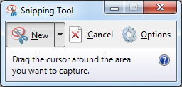

favorites
Open-Source COM Add-In for Microsoft Excel

