Slide 1

NIEM MilOps Configuration Control Board (CCB)
Thursday 29 June 2017
https://wss.apan.org/s/NIEM_MilOps/default.aspx

Slide 2
Agenda
Time | Length (min) | Topic | Presenter | Comments
1000 – 1005 | 5 | Opening Remarks / Introductions | Mr. Ralph Oconnell | Welcome
CCB Business Topics
1005 – 1020 | 15 | Current MilOps Projects | Frank Klucznik, Rodney McCoy | SEIWG POA&M, USMTF
1020 – 1025 | 5 | MilOps v4.0+, Metrics, POA&M | Frank Klucznik | MilOps Domain Metrics, NIEM v4.0+ Release Schedule
1025 – 1030 | 5 | Admin | Mike Gilman | MilOps CCB CY2017 Schedule, Action & Business Items
Information Sharing
1030– 1045 | 15 | NIEM PMO Update | Derek Nisco | NBAC Activities
1045 – 1100 | 15 | Stakeholder Collaboration | All | “Updates from the field” IEPD Development, NIEM Mapping etc.
1100 – 1105 | 5 | Closing Remarks | Mr. Ralph Oconnell

Slide 3
Opening Remarks
Mr. Ralph Oconnell
Standardized Data sharing remains a top priority to our warfighters in the DoD and Mission Partner Environment (MPE)
My privilege to become the NIEM MilOps Domain Steward Representative
LTC Karla Keelean has done great work the past three years and is being transferred to Fort Lewis, Washington
Mr. Gilman, MilOps Domain CCB Secretary, Mr. Klucznik, and the GTRI team continue to advance the maturation of the MilOps Domain
Mr. McCoy is a MilOps voting member on the NBAC and is working to make the USMTF MIL-STD-6040 Interface NIEM conformant
Ms. Grace is our supervisor and is promoting NIEM adoption across many JS J6 project initiatives
Mr. Schultz NIEM Business Architecture (NBAC) Co-chair
Mr. Whitehead MilOps Domain Steward
Future progress is critically dependent on MilOps stakeholder participation and support – we can do better by working together!
3

Slide 4
Current MilOps Projects
Frank Klucznik,
Rodney McCoy
Security Equipment Integration Working Group
U.S. Message Text Format
4

Slide 5
SEIWG Change Request
Security Equipment Integration Working Group (SEIWG)
http://www.acq.osd.mil/ncbdp/nm/pseag/about/seiwg.html
Jul: Develop CR and Impact and Solutions Assessment (ISA)
Aug: 30 day Stakeholder review of CR/ISA
30 Aug: Technical Design Review (TDR)
29 Sep: MilOps Configuration Control Board (CCB)
Force Protection Systems Information Interchange standardizes data sharing among sensors and software supporting the Joint Force Protection Reference Architecture across the Department
Physical Security Enterprise & Analysis Group (PSEAG) is an Official US Government Organization under the Office of the Deputy Assistant Secretary of Defense for Nuclear Matters
5
Notes:
The Security Equipment Integration Working Group (SEIWG) has developed an exemplar DoD NIEM IEPD. This new IEPD is intended for use by systems exchanging data using the SEIWG interoperability standard for Force Protection Systems Information Interchange (aka, SEIWG-0101C). The IEPD will be designated "SEIWG-0102-NIEM," and is scheduled for release in the May/Jun 2017 timeframe. The SEIWG intentionally designed this IEPD for public release (aka, Distribution A) in an attempt to standardize sensors and software supporting the Joint Force Protection Reference Architecture across the Department. The SEIWG was established by DoDI 3224.03 - Physical Security Equipment Research, Development, Test and Evaluation, under the Assistant Secretary of Defense for Nuclear, Chemical and Biological Defense Programs, Physical Security Enterprise and Analysis Group. The scope of interoperability standards developed by the SEIWG spans from force protection systems sensor information to force protection systems command and control information.

Slide 6
USMTF Migration to NIEM
Rodney McCoy
6

Slide 7
US Message Text Format National Information Exchange Model (NIEM) Update
UNCLASSIFIED
Mr. Rodney McCoy
USMTF Configuration Management, Data and Services Division, JS J6
29 June 2017

Slide 8
Agenda
What Is United States Message Text Format (USMTF)?
What Does USMTF Provide?
USMTF Today
USMTF Configuration Management Process
USMTF NIEM Background
USMTF CCB Decisions
Interface Change Proposals

Slide 9
What Is USMTF?
A single set of operationally agreed, information definitions and expressions for the exchange of character oriented information in XML format, e.g. Air Tasking Order, Airspace Control Order
Mandated per CJCSI 6241.04 for all DoD IT and National Security systems
Implemented IAW MIL-STD-6040B

Slide 10
What Does USMTF Provide?
Standardization of information exchange
Regulatory guidance (MIL-STD-6040) for Joint interoperability testing and certification
Proven process in securing joint and coalition coordination of IERs
Established configuration management process
Responsiveness to user requirements
Harmonization with NATO
Compliance with DoD net centric requirements
No cost to the user -- support provided by the JINTACCS program
Notes:
Information Exchange Requirements
Joint Interoperability of Tactical Command and Control Systems

Slide 11
USMTF Today
Migrated to XML in 2004
Schemas are W3C compliant
All messages are represented by an XML schema
Individual messages managed by version number and no longer by yearly baseline
Message catalog available on-line
Message catalog updated after each USMTF CCB

Slide 12
USMTF Configuration Management Process
Operational Community
(Establishes requirement)
USMTF Service Representative
(Coordinates IER and submits Change Proposal to DISA for
USMTF CCB agreement – JS J6/DSD is the COCOM Lead)
USMTF CCB
(Configuration Management forum for USMTF -- consist of members
from USA, USAF, USN, USMC, DIA, NGA, NSA, JS (JS J6/DSD is the JS voting member)

Slide 13
USMTF NIEM Background
September 2014: USMTF CCB agreed to produce NIEM Compliant Schemas to expose data IAW DoD Instruction 8320.07
Part of an almost two-year decision to produce Garden of Eden (GoE) Schemas and expose data down to the field level
November 2015: USMTF CCB decided to hold a series of Technical Review Panels (TRP)s to review NIEM decision
November 2015 – Present: Through four TRP’s and 2 CCB meetings, the USMTF CCB agreed to pursue complete transformation of existing USMTF XML to NIEM conformant XML
Notes:
The September 2014 decision was to become as NIEM compliant as we could be while continuing with Garden of Eden - which was the main focus.
We did not want to design any roadblocks to NIEM conformance into the schema generator should the CCB decide later to become NIEM conformant
DoDI 8320.07 directs to consider using NIEM as an enabler for ensuring data, information, and ensure IT services are visible, accessible, understandable, trustworthy, and interoperable

Slide 14
USMTF CCB Decisions
The Technical Review Panels made the following recommendations which were voted on and accepted by the CCB:
Follow the NIEM Naming and Design Rules (NDR)
Create NIEM CONFORMANT schemas
Use Reference Schemas for all but Messages and Segments
Messages will be equivalent to NIEM Information Exchange Package Documentation (IEPD) and will not be extended
Create a Parallel Database to make all of the changes
Expose and XML’ize Segments, Set and Fields
Rename and Deconflict Segments, Sets and Fields
Update MTF Attributes and App Info
Define Acronyms and Local Terms
Notes:
The CCB concluded that all of the XML-MTF schemas except for message.xsd and Segments.xsd will be reference schemas with appropriate augmentation points.
At that time all schemas except message schemas were scheduled to be Reference but now looks like Messages and Segments will be extension.
Extension schemas and reference schemas rules is you have to be reference schema to be discoverable in the NIEM Schema Subset Generation Tool SSGT
The Move created global segment elements no changes to slash delimited rules

Slide 15
USMTF CCB Decisions (Continued)
Enable Rules-based validation with Schematron
Convert the existing Structural Language into Schematron Asserts
Create Distribution Statement Tag
A, B, C, D as a single App Info

Slide 16
Interface Change Proposals
XML-MTF ICPs:
M201604C1IF Segments Update
(Approved Aug 2016)
M201605C1IF Message Updates for NIEM Conformance
(Approved Nov 2016)
M201607C1IF Set Updates for NIEM Conformance (Voting July 2017)
M2017XXXX Creation of Fields for NIEM Conformance (Electronic Voting Sep 2017)
GOAL: Complete USMTF NIEM Conformant XML Transformation by 31 Dec 2017
Notes:
DISA in conjunction is working on the schema generation tool to incorporate the new rules and ICPs as we finish them

Slide 17
Summary / Conclusion
USMTF is mandated per CJCSI 6241.04B
It is a MIL-STD
Represents clear authority, precedent, and coordinated Joint agreements
Clear path for harmonization / coordination with coalition
Provides a common warfighter syntax for the exchange of character oriented information in XML
Supports DoD net centric requirements/interoperability
USMTF support at no cost to user
NIEM Conformant XML Instantiation in Dec 2017

Slide 18
UNCLASSIFIED
Questions?

Slide 19
MilOps v4.0+
Update
Frank Klucznik
19

Slide 20
MilOps v4.0+ POA&M
Jul: NIEM v4.0 public release
Jul/Aug: MilOps non-public release
Aug: Update MilOps Sources Information
Sep: Publish release in DSE
Aug/Sep: Generate DoD SSGT Virtual Machine
Oct/Nov: Kick-off NIEM v4.1 content updates

Slide 21
MilOPS v4.0 by the numbers
This data is preliminary and was generated prior to the official release of NIEM v4.0.
Details supporting these data points are provided the change logs bundled with the NIEM v4.0 release.

Slide 22
MILOPS CCB CY17 Schedule / Admin Items Mike Gilman

Slide 23
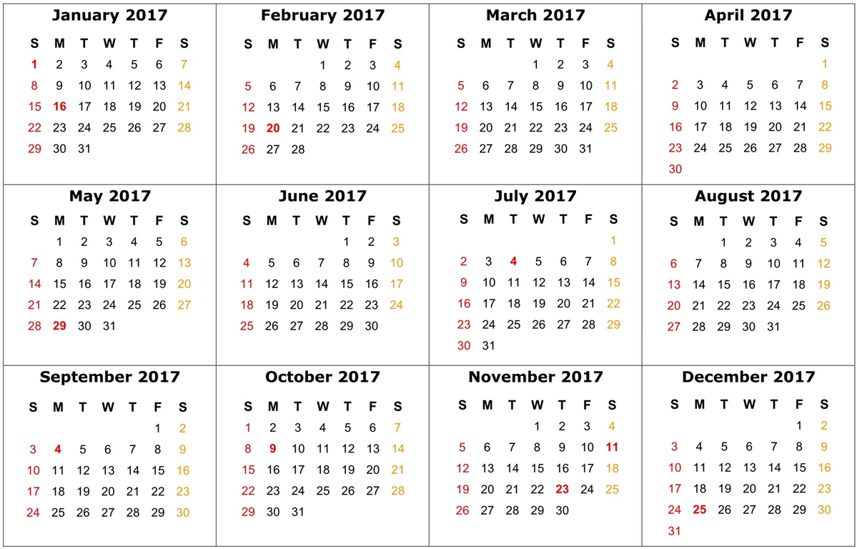
MilOps CCB CY17
Schedule
✓
✓
✓
✓
NOTES
CRs may be submitted at anytime
Deadlines and windows are designed for planning purposes
CCB dates are fixed; all other dates are flexible
✓
KEY
CR Deadline
ISA Distribution
TDR window
Final CR/ISA
CCB

Slide 24

Announcement
DHS S&T FRG PRESENTS – EMERGENCY MANAGEMENT INFORMATION SHARING INTEROPERABILITY TRAINING WORKSHOP
Join the DHS S&T First Responders Group for an in-depth overview of emergency management focused data standardization interoperability capabilities and information sharing initiatives.
July 12, 2017 9:00am – 12:00pm Virtual Training Conference Room A, B, & C – (no telecom)
POC Lain McNeill 'lain.mcneill@cse-corp.com'
Notes:
Dept. Homeland Security Science & Technology First Responders Group
Topics covered to include:
• Why Standardize Information Sharing?
• How to Easily Automate Exchanges via National Information
Exchange Model (NIEM)
• Best Practices in sharing Existing Data Exchanges
• Insight into Operational Alignment Enhancements Facilitated by
Automated Information Exchange and
• Key Participants, Activities and Resources
• How to Gain Access to Free Information Sharing Software Tools

Slide 25
MilOps Strategic Plan
Aligned with Joint Staff and Joint Staff J6 Mission and DHS / JS J6 MOU
Aligned with NIEM Strategic Objectives and the NBAC Roadmap Goals and deliverables
Identifys MilOps Strategic Goals and Objectives for FY17 – 18
Notes:
The MilOps Domain has embraced a process which led to the completion of a two year Strategic Plan to identify the future direction of the NIEM MilOps Domain and Community of Interest (COI). This two year Strategic Plan is a vision articulated in current year goal statements with objectives that identify where the MilOps Domain will focus its efforts. The vision attempts to focus on how the organization will provide beneficial outcomes to members and other stakeholders
JS Mission - To assist the CJCS in providing the best military advice while advancing cyber defense, joint/coalition interoperability and C2 capabilities required by the Joint Force to preserve the Nation's Security.
JS J6 Mission - To enable warfighter access to authoritative data sources and improves data interoperability by establishing common C2 data and service standards, integrating these standards into capability requirements, and facilitating implementation within programs of record. (Joint Staff J6 Mission Statement)
DHS and the Joint Staff will enhance unclassified information sharing and safeguarding among their respective mission partners. (Ref p)

Slide 26
Action Items
Action Item ID # | Task | OPR | Due Date | Status
2017-01 | Publish MilOps 4.0 to DoD Repository The v4.0 package is available at http://niem.github.io/niem-4.0 | Secretariat | September 2017 | Open
2017-02 | Establish Tiger Team to review MOMS content for future harmonization | Lead Domain Modeler | September 2017 | Open
2017-03 | MilOps Strategic Plan out for Comments | MilOps Secretariat | August 2017 | Open
2017-04 | Complete NBAC Domain Scorecard | MilOps Steward Representative | September 2017 | Open
Notes:
We received some comments about NIEM 4.0 RC1 during the review and have tried to address the resolvable issues in this RC2. At this stage of the process, we are very close to the final release and are looking to address bugs only. Please review to ensure (1) any raised issues have been addressed appropriately and (2) there are no critical issues with the package. Non-critical issues can be queued for the next release.
As of Monday 26 June, the RC2 package is available at the URL in the Task Column
Since the PMO is asking for confirmation of fixes, this will be a short review period byCOB Monday, June 26.
If RC2 is confirmed, then the content will be locked and we will start to prepare the final release on Tuesday. Otherwise, we will continue to iterate with release candidates and reviews until no significant issues are raised.

Slide 27
NBAC Activities
Derek Nisco
NIEM V4.0 Content Subcommittee Update
NBAC Domains Score Card Annual Review
JSON Schema Generation Tool
Human Capital Domain On-boarding
FY2017- 2018 NBAC Strategic Roadmap

Slide 28
Stakeholder Collaboration
Programs Considering NIEM?
IEPD Development?
NIEM Mapping?
Demonstrations, Exercises, Experiments?
Recommendations & Good Ideas?

Slide 29
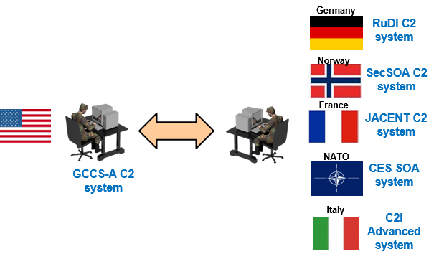
Tactical Infrastructure Enterprise Services Coalition Warrior Program
Warfighter Problem: Coalition armed forces’ IT systems employ different IT standards, preventing exchange of critical warfighter information
Solutions Approach:
1. Make Data Understandable
Need a lightweight, agile standards-based information exchange framework
Employ the National Information Exchange Model
2. Identify Trusted Consumers
Need a common Identify and Access Management (IdAM) capability
Employ the US Army’s Tactical level solution
3. Exchange only releasable data
Need an alignment between US (IC-ISM) and NATO (STANAG 4774 / 4778) security labeling requirements
Employ data redaction service to ensure only releasable information is provided to trusted consumers
Interoperability Benefits:
Common standards / reusable exchange tools;
Aligns disparate COI’s, not just C2, at the enterprise level;
Builds automated access controls for (1) partner access to network information, and (2) message content on each message;
Leverages automated security markings services;
Same approach as directed for US DOD use in joint and interagency information exchanges
Key NATO and member nation C2 systems
Proof of Concept demonstrated and validated at latest NATO CWIX event
Notes:
ABAC: Attribute based Access Control
Purpose
Develop and transition improved coalition information sharing capabilities in the following key function areas: Identity and Access Management (IdAM); Confidentiality / Labeling; and, Use of NIEM conformant messaging.
Objectives
IdAM – Provide an interoperable, automated solution for exchanging/validating user credentials, and managing access to web services based on credentials and access policies.
Confidentiality / Labeling – Use existing coalition guidance to apply labels to data objects that facilitate automated, fine-grained access control and redaction; use case is situational awareness data typically displayed on a Common Operating Picture (COP).
Use of NIEM – Build and exchange track data using NIEM conformant messages.

Slide 30
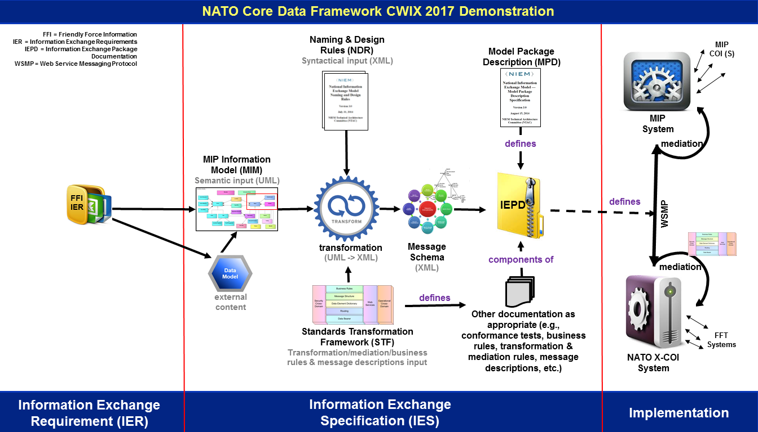
NATO Core Data Framework (NCDF) Demonstration
Venue: Coalition Warrior Interoperability Exercise (CWIX), June 2017
Partners:
NATO NCIA using FFI-compliant C2 system.
DEU MOD using Multilateral Interoperability Programme (MIP)-4 compliant C2 system.
Aim: Demonstrate effective land COP message exchanges using NIEM-conformant message interfaces.
Technology: Software Development: This project develops and implements a data standard based ability to share land COP messages.
Benefits:
Early demonstration of NCDF processes and tools
Mature DM CaT, NCDF documentation
Increase NATO familiarization with NIEM
Advance the alignment of MIP and NIEM
Notes:
Also using WSMP as the web services messaging protocol

Slide 31
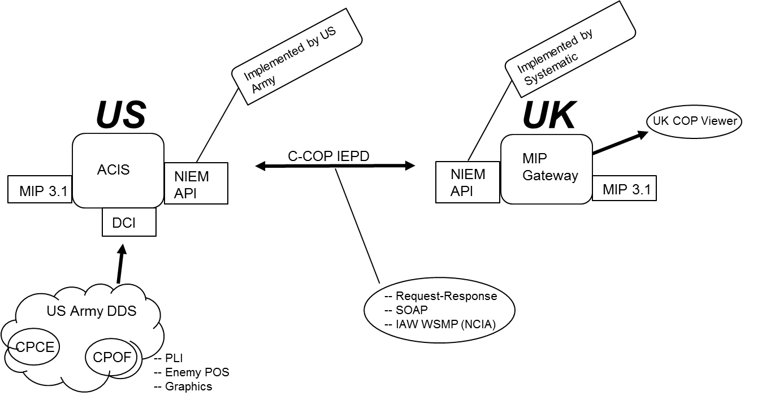
UK – MIP – NIEM Message Exchange Demonstration
Bold Quest 17.2 Execution (Oct-Nov 2017)
Partners:
US Army PEO C3T, PM MC, SMC using GCCS-A C2 system.
UK MOD using Multilateral Interoperability Programme (MIP) standard.
Aim: Demonstrate effective land COP message exchanges using NIEM-conformant message interfaces.
Technology: Software Development: This project develops and implements a data standard based ability to share land COP information.
Benefits:
Conducts proof-of-concept demonstration for UK forces on utility of NIEM conformant message interfaces;
Sustains NIEM incorporation with US Army MIP team;
Incorporates NATO web service standard into US Army C2 architecture.
Notes:
SMC: Strategic Mission Command
WSMP: Web Services Messaging Protocol (WSMP)

Slide 32

Closing Remarks
Mr. Ralph O’Connell MilOps Domain Steward Representative (757) 836-8092 ralph.m.oconnell.civ@mail.mil
Stakeholder input is essential to the MilOps Domain FY-17/18 Strategic Plan
MilOps Domain will mature through NIEM adoption by the Security Equipment Integration Working Group (SEIWG) and U.S. Message Text Format (USMTF) CCB
I am seeking unity of effort to improve data sharing and interoperability through standardized DOD information exchanges
Please contact me if you have any recommendations or good ideas to improve the efficiency and effectiveness of the NIEM MilOps Domain

