Slide 1
Improving Data Interoperability Supporting the Warfighter
Ms. Laura Burkhart
Joint Staff J6 DDC5I
Data and Services Division
Senior Research Scientist
Georgia Tech Research Institute
Laura.Burkhart@gtri.gatech.edu

Slide 2
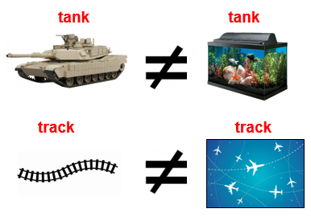
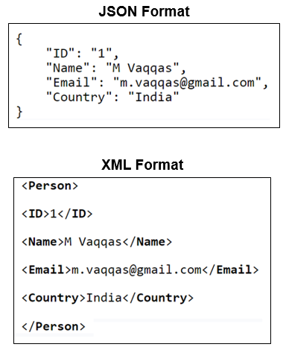

“Interoperability”
Interoperability is defined by IEEE as “the ability of two or more systems or components to exchange information and to use the information that has been exchanged.”
Interoperability is achieved by adhering to common standards and/or using a gateway to translate one system’s information to another format.
Syntax
Semantics
Structure
Notes:
SYNTAX: Although the same data is represented in three different syntactical formats, none are interoperable w/ each other. A computer program designed to read one format would not understand the same data in either of the other two formats unless additional interfaces were developed to support them.
SEMANTICS: Although the graphical comparisons are laughable to a human; computers cannot discern the meaning of one string (e.g., tank vs. tank) from the other unless humans program them to. A computer program designed to recognize an aircraft track will not likely understand a rail road track.
Most people will recognize a 10 digit phone number. However, how do you discern which is a home, work or cell phone number. The same is true for an email address. Some people will know that “mail.mil” is a Department of Defense mail exchange, but not everyone will. Furthermore, some people use their “gmail” accounts for work. How does a computer know? The same can inferences may be applied to a mailing address as well.

Slide 3
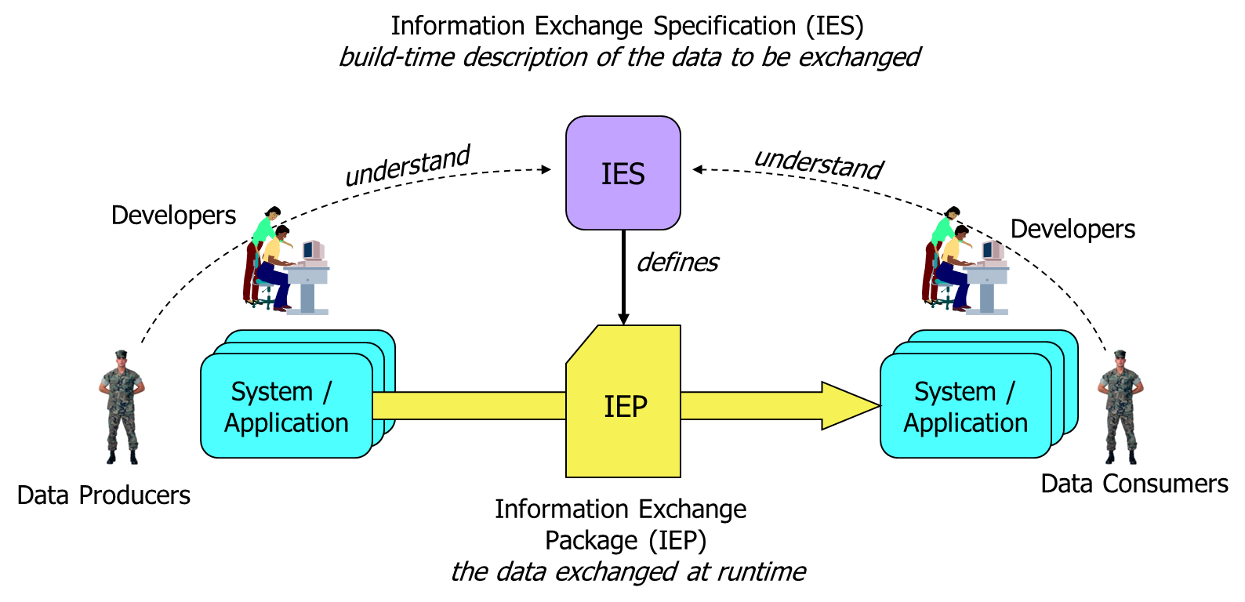
Data Interoperability OV-1
Notes:
For machine-to-machine data interoperability, there are software developers who build applications on behalf of producers and consumers. They work from an information exchange specification, a build-time description of the data to be exchanged at runtime. If they do their jobs right, then the data produced at one side will be properly interpreted at the other, and everyone will be happy.
IES – Represents a reusable technical specification defining the structure and business rules for the data being exchanged. NOTE: In NATO an Information Exchange Requirement (IER) is the equivalent of the IES in this diagram, and the Information Exchange Specification (IES) is the solution implementation of an IER.
IEP – Is an instance of the data being exchanged.

Slide 4
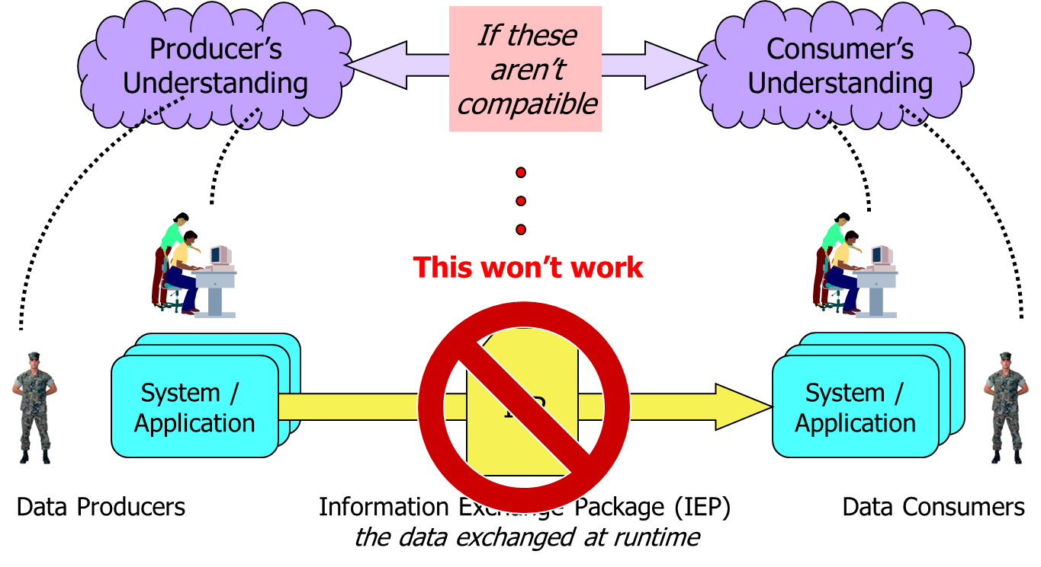
Data Interoperability Problem
The root cause of the problem is incompatible syntax, semantics and data structure.
Notes:
The data interoperability challenge is to ensure that the different developers have a compatible understanding of the data to be exchanged – because if the people on the left have a different understanding than the people on the right, then something will be broken and someone will be unhappy.
This is a complex problem involving among other things:
Multiple Data Standards
Military Standards (USMTF, VMF, TDL, Symbology, etc.)
Intelligence Community Standards (NTK, ISM, etc.)
Geospatial Standards (GML, KML, OGC, etc.)
Et al.
Lack of a coordinated data governance within the Services and across the Department
The OPEN Government Data Act directs agencies to publish their non-sensitive data in a machine-readable format and also requires agencies to hire chief data officers
Existing, incompatible operational systems, gateways, cross-domain solutions, etc.
Siloed budget and funding streams
And much more…

Slide 5
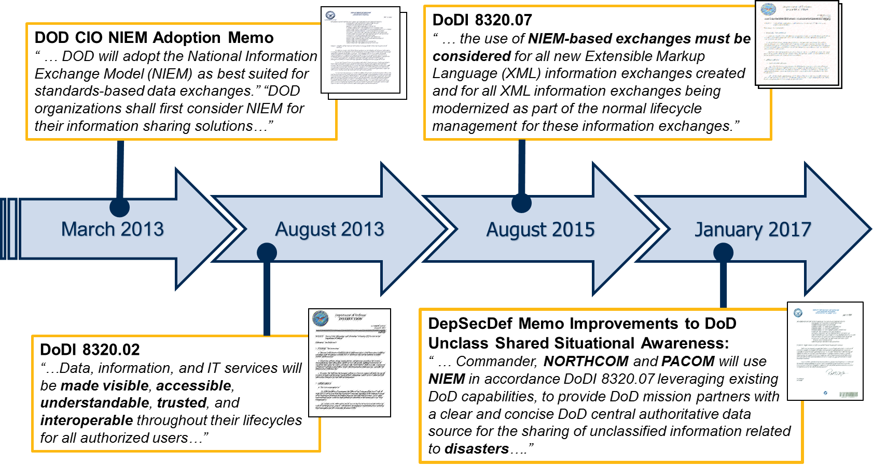
DOD Information Sharing Policy & Guidance
2003 – Net-Centric Data Strategy
Notes:
DoD Data Strategy has been consistent for 10+ years now. This policy was developed with the knowledge that data is the foundation to all warfighter decision making, and intent to mitigate the data interoperability problem. NIEM chosen by the DoD CIO and called explicitly listed in various DoD Information Sharing Policy & Guidance as the best available “standards based approach” for improving data interoperability supporting the warfighter. Best option for multiple standards-based data exchanges.
Overarching data strategy policy is a modernization and continuation of the 2003 Net-Centric Data Strategy. Data, information, and IT services (DIIS) are enablers of information sharing to the DoD. Key tenants are that DIIS must be visible, accessible, understandable, trusted and interoperable. Data, information, and IT services are trusted when they have provided sufficient pedigree and descriptive metadata for consumers to rely on them as an ADS, and they comply with applicable information assurance and cyber security policies.
DODI 8320.07, Implementing the Sharing of Data, Information, and Information Technology (IT) Services in DOD, 3 AUG 2015
standardizes use of XML across the department
establishes the Military Operations domain for semantic content.
promotes interoperability at the information exchange data level.
directs the use of NIEM for all XML information exchanges created or modernized as a part of the normal lifecycle management

Slide 6
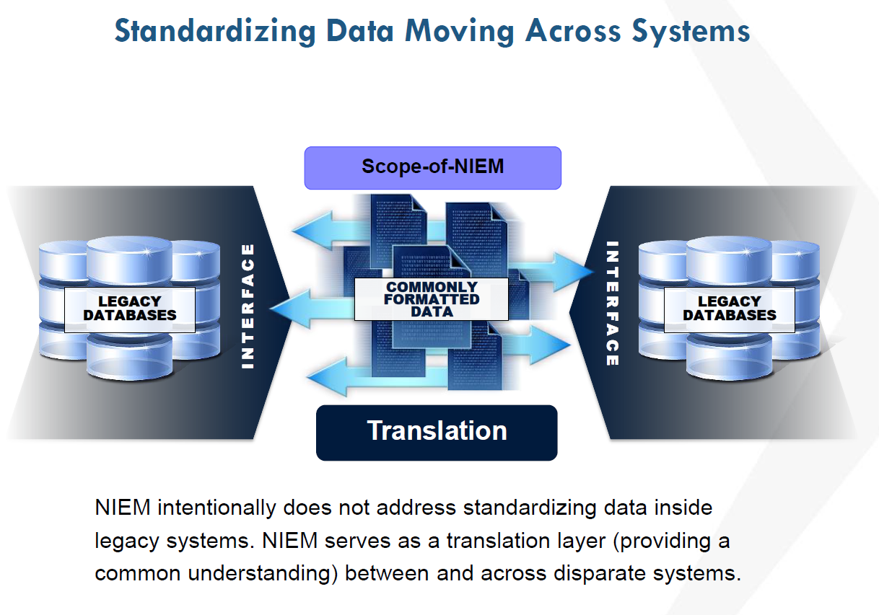
National Information Exchange Model
Warfighter data interoperability framework to enable information exchange among Combatant Commands, Service Organizations, Agencies and Mission Partners
“Whole of Government Approach” across multiple spectrums of operations
12 of 15 Federal Agencies
Internationally (Canada, Mexico, EUROPOL)
NATO
Multilateral Interoperability Programme (MIP)
Standardizes data exchange requirements
XML-based data exchanges and non-normative guidance for JSON-LD
NIEM XML- based data exchange Specifications (IESs) reuse means:
Faster mediation
Rapid implementation
Increases interoperability
Lowers development costs
Common framework for Syntax and Semantics
Notes:
National Information Exchange Model (NIEM) is a standards based approach designed to uniformly develop, centrally maintain, quickly identify and discover, efficiently reuse the enterprise wide information sharing standards and processes across multiple mission areas. NIEM is designed to develop, disseminate, and support enterprise‐wide information sharing standards and processes across the whole of the departments of Defense, Justice, Public Safety, Emergency and Disaster Management, Intelligence, and Homeland Security enterprise at all levels and across all branches of government.
1) Using XML to standardize data exchanges can be a stand-alone effort between interested parties, or within a specific COI. XML is a widely used language, and considerable resources exist to provide guidance to organizations seeking to create effective information exchanges using XML. This approach requires an established framework that provides consistent naming and design rules, and known processes for managing the building, implementation, and storing of data interface agreements.
2) The XML approach can improve information interoperability and data sharing among Command and Control (C2) information technology nodes and provide information integration among mission partners. The approach has demonstrated its ability to establish effective C2 data sharing environments without negatively impacting existing data exchanges, existing data stores, or data sharing standards.
3) A framework for using XML-based data exchanges currently exists with the National Information Exchange Model (NIEM); an approach that has been adopted for use by the US Department of Defense.

Slide 7
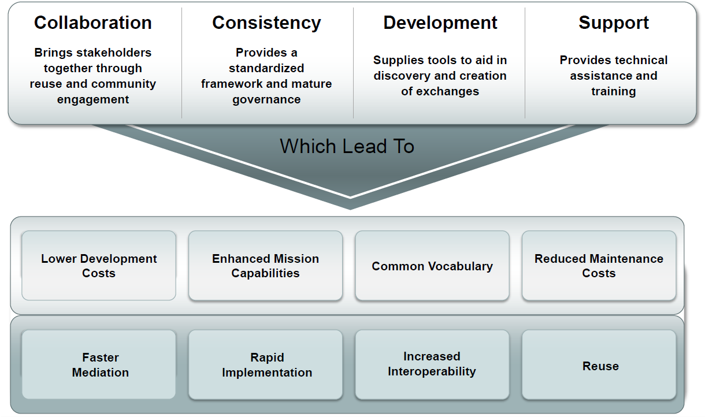
Value NIEM Offers
Notes:
Provides an agreed upon common language (e.g., syntax and semantics) for sharing data among all partners
Allows communities to come together to solve tough data sharing problems (e.g., cross COI, cross domain, etc.)
As an XML based format, NIEM allows for exchange of data from existing IT systems without affecting legacy data structures.
NIEM (XML) provides greater flexibility for modification and enhancements (e.g., JSON, binary, etc. formats from a single semantic base)
Allows reuse of exchange specifications, as well as existing successful models of enterprise adoption including web services and SOA/ESBs.
NIEM concepts and principles have consistently demonstrated these values in DoD for over 7 years:
- TIES JCTD
- TEDS JCTD
- SIRI (NATO M&S COE) – binary XML
- CWIX 16, 17
- Bold Quest 17

Slide 8
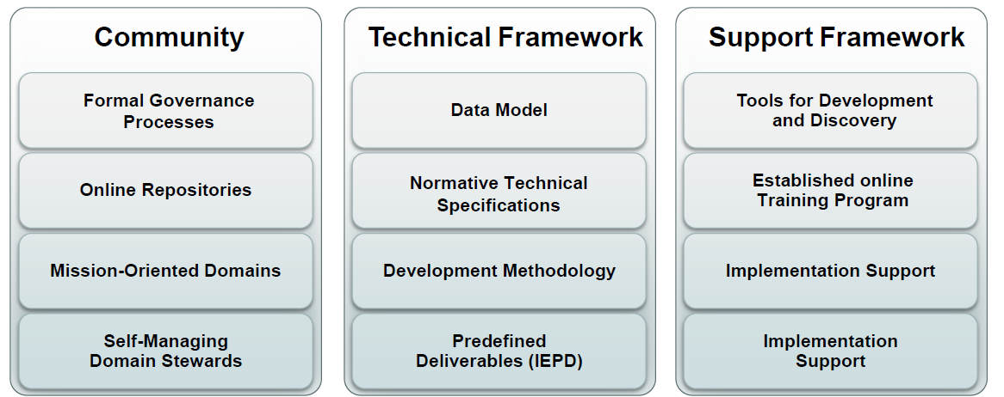
NIEM OV-1
NIEM is a community-driven, whole-of-government, standards-based approach to exchanging information. Diverse communities collectively leverage NIEM to increase efficiencies and improve decision-making.
Notes:
Build by the community over 10+ years (including: Federal, State, Local, Tribal, international stakeholders)
It’s more than just a data model
It’s more than just a pile of technical standards
Starts with: Distributed governance
Provides Normative Technical Specifications and guidance
- use to create the NIIEM reference data model
- used to develop Information Exchange Specifications (referred to as Information Exchange Package Documentation (IEPD))
Tool Support
Training Support
Implementation Support

Slide 9
Distributed Governance
NIEM ESC
NIEM Executive Steering Council
NIEM PMO
Program Management Office
Executive Director
NTAC
NBAC
NIEM Technical Architecture
Committee (tech specs)
NIEM Business Architecture
Committee (data model)
Domain Stewards (14+)
User
Community
IEPD Developers
Each color differentiates an independent area of governance supported by NIEM.
Notes:
ESC – NIEM vision, and decision-maker for membership, funding, and program direction.
(Justice, DHS, HHS)
PMO – manages day-to-day program operations; facilitates collaboration with community and stakeholders in developing NIEM-based information exchange solutions. (DHS transitioning to DoD 2QTRFY18)
NBAC – guides development, harmonization, evolution, and implementation of NIEM Core data components, as well as governs processes for participating in NIEM domains.
NTAC – responsible for defining technical architecture that governs NIEM.

Slide 10
NIEM Technical Specifications
Naming & Design Rules
(XSD/XML documents)
Reference
Constraint
Subset
Extension
IEPs (instances)
(other conformance targets?)
Schematron Rules
Specs for schemas, MPDs, and other artifacts
Wantlist
JSON Specs
Domain Update
HL Version Arch
Code Lists
Business rules
BIEC / EIEM
UML Profile
Usage Patterns
IEPD Certification
JSON Guidance
Ontology
MPD Specification:
IEM (the schema sets)
MPD Catalog with metadata
XML Catalog
Versioning
URI scheme
Change log
Master Document
Lineage
Packaging
IEPD Implementer documentation
Conformance Tgt Attribute
KEY
Done
Initialized
Conformance Specification
No spec
Notes:
Technical specifications are configuration managed by the NIEM PMO, but developed and matured by the NIEM user community based on community needs.
Mapping of the supporting NIEM technical specifications that establish the NIEM technical architecture.

Slide 11
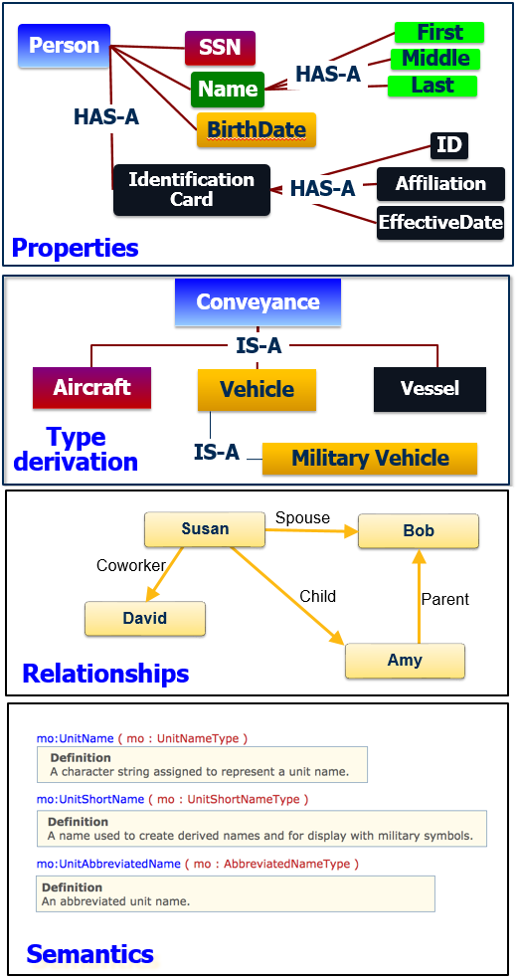
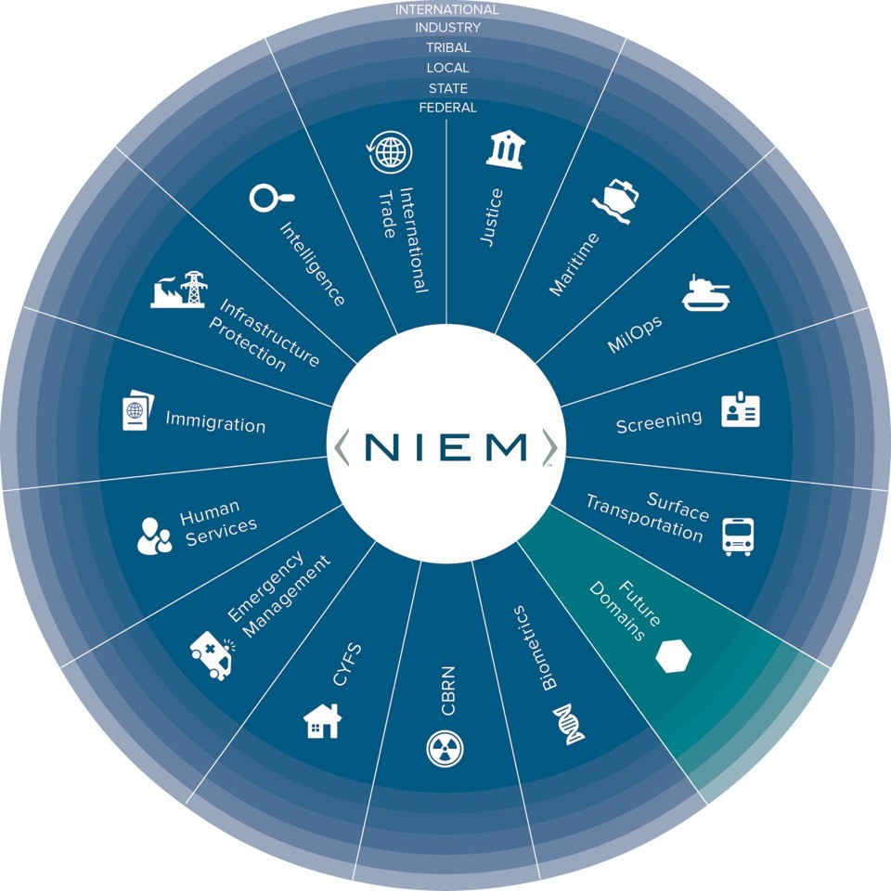
Reference Data Model
Notes:
An implementation of the NIEM technical architecture; model of reusable data components for building Information Exchange Specifications.
Defines semantics in types, properties and relationships in a Resource Description Framework (RDF).
The model is developed, managed and maintained by the NIEM PMO and community of chartered Domain Stewards.

Slide 12
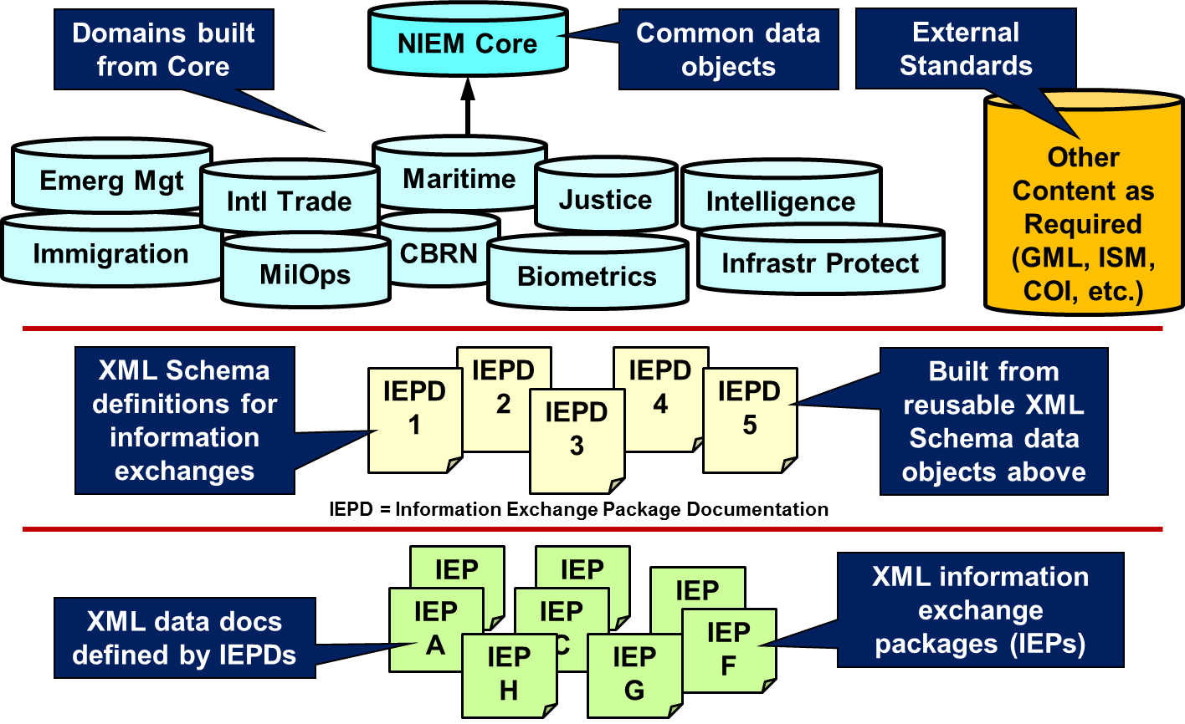
NIEM IEPD
An Information Exchange Package Documentation (IEPD) is a collection of artifacts that describe the construction and content of an information exchange
Business Rules
Information Exchange Requirements
Supporting Documentation
Notes:
An IEPD represents the culmination the NIEM technical architecture, reference data model and information exchange requirements. When completed, the IEPD represents the concrete agreement among exchange partners on how the data will be shared. It is also a discrete technical specification that may be shared, published in a registry for search and discovery, or reused as a basis for developing other IEPDs.
Core Functions of an IEPD:
Developed to provide the business, functional, and technical details of the information exchange through predefined artifacts
Created with a core set of artifacts in a prescribed format and organizational structure to allow for consistency
Designed to be shared and reused in the development of new information exchanges through the publication in IEPD repositories

Slide 13
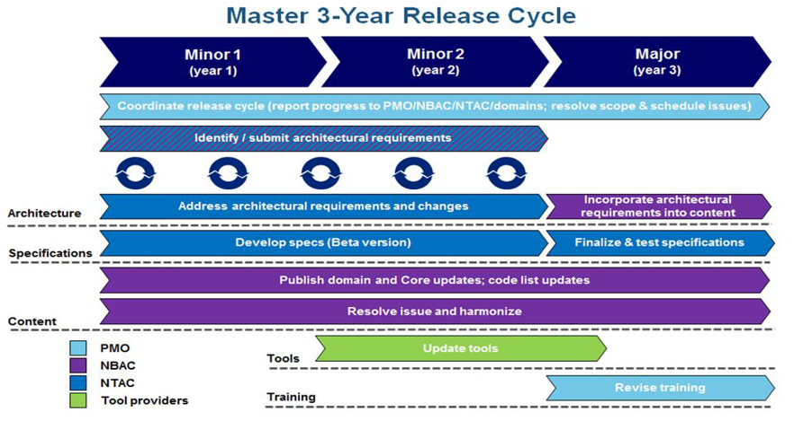
Configuration Management
Notes:
High Level Version Architecture - Describes NIEM major and minor release cycles and how NIEM governance bodies update the schema documents and data components that comprise NIEM.

Slide 14
Select NIEM DOD Engagements
UNCLASSIFIED (U)
Effort | Partner ORGs | Overview | Engagement
MILSTD 6040 U.S. Message Text Format (USMTF) | USMTF CCB | Onboard/Technical Support to transform existing USMTF XML into a NIEM conformant construct. Potential to include 20,000 new data components into the MilOps Domain | DOD
Medical COI Information Interoperability (HL7) | Defense Health Agency / DOD CIO / OJSS | Assistance to DOD and Interagency health services COI’s striving to standardize data interfaces and improve medical information interoperability | DOD / Interagency
MILSTD 6016 Tactical Data Link (Link-16) J-series messages XML standardization | Joint Multi-TDL CCB | Approved Draft Interface Change Proposal to develop Appendix to provide guidelines for generation of J-Series message data as NIEM conformant XML | DOD
MILSTD 6017 Variable Message Format (VMF) | JMSWG XMLSG | Development of a NIEM Conformant variant of VML | DOD
NCDF Data Standardization / Exchange Demonstration at Coalition Warrior Interoperability Exercise (CWIX 2017) | JS J6, USMC/MCTSSA, ACT/NATO, NCIA, DEU/MIP | Early use case of NCDF processes (IER, IES, and Implementation); mediation between FFI and MIP using NIEM NDR; followed NATO’s web services standard (WSMP) | Multinational
USSOCOM Data Strategy | USSOCOM | Incorporated NIEM as a standards based approach to sharing information in the USSOCOM J3x Data Strategy | DOD
Security Equipment Integration Working Group (SEIWG) | Physical Security Enterprise & Analysis Group | Tech Support to implement NIEM IEPDs supporting Force Protection Systems Sensor Information message exchanges | DOD
UNCLASSIFIED (U)
14

Slide 15
Select NIEM DOD Engagements
UNCLASSIFIED (U)
Effort | Partner ORGs | Overview | Engagement
Tactical Service Oriented Architecture (TSOA) | USMC/MCTSSA | Onboard Alignment of their message schema to NIEM conformant JSON | DOD
Warfighter Mission Area Architecture Federation and Integration Portal | JS J6 AID USA/TRADOC | Tech Support WMA AFIP NIEM IEPD supporting exchanging DoDAF artifacts across a Service level federation (ArCADIE) | DOD
USAF Cursor on Target (CoT) | AFSOC, AFLCMC | Implement NIEM v3.0 conformant representation of CoT version 2 +10 | DOD
Antisubmarine Warfare (ASW) Community of Interest (COI) “Track” harmonization | ASW COI | Map ASW COI data model (ACM) UML track information to allow NIEM conformant information exchanges | DOD
US NAVY – Robotic and Autonomous Systems Information Interoperability Line of Effort | NAVAIR PMA 281 | Demonstrate standardized data interfaces uses in Advanced C2 NIOP. Demonstrate manned-unmanned teaming capabilities | DOD
USAF – Robotic and Autonomous Systems Information Interoperability Line of Effort | USAF/AFRCO | Demonstrate utility of NIEM for USAF unmanned systems messaging capability currently provided in UCI / CMCC capabilities. | DOD
GCCS-JE Demonstration Experiment | DOD CIO, DISA, JS J6 | Incorporate NIEM conformant information exchanges into the GCCS-JE experiment | DOD
Standardizing Coalition C2 Access, Data and Services (SCC2ADS) Line of Effort | USN / USMC/TSOA ACT/NATO | Develop and implement standardized data interfaces for use in coalition C2 systems and prototype access control measures into the shared messages | Multinational
UNCLASSIFIED (U)
15

Slide 16
References
Starting Point: https://www.niem.gov/
Training: https://www.niem.gov/training
Technical Resources: https://www.niem.gov/techhub
Current Release: https://www.niem.gov/techhub/niem-model/current-release
IEPD Developer Resources: https://www.niem.gov/techhub/iepd-resources
Implementation Support: https://niem.github.io/
Tools: https://www.niem.gov/tools-catalog
Joint Staff J6 POC: ralph.m.oconnell.civ@mail.mil; mark.r.dotson.ctr@mail.mil

Slide 17
Questions

