Slide 1
Options Pricing in Discrete Levy Models
Joseph Loss
Yuchen Duan
Daniel Liberman

Slide 2
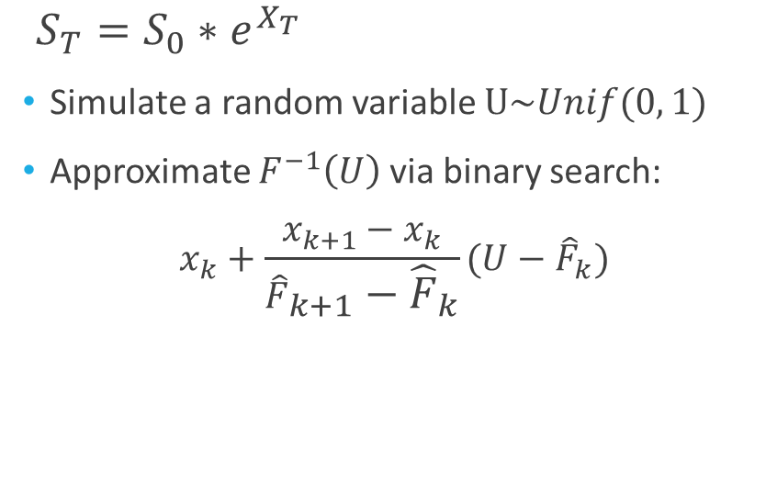
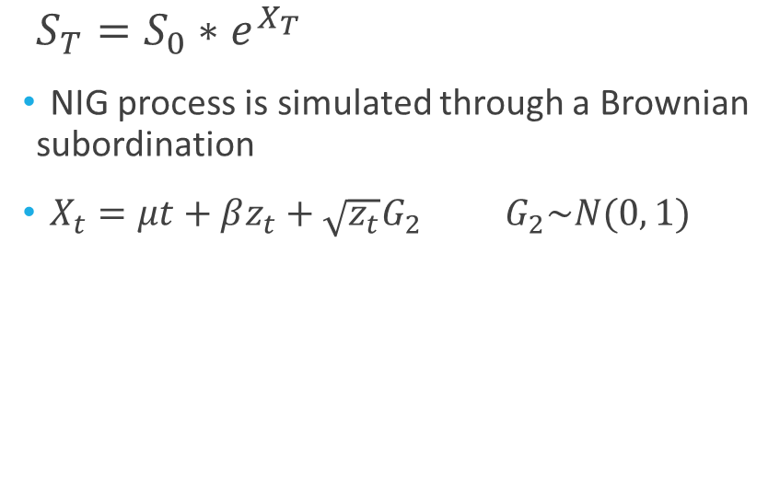
Background: European Vanilla Put Options
Normal Inverse Gaussian algorithm
Inverse-Transform Method
$S_{T}=S_{0}∗e^{X_{T}}$
NIG process is simulated through a Brownian subordination
$X_{t}=μt+βz_{t}+\sqrt{z_{t}}G_{2} G_{2}\sim N(0, 1)$
$S_{T}=S_{0}∗e^{X_{T}}$
Simulate a random variable $U\sim Unif(0, 1)$
Approximate $F^{−1}\left(U\right)$ via binary search:
$$x_{k}+\frac{x_{k+1}−x_{k}}{{\hat{F}}_{k+1}−{\hat{F}}_{k}}(U−{\hat{F}}_{k})$$

Slide 3
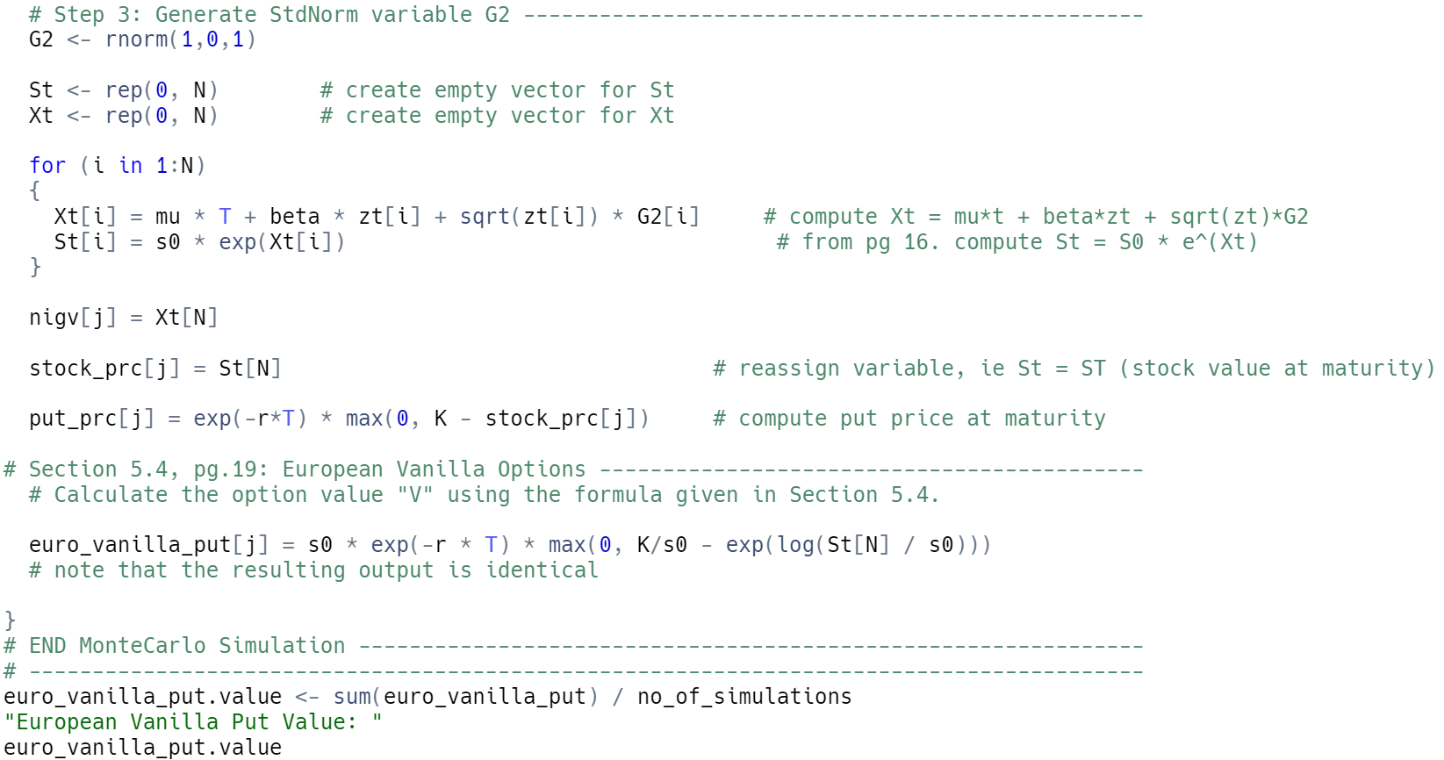
Normal Inverse Gaussian Algorithm

Slide 4
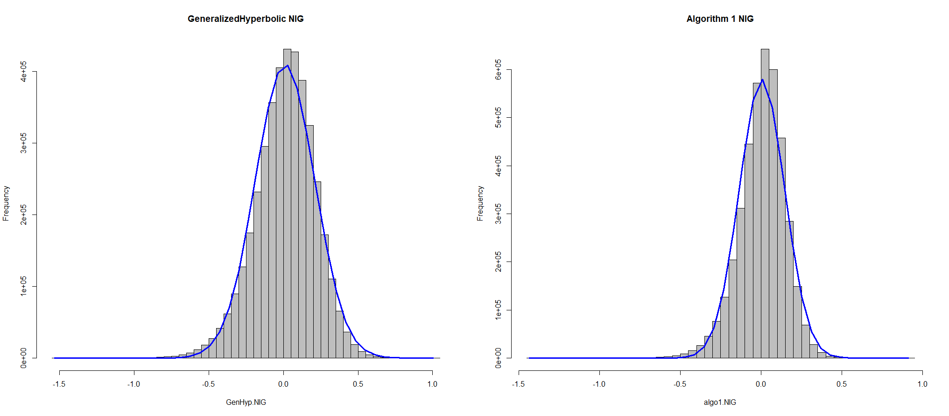
NIG Distribution

Slide 5
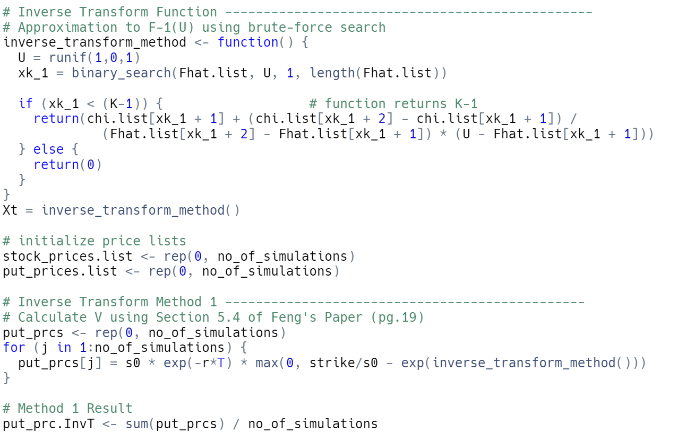
Inverse-Transform Algorithm

Slide 6
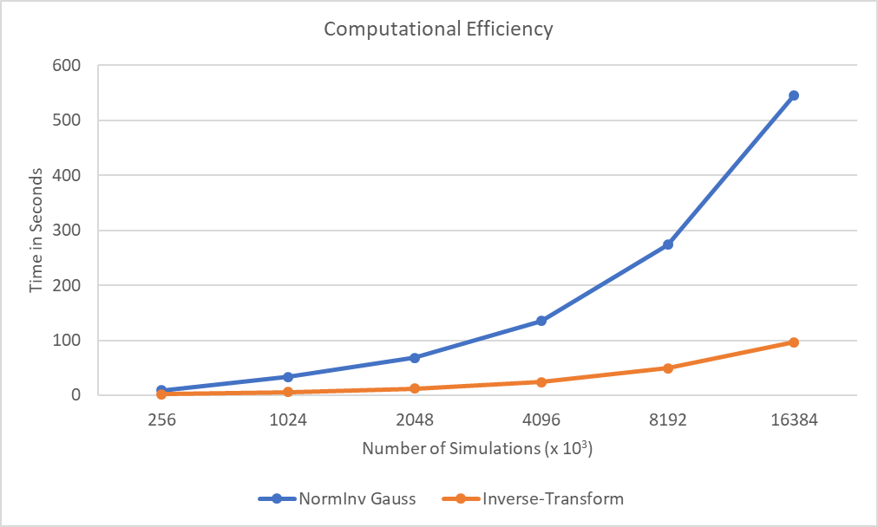
Comparison: Timing Efficiency Plots

Slide 7



Contact Information
Joseph Loss
loss2@illinois.edu
University of Illinois
MS Financial Engineering
Yuchen Duan
yuchend3@illinois.edu
University of Illinois
MS Financial Engineering
Daniel Liberman
danliber92@gmail.com
University of Illinois
BS Finance

