Slide 1
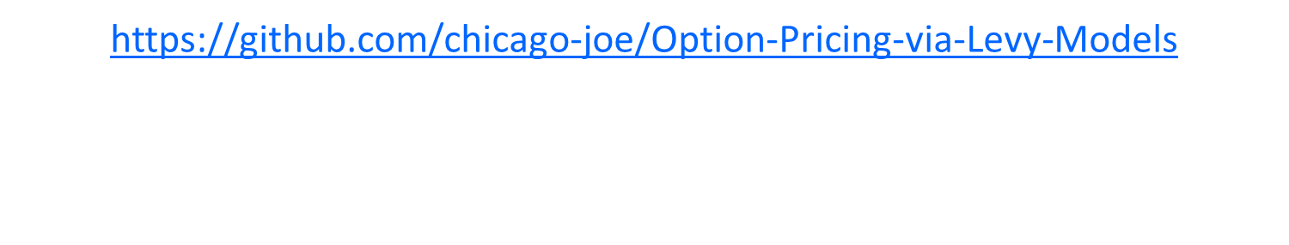
Options Pricing in Discrete Lévy Models
Source Code and Documentation:
Joseph Loss
Yuchen Duan
Daniel Liberman

Slide 2
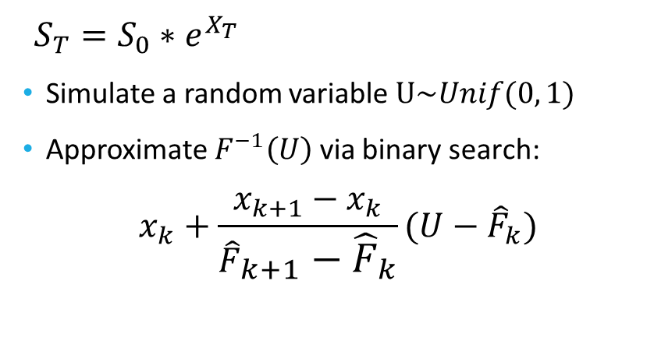
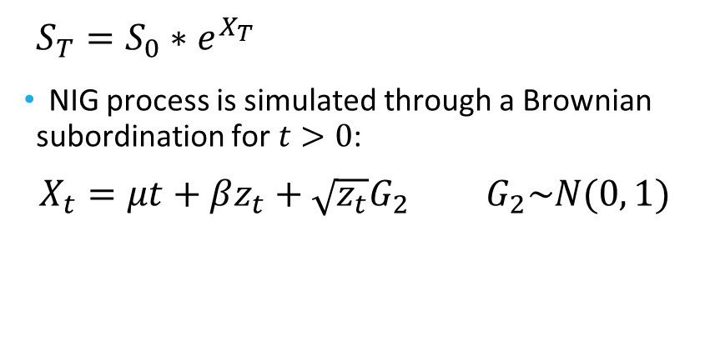
Background: European Vanilla Put Options†
Normal Inverse Gaussian algorithm
Inverse-Transform Method
$S_{T}=S_{0}∗e^{X_{T}}$
NIG process is simulated through a Brownian subordination for $t>0$: $X_{t}=μt+βz_{t}+\sqrt{z_{t}}G_{2} G_{2}\sim N(0, 1)$
$S_{T}=S_{0}∗e^{X_{T}}$
Simulate a random variable $U\sim Unif(0, 1)$
Approximate $F^{−1}\left(U\right)$ via binary search:
$$x_{k}+\frac{x_{k+1}−x_{k}}{{\hat{F}}_{k+1}−{\hat{F}}_{k}}(U−{\hat{F}}_{k})$$
†Liming Feng, et al. “Simulating Lévy Processes from Their Characteristic Functions and Financial Applications.” University of Illinois, 30 July 2011

Slide 3
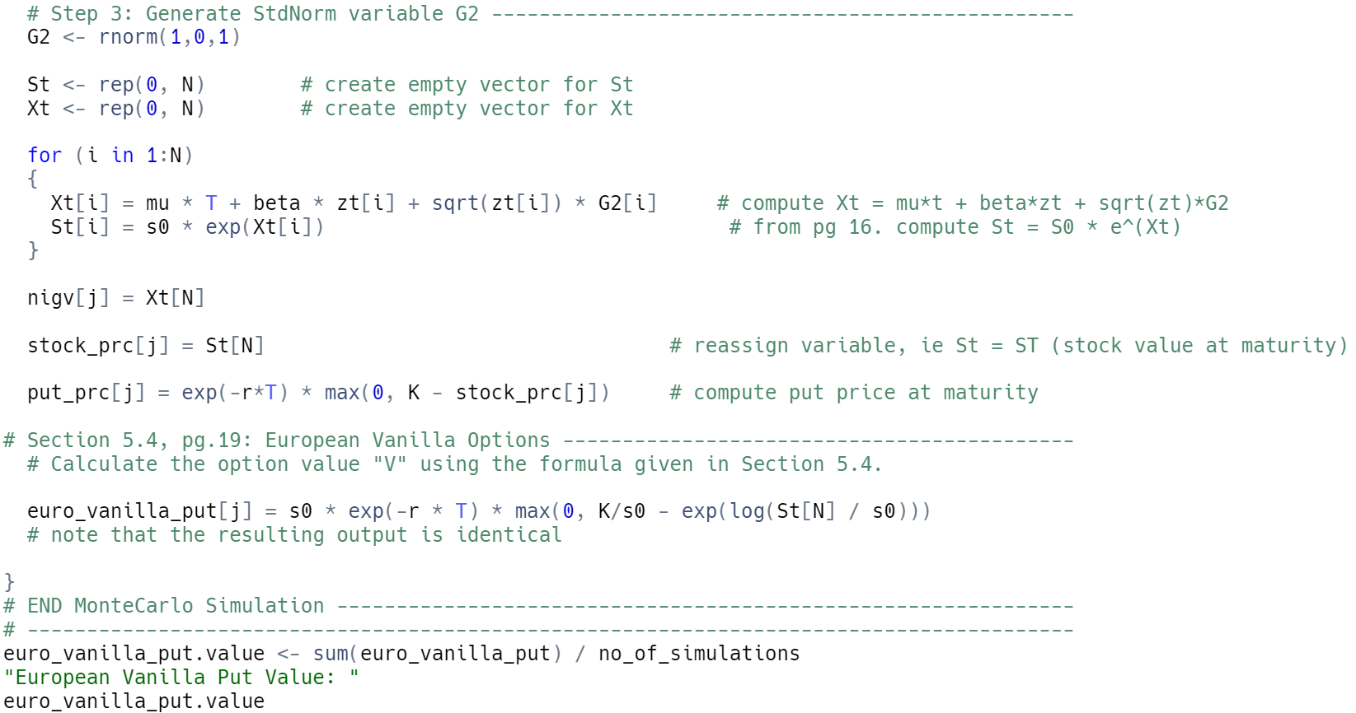
Normal Inverse Gaussian Algorithm

Slide 4
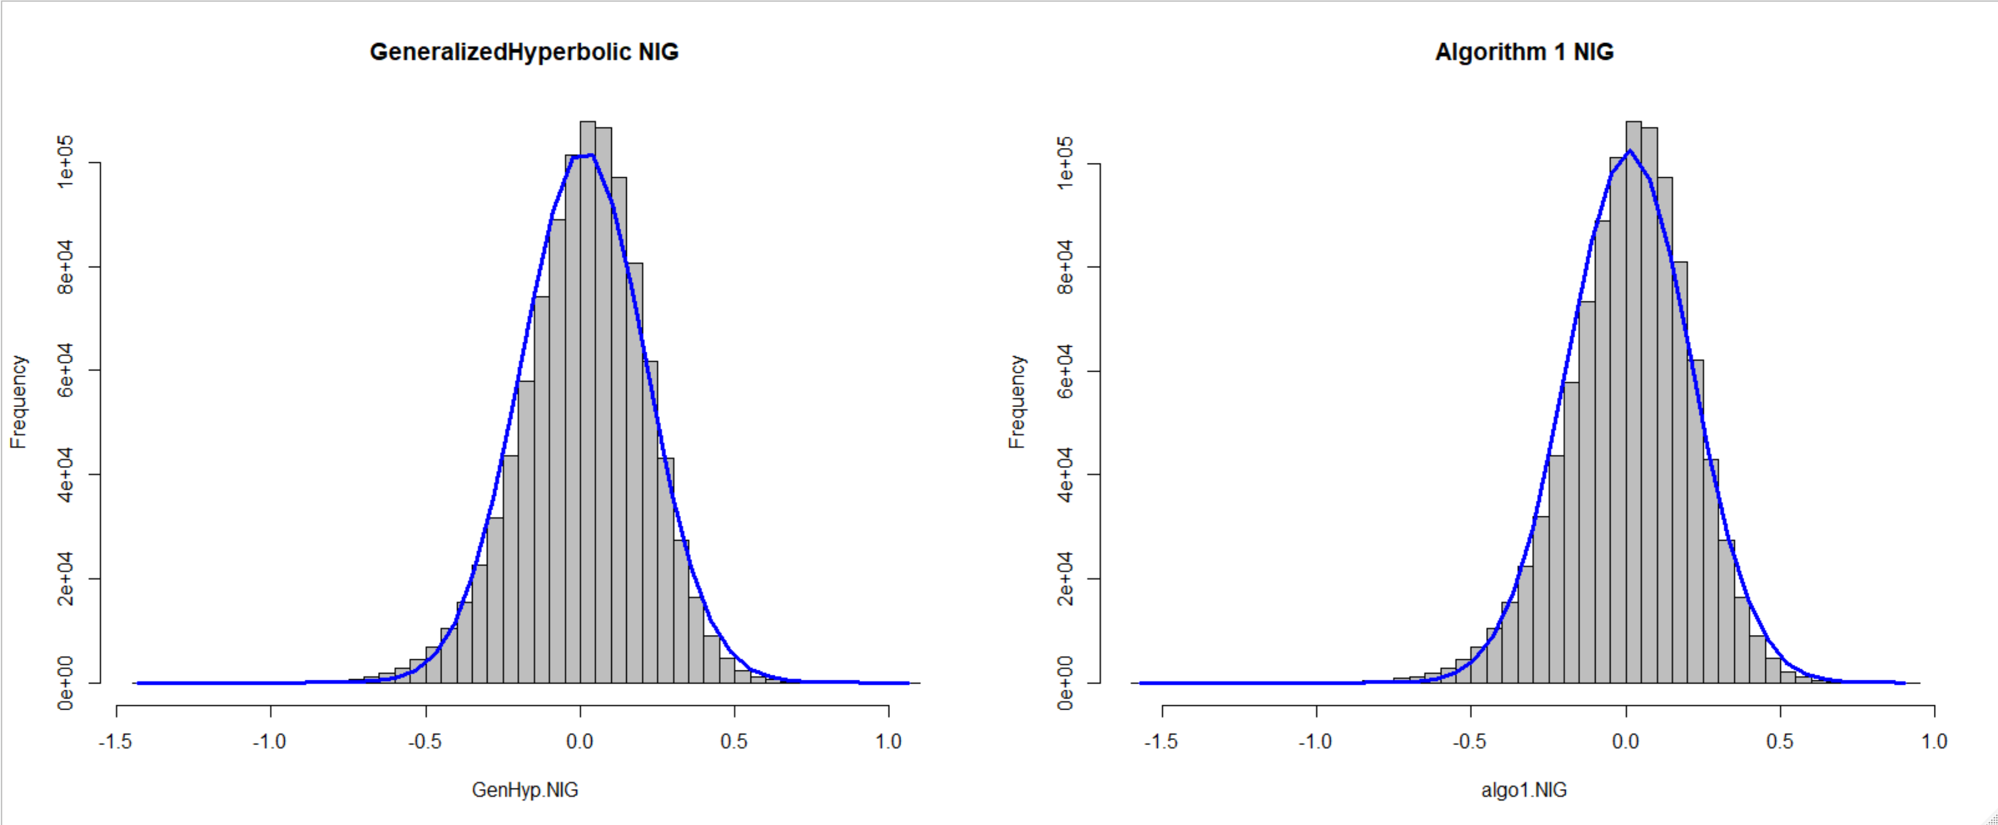
Normal Inverse Gaussian Distribution

Slide 5
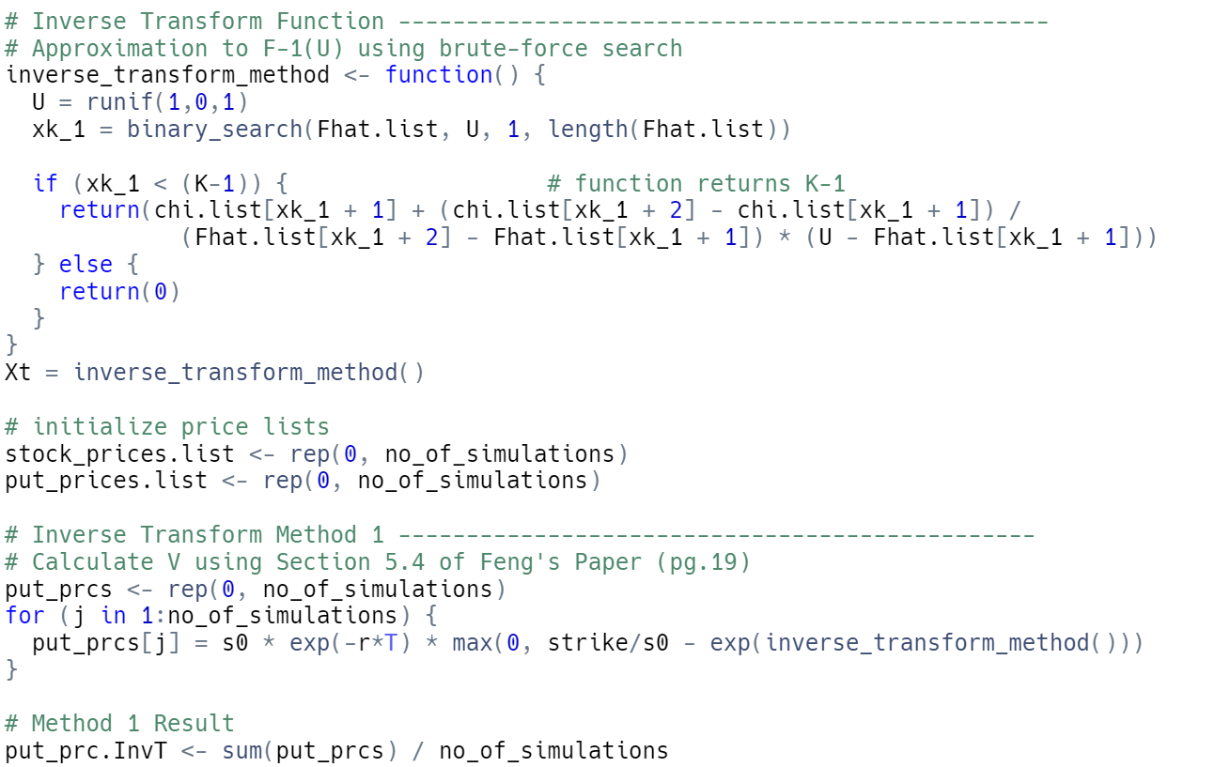

Inverse-Transform Algorithm
Simulating from the distribution of$\hat{F}\left(x\right)$:
$$\left\{\begin{aligned}0, x<x_{0} \\ &{\hat{F}}_{k−1}+\frac{{\hat{F}}_{k}−{\hat{F}}_{k−1}}{η}\left(x−x_{k−1}\right), x_{k−1}<x<x_{k} \\ 1, x≥x_{K}\end{aligned}\right.$$

Slide 6
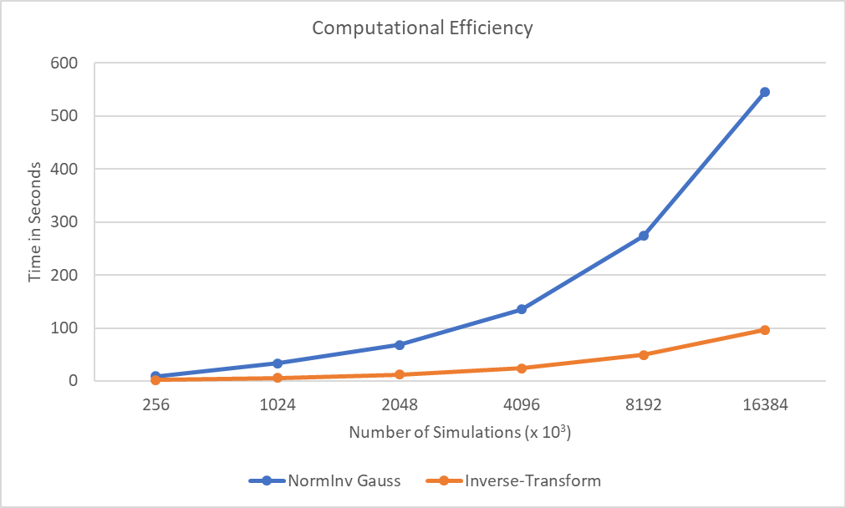
Comparison: Timing Efficiency Plots

Slide 7

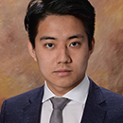

Contact Information
Joseph Loss
loss2@illinois.edu
University of Illinois
MS Financial Engineering
HIRE ME FOR SUMMER!!
Yuchen Duan
yuchend3@illinois.edu
University of Illinois
MS Financial Engineering
HIRE ME FOR SUMMER!!
Daniel Liberman
danliber92@gmail.com
University of Illinois
BS Finance
Back To School…

