Slide 1
Frequency Collision-aware Layout Passes
Sitong Liu
Qiskit Demo Day - Sep 1st 2022
Co-authored-by: Toshinari Itoko itoko@jp.ibm.com
Co-authored-by: Naoki Kanazawa nkanazawa1989@gmail.com
Related PR: #8621

Slide 2
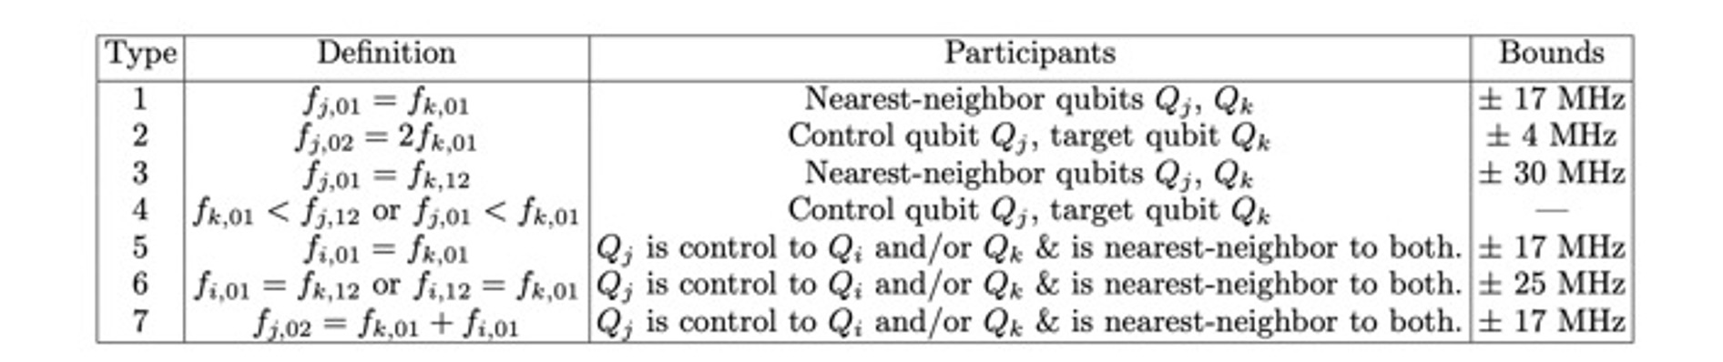
What is frequency collision?
Frequency collision, also known as "frequency crowding", occurs due to the unwanted degeneracy of qubits, which leads to the degradation of control fidelity for native gates in a given architecture.
Types of frequency collisions:
Hertzberg, J.B., Zhang, E.J., Rosenblatt, S. et al. Laser-annealing Josephson junctions for yielding scaled-up superconducting quantum processors. npj Quantum Inf 7, 129 (2021). https://doi.org/10.1038/s41534-021-00464-5
f_{qubit, ij}: Degeneracies among the |0>→|1>, |1>→|2> and |0>→|1> transitions, where i, j = 0,1,2

Slide 3
Type 6
f01(t) = f12(s)
CR(c, t) may induce 1->2 on s when s is 1
➔ CR(c, t) or qubit s is not available
Memo: Avoiding CR(c, t) would be less restrictive than avoiding the use of qubit s
s
c
t
Note: If CR(c, t) implements CX(t, c), CX(t, c) is not available as well as CX(c, t)
Spectator qubit
Control qubit
Target qubit

Slide 4
Background
Why should we care about frequency collision?
Impair one-qubit and two-qubit gate fidelities of the qubits which are affected by frequency collisions.
For example, the effect of frequency collisions involving spectator qubits (e.g. type 6) may not be well reflected in 1- or 2-qubit gate error rates measured by Randomized benchmarking because they only occur when triplet of qubits are used simultaneously.
Thus, by
perform a collision analysis based on calibrations data provided by backends,
construct a frequency collision-aware layout/post layout pass,
we should be able to provide a transpiler pass-based solution that avoids frequency collision when choosing the layout and hopefully, achieves better fidelity.

Slide 5
Background - Staged Pass Manager (0.21.0 released)
A PassManager subclass that enables building a compilation pipeline with defined phases to perform circuit compilation. Each phase is a PassManager object that will get executed in a fixed order. By default instances of StagedPassManager define a typical full compilation pipeline from an abstract virtual circuit to one that is optimized and capable of running on the specified backend.
https://qiskit.org/documentation/stubs/qiskit.transpiler.StagedPassManager.html
The default pre-defined stages are:
init
layout set_layout, VF2Layout, FullAncillaAllocation, etc.
routing StochasticSwap, (post), VF2PostLayout, etc.
translation BasisTranslator, etc.
optimization cx_cancellation, etc.
scheduling DynamicalDecoupling, etc.

Slide 6
Background - Staged Pass Manager
init
pre_laypout - collision analysis pass
layout - VF2LayoutFreqAware pass
routing
post_routing - VF2PostLayoutFreqAware pass
translation
optimization
scheduling

Slide 7
Frequency Collision Analysis Pass
Hertzberg, J.B., Zhang, E.J., Rosenblatt, S. et al. Laser-annealing Josephson junctions for yielding scaled-up superconducting quantum processors. npj Quantum Inf 7, 129 (2021). https://doi.org/10.1038/s41534-021-00464-5

Slide 8
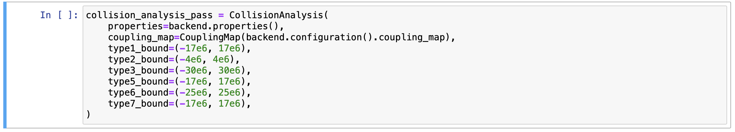
Collision Analysis Pass
Output (in Property set):
'collisions':
…
<CollisionTypes.TYPE5: 'SPECTATOR_F01_F01'>: [Collision(control=7, target=4, spectator=6, lhs=15668817.142080307), Collision(control=7, target=6, spectator=4, lhs=-15668817.142080307)], <CollisionTypes.TYPE6: 'SPECTATOR_F01_F12'>: [], <CollisionTypes.TYPE7: 'SPECTATOR_F02/2_F01'>: [Collision(control=14, target=13, spectator=11, lhs=5535830.592731476)]},
'collision_bound': {<CollisionTypes.TYPE1: 'F01_F01'>: (-17000000.0, 17000000.0), <CollisionTypes.TYPE2: 'CR_F02/2_F01'>: (-4000000.0, 4000000.0), <CollisionTypes.TYPE3: 'F01_F12'>: (-30000000.0, 30000000.0), <CollisionTypes.TYPE5: 'SPECTATOR_F01_F01'>: (-17000000.0, 17000000.0), <CollisionTypes.TYPE6: 'SPECTATOR_F01_F12'>: (-25000000.0, 25000000.0), <CollisionTypes.TYPE7: 'SPECTATOR_F02/2_F01'>: (-17000000.0, 17000000.0)}

Slide 9
Collision Analysis Pass
 | Type 1 | Type 2 | Type 3 | Type 5 | Type 6 | Type 7
ibmq_belem (5) |  |  |  | 1 |  | 1
ibmq_guadalupe (16) |  |  |  |  | 3 | 1
ibmq_montreal (27) |  |  |  | 4
ibmq_toronto (27) |  |  |  | 4
ibmq_kolkata(27) |  |  |  | 1 |  | 1
ibmq_mumbai(27) |  |  |  |  | 1
ibm_hanoi(27) |  |  |  | 1 | 1
ibm_cairo(27) |  |  |  | 1 | 2
ibm_auckland(27) |  |  |  | 1 | 1 | 4
ibm_geneva(27) |  |  |  |  |  | 2
ibm_washington(127) |  |  | 2 | 3 | 1 | 3
* Type4 is omitted here.
Date: 2022/09/01

Slide 10
Layout Algorithm Design
How VF2_layout Pass Works
Build interaction graph from dag (circuit)
If <=max_trial:
Run VF2 to find mappings (as a subgraph isomorphism problem)
score(mapping) #Comparing the score of the current mapping to the existing best mapping
If better:
Replace best mapping
score(mapping, average_error_mapp):
fidelity=1
for single qubit gate:
for each qubit:
fidelity *= (1 – average_single_qubit_error[qubit] ) ** single_gate_count[qubit]
for 2 qubit gate:
gate_count=edge_weight in dag
for each edge:
fidelity *= (1 – average_two_qubit_gate_error[edge] ) ** two_qubit_gate_count[edge]
return 1- fidelity
build_average_error_mapp():
…
error map={qubit: sum(error rate of gates on qubit)/number of gates on qubit (including read out error), [control, target] for edges;

Slide 11
Layout Algorithm Design
Replacing the function for scoring the mapping:
…
def score_layout(avg_error_map, layout, bit_map, reverse_bit_map, im_graph, strict_direction=False):
"""Score a layout given an average error map."""
bits = layout.get_virtual_bits()
fidelity = 1
for bit, node_index in bit_map.items():
gate_count = sum(im_graph[node_index].values())
fidelity *= (1 - avg_error_map[(bits[bit],)]) ** gate_count
for edge in im_graph.edge_index_map().values():
gate_count = sum(edge[2].values())
qargs = (bits[reverse_bit_map[edge[0]]], bits[reverse_bit_map[edge[1]]])
if not strict_direction and qargs not in avg_error_map:
qargs = (qargs[1], qargs[0])
fidelity *= (1 - avg_error_map[qargs]) ** gate_count
return 1 - fidelity
…
with the scoring method calculates the score of the layout based on the frequency collisions exhibited in the current layout.

Slide 12
Layout Algorithm Design
Method for scoring the layout:
zero-one method
If the current layout contains qubits that will occur frequency collision, return 1 (bad score); otherwise, return 0
gate-count method
If the current layout contains qubits that are subject to frequency collision, the fidelity score of the current layout is reduced accordingly to the number of 1-qubit and 2-qubit gates applied to these (affected) qubits.
freq-differ method
If the current layout contains qubits that will occur frequency collision, the fidelity value of the layout is reduced according to the frequency difference/bound value of the collision qubit.

Slide 13
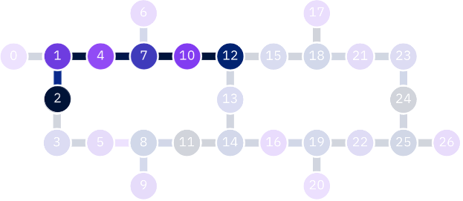
Evaluation
Evaluating with precompiled QV64 circuits
Assumption: If the frequency collision-aware layout pass performs better than the original pass considering only the gate error, the resulting HOP (heavy output probabilities) value should be higher compared to the original pass.
Environment setup:
Transpiler pass to be tested:
VF2PostLayoutFreqAware pass
Circuits for testing:
pre-mapped QV64 circuits using BIP Mapping, physical qubits to be used in the mapping are fixed.

Slide 14
Evaluation
Evaluating with precompiled QV64 circuits
Evaluation Method:
Comparing the obtained HOP values by combining the frequency-aware score and the gate error score with different weights.
Ex. score of layout = frequency_weight * freq-differ score + (1- frequency_weight) * gate-error score
where:
the weight is set between 0 and 1 ([0, 0.25, 0.5, 0.75, 1], for example)
the frequency aware score, gate error score, and the score of layout are all in the range [0,1]

Slide 15
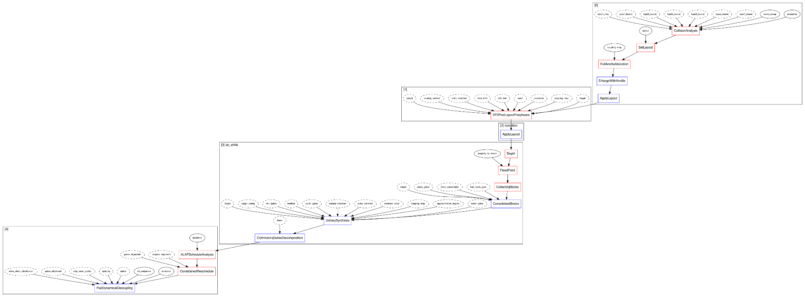
Evaluation
Evaluating with precompiled QV64 circuits
Embed the pre-mapped circuits onto the larger device coupling map
Apply the VF2PostLayoutFreqAware pass to find a better layout after transpilation is complete.
VF2PostLayoutFreqAware pass
Collision analysis pass

Slide 16
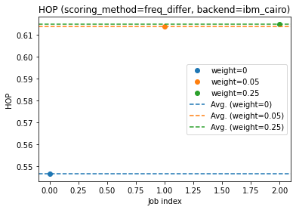
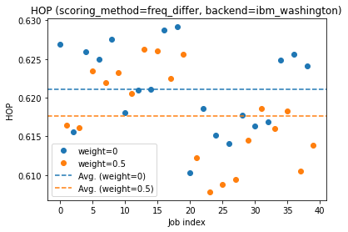
Current Findings:
The algorithm only uses the freq-aware score without considering the gate error did not perform well.
Time variation of HOP was found to be large (about 0.02), and the statistical error should be about 0.001.
When tuning the weight manually, it was found that the results were better than the gate error in some cases (and worse in some cases).
Number of circuits=100 shots=2500
Number of circuits= 300
shots = 2000

Slide 17
Future updates:
Improvement of the algorithms Scoring algorithm:
gate count + freq differ, collision type dependent, etc.
Automatic best weight selection
Future updates in the draft PR (#8621)
Add VF2LayoutFreqAware pass
Add VF2PostLayoutFreqAware pass
Add tests
Improve docs

Slide 18
Reference:
[1] Hertzberg, Jared & Zhang, Eric & Rosenblatt, Sami & Magesan, Easwar & Smolin, John & Yau, Jeng-Bang & Adiga, Vivekananda & Sandberg, Martin & Brink, Markus & Chow, Jerry & Orcutt, Jason. (2021). Laser-annealing Josephson junctions for yielding scaled-up superconducting quantum processors. npj Quantum Information. 7. 129. 10.1038/s41534-021-00464-5.

