Slide 1
Qiskit toqm
Time-optimal qubit mapping for Qiskit

Slide 2
Qiskit TOQM
A new layout and routing pass for Terra.
Impl. of: https://dl.acm.org/doi/10.1145/3445814.3446706
Minimizes overall circuit duration, rather than depth.
Implemented in C++.
Separate add-on Python package: qiskit-toqm
Forks the original reference impl.

Slide 3
Algorithm
Minimizes overall circuit duration.
We need instruction durations for native gates and swaps.
A*-based.
Nodes are partially routed circuits.
Expand node by appending a gate or a swap
Node cost: duration so far + costfunc(remaining).
Determines layout as well.
Optimal or heuristic modes (needed for large circuits).

Slide 4
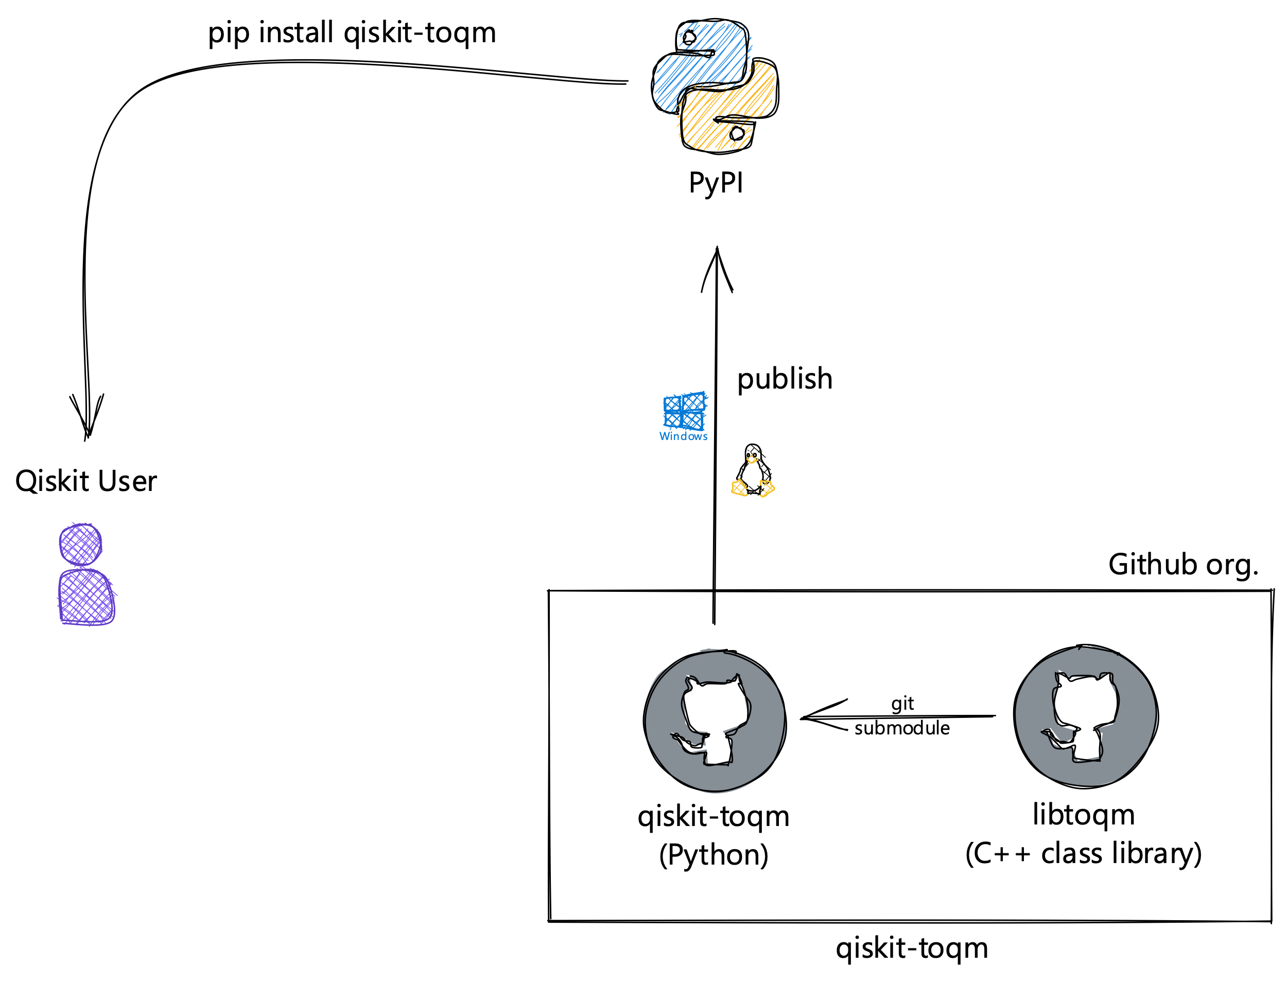
Project Structure

Slide 5
Why separate from Terra?
New layout + routing techniques published often.
Contribute to Qiskit ecosystem without maintainer overhead.
C++
Reusable pattern for C/C++ research code.

Slide 6
Usage
Choices:
Use preset pass manager with opt. level.
Terra 0.21.0
Construct a pass manager.
Fine tune control.

Slide 7
Preset pass manager

Slide 8
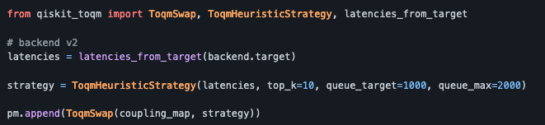
Custom pass manager

Slide 9
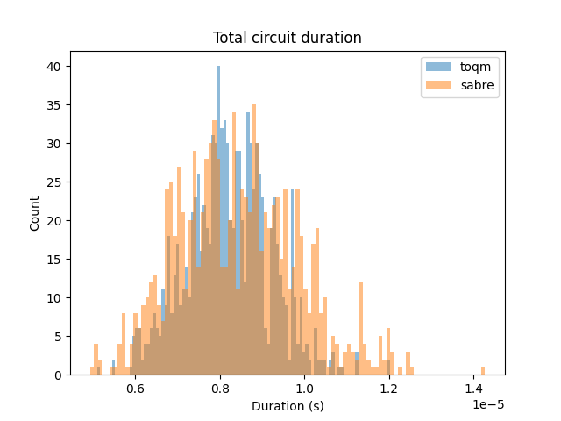
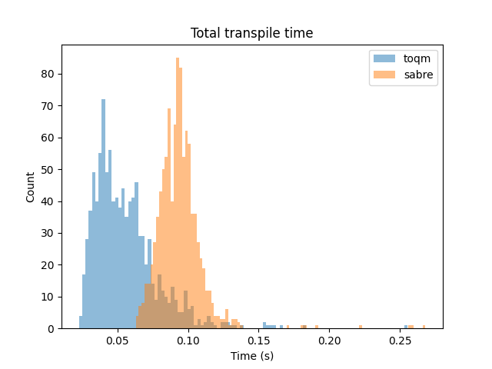
Benchmark
Terra optimization
toqm: level 0
sabre: level 3
1000 QV 256 circuits transpiled to 8Q bi-direction line

Slide 10
Links
Github organization: https://github.com/qiskit-toqm/
Contains qiskit-toqm (Python package) and libtoqm (C++ class lib)
TOQM paper: https://dl.acm.org/doi/10.1145/3445814.3446706

