Slide 1
Approximate Quantum Compiling — 19.08.2021

Slide 2
Approximate quantum compiling
The approximate quantum compiling problem can be stated, for a target U and control V, as
If the control V is written in terms of CNOTs and rotations, this becomes
We focus on particular CNOT structures..
Based on the paper: Liam Madden, Andrea Simonetto, “Best Approximate Quantum Compiling Problems”, https://arxiv.org/abs/2106.05649
A pull request: https://github.com/Qiskit/qiskit-terra/pull/6727

Slide 3
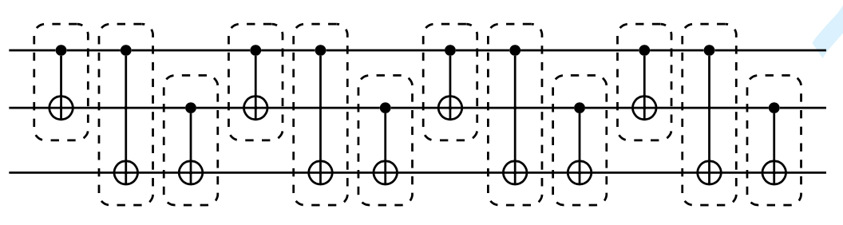

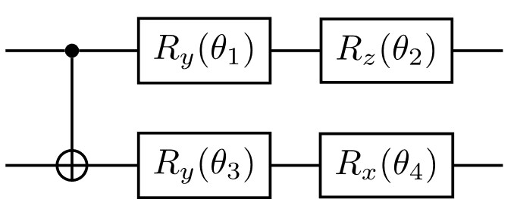
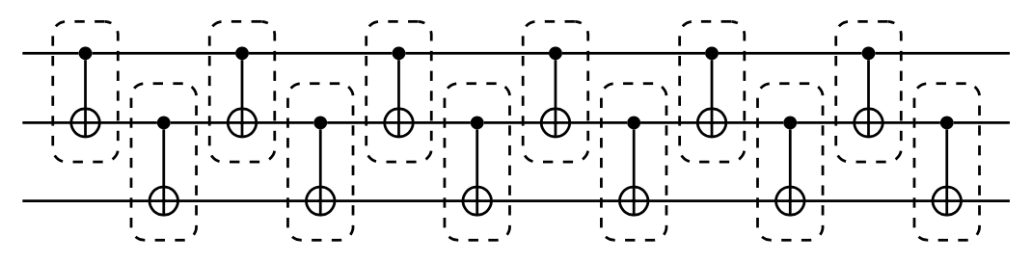
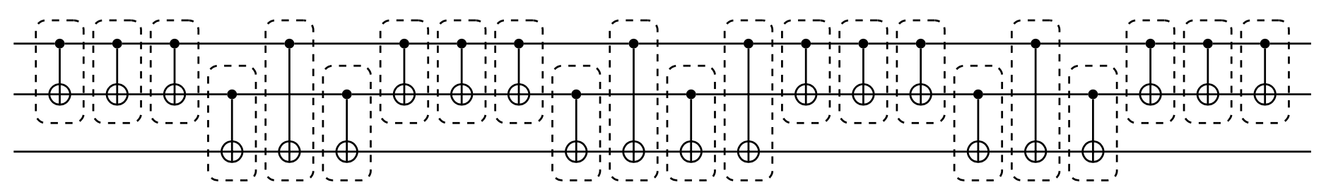
Approximate quantum compiling
Sequential structure:
Spin structure:
Cartan structure:
Each block on the diagrams is a CNOT unit consisting of four gates:

Slide 4
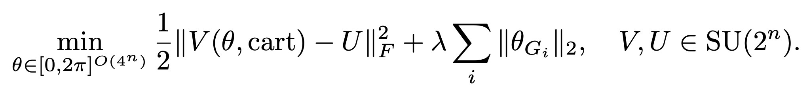
Approximate quantum compiling
Statement. fixing the structure, the problem becomes:
This can be solved via first- or second- order methods because:
The cost is infinitely differentiable
The cost gradient is Lipschitz continuous (Hessian is bounded)
There are strong reasons to believe that stationary points are minima up to a global phase if m is sufficiently large
A group LASSO regularization can be added with the goal of compressing a structure:

Slide 5
Approximate quantum compiling
Example: Multiple-controlled X-gate
Number of qubits | Number of CNOTs | Fidelity | Number of CNOTs in Qiskit exact transpilation*
6 | 10 | 93.9% | 36
7 | 12 | 96.9% | 92
8 | 14 | 98.4% | 188
9 | 16 | 99.2% | 380
10 | 18 | 99.6% | 764
* tqc = transpile(qc, basis_gates=["u1", "u2", "u3", "cx"], optimization_level=3, layout_method="sabre")

