Slide 1
Introducing Tensor Network Simulator on Qiskit Aer
Jun Doi
IBM Quantum, IBM Research – Tokyo
doichan@jp.ibm.com

Slide 2
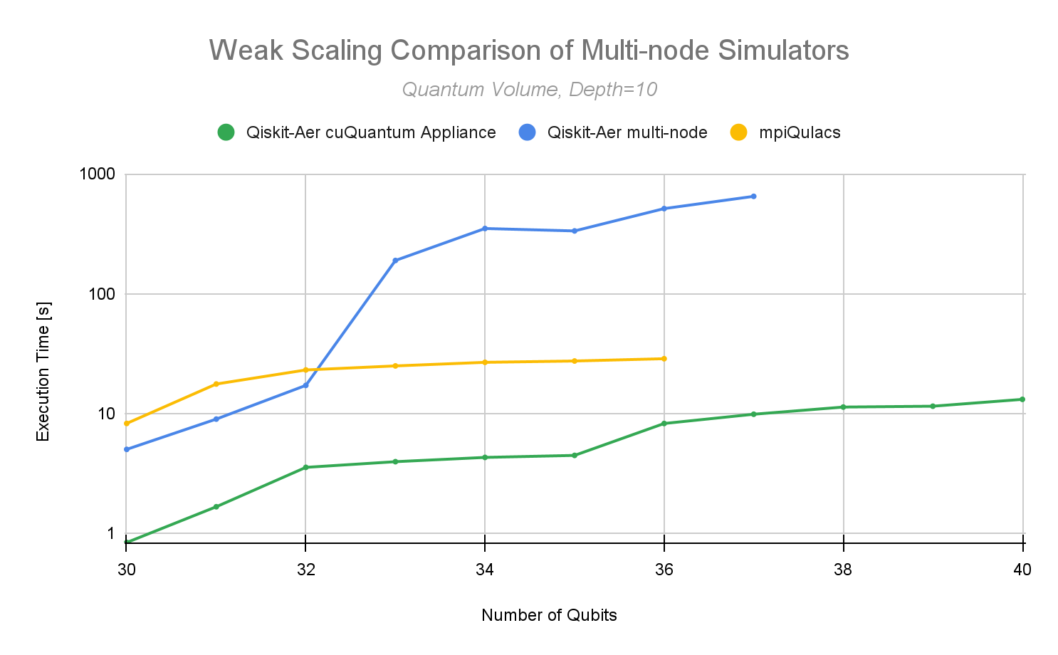
Qiskit Aer cuQuantum support
Accelerated statevector simulations by using NVIDIA’s cuQuantum SDK
https://developer.nvidia.com/blog/best-in-class-quantum-circuit-simulation-at-scale-with-nvidia-cuquantum-appliance/

Slide 3
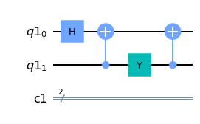
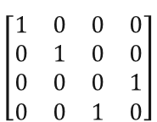
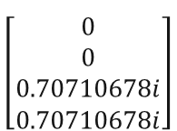

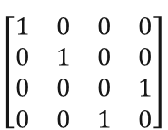


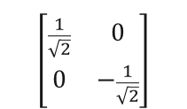
Tensor Network Simulator Overview
Input circuit
Tensor Network
$$\left[\begin{matrix}\frac{1}{\sqrt{2}} & 0 \\ 0 & −\frac{1}{\sqrt{2}}\end{matrix}\right]$$
Output (statevector)
Initial states
$$\left[\begin{matrix}1 & 0 & 0 & 0 \\ 0 & 1 & 0 & 0 \\ 0 & 0 & 0 & 1 \\ 0 & 0 & 1 & 0\end{matrix}\right]$$
$$\left[\begin{matrix}1 & 0 & 0 & 0 \\ 0 & 1 & 0 & 0 \\ 0 & 0 & 0 & 1 \\ 0 & 0 & 1 & 0\end{matrix}\right]$$
$$\left[\begin{matrix}0 \\ 0 \\ 0.70710678i \\ 0.70710678i\end{matrix}\right]$$
$$\left[\begin{matrix}1 & 0\end{matrix}\right]$$
$$\left[\begin{matrix}1 & 0\end{matrix}\right]$$
$$\left[\begin{matrix}0 & −i \\ i & 0\end{matrix}\right]$$
Output can be obtained by contracting tensor network

Slide 4

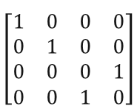





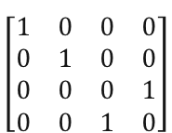


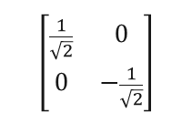
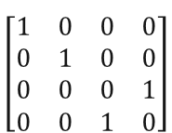
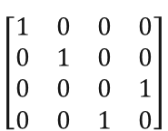







Using Density Matrix Representation
$$\left[\begin{matrix}\frac{1}{\sqrt{2}} & 0 \\ 0 & −\frac{1}{\sqrt{2}}\end{matrix}\right]$$
Output
Initial states
$$\left[\begin{matrix}1 & 0 & 0 & 0 \\ 0 & 1 & 0 & 0 \\ 0 & 0 & 0 & 1 \\ 0 & 0 & 1 & 0\end{matrix}\right]$$
$$\left[\begin{matrix}1 & 0 & 0 & 0 \\ 0 & 1 & 0 & 0 \\ 0 & 0 & 0 & 1 \\ 0 & 0 & 1 & 0\end{matrix}\right]$$
$$\left[\begin{matrix}1 & 0\end{matrix}\right]$$
$$\left[\begin{matrix}0.70710678i & 0.70710678i\end{matrix}\right]$$
$$\left[\begin{matrix}1 & 0\end{matrix}\right]$$
$$\left[\begin{matrix}0 & −i \\ i & 0\end{matrix}\right]$$
Sum of statevector is calculated, but this is not measured probability
Using density matrix to get probabilities (norm of statevector)
$$\left[\begin{matrix}\frac{1}{\sqrt{2}} & 0 \\ 0 & −\frac{1}{\sqrt{2}}\end{matrix}\right]$$
Output (reduced density matrix of qubit 0)
$$\left[\begin{matrix}1 & 0 & 0 & 0 \\ 0 & 1 & 0 & 0 \\ 0 & 0 & 0 & 1 \\ 0 & 0 & 1 & 0\end{matrix}\right]$$
$$\left[\begin{matrix}1 & 0 & 0 & 0 \\ 0 & 1 & 0 & 0 \\ 0 & 0 & 0 & 1 \\ 0 & 0 & 1 & 0\end{matrix}\right]$$
$$\left[\begin{matrix}1 & 0\end{matrix}\right]$$
$$\left[\begin{matrix}0.5 & 0 \\ 0 & 0.5\end{matrix}\right]$$
$$\left[\begin{matrix}1 & 0\end{matrix}\right]$$
$$\left[\begin{matrix}0 & −i \\ i & 0\end{matrix}\right]$$
Hermitian tensor network
Trace of reduced density matrix is measured probabilities
$$\left[\begin{matrix}\frac{1}{\sqrt{2}} & 0 \\ 0 & −\frac{1}{\sqrt{2}}\end{matrix}\right]$$
$$\left[\begin{matrix}1 & 0 & 0 & 0 \\ 0 & 1 & 0 & 0 \\ 0 & 0 & 0 & 1 \\ 0 & 0 & 1 & 0\end{matrix}\right]$$
$$\left[\begin{matrix}1 & 0 & 0 & 0 \\ 0 & 1 & 0 & 0 \\ 0 & 0 & 0 & 1 \\ 0 & 0 & 1 & 0\end{matrix}\right]$$
$$\left[\begin{matrix}1 & 0\end{matrix}\right]$$
$$\left[\begin{matrix}1 & 0\end{matrix}\right]$$
$$\left[\begin{matrix}0 & i \\ −i & 0\end{matrix}\right]$$
So we can simulate using both statevector and density matrix methods in tensor network method

Slide 5
How to Use Tensor Network Simulator
Build from source
1) Install required software
CUDA toolkit (https://developer.nvidia.com/cuda-toolkit)
cuQuantumSDK (https://developer.nvidia.com/cuquantum-sdk)
cuTENSOR (https://developer.nvidia.com/cutensor)
2)Build Qiskit Aer with cuQuantum support
python ./setup.py bdist_wheel -- -DAER_THRUST_BACKEND=CUDA -DCMAKE_VERBOSE_MAKEFILE=true -DAER_DEBUG=false -DAER_MPI=false -DCMAKE_CUDA_FLAGS=-std=c++14 -DAER_CUDA_ARCH=“7.0” -DCUQUANTUM_ROOT=/home/doichan/cuQuantum/cuquantum -DCUTENSOR_ROOT=/home/doichan/cuTENSOR/cuTENSOR -DAER_ENABLE_CUQUANTUM=true --
Run tensor network simulator
sim = AerSimulator(method='tensor_network', device='GPU')
device=‘CPU‘ is not supported currently

Slide 6
Simulating QAOA by Tensor Network
Simulating QAOA circuit with expectation values
Using NVIDIA Tesla V100 (32GB)

Slide 7
What is Good Application for Tensor Network Simulator ?
Small number of entanglements
Size of tensor for network contraction is depending on complexity of circuit
Small number of branches
Multi-shots simulation takes very long time
Without measure / sampling measure
Expectation values is very fast ☺
So what is good application?
It is similar to circuit cutting / knitting

