Slide 1




Qiskit Advocate Mentorship Program #20 Implement new features and improve documentation in Operators
Mentor:
Ikko Hamamura
Mentees:
Daiki
Murata
Yuma
Nakamura
Kazumasa Umezawa

Slide 2
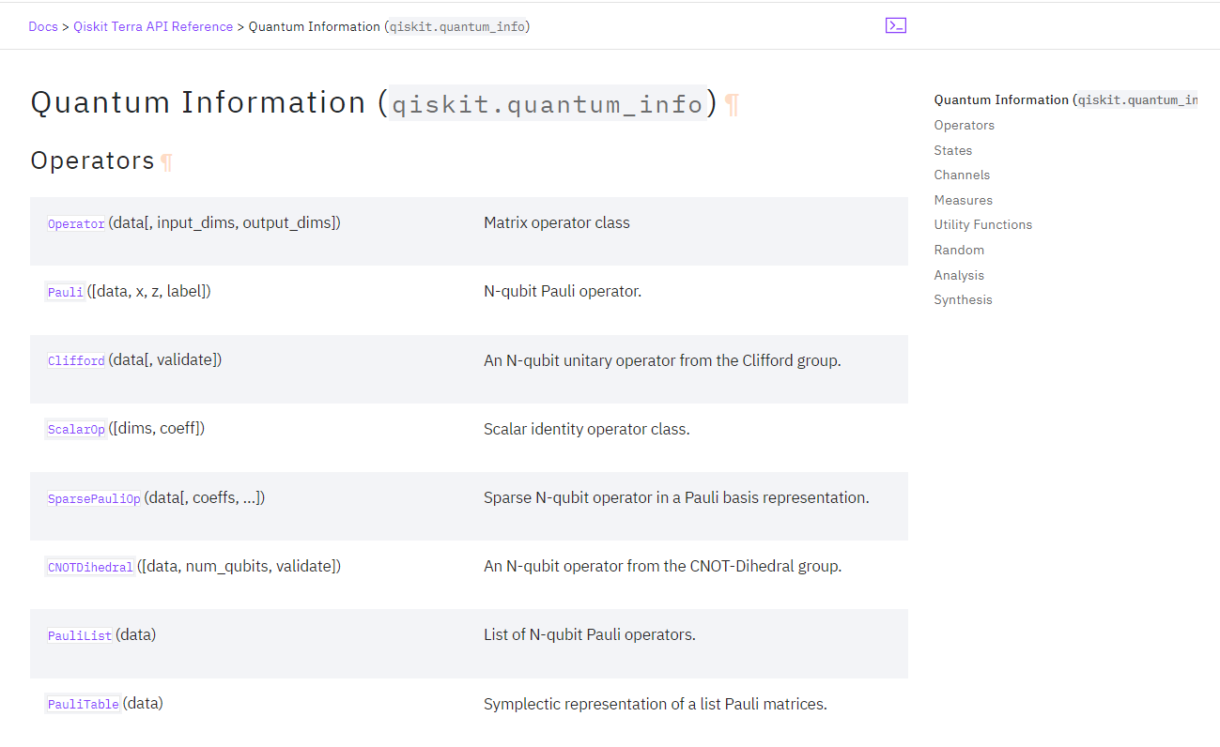
Make code contribution around Operators
https://github.com/qiskit-advocate/qamp-spring-22/issues/20#issuecomment-1114189001
No. | Member | Summary
1 |  | Alias BaseOperator._matmul _ to BaseOperator.dot
2 |  | Alias BaseOperator._mul _ to BaseOperator._multiply_
3 |  | Check input label SparsePauliOp
4 |  | Remove deprecated classes and methods
5 |  | Implement argsort and sort method to SparsePauliOp
6 |  | Investigation to improve the performance of to_matrix ()
7 |  | Implement general grouping of PauliOp/SparsePauliOp by commutation
8 |  | Investigation to improve the performance of time evolution of Ops

Slide 3
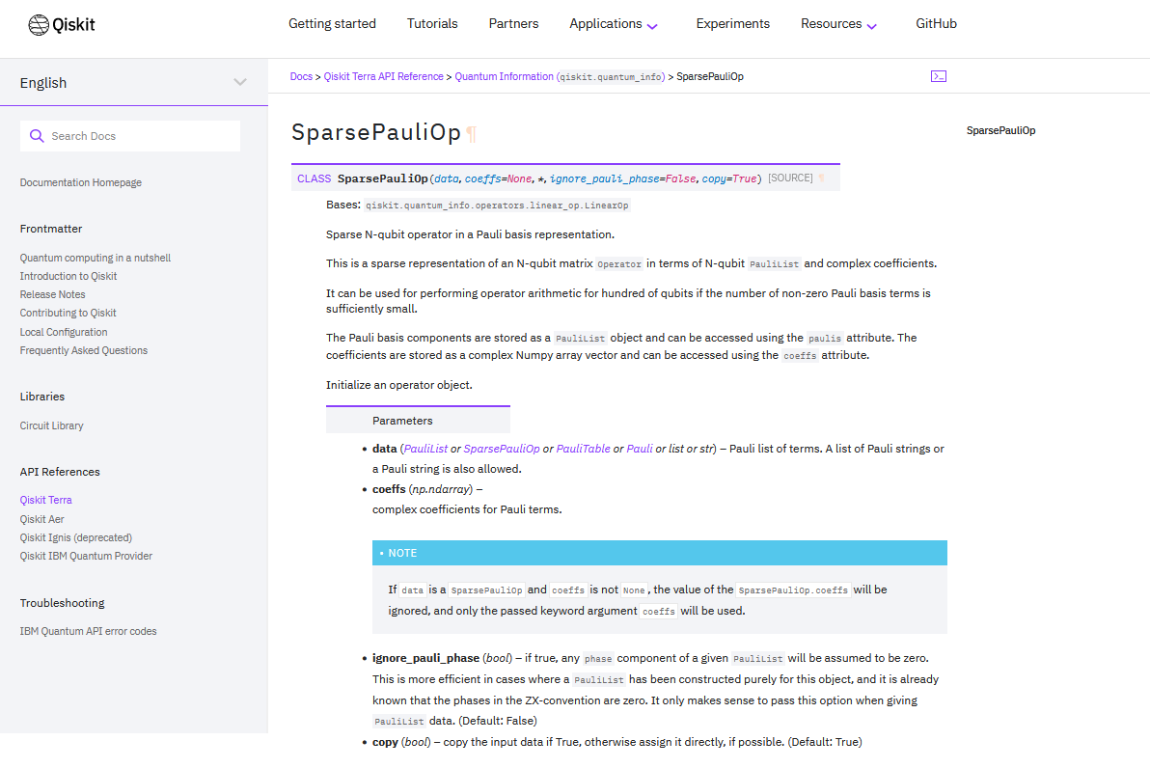
Implement argsort and sort method to SparsePauliOp
【SparsePauliOp】
This is a sparse representation of an N-qubit matrix Operator in terms of N-qubit PauliList and complex coefficients.
【Motivation】
PauliList has argosort() method and sort() method .
We need these features in SparcePauliOp .
【Done】
Added two methods for the following functions to SparsePauliOp.
Added 7 cases of tests related to them.
sent a pull request.
https://github.com/Qiskit/qiskit-terra/pull/8016

Slide 4
Features of SparcePauliOp sort
【 Features of SparcePauliOp sort 】
After sorting the coefficients using numpy's argsort, sort by Pauli.
SparsePauliOp
label
coeffs
XX
2.+1.j
XX
2.+2.j
XX
3.+0.j
YI
3.+0.j
II
4.+0.j
XZ
5.+0.j
XY
6.+0.j
XI
7.+0.j
Lexicographically sorted
Weight sorted
sort()
sort(weight=True)
SparsePauliOp
SparsePauliOp
label
coeffs
II
4.+0.j
XI
7.+0.j
XX
2.+1.j
XX
2.+2.j
XX
3.+0.j
XY
6.+0.j
XZ
5.+0.j
YI
3.+0.j
label
coeffs
II
4.+0.j
XI
7.+0.j
YI
3.+0.j
XX
2.+1.j
XX
2.+2.j
XX
3.+0.j
XY
6.+0.j
XZ
5.+0.j
If Pauli is the same, it will be sorted by coefficient.
If Pauli is the same, it will be sorted by coefficient.

Slide 5
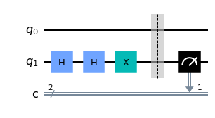
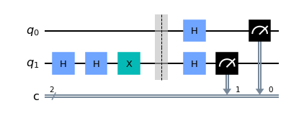


Efficient Evaluation of Observable
Background Evaluation of observable requires multiple measurement, where commutating observable can be evaluated simultaneously (grouping).
e.g. H = <I@Z> + <X@X> + <I@X> can be evaluated only by calculating <I@Z> and <X@X>
$$U_{φ}$$
$$U_{φ}$$
Measurement for <I@Z>
Measurement for <X@X>
Notes:
My contribution is efficient evaluation of observable by grouping operators.
In quantum chemistry, especially VQE, requires a number of evaluations of expectation.
If some of observables are commutating each other, we can apply simultaneous measurement.
It can be done by grouping operators according to commutation.
For example, let Hamiltonian be I@Z, X@X and I@X.
Since X@X and I@X are commuting, this evaluation only need to calculate I@Z, X@X

Slide 6
Efficient Evaluation of Observable
Background Evaluation of observable requires multiple measurement, where commutating observable can be evaluated simultaneously (grouping).
e.g. H = <I@Z> + <X@X> + <I@X> can be evaluated only by calculating <I@Z> and <X@X>
Existing Grouping Algorithm
New Algorithm
qubit-wide commutation is inspected
General commutating rule is employed
Inspect
Inspect (entirely)
<I@Z> <X@X> <I@X>
<X@X> <Y@Y>
Inspect
<X@X> and <Y@Y> are commutating but qubit-wise commutating rule cannot detect!!
Notes:
Existing implementation only check qubit wise commutation. However this method is not equals to general commutation rule.
On my implementation, general commutation is evaluated efficiently.
These two implementation makes difference when we consider X@X and Y@Y commutation, where qubit-wise commutation results in incorrect commutation

Slide 7
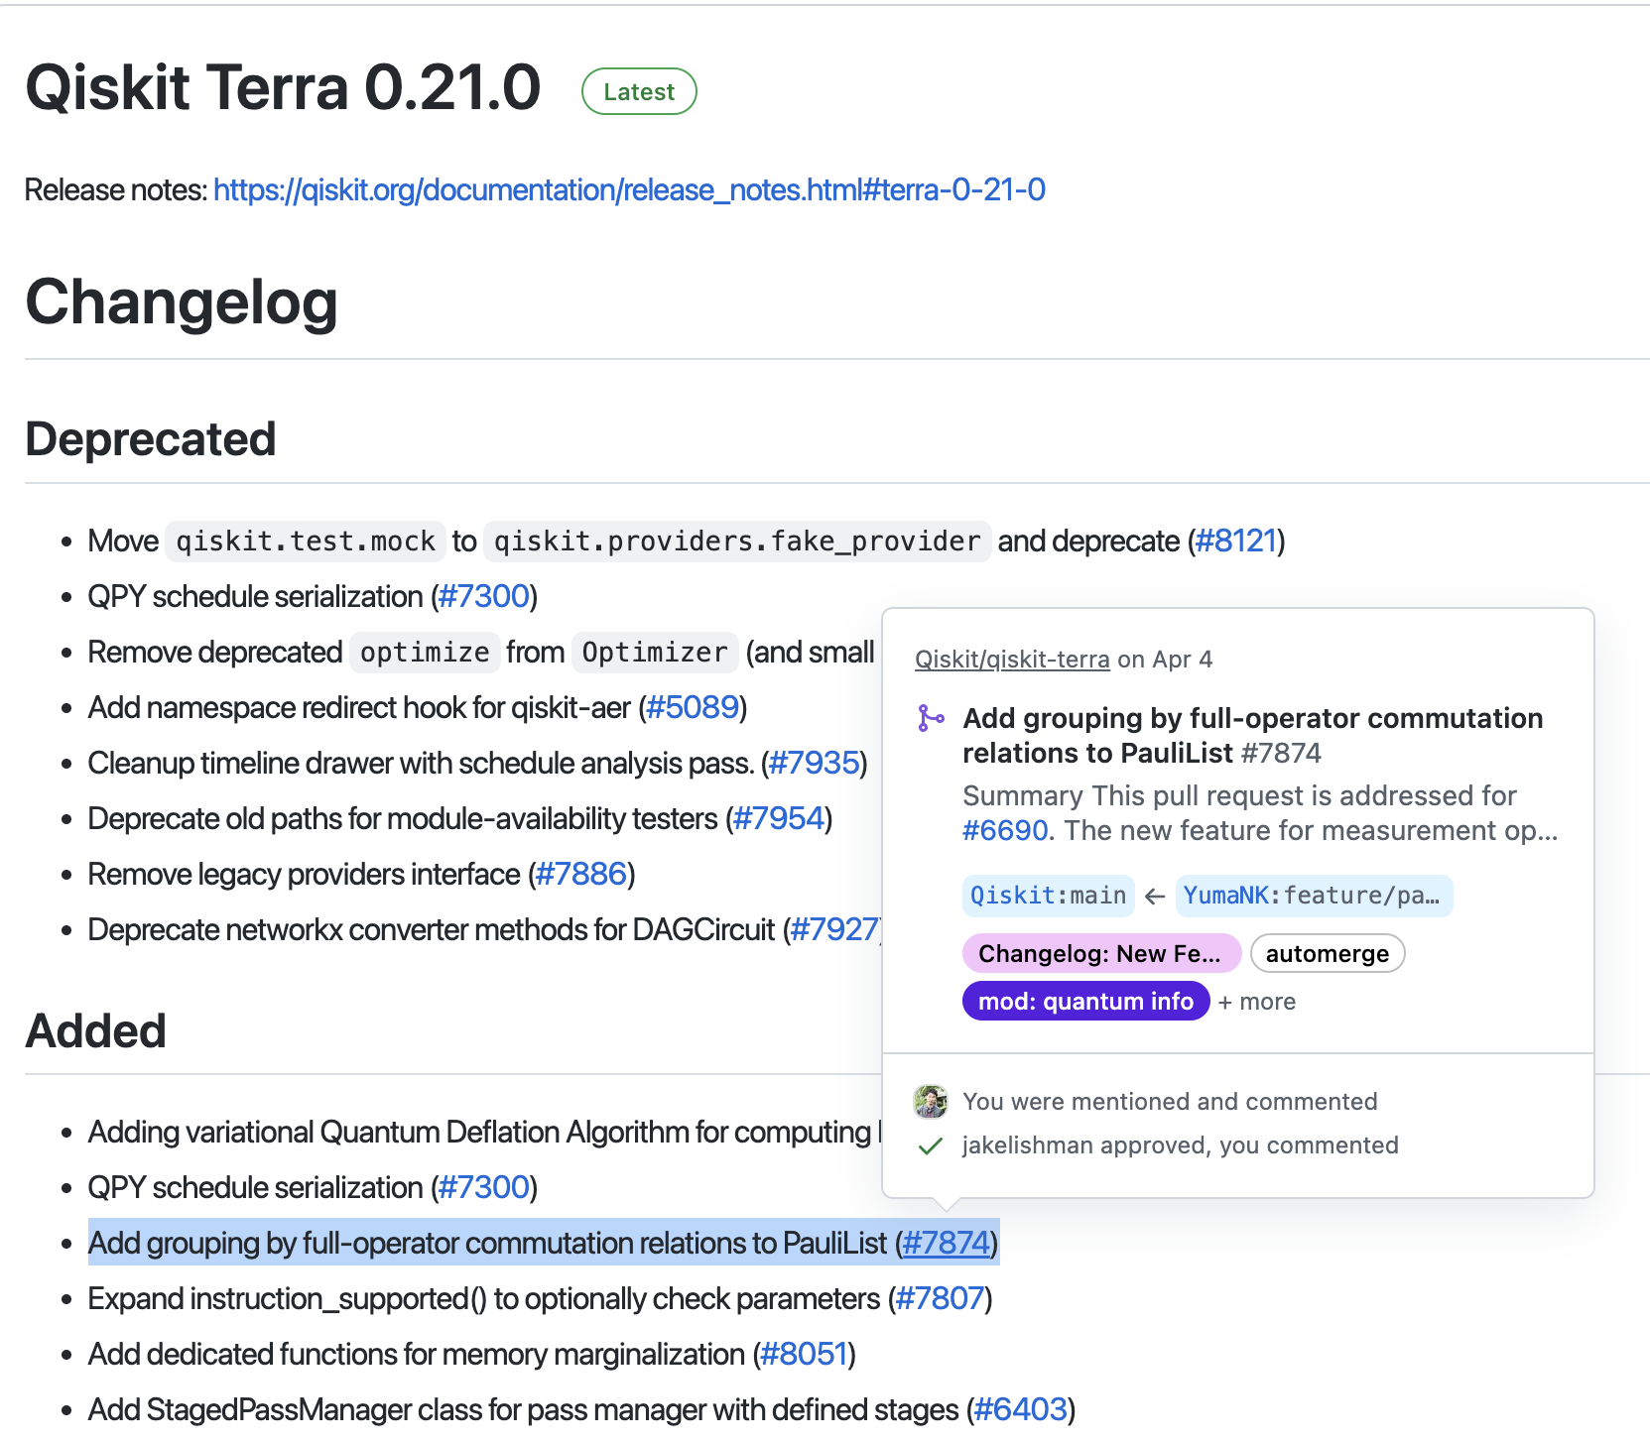
This feature become available at Terra 0.21
https://github.com/Qiskit/qiskit-terra/releases
Notes:
This new feature is now merged to main branch last month so that you can use it from Terra 0.21.
You can see more detail on ReleaseNote or documentation page.

Slide 8
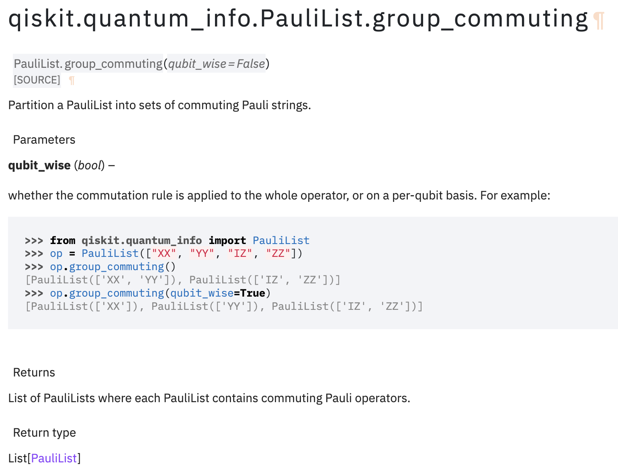
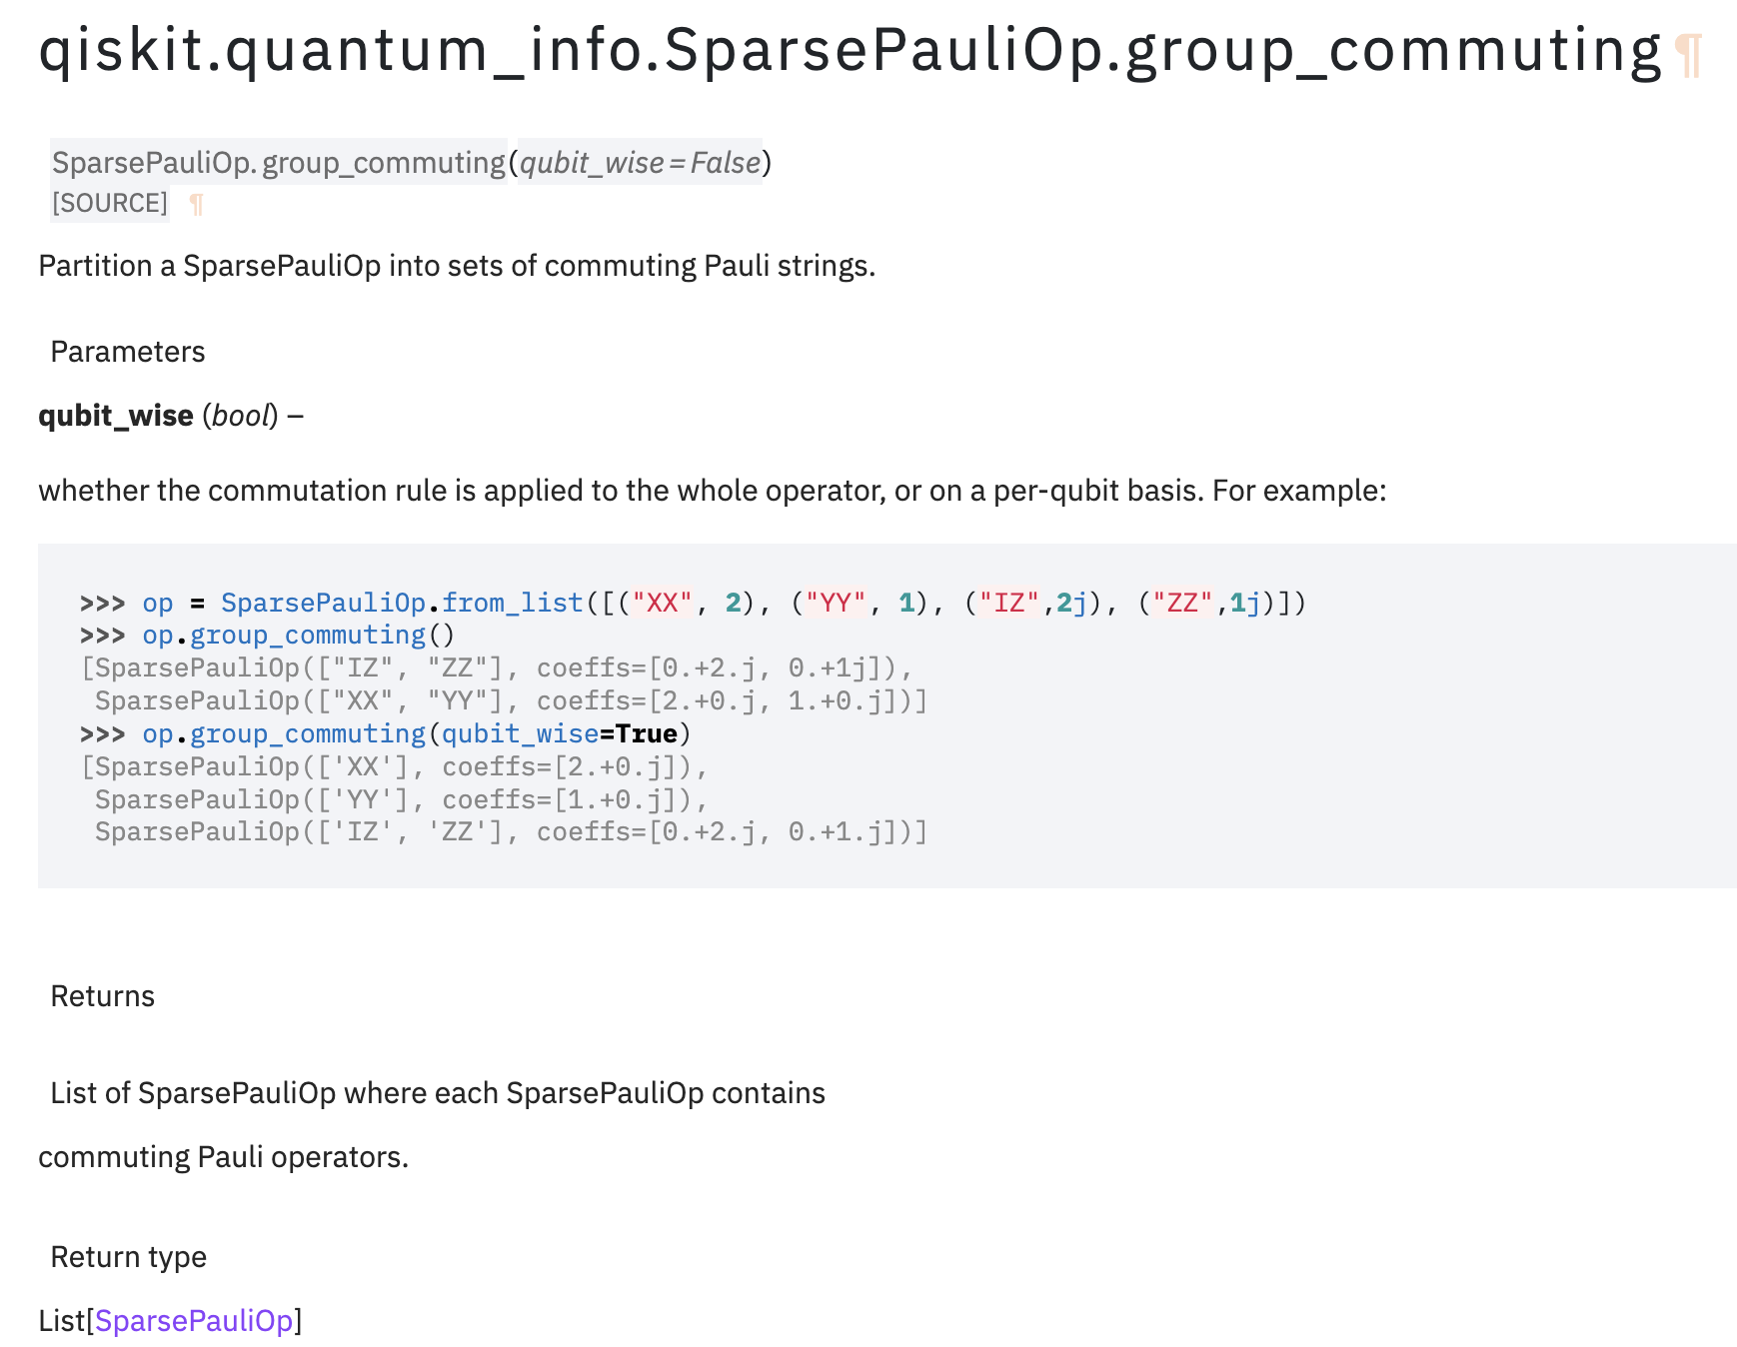
This feature become available at Terra 0.21
https://qiskit.org/documentation/stubs/qiskit.quantum_info.PauliList.group_commuting.html
https://qiskit.org/documentation/stubs/qiskit.quantum_info.SparsePauliOp.group_commuting.html
Notes:
The grouping feature is implemented as the name of group_commuting in the class of PauliList and SparsePauliOp.
You can see that entire commuting rule results in smaller number of groups compared to qubitwise commuting.

Slide 9

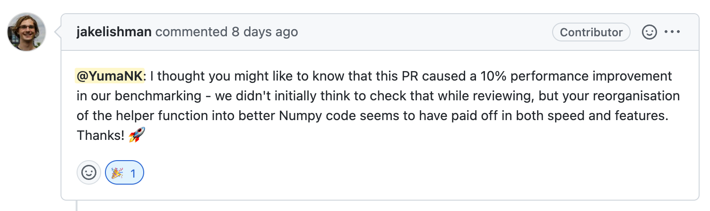
This feature become available at Terra 0.21
: :
Notes:
In addition to my mentor Ikko, Jake reviewed my pull request and advised about readable coding especially numpy operation.
Thanks to his kind help, we achieved clear performance improvement of 10%.

Slide 10
Efficient Evaluation of Observable
Impact
Grouping observable reduce the number of required measurement.
Its reduction contributes to faster VQE.
Molecule | Transformation | Number of Groups
Molecule | Transformation | No-grouping | Qubit-wide Commutation | General Commutation
LiH | JW | 631 | 136 | 35
 | Parity |  | 165 | 35
 | BK |  | 211 | 35
BeH₂ | JW | 1150 | 215 | 58
 | Parity |  | 323 | 58
 | BK |  | 341 | 58
H₂O | JW | 1858 | 380 | 84
 | Parity |  | 495 | 82
 | BK |  | 515 | 82
NH₃ | JW | 4973 | 1052 | 117
 | Parity |  | 1091 | 115
 | BK |  | 1086 | 115
HCl | JW | 4427 | 906 | 110
 | Parity |  | 1098 | 112
 | BK |  | 1434 | 112
Pull Request (merged) → https://github.com/Qiskit/qiskit-terra/pull/7874
*value referenced from Ikko Hamamura and Takashi Imamichi, npj Quant. Info. 6, 56 (2020)
Notes:
As the use case of this feature, we expect that we are able to reduce calculation of VQE 20 times smaller.
Here I will show it in short demo taking the example of Qiskit Challenge 2022 exercise 4.

Slide 11
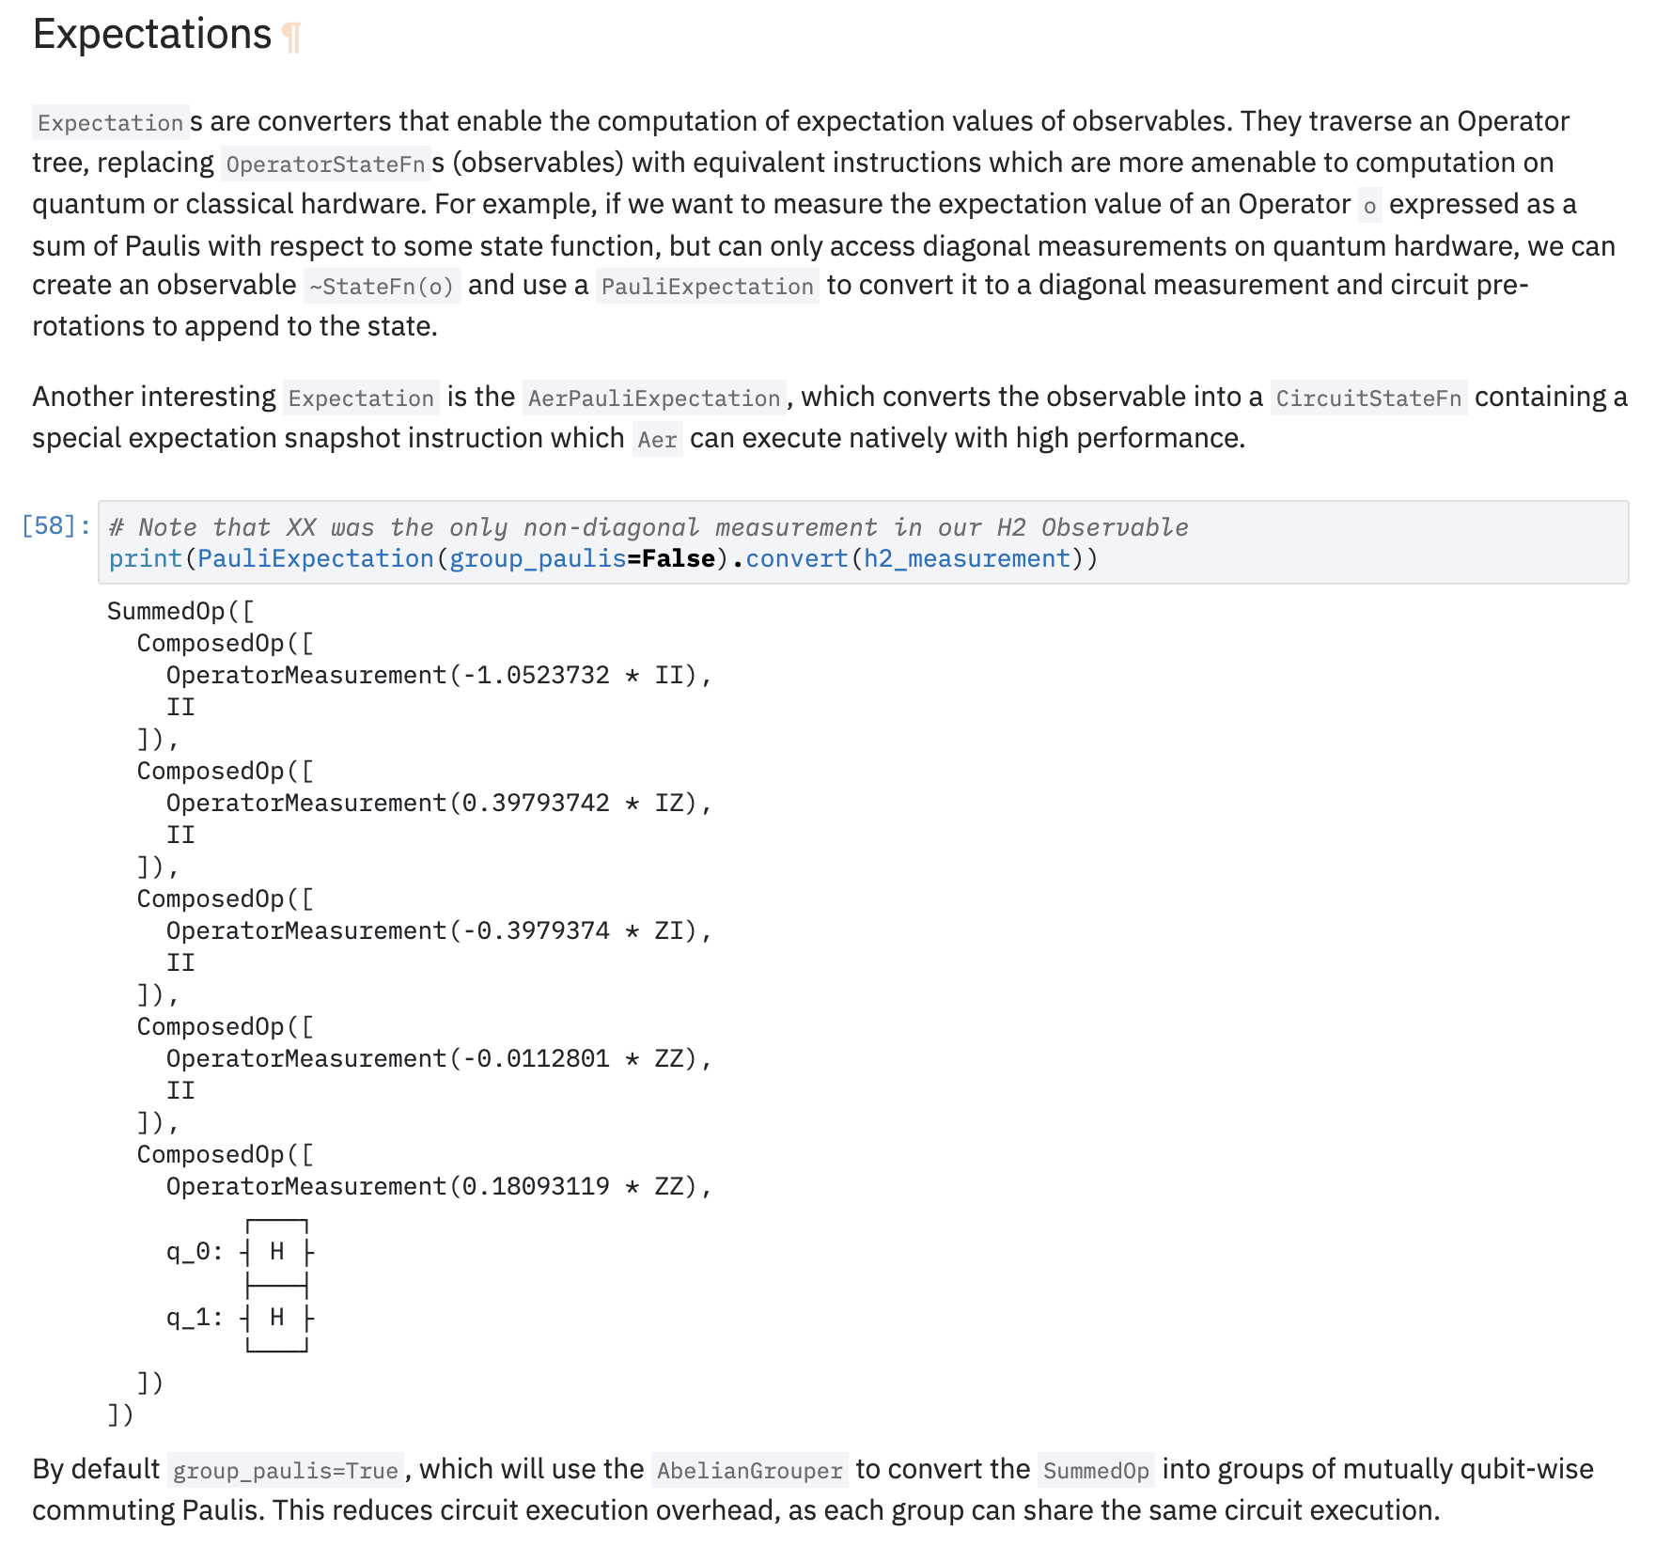
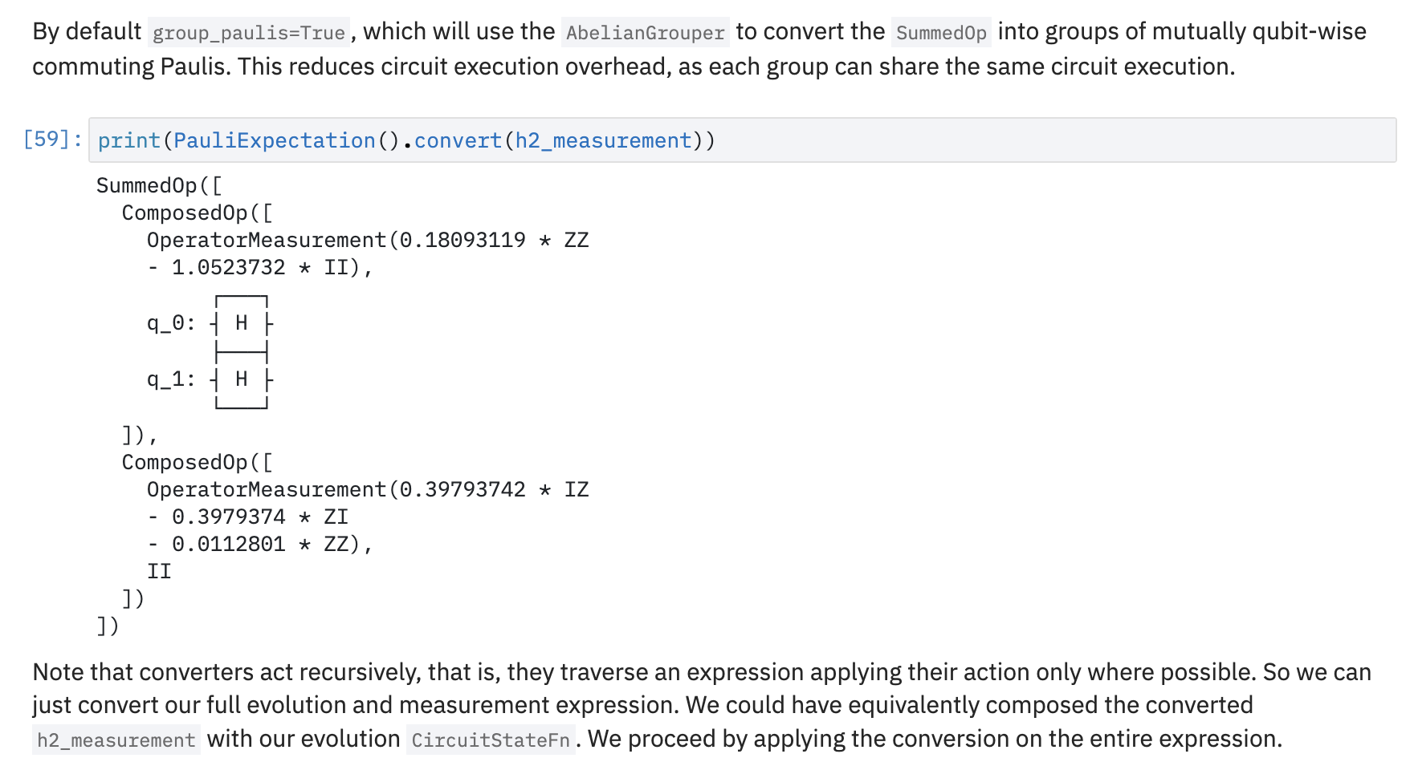
Future Work
Our work could apply to AbrianGrouper in optflow, since AbrianGrouper still uses qubit-wise commutation
https://qiskit.org/documentation/tutorials/operators/01_operator_flow.html
Notes:
Let me mention the future work.
This is the tutorial page of operator_flow class.
In this tutorial, AbrianGrouper option is used to reduce calculation.
I found that the internal algorithm still use qubit-wise commutation, meaning that my algorithm can come into play.
I am planning switching this algorithm into my developed algorithm.

Slide 12
Summary
We are aiming to contribute Qiskit.quantum_info
Alias of BaseOperator
Sort Pauli operators
Grouping Pauli operator for simultaneous measurement
Our contributions will appear on github pull-request soon!!
Notes:
Here is a summary of our work.
We have contributed Qiskit Github especially for quantum_info module.
Our derivable are implementation of Alias of BaseOperator, sorting Pauli operators, and grouping Pauli Operator for simultaneous measurement. Our contribution will appear on qiskit-terra in future version.

Slide 13
Thank you

