Slide 1
Software design overview

Slide 2
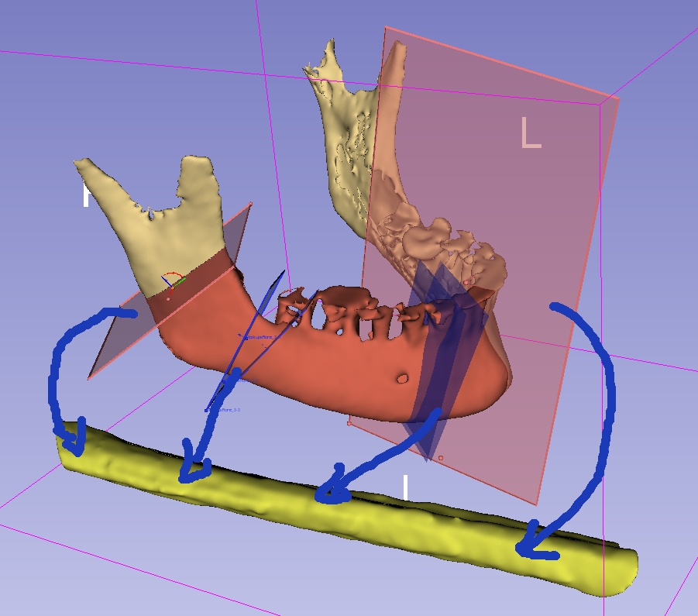
MandibleCutPlanes (multiple)
(center is snapped to MandibleCurve)
vtkMRMLMarkupsPlaneNode
Phase 1:
Segment mandible and fibula
Define MandibleCurve
Define FibulaLine axis and front direction
Define 3-6 planes along the MandibleCurve
Phase 2:
Generate cutting guide
Phase 3:
Blood vessel visualization
MandibleSegmentation
vtkMRMLSegmentationNode
1
y
y
MandiblePlaneStraight
MandibleCurve
(curve outside the bone, surface)
vtkMRMLMarkupsCurveNode
MandiblePlane
2
x
3
x
4
z
x
z
1
2
FibulaLine
(straight line on the surface of the fibula)
vtkMRMLMarkupsLineNode
Fibula
z
2
3
4
y
3
FibulaCutPlanes (multiple)
(placed automatically, based on MandibleCurve and MandibleCutPlanes)
vtkMRMLMarkupsPlaneNode
FibulaSegmentation
vtkMRMLSegmentationNode

Slide 3
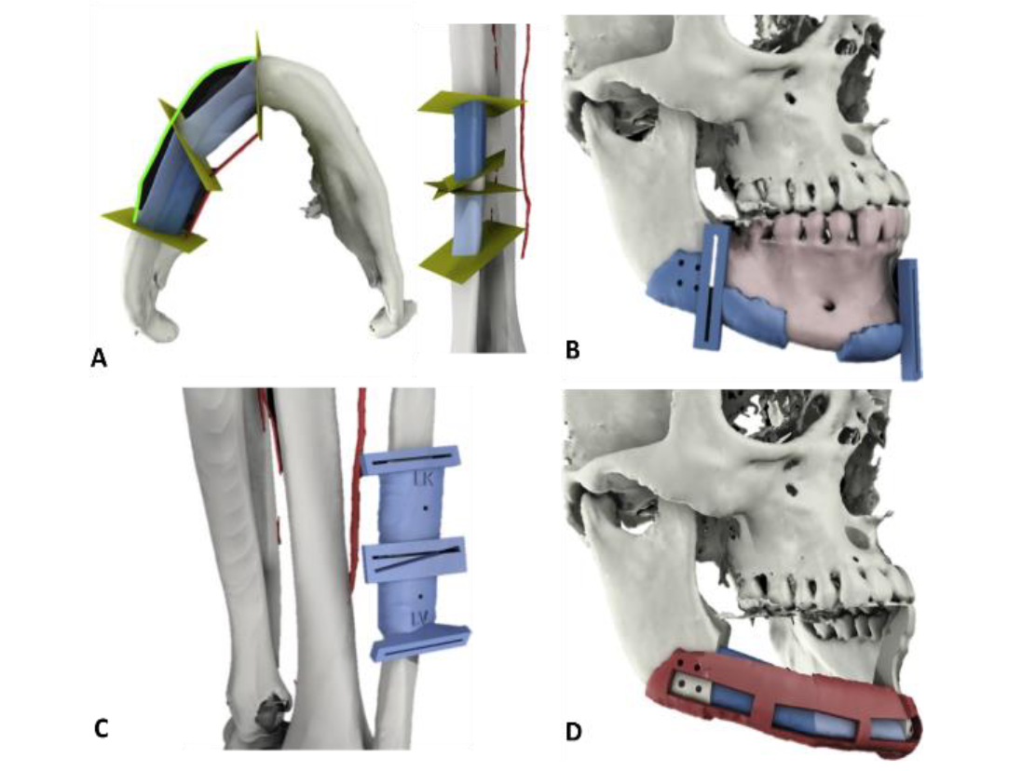

Slide 4
Coordinate systems
CurvePointAxisAtPoint(i): axis given by the function GetCurvePointToWorldTransformAtPointIndex
Origin: i
X: given by the function
Y: given by the function
Z: tangent of mandible curve, from start to end direction (given by the function)
AxisAtMandiblePlaneStraightOrigin = CurvePointAxisAtPoint(MandiblePlaneStraightOrigin)
MandiblePlaneStraight: plane aligned with anatomy (mandible curve)
Origin: MandiblePlaneStraightOrigin
X: AxisAtMandiblePlaneStraightOrigin(Y)  AxisAtMandiblePlaneStraightOrigin(Z), approximate lingual direction
Y: AxisAtMandiblePlaneStraightOrigin(Z)  posterior direction, approximate superior direction
Z: AxisAtMandiblePlaneStraightOrigin(Z), tangent of mandible curve in crescent direction
MandiblePlane: slightly rotated MandiblePlaneStraight
Origin: cutting plane position
X, Y, Z: cutting plane X, Y, normal
StartMandibleCurvePoint
MandibleCurve
CurvePointAxisAtPoint(i)
i
x
MandiblePlaneStraight
y
y
z
y
x
MandiblePlaneStraightOrigin
x
z
MandiblePlane
z
EndMandibleCurvePoint

Slide 5
Segment angle 0
mandibleAxis0ToFibulaRotationTransform: Rotation from mandibleAxis0 to Fibula
mandibleAxis0
Segment angle 1
mandibularPlanesList = [MandiblePlane0, MandiblePlane1, …]
fibulaPlanesList = [FibulaPlane0A, FibulaPlane0B, FibulaPlane1A, FibulaPlane0B, …]
y
x
Mandible plane 0
Mandible Line 0
middleAxis
y
z
x
Mandible Line 1
Mandible plane 2
z
Mandible plane 1
Segment angle 1
Coordinate systems
mandibleAxis0:
Origin: MandiblePlane0Origin
X: mandiblePlane0(Y)  Z
Y: Z  X
Z: mandibleLine0 direction
middleAxis:
Origin: MandiblePlane1Origin
X: mandiblePlane1(Y)  Z
Y: Z  X
Z: (mandibleLine0 + mandibleLine1) direction
Segment angle 0
y
x
Fibula plane 0B
Fibula plane 1A
z
Fibula
Bone segment 0
Bone segment 1
Fibula plane 0A
Fibula plane 1

Slide 6
Fibula:
Origin: StartPoint
X: medial direction (Zposterior for left fibula) (Zanterior for right fibula)
Y: ZX (anterior direction for left fibula) (posterior direction for right fibula)
Z: fibulaLineDirection
FibulaPlane0A: rotated and translated mandiblePlane0
Origin: FibulaPlane0AOrigin (defined by a distance to the StartPoint set up by the user)
X: orthogonal to Z, approximately orthogonal to FibulaY
Y: orthogonal to Z and X
Z: cutting plane normal
FibulaPlane0B: rotated and translated mandiblePlane1
Origin: FibulaPlane0BOrigin (defined FibulaPlane0AOrigin plus distance between MandiblePlane0 and MandiblePlane1)
X: orthogonal to Z, approximately orthogonal to FibulaY
Y: orthogonal to Z and X
Z: cutting plane normal
IntersectionAxis: Axes where all the fibulaPlanes are translated to calculate the intersection with the FibulaModel
Origin: GUI defined point over the FibulaLine
X: same as FibulaX
Y: same as FibulaY
Z: same as FibulaZ
y
y
y
x
x
y
x
z
z
z
FibulaLine
StartPoint
EndPoint
Fibula
z
x
IntersectionAxis
FibulaPlane0A
FibulaPlane1A

Slide 7
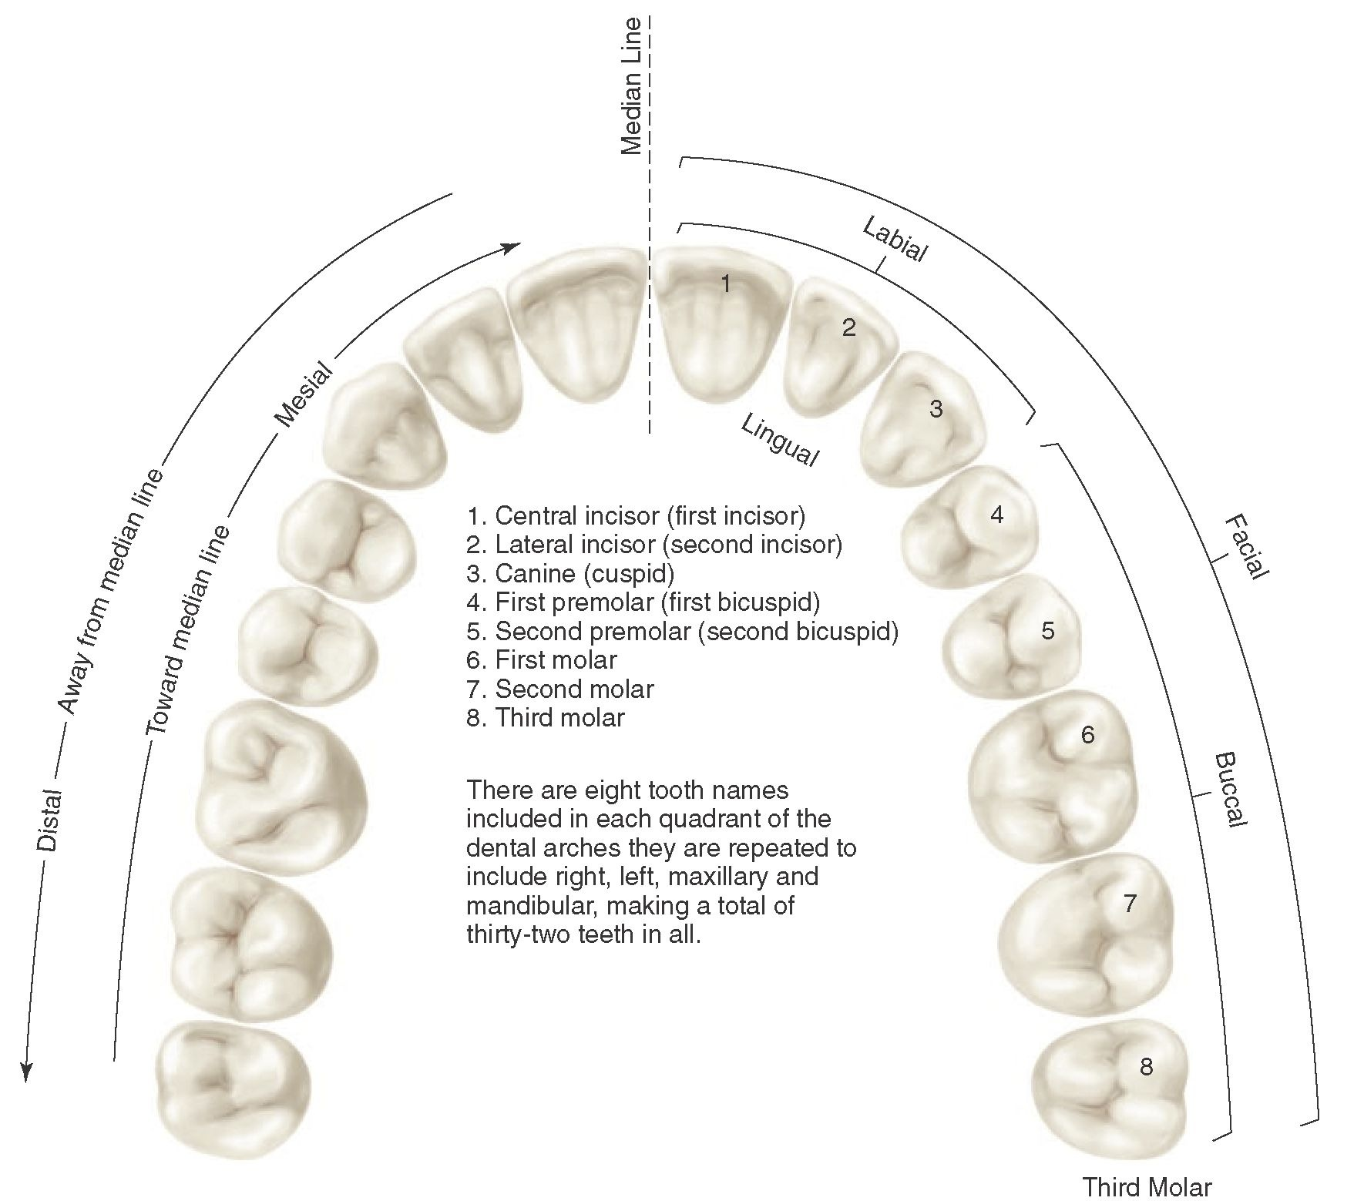

Slide 8
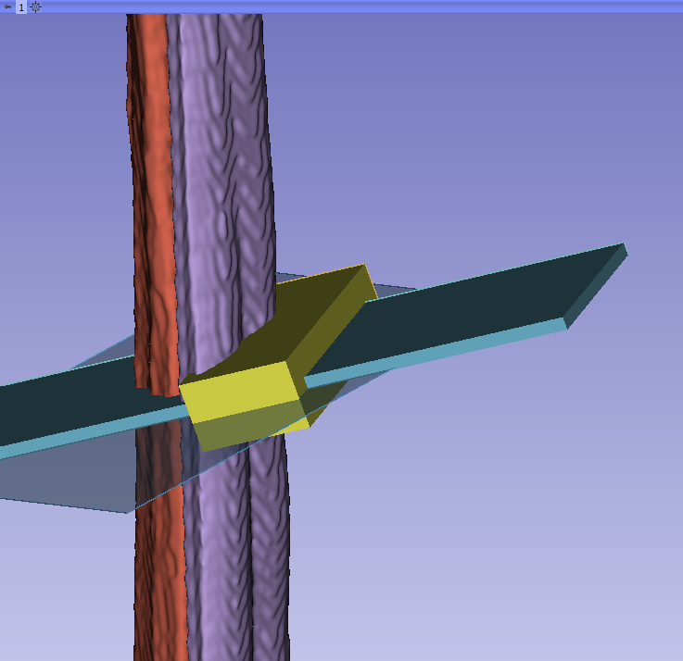
Surgical Guide Generation parameters definition
slotWall
miterBoxLength
biggerMiterBoxLength
biggerMiterBoxHeight
miterBoxWidth
biggerMiterBoxWidth

Slide 9
miterBoxWidth = miterBoxSlotWidth+2*clearanceFitPrintingTolerance miterBoxLength = miterBoxSlotLength miterBoxHeight = 70 biggerMiterBoxWidth = miterBoxSlotWidth+2*clearanceFitPrintingTolerance+2*slotWall biggerMiterBoxLength = miterBoxSlotLength+2*slotWall biggerMiterBoxHeight = miterBoxSlotHeight

Slide 10
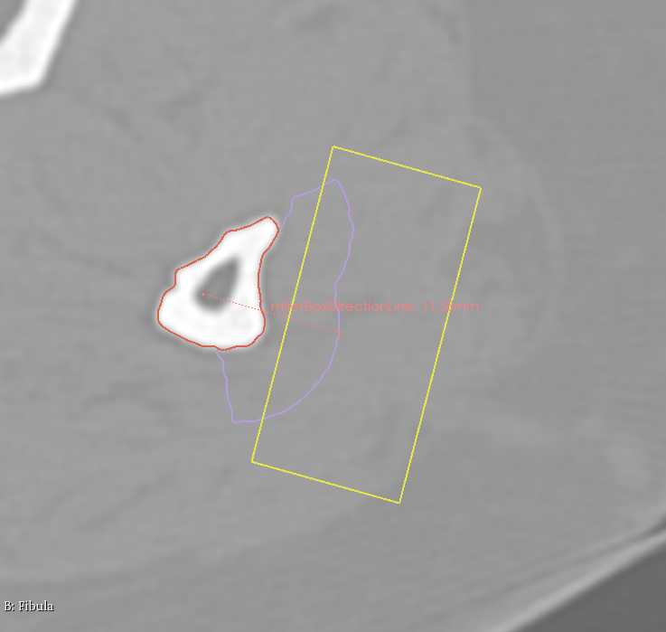
miterBoxDirectionLine defines the direction the miterBoxes will have
Same direction as miterBoxDirectionLine

