Slide 1
Software design overview

Slide 2
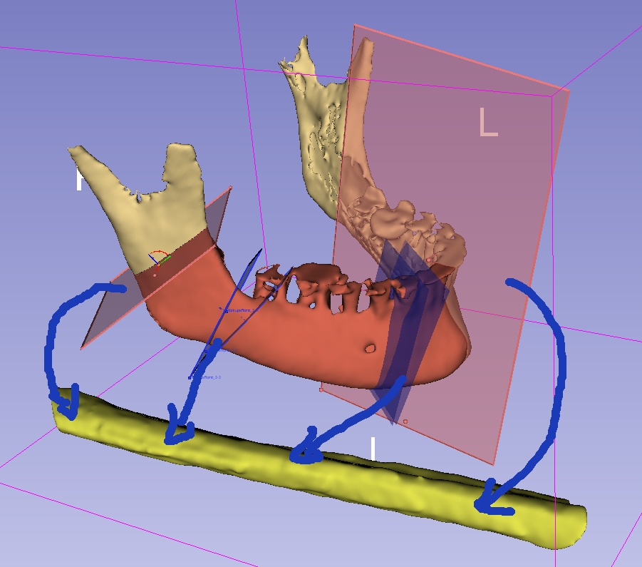
MandibleCutPlanes (multiple)
(center is snapped to MandibleCurve)
vtkMRMLMarkupsPlaneNode
Phase 1:
Segment mandible and fibula
Define MandibleCurve
Define FibulaLine axis and front direction
Define 3-6 planes along the MandibleCurve
Phase 2:
Generate cutting guide
Phase 3:
Blood vessel visualization
MandibleSegmentation
vtkMRMLSegmentationNode
1
y
y
MandiblePlaneStraight
MandibleCurve
(curve outside the bone, surface)
vtkMRMLMarkupsCurveNode
MandiblePlane
2
x
3
x
4
z
y
z
1
2
FibulaLine
(straight line on the surface of the fibula)
vtkMRMLMarkupsLineNode
Fibula
x
2
3
4
z
3
FibulaCutPlanes (multiple)
(placed automatically, based on MandibleCurve and MandibleCutPlanes)
vtkMRMLMarkupsPlaneNode
FibulaSegmentation
vtkMRMLSegmentationNode

Slide 3
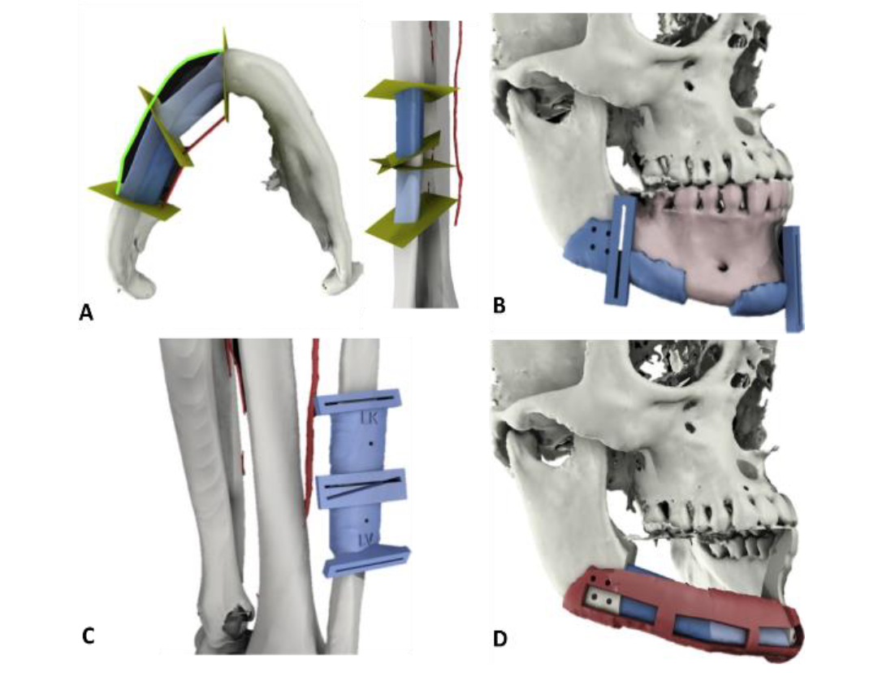

Slide 4
Segment angle 1
Segment angle 2
Mandible plane 1
Bone segment 1
Bone segment 2
Mandible plane 3
Mandible plane 2
Segment angle 2
Segment angle 1
y
x
Fibula plane 1B
Fibula plane 2A
z
Fibula
Bone segment 1
Bone segment 2
Fibula plane 1
Fibula plane 3

Slide 5
MandibleCurve
Coordinate systems
MandiblePlaneStraight: plane aligned with anatomy (mandible curve)
Origin: cutting plane position
X: lingual direction
Y: superior direction
Z: tangent of mandible curve, mesial direction
MandiblePlane: slightly rotated MandiblePlaneStraight
Origin: cutting plane position
X, Y, Z: cutting plane X, Y, normal
Fibula:
Origin: user-defined position along fibula line
X: user-defined direction
Y: ZX
Z: tangent of mandible curve, mesial direction
FibulaPlaneStraight: plane aligned with anatomy (fibula line)
Origin: user-defined position along fibula line
X, Y, Z: same as Fibula axis directions
FibulaPlane: slightly rotated FibulaPlaneStraight
Origin: same as FibulaPlaneStraight
X, Y, Z: cutting plane X, Y, normal
MandiblePlaneStraight
y
y
x
x
z
MandiblePlane
z
FibulaPlaneStraight
y
y
x
y
x
z
x
z
FibulaLine
Fibula
z
FibulaPlane

Slide 6
