Slide 1
Software design overview

Slide 2
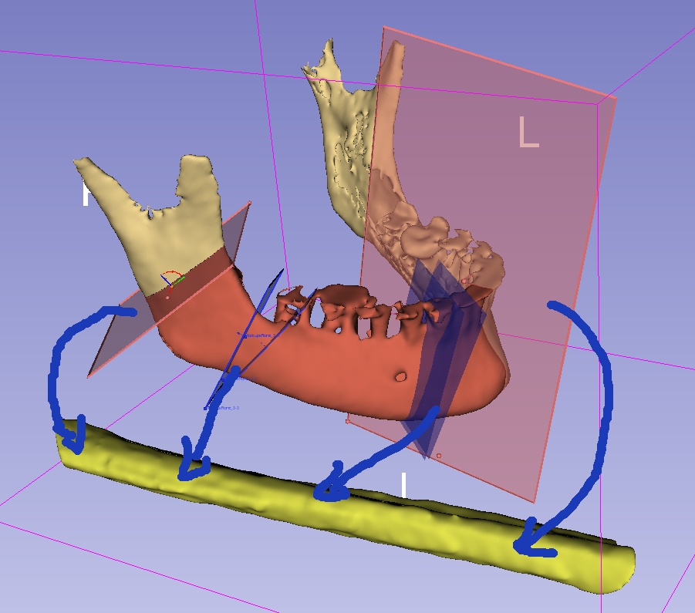
MandibleCutPlanes (multiple)
(center is snapped to MandibleCurve)
vtkMRMLMarkupsPlaneNode
MandibleSegmentation
vtkMRMLSegmentationNode
MandibleCurve
(curve inside the bone, centerline)
vtkMRMLMarkupsCurveNode
FibulaLine
(straight line inside fibula center)
vtkMRMLMarkupsLineNode
FibulaSegmentation
vtkMRMLSegmentationNode
FibulaCutPlanes (multiple)
(placed automatically, based on MandibleCurve and MandibleCutPlanes)
vtkMRMLMarkupsPlaneNode

Slide 3
