Slide 1
Software design overview

Slide 2
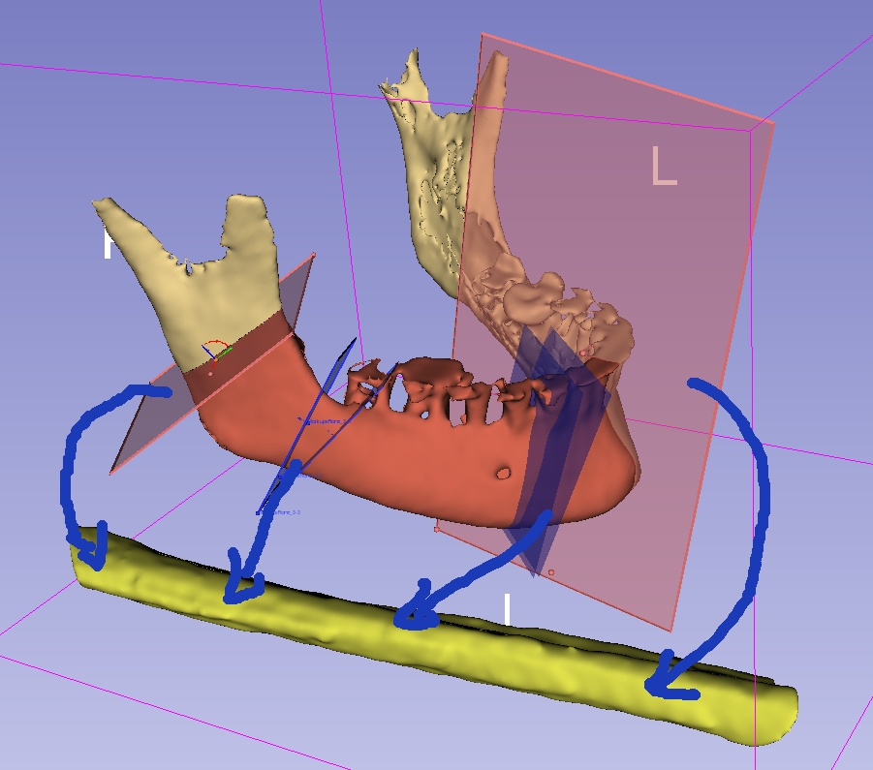
MandibleCutPlanes (multiple)
(center is snapped to MandibleCurve)
vtkMRMLMarkupsPlaneNode
Phase 1:
Segment mandible and fibula
Define MandibleCurve
Define FibulaLine axis and front direction
Define 3-6 planes along the MandibleCurve
Phase 2:
Generate cutting guide
Phase 3:
Blood vessel visualization
MandibleSegmentation
vtkMRMLSegmentationNode
1
MandibleCurve
(curve outside the bone, surface)
vtkMRMLMarkupsCurveNode
2
3
4
y
1
2
FibulaLine
(straight line on the surface of the fibula)
vtkMRMLMarkupsLineNode
Fibula
x
2
3
4
z
3
FibulaCutPlanes (multiple)
(placed automatically, based on MandibleCurve and MandibleCutPlanes)
vtkMRMLMarkupsPlaneNode
FibulaSegmentation
vtkMRMLSegmentationNode

Slide 3
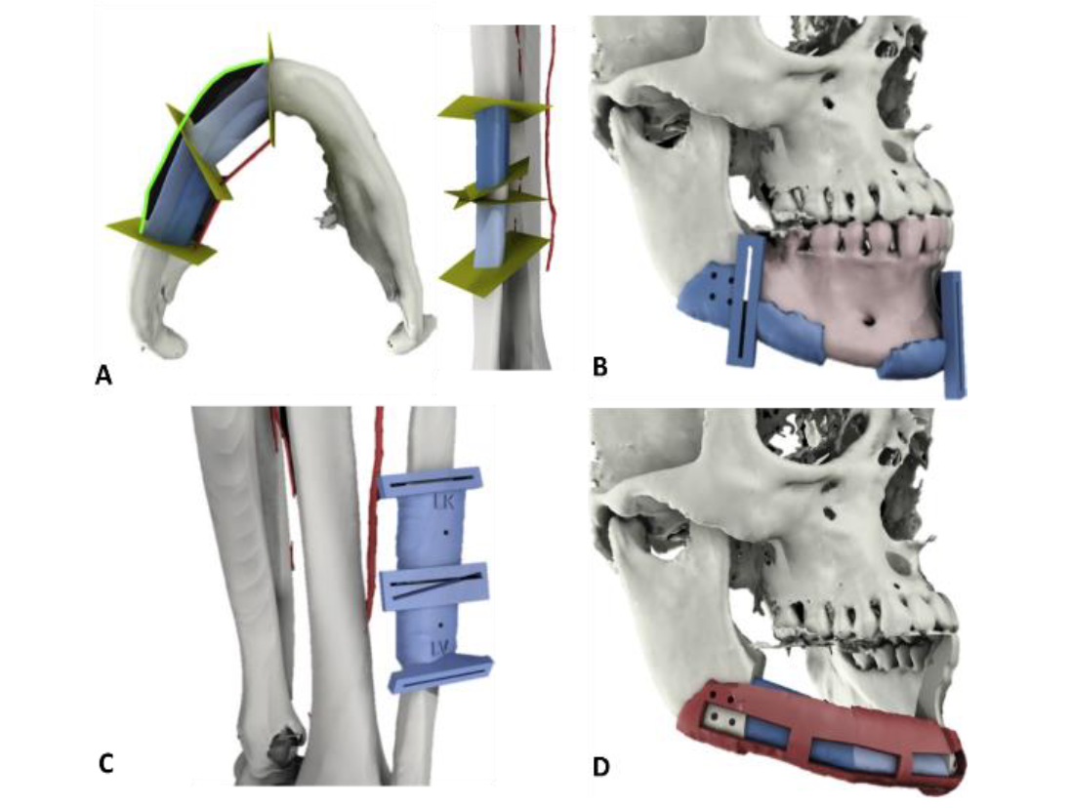

Slide 4
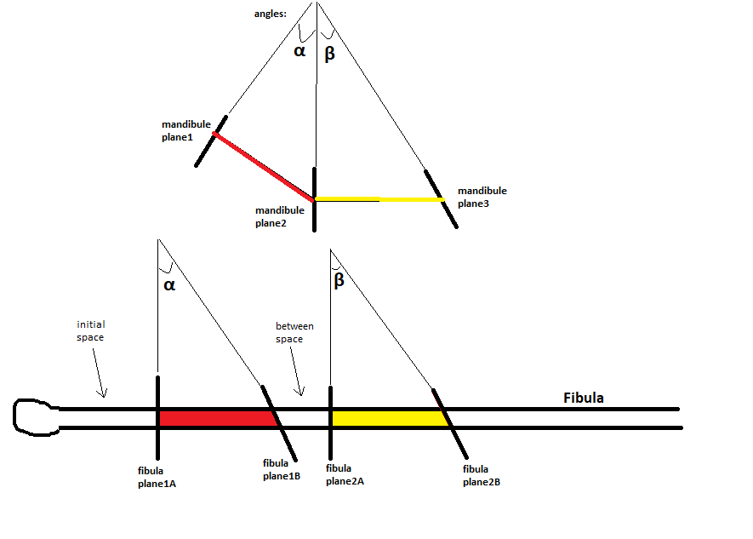
y
x
Fibula
z

