Slide 1
Software design overview

Slide 2
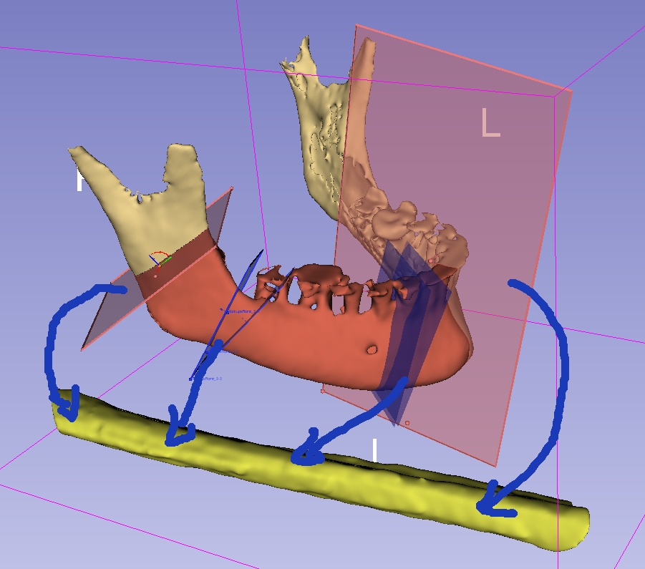
MandibleCutPlanes (multiple)
(center is snapped to MandibleCurve)
vtkMRMLMarkupsPlaneNode
Phase 1:
Segment mandible and fibula
Define MandibleCurve
Define FibulaLine axis and front direction
Define 3-6 planes along the MandibleCurve
Phase 2:
Generate cutting guide
Phase 3:
Blood vessel visualization
MandibleSegmentation
vtkMRMLSegmentationNode
1
y
y
MandiblePlaneStraight
MandibleCurve
(curve outside the bone, surface)
vtkMRMLMarkupsCurveNode
MandiblePlane
2
x
3
x
4
z
y
z
1
2
FibulaLine
(straight line on the surface of the fibula)
vtkMRMLMarkupsLineNode
Fibula
x
2
3
4
z
3
FibulaCutPlanes (multiple)
(placed automatically, based on MandibleCurve and MandibleCutPlanes)
vtkMRMLMarkupsPlaneNode
FibulaSegmentation
vtkMRMLSegmentationNode

Slide 3
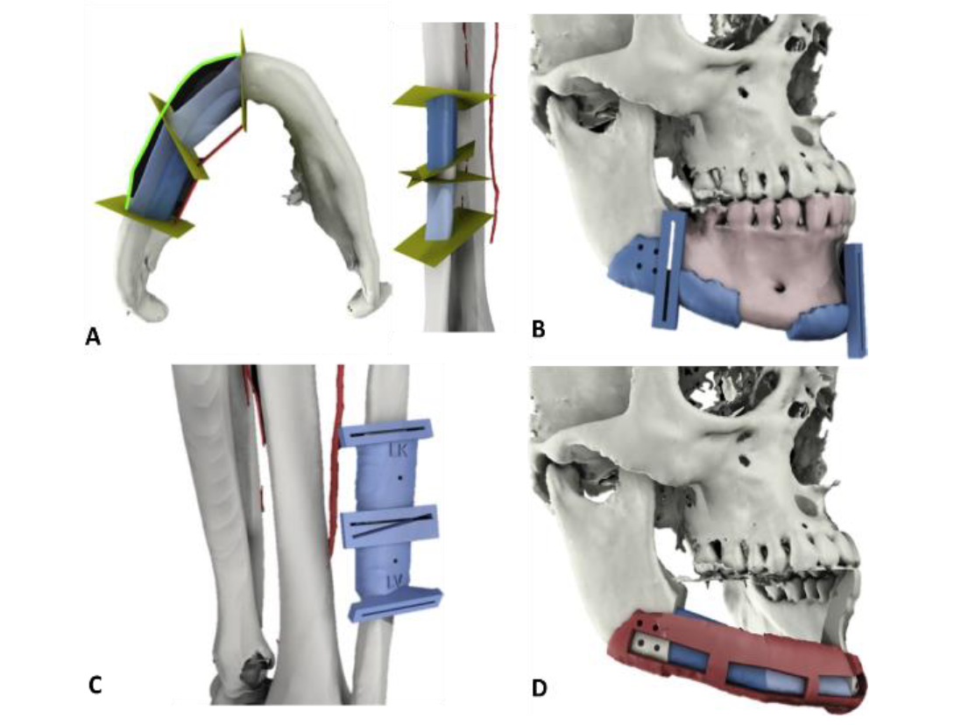

Slide 4
Coordinate systems
CurvePointAxisAtPoint(i): axis given by the function GetCurvePointToWorldTransformAtPointIndex
Origin: i
X: given by the function
Y: given by the function
Z: tangent of mandible curve, from start to end direction (given by the function)
AxisAtMandiblePlaneStraightOrigin = CurvePointAxisAtPoint(MandiblePlaneStraightOrigin)
MandiblePlaneStraight: plane aligned with anatomy (mandible curve)
Origin: MandiblePlaneStraightOrigin
X: AxisAtMandiblePlaneStraightOrigin(Y)  AxisAtMandiblePlaneStraightOrigin(Z), approximate lingual direction
Y: AxisAtMandiblePlaneStraightOrigin(Z)  posterior direction, approximate superior direction
Z: AxisAtMandiblePlaneStraightOrigin(Z), tangent of mandible curve in crescent direction
MandiblePlane: slightly rotated MandiblePlaneStraight
Origin: cutting plane position
X, Y, Z: cutting plane X, Y, normal
StartMandibleCurvePoint
MandibleCurve
CurvePointAxisAtPoint(i)
i
x
MandiblePlaneStraight
y
y
z
y
x
MandiblePlaneStraightOrigin
x
z
MandiblePlane
z
EndMandibleCurvePoint

Slide 5
0)
rotationAxisZ0: MandibleLine0BoneSegment0
Segment angle 0
rotationAxisZ0: MandibleAxis0(Z)Fibula(Z)
rotationAxisZ0
Segment angle 1
Bone segment 0
Bone segment 0
mandibleAxis0
rotationAxisZ0
y
rotationAngleZ0
rotationAngleZ0
x
Mandible Line 0
Mandible plane 0
Mandible Line 0
startPointML0
Mandible Line 0
z
1)
rotationAngleX0
Mandible Line 1
y
y
Mandible plane 2
x
endPointML0
x
rotationAxisX0: Z (or -Z) (should be checked)
Mandible plane 1
Fibula
z
Segment angle 1
z
mandibleAxis0Rotated
Segment angle 0
mandibleAxis0ToFibulaRotationTransform = Concatenate(Rotation(rotationAxisZ0, rotationAngleZ0), Rotation(rotationAxisX0, rotationAngleX0))
y
x
Fibula plane 0B
Fibula plane 1A
Coordinate systems
mandibleAxis0:
Origin: MandiblePlane0Origin
X: mandiblePlane0(Y)  Z
Y: Z  X
Z: mandibleLine0 direction
z
startPointBS0
endPointBS0
Fibula
Bone segment 0
Bone segment 1
Fibula plane 0A
Fibula plane 1

Slide 6
Fibula:
Origin: StartPoint
X: medial direction (Zposterior for left fibula) (Zanterior for right fibula)
Y: ZX (anterior direction for left fibula) (posterior direction for right fibula)
Z: fibulaLineDirection
FibulaPlane0A: rotated and translated mandiblePlane0
Origin: FibulaPlane0AOrigin (defined by a distance to the StartPoint set up by the user)
X, Y, Z: mandibleAxis0ToFibulaRotationTransform(MandiblePlane0)
FibulaPlane0B: rotated and translated mandiblePlane1
Origin: FibulaPlane0BOrigin (defined FibulaPlane0AOrigin plus distance between MandiblePlane0 and MandiblePlane1)
X, Y, Z: mandibleAxis0ToFibulaRotationTransform(MandiblePlane1)
y
y
x
y
x
z
z
FibulaLine
StartPoint
EndPoint
Fibula
z
x
FibulaPlane0A
FibulaPlane1A

Slide 7
