Slide 1
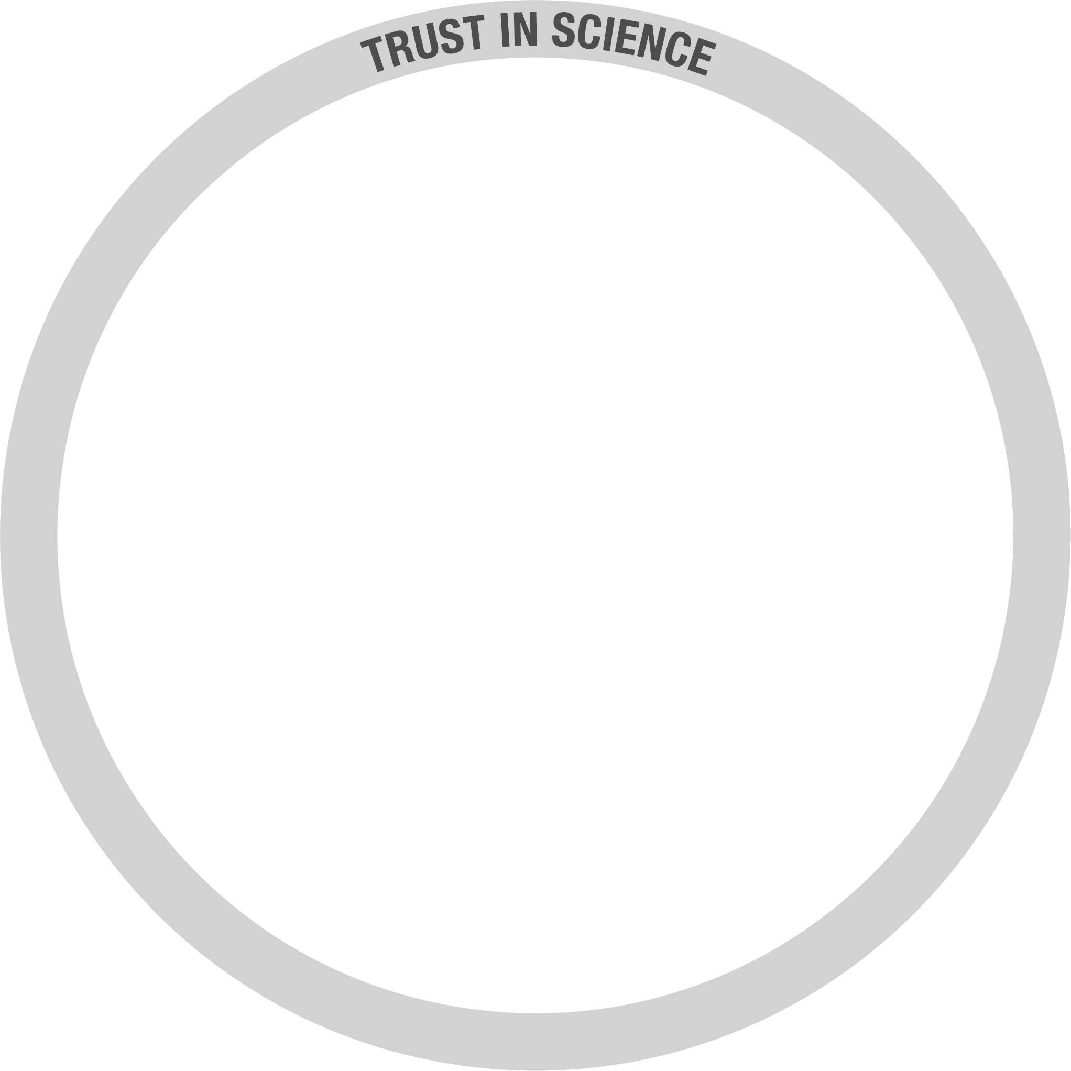
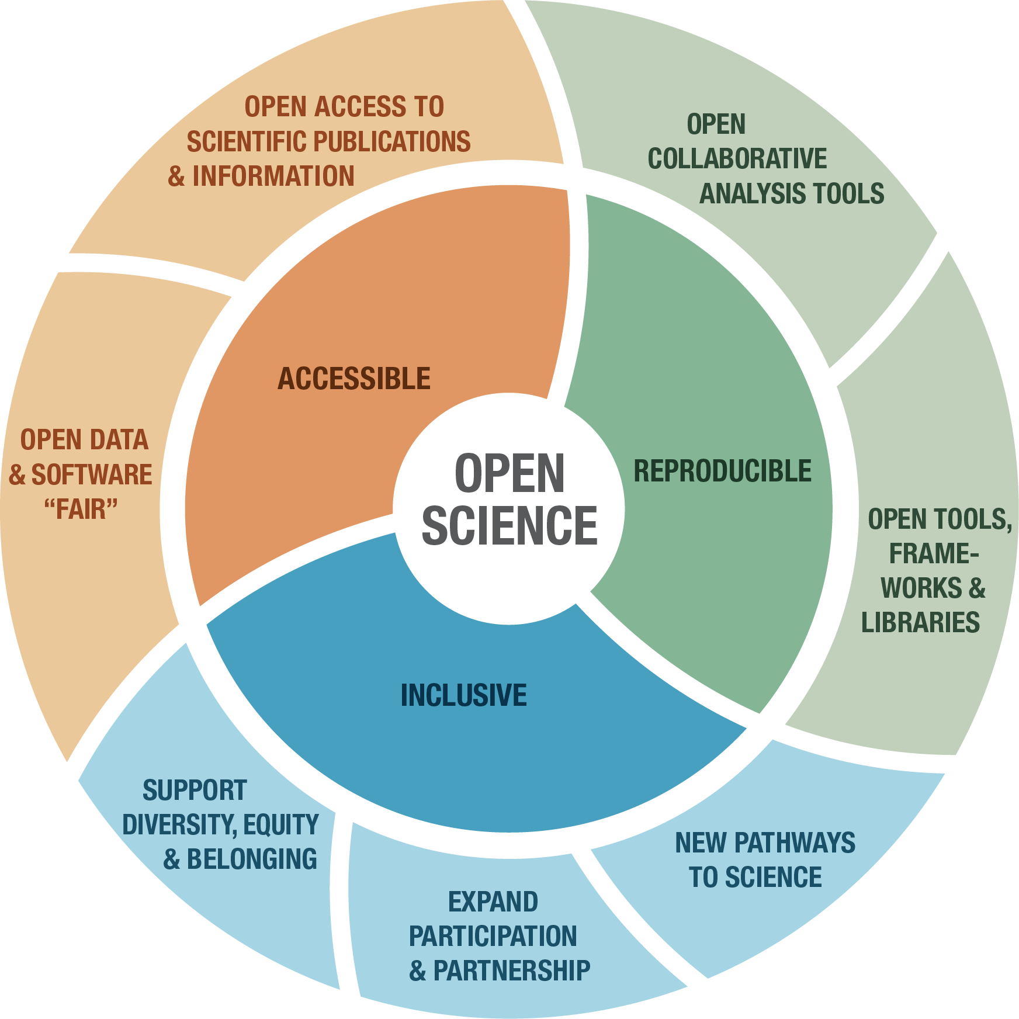
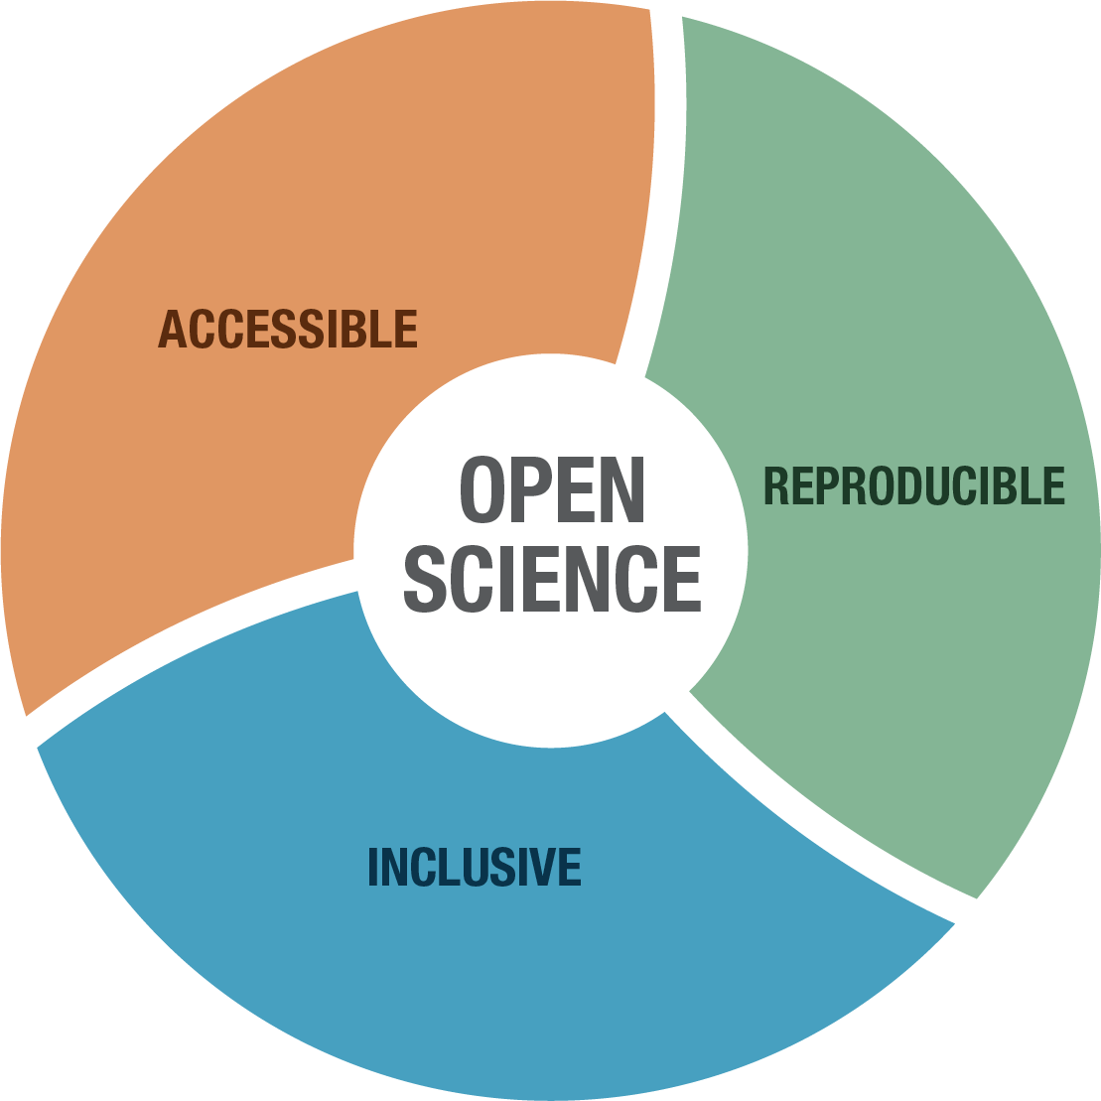
Why open science?
How:
Open, transparent, collaborative, and inclusive scientific practices
+
More accessible & verifiable scientific knowledge subject to scrutiny and critique
Results:
More efficient enterprise
Improves quality
Improves reproducibility
Expands the impact of science
Increases reliability
Provides robust evidence for decision-making and policy
Increase trust in science

