Slide 1
Hypervisor based memory introspection
Andrei LUȚAȘ Senior Introspection Research Lead
Notes:
Yesterday we already had presentations - about exploits (from Catalin),
and several presentations touching memory introspection briefly
I will go into more details, about HVMI as a TECHNOLOGY...
please bear with me even if I go into technical details, I will try to explain them

Slide 2
Outline
1
Security issues today
2
Hardware virtualization
3
Memory introspection basics
4
Fighting advanced threats with user-mode HVMI
5
Memory introspection technology use-cases
6
Q & A
Notes:
Use Agenda with Section Titles to provide an overview on the topics in your presentation.

Slide 3
Security Issues today
Notes:
biggest security issue ‘HUMANS working with computers’ (PROGRAMMING them & USING them)
unfortunately, without HUMANS developing and using computers, we would most likely have NO sales either... :)

Slide 4
Security issues today
advanced malware types
rootkits
kernel exploits
zero-days
APTs, botnets, cyber-espionage etc. heavily rely on those to penetrate defenses
CVE-2012-0158 → APT28
CVE-2013-1347 → Energetic Bear
…
traditional security solutions are software-only
software almost always has bugs, and thus tends to be exploitable
source: based on nvd.nist.gov
source: based on nvd.nist.gov
Notes:
we have a LOT of malware today, NOT all of them can be considered technically really advanced, but only a small part of them
but that small part can cause a LOT of pain and damage for the enterprises
here we see only KERNEL vulnerabilities... there are MUCH MANY MORE application vulnerabilities
not all vulnerabilities are exploitable (easily), but still there are sufficient for skilled attackers
software is written by humans... humans tend to be error-prone

Slide 5
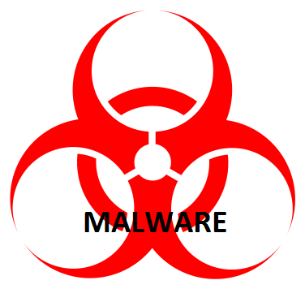

lack of isolation problem
Malware today gets to execute in the same context and with the same privileges as anti-malware software
Common Malware
Advanced Malware
App1 (Office)
App2 (Browser)
Security Solution
App1 (Office)
App2 (Browser)
Security Solution
Drivers
OS Kernel
Security Filter
Drivers
OS Kernel
Security Filter
ISOLATION Kernel Controlled
ISOLATION Kernel Controlled
Isolation Bypassed & Malware Controlled
Notes:
traditionally OS controls applications, apps can NOT touch / interfere with OS
isolation is enforced by OS kernel
OS kernel is MORE privileged then apps
isolation is bypassed using exploits, using malware with valid digital signatures, ...
Q: how many malware with valid digital signature there is out in the wild? guess: millions ☺

Slide 6
5-step kill chain
Espionage & data exfiltration
Identity theft
Sabotage
Code injection → Zeus, Epic Turla, Energetic Bear, …
API hooking → Dyreza, GameOver, ….
Spear phishing
Drive-by downloads
Trojans
1. attack vector
2. exploit
3. user-app payload
4. kernel payload
5. remote control of victim
CVE-2012-0158 → APT28
CVE-2013-1347 → Energetic Bear APT CVE-2014-0497 → DarkHotel APT
…
Stealthiness & Persistence → kernel rootkits (Necurs, TDL), bootkits, …
Notes:
everything starts usually with an unsolicited email and an attachment (DOC, PDF) that contains an exploit for a given vulnerability...
the initial exploit code usually downloads from the internet (malware server) bigger payloads
either injected into user-mode apps (e.g. explorer.exe) or loaded into kernel for complete machine takeover

Slide 7
Hardware virtualization

Slide 8
solving the lack of isolation problem
Guest VM
bare metal hardware fully controlled by hypervisor – more “powerful” than OS
we are running traditional operating systems and apps as a “guest VM” above the hypervisor
hardware accelerated virtualization (Intel VT-x → CPU virtualization, Intel EPT → memory virtualization, …)
App1 (Office)
App2 (Browser)
Security Solution
Drivers
OS Kernel
Security Filter
Hypervisor
ISOLATION -- Hypervisor controlled and ENFORCED by HARDWARE
Notes:
virtualization was NOT created for security reasons
however offers some very appealing features that security can be built upon
a completely new, MORE PRIVILEGED execution layer, BELOW the traditional OS KERNEL
IMPORTANT: even if an advanced malware takes over the OS kernel, it still will be *CONTAINED* inside the limits of the guest VM
IDEA: can we put a security engine OUTSIDE of the guest VM (e.g. into the hypervisor?)

Slide 9
Virtualization strengths
strong isolation – hypervisors are running below the OS kernel, in a separated more-privileged context, with CPU-enforced isolation
visibility and fidelity – hypervisors control the system’s memory and CPU, and have the ability to intercept and analyze operations performed by guest OS and apps, including possible malware
reduced attack surface – a hypervisor (and incorporated technologies, such as memory introspection) is smaller in size (and complexity) than a traditional anti-malware solution, and is also much smaller than the operating system’s kernel
defense in depth compatibility – a hypervisor and memory introspection based technology is easily compatible with traditional anti-malware technologies and can significantly extend their capability (it does not fully replace them)
hardware acceleration – Intel have been for years and is also right now actively working to change the silicon (e.g. new instructions, new features and arch changes) in order to better support memory introspection (and other virtualization based security technologies)
Notes:
HARDWARE silicon enforced isolation
malware can NOT avoid being analyzed; it can be VERY HARD (as we will see later on the semantic gap) to obtain some information from the outside, but once we find a way to obtain that information, malware from inside the VM can NOT avoid this
IMPORTANT: HVMI technologies are NOT meant to be used as complete 100% replacement for traditional AM technologies; HVMI takes the fight to a NEW level

Slide 10
building security on isolation
Hypervisor Controlled, Hardware Enforced STRONG ISOLATION
Protected area
Root VM (dom0)
SVA VM
VM₁
VM₂
VM_{N}
Security Engine
Hypervisor
Security Engine Alternative 2
Notes:
this setup was already presented yesterday by our partners from CITRIX
I stress again, that the key element here is the hardware enforced STRONG isolation (between the VMs, between the VMs and the SVA, ...)

Slide 11
memory introspection basics

Slide 12
What is memory introspection?
provide security from outside the guest OS
not relying on guest OS – can be compromised by advanced threats
relying on hardware accelerated virtualization (Intel* VT-x, EPT, …)
analyze raw memory image of guest OS and applications
hook / mark 4K pages as non-execute or non-writable
audit access of those areas by the code running in VM
write attempts, execute attempts
allow or deny attempts – decision provided by security logic
Notes:
- IMPORTANT: memory centric; HVMI is based on watching running applications, NOT files on a disk !!!

Slide 13
Challenges of HVMI
bridge the semantic gap – correlate raw 4K physical memory pages with meaningful OS data structures and operations
what objects are inside a guest VM?
what operations are being performed inside a guest VM?
ensure acceptable / low performance overhead
forward lots of event notifications with low overhead to engine
intercept only meaningful events
handle events quickly (analysis of event, re-execution / emulation, event forwarding, …)
Notes:
comparison: think about the semantics of a DISK-level view: e.g. an array of billions of bytes (block storage, 512 byte blocks / sectors) as a RAW view VS files, folders, names, access rights, timestamps etc. that MAKES SENSE to us as users (have semantics, meaning)
OBJECTS + OPERATIONS on them
performance is handled at three levels: silicon (CPU), hypervisor level (the way we are integrating the engine with the HV, the way sends events to us), security solution level (algorithms)
a lot of effort has been invested into this, more can be done
INTEL gradually introduced new technologies, will be likely introducing more → under RS-NDA
please search for Andrei LUTAS’s presentations last year at USENIX Annual Technical Conference, at Intel Developer Forum from San Francisco, ...

Slide 14
introspection protected areas at a glance
EPT protected areas
provide detection of alteration attempts, ensuring protection of critical code & data
OS kernel code
user mode stacks & heaps
kernel driver code and data
user mode code
critical kernel data System Service Dispatch Table (SSDT), Interrupt Descriptor Table (IDT), …
Guest VM
Physical Memory Space
EPT protected areas
detection of operations & events (ex. module load, process start, paging structures change, …)
Notes:
again OBJECTS + OPERATIONS
we are NOT covering every single data structure or app; there need to be a balance made between coverage and performance impact

Slide 15
Kernel HVMI
HVMI solution
App1 (Office)
App2 (Browser)
Security Solution
Drivers
OS Kernel
Security Filter
Protected by KERNEL MODE introspection
Hypervisor
ISOLATION -- HVMI controlled & ENFORCED by HARDWARE
Notes:
- kernel mode introspection has been traditionally research by academia for 10+ years

Slide 16
KERNEL HVMI & USER HVMI
Protected by USER MODE introspection
HVMI solution
App1 (Office)
App2 (Browser)
Security Solution
Drivers
OS Kernel
Security Filter
Protected by KERNEL MODE introspection
Hypervisor
ISOLATION -- HVMI controlled & ENFORCED by HARDWARE
Notes:
- we advanced the state of the art (again, big thanks to Andrei LUTAS), by protecting USER MODE applications directly from the HV level

Slide 17
fighting Advanced threats with user-mode HVMI

Slide 18
User-mode memory introspection
monitor user-mode applications (such as web-browsers, Microsoft Office, Adobe Reader, … – those apps are key infection vectors today) for
detection of malicious code injection
detection of function detouring
detection of illegitimate code execution from stack / heap
generic detection of malicious code unpacking
enforcement of generic Write-XOR-eXecute (W⊕X) policy
...
injection of remediation tools into the guest runtime on-the-fly (no help from ‘within’ guest needed)
Notes:
as you will see, injection is WIDELY used by APTs today
to be honest, remediation agent shall not be perceived as 100% fix; think about that we ARE facing ADVANCED, NEVER SEEN BEFORE malware / attacks... so we DO have a chance to identify and remove all components of a malware, but we might, in some cases, fall back just to offer protection and telling the IT Admin to revert the machine to a known good clean state

Slide 19
5-step kill chain and KERNEL HVMI
Code injection → Zeus, Epic Turla, Energetic Bear, …
API hooking → Dyreza, GameOver, ….
Espionage & data exfiltration
Identity theft
Sabotage
Spear phishing
Drive-by downloads
Trojans
KERNEL MODE HVMI
1. attack vector
2. exploit
3. user-app payload
4. kernel payload
5. remote control of victim
CVE-2012-0158 → APT28
CVE-2013-1347 → Energetic Bear APT
…
Stealthiness & Persistence → kernel rootkits (Necurs, TDL), bootkits, …

Slide 20
5-step kill chain and USER HVMI
USER MODE HVMI
Code injection → Zeus, Epic Turla, Energetic Bear, …
API hooking → Dyreza, GameOver, ….
Espionage & data exfiltration
Identity theft
Sabotage
Spear phishing
Drive-by downloads
Trojans
KERNEL MODE HVMI
1. attack vector
2. exploit
3. user-app payload
4. kernel payload
5. remote control of victim
CVE-2012-0158 → APT28
CVE-2013-1347 → Energetic Bear APT
…
Stealthiness & Persistence → kernel rootkits (Necurs, TDL), bootkits, …
UM HVMI is STRONGLY ISOLATED (enforced by hardware) and provides GENERIC detection mechanisms
Notes:
- hopefully now the strength and true values of HVMI will be clean to everyone

Slide 21
memory introspection technology use-cases

Slide 22
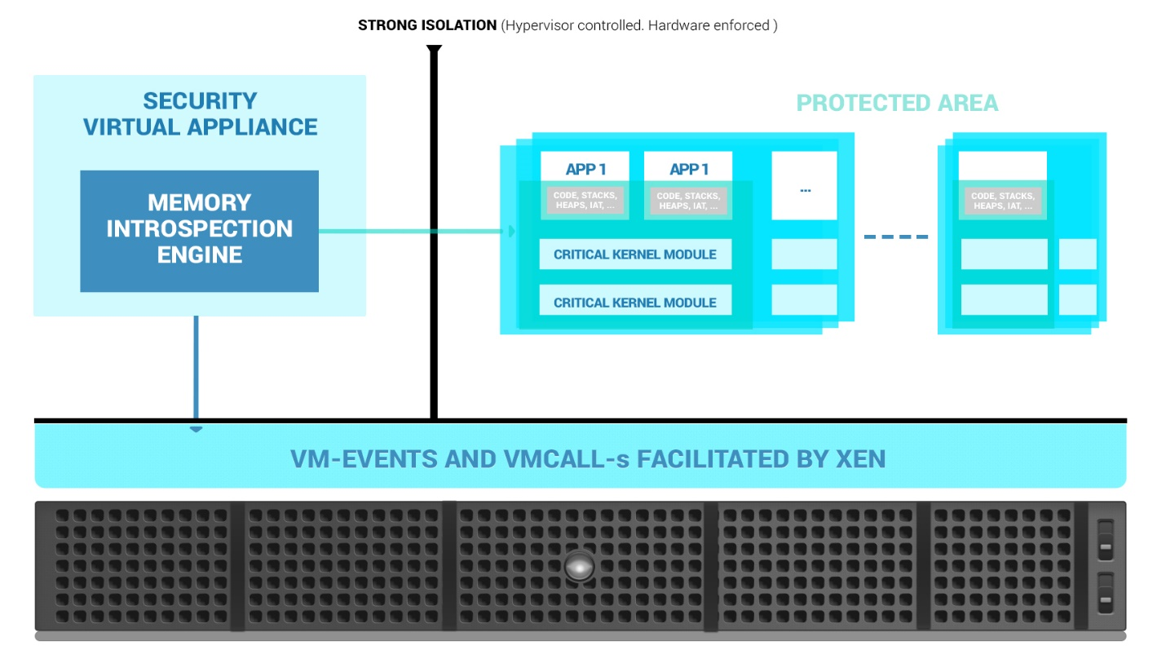
MEMORY INTROSPECTION TECHNOLOGY USE CASES
protecting multi-VM servers
datacenters, cloud, ...
GravityZone on Xen Server
Supports Windows 7 and newer (32 and 64 bit)
Supports Linux RHEL, CentOS, Ubuntu (64 bit)
protecting enterprise client endpoints
detecting sophisticated attacks using on-premise enterprise solutions
Notes:
IMPORTANT: I must underline, that I am talking about TECHNOLOGY here, NOT about products... the way this is productized is a different question
SERVERS
ENDPOINTS
on-premise, e.g. EMAIL attachment filtering

Slide 23
Q & A

Slide 24
Notes:
Logo
You can use this slide when ending a presentation or during Q&A.
It can be even projected before you begin your presentation while the members of the audience arrive and take their seats.
Note: It should only be used when having the Title Slide and Bumper Slides on a white background.

