Slide 1
Galaxy and WebApollo for Undergraduate Genomics Instruction
Jason Gill
Department of Animal Science
Center for Phage Technology
Texas A&M University

Slide 2
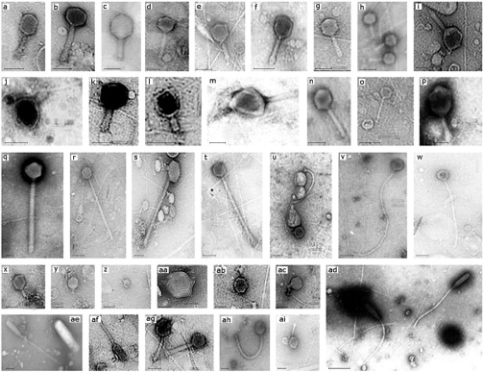
Why phages?
Phages are the most abundant organisms on Earth, about 10³¹ in total
Recent interest as therapeutics and for their role in natural environments
Phage genomes are small, ~40-200 kb
Small enough for one person to comprehend
Prokaryotic gene organization
Easily inferred gene locations and protein sequences
Phages are highly diverse, many novel genes
Easier to obtain “unique” sequences
Phages provide examples of many biological concepts
Transcriptional control and gene regulation
Nucleotide metabolism, DNA replication
Protein folding, structure and domains
Evolution and horizontal gene transfer
Sulcius et al. 2011, Oceanologia

Slide 3


Why phages?
Phages are the most abundant organisms on Earth, about 10³¹ in total
Recent interest as therapeutics and for their role in natural environments
Genomes are small, 40-300 kb
Small enough for one person to comprehend
Prokaryotic gene organization
Easily inferred gene locations and protein sequences
Phages are highly diverse, many novel genes
Easier to obtain “unique” sequences
Phages provide examples of many biological concepts
Transcriptional control and gene regulation
Nucleotide metabolism, DNA replication
Protein folding, structure and domains
Evolution and horizontal gene transfer
Sulcius et al. 2011, Oceanologia

Slide 4
Galaxy for genomics instruction
Since 2001, an undergraduate phage genomics course has been run in the Department of Biochemistry & Biophysics at Texas A&M University
Uses bacteriophage genomes to illustrate principles of genomics and bioinformatics
2001-2007: Students acquired DNA sequence by Sanger sequencing and assembly, some annotation at the end
2009-present: Students are provided with finished contigs at the start of the class, spend entire class annotating
Starting in 2015, switched from command-line bioinformatics to a Galaxy-based platform

Slide 5
Genome annotation tools
Fully automated annotation
Semi-automated annotation
RAST/myRAST/RASTtk
http://rast.nmpdr.org/
Prokka
http://www.vicbioinformatics.com/software.prokka.shtml
NCBI Prokaryotic Pipeline
https://www.ncbi.nlm.nih.gov/genome/annotation_prok/
DNA Master
http://cobamide2.bio.pitt.edu/
CPT Galaxy/Apollo
https://cpt.tamu.edu/galaxy-pub/
Manual annotation / genome editors
Sanger Artemis
http://www.sanger.ac.uk/science/tools/artemis
Broad Argo
https://archive.broadinstitute.org/annotation/argo/

Slide 6
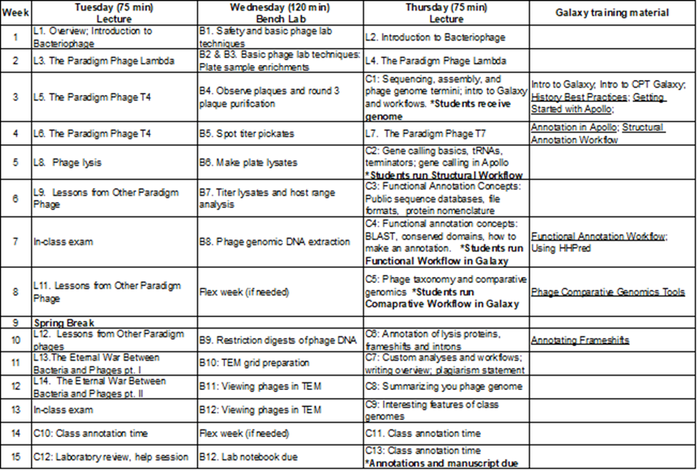
BICH 464 course design
Students receive an unannotated FASTA DNA sequence early in the semester
Galaxy is used to automate analyses and “busywork”
Standardizing file formats, merging data
Annotate genome, write a brief report

Slide 7
Genome annotation
Predict which regions of DNA encode proteins (CDS)
- Reading frame
- Coding start and stop
- Predicted amino acid sequence
STRUCTURAL
Predict the functions of proteins
TMhmm
BLAST
FUNCTIONAL
InterProScan
LipoP
Function based on similarity to other proteins with known function
Function based on peptide sequence motifs

Slide 8
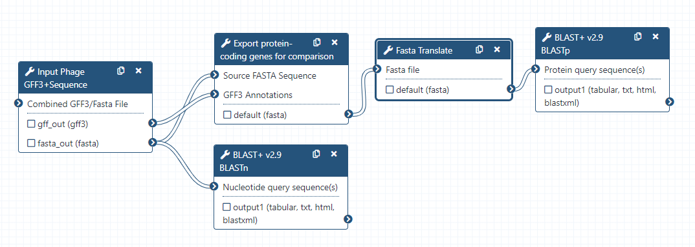
Galaxy workflows
The bulk of analyses are conducted by two workflows: Structural and Functional
Some analyses take a long time; output from one job will automatically be handed off to the next when it finishes
Workflows are facilitated by the wide variety of parsers and file converters available in the CPT Galaxy

Slide 9
What is WebApollo?
WebApollo is an interactive genome visualizer that supports collaborative genome annotation
An extension of the popular JBrowse genome viewer that allows editing
“Google Docs, but for genomes”
Maintains genome annotations and multiple evidence “tracks” to guide annotations
The tools have been developed that bridge Galaxy ←→ Apollo

Slide 10
The Galaxy-Apollo Bridge
User uploaded data
Galaxy-Apollo Bridge
JBrowse
Galaxy
Analysis of DNA and protein sequences
Organism
Genome & annotations
Apollo
Evidence review and annotation
Evidence
Gene calls, BLAST results, etc.
Retrieve
Organism and annotations
Download to user’s computer

Slide 11
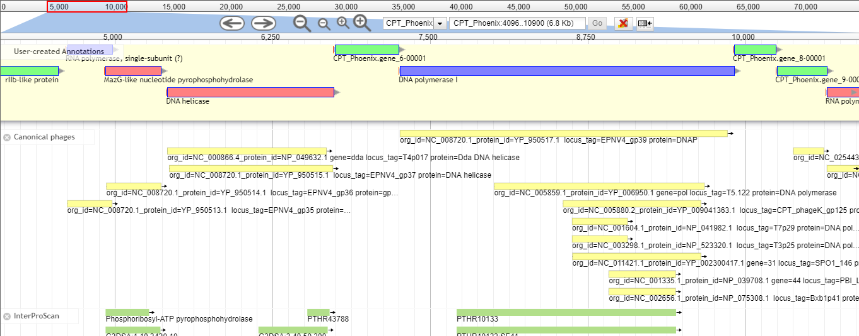
Annotations in Apollo
User annotations appear in the top-most User-created Annotations track of the display
Evidence tracks below this are generated by various tools in Galaxy and imported to Apollo

Slide 12

Phage annotation on the CPT Galaxy-Apollo system
Unannotated DNA sequence
Annotated genome file
(GenBank/GFF3)
Galaxy
Structural workflow
Galaxy
Functional workflow
Galaxy
Genome export
Apollo
User calls genes
Apollo
User annotates genes
Galaxy
Other analyses

Slide 13
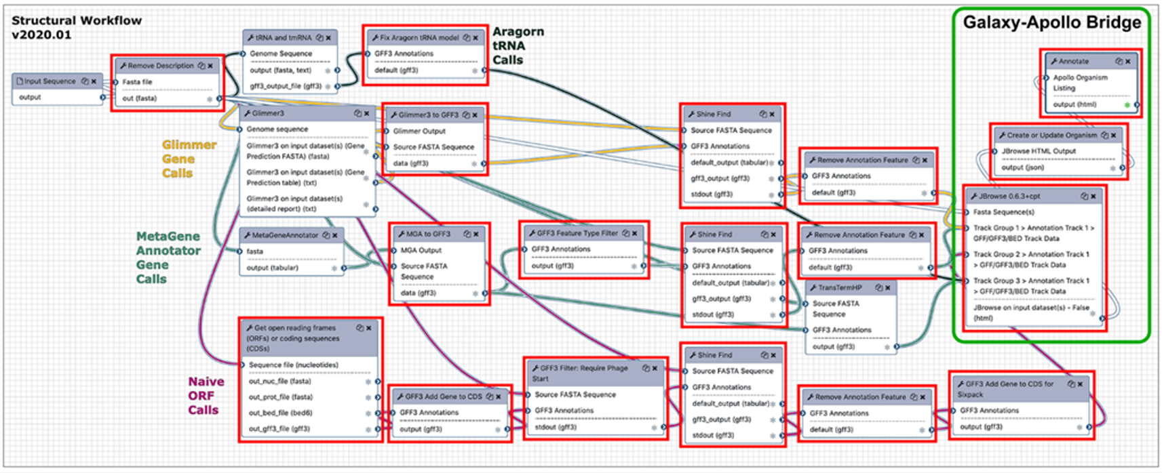
Structural workflow

Slide 14
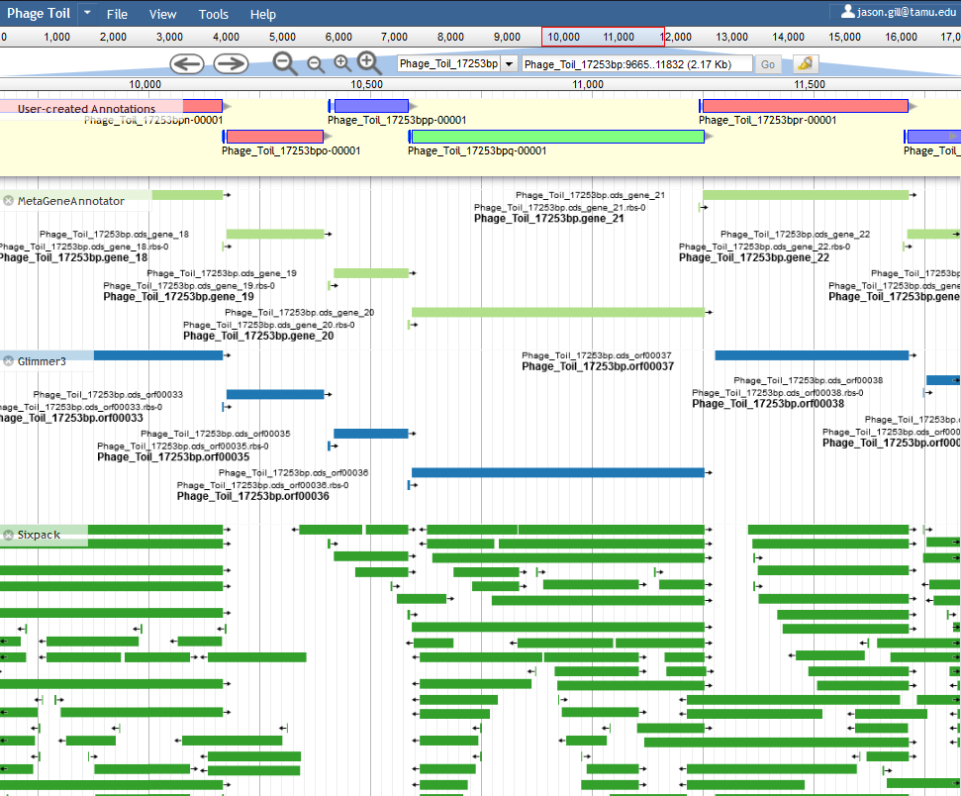
Structural workflow output in Apollo
The programs MetaGeneAnnotator (MGA) and Glimmer3 will detect most protein-coding genes
We use our own tool, Shine Find, to automatically detect S-D sequences upstream of predicted genes as a means of quality control
The vast majority of “real” genes will have a valid Shine-Dalgarno sequence associated with them
Protein-coding genes exported back to Galaxy for functional annotation analyses

Slide 15
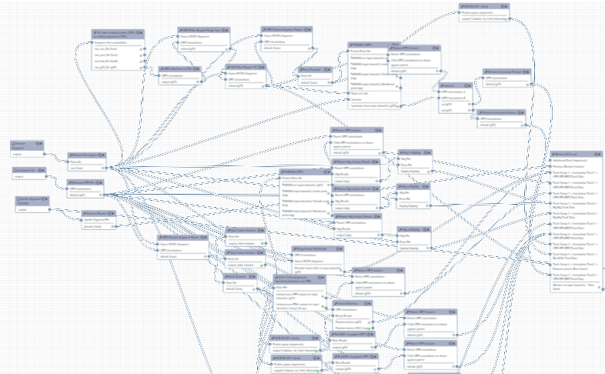
The CPT Galaxy Functional Annotation workflow

Slide 16
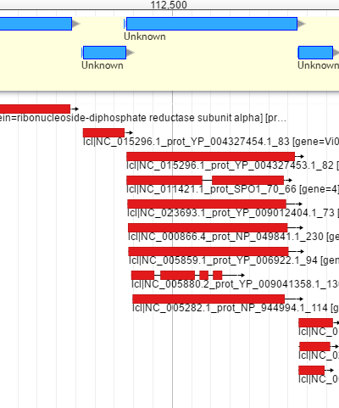
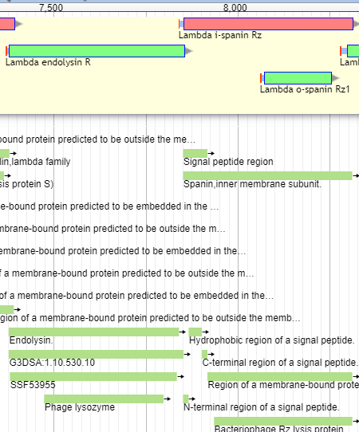
BLAST and InterProScan results in Apollo
This is BLAST against a custom database containing only paradigm phages
Other BLAST tracks are available
SwissProt, TrEMBL, NR
InterProScan searches for conserved domain hits in 13 member databases
Results often sparse but more informative

Slide 17
Other workflows and tools
Identification of promoters, terminators, tRNAs
Identification of prokaryotic introns
Parses BLASTp results to identify adjacent CDSs with similarity to the same protein
Identification of phage lysis genes
Often have embedded gene arrangements
Comparative genomics
Parses BLASTn and BLASTp results to return most related organisms
Export of annotated genomes as GFF3 or GenBank format, generate /locus_tag fields, sequentially number for deposition
Generate graphical genome maps

Slide 18
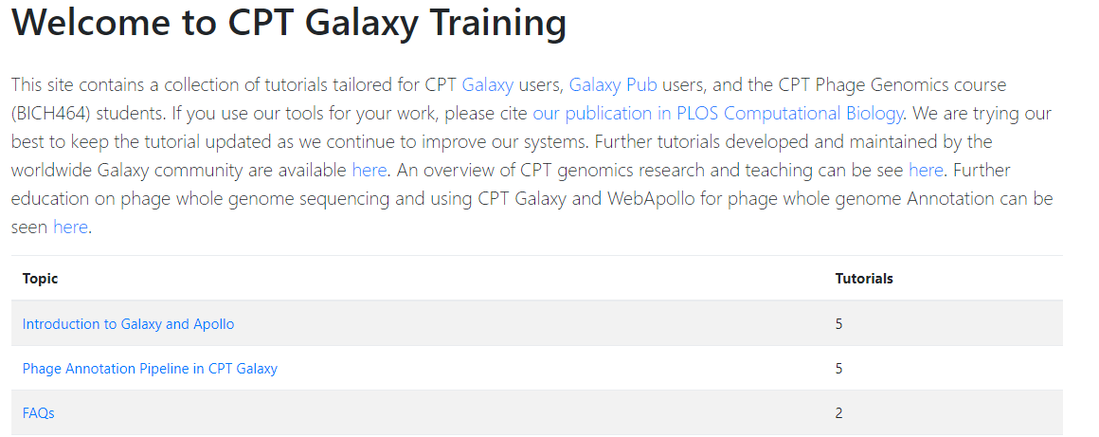
Galaxy training resources
Galaxy home: https://usegalaxy.org/
Galaxy 101: https://galaxyproject.org/tutorials/g101/
CPT Galaxy training: https://cpt.tamu.edu/training-material

Slide 19
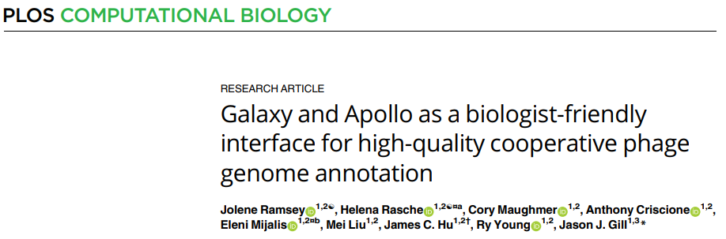
Galaxy training resources
Galaxy home: https://usegalaxy.org/
Galaxy 101: https://galaxyproject.org/tutorials/g101/
CPT Galaxy training: https://cpt.tamu.edu/training-material

Slide 20
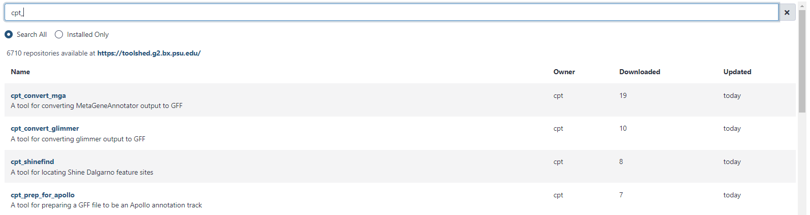
CPT tools now in the Galaxy Toolshed!
70 tools deposited, findable by searching the Toolshed for cpt_
Tools needed for workflows, plus others
Development repository: https://github.com/TAMU-CPT/CPT-ToolshedSource

Slide 21



Project leads
Jason Gill
James Hu
Mei Liu
Jolene Ramsey
Ry Young
Special thanks
Nathan Dunn
Suzanna Lewis
Ian Holmes
Liz Summer
The Galaxy community
BICH 464 students past, present and future
Coding and maintenance
Anthony Criscione
Cory Maughmer
Eleni Mijalis
Helena Rasche
Curtis Ross
cpt.tamu.edu

