Slide 1
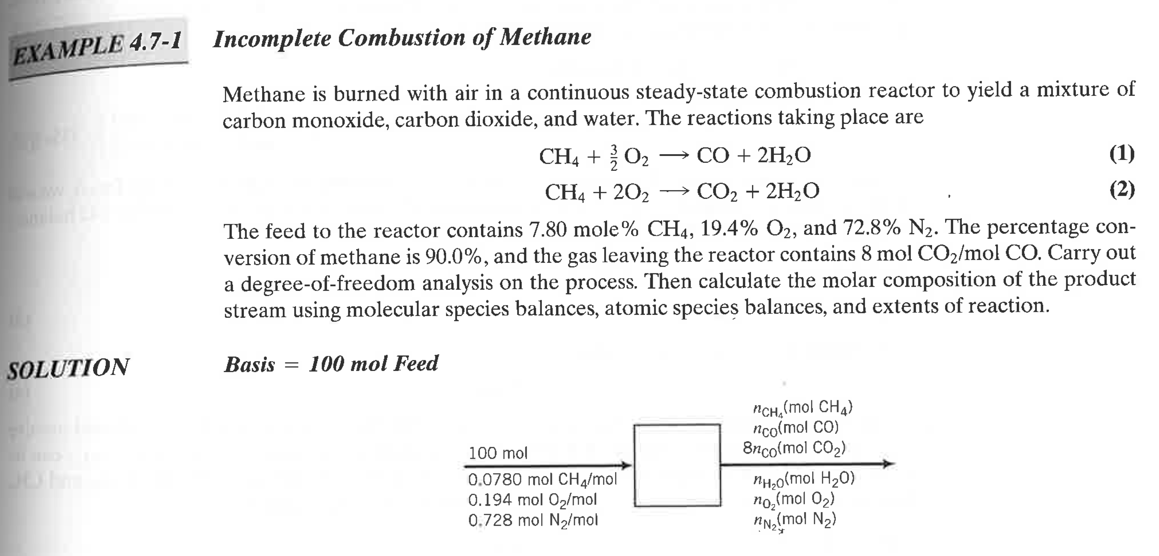
Atomic Species (Mass) Balance Example
Elementary Principles of Chemical Process Engineering, Third Edition, Felder and Rousseau (2005)

Slide 2
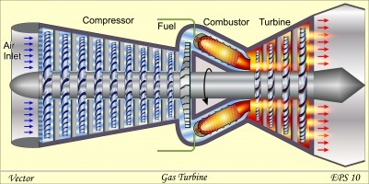
How to solve with linear algebra and MATLAB?
Three Steps:
Develop a mathematical model (using concepts from last semester)
Transform model into matrix form
Implement and solve in MATLAB
Feed Flow Rates (mol)
given
Effluent Flow Rates (mol)
unknown
Degree of Freedom Analysis
6 variables (unknowns) implies we need 6 equations

Slide 3
Step 1: Mathematical Model
When in doubt, in = out!
Inert Balance
C Balance
CH₄ Conversion Specification
“the percent conversion of methane is 90.0%”
H Balance
Effluent Ratio Specification
“gas leaving the reactor contains 8 mol CO₂ / mol CO”
O Balance

Slide 4
Step 2: Matrix Form
1
4
2
5
3
6

Slide 5
Step 2: Matrix Form
Focus on equation 4
Rearrange
4

Slide 6
Step 2: Matrix Form
1
4
2
5
3
6
1
2
3
4
5
6

