Slide 1

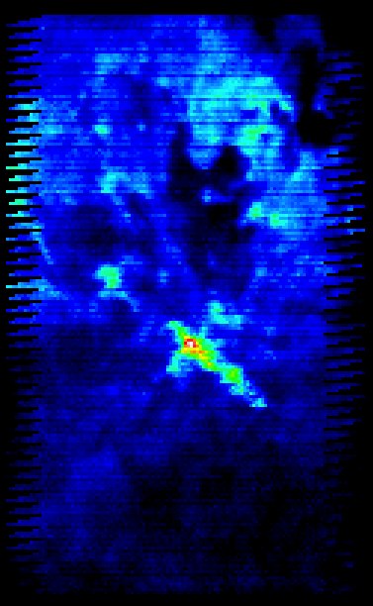
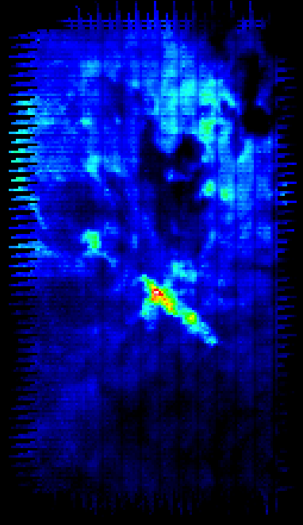
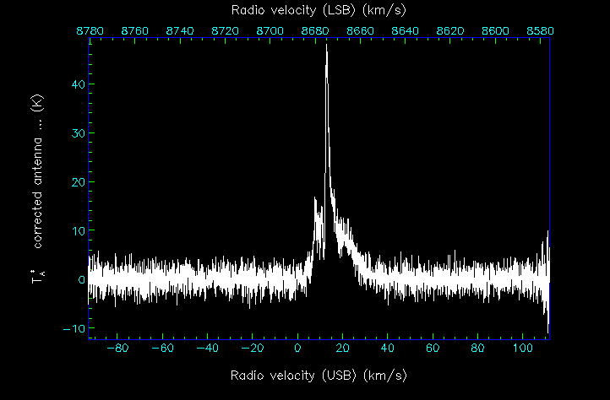
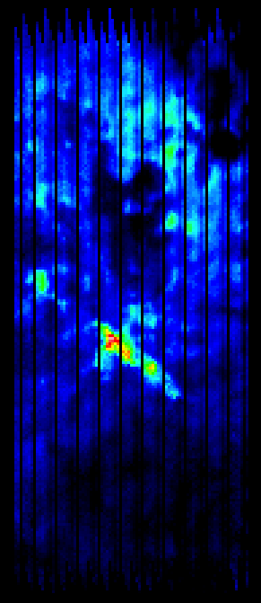


Developments in the Starlink Software Collection
Tim Jenness (JAC), David Berry (UCLan), Brad Cavanagh (JAC), Malcolm Currie (RAL), Peter Draper (Durham), Frossie Economou (JAC)
The Starlink Software Collection is now an open source software project using primarily the Gnu General Public License. Since the demise of the Starlink Project in 2005, the Joint Astronomy Centre has been leading development of the software in order to enhance the processing and visualization of 3D data (RA, declination and frequency) from JCMT’s heterodyne instrumentation, to support the UKIRT and JCMT data reduction pipelines, and also to facilitate the ingestion of pipelined data products into the JCMT Science Archive (JSA) hosted at CADC.
Provenance
A key functionality of modern science archives is the ability to track which raw observations contributed to a particular reduced data product. Whilst it is possible for the data pipeline to keep track of input files and then fix up headers in the products, the approach we have taken is for each individual DR application to track provenance automatically. This has a key advantage in simplifying pipeline infrastructure whilst ensuring that products reduced outside the pipeline environment also track provenance. The core Starlink applications (including KAPPA, CCDPACK, and SMURF) have all been modified to make use of this feature but the key thing to note is that the change in each application is tiny with the real work being done by the file I/O library. The I/O library (NDF for Starlink) has been modified to provide triggers each time a data array is read (memory mapped or copied) and output data files are automatically opened at the end of processing to receive any provenance from input files. All ancestors are stored in each output file such that intermediate files are not required to check provenance. Root ancestors created by applications handling raw data files insert a unique observation identifier into the provenance information in order to be able to relate products to the original raw data files.
Application Enhancements
In addition to the changes described elsewhere in this poster there have been enhancements to the applications. Also, the binary release of the Starlink software is now relocatable into any directory. Of the more than 100 changes in the last year, the most significant are listed below.
GAIA
can now browse components in NDF and FITS files in addition to the primary data array.
It is now possible to screen grab the active window.
KAPPA
WCSSLIDE can be used to apply pointing shifts to the world coordinates of an image.
PLUCK allows a spectrum to be extracted from a cube at an arbitrary position (using regridding techniques).
MFITTREND can now use spline fitting to remove baseline features from data cubes.
Applications have been added for manipulating provenance.
The MSTATS application now offers a wider selection of statistics.
SMURF
A time series file can now be created from a data cube and a reference time series. This allows a baseline mask to be calculated for the raw data or for an iterative reduction technique to be used.
PICARD
A recipe is now available for automatic baseline removal of data cubes. This uses feature detection using the CUPID application to locate emission regions in a smoothed cube before fitting baselines.
Thread Support
Now that multi-core architectures are common-place and data rates are still increasing, it is important to add support for multiple threads in the data reduction algorithms. Historically the Starlink software was written in Fortran 77 (inherently unsafe) or when in C has included a dependence on many global variables (mainly because it was a port of a Fortran program or library that used COMMON blocks). Due to the processing demands of HARP and SCUBA-2 we have begun work adding threads to our applications and making some of the key libraries thread-safe.
The AST library is now thread-safe.
The Error Message system (EMS) library can now handle error contexts in multiple threads using thread-local storage
The SCUBA-2 and HARP data processing application (SMURF) can now use multiple threads when regridding cubes (regridding separate frequency channels independently) or making SCUBA-2 images (make maps from each file in a separate thread and then combine).
Starlink and the VO
The JCMT Science Archive is committed to being fully VO-compliant, but this requires that users have tools to access the diverse data products. We are modifying GAIA to enable it to use SIAP queries and wish to extend it, in conjunction with CADC, to support data cube queries since they are a primary product of our heterodyne instrumentation. Also, submillimetre images and cubes are usually full of amorphous emission ill-suited to a point source description, so GAIA needs to be able to visualise clump outlines, such as those found using the CUPID application, and retrieve those outlines from the JSA. GAIA and SPLAT already use the PLASTIC protocol for inter-process communication but we intend to switch to SAMP.
Obtaining the Software
The Joint Astronomy Centre releases binary distributions for a number of platforms (32- and 64-bit Linux, based on Centos5.2, and Mac OS X Intel and powerPC (using Tiger, since Leopard X11 is not compatible with Tiger)). The most recent release is named lehuakona. It will be available from http://starlink.jach.hawaii.edu.
The source code is also freely available for download. It is known to build on Linux, Solaris 10 (32- and 64-bit), Mac OS X (Intel, PowerPC, 32- and 64-bit) and with a number of compilers including Gnu gcc with g95 or gfortran, Sun and Intel compilers.
In this example, data from two distinct observations are mosaicked into a single data cube. The extracted spectrum has a reference to its direct parent (the coadded cube) and also references to the raw time series spectra. The coadded cube has references to the two input cubes and also the raw time series. The input data cubes just refer to the raw data. The black vertical lines are due to missing receptors on the array.
http://starlink.jach.hawaii.edu

