Slide 1
Repurposable Devices and Tock
Tock World 5
July 19, 2022
Brad Campbell – bradjc@virginia.edu

Slide 2



Repurposable IoT Devices
100 years
~3 years
?? years
Devices designed today with new abstractions and architectures to enable longevity and utility commensurate with the physical hardware itself
Why?
IoT devices hard to deploy → want them to keep working for decades
E-waste is a growing concern, hard to recycle small IoT devices
Use cases change → want to update devices

Slide 3
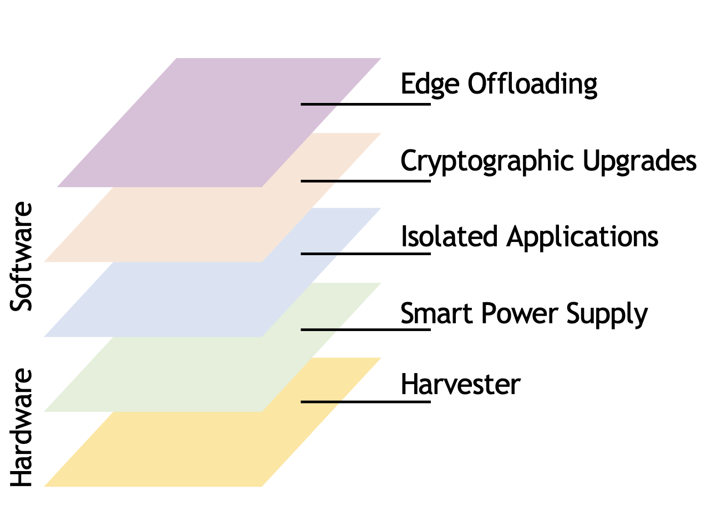
Long-lived device challenges
Energy availability
Harvesting required
Energy conditions change over time
Use case changes
Applications 10 years from now different than today
Moore’s law never really ended
Tomorrow’s software written for tomorrow’s hardware
Deployed devices use today’s hardware

Slide 4
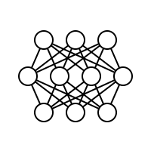
Opportunity for Tock & Repurposable Devices
Prerequisite: decouple apps from hardware and system management
Syscall interface enables this
Enabling:
Threat model
Trusted apps (AppID)
Robust cryptography APIs
App
App
App
Crypto
Tock Operating System
RL-based Power Supply
Energy-Harvesting IoT Device

Slide 5
Application loading
Goal: dynamically add and execute new apps
Stages
Design space
Where should app loading mechanism live in Tock?
Current approach:
As much as possible in userspace
Capsule facilitates writing flash
Core kernel approves new app, adds to queue, and executes
Userspace Loader
App
Application Loading
Tock
Capsules
Core Kernel

Slide 6
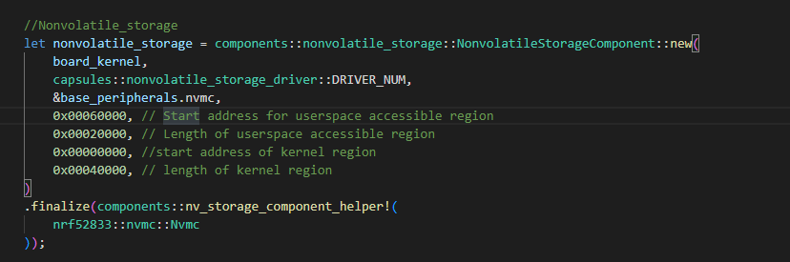
OTA implementation for Tock
Prototype: OTA app runs in userspace
First version used hardcoded addresses
OTA
Need to be changed according to the size of OTA app
App Layer
System Call Interface
Capsule Layer
nonvolatile_storage_driver
Component Layer
nonvolatile_storage
Hardware Layer
Flash Memory

Slide 7
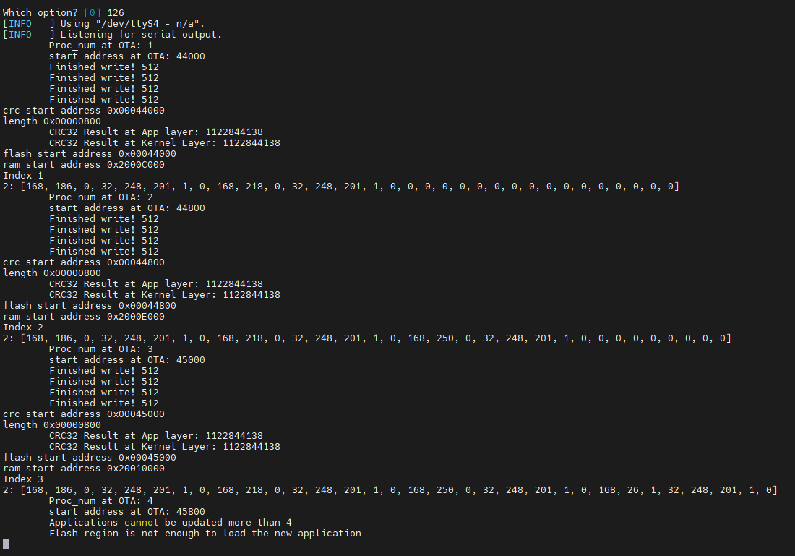
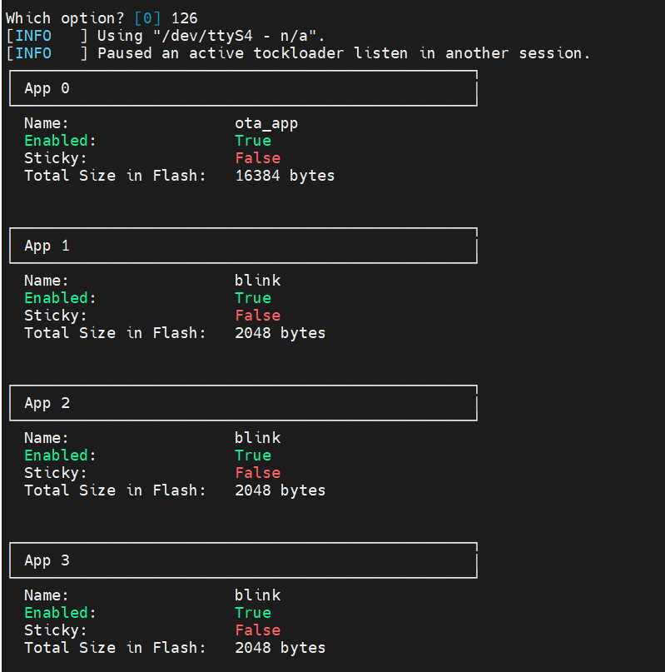
Load apps and update the PROCESSES array
Kernel
Static
APP1
Grant 1
Process Control Block 1
APP2
Grant 2
Process Control Block 2
App 1
App 2
App 3

Slide 8
Current status: PR#3068
Feedback list of ‘pull request’
Minimized the usage of ‘Unsafe’ in kernel module => Done! (use ‘Unsafe’ at core::slice::from_raw_parts / ProcessStandard::create / *self.ptr_process.offset(proc_data.index.try_into().unwrap()) = Some(process))
Removed 3 Global variables (INDEX_OF_PROCESS / FLASH_START_ADDRESS / UNUSED_RAM_START_ADDRESS) => Done! (replaced by grant)
Removed Hard code (#define) in OTA app => Done!
Removed unnecessary code snippets (debug!(), test code, extern C..) => Done!
Make CRC32(gh #3090) public to use it in process_load_utilities.rs => Done! (with the help of Alistair Francis)
Need to transfer process_load_utilities.rs into capsule => To do?
Others
Integrate ‘button version OTA app’ with ‘UART version OTA app’. For implementation test of OTA app, the button version OTA will be used
Organized code (Python, process_load_utillties)
Update the pull request??

Slide 9
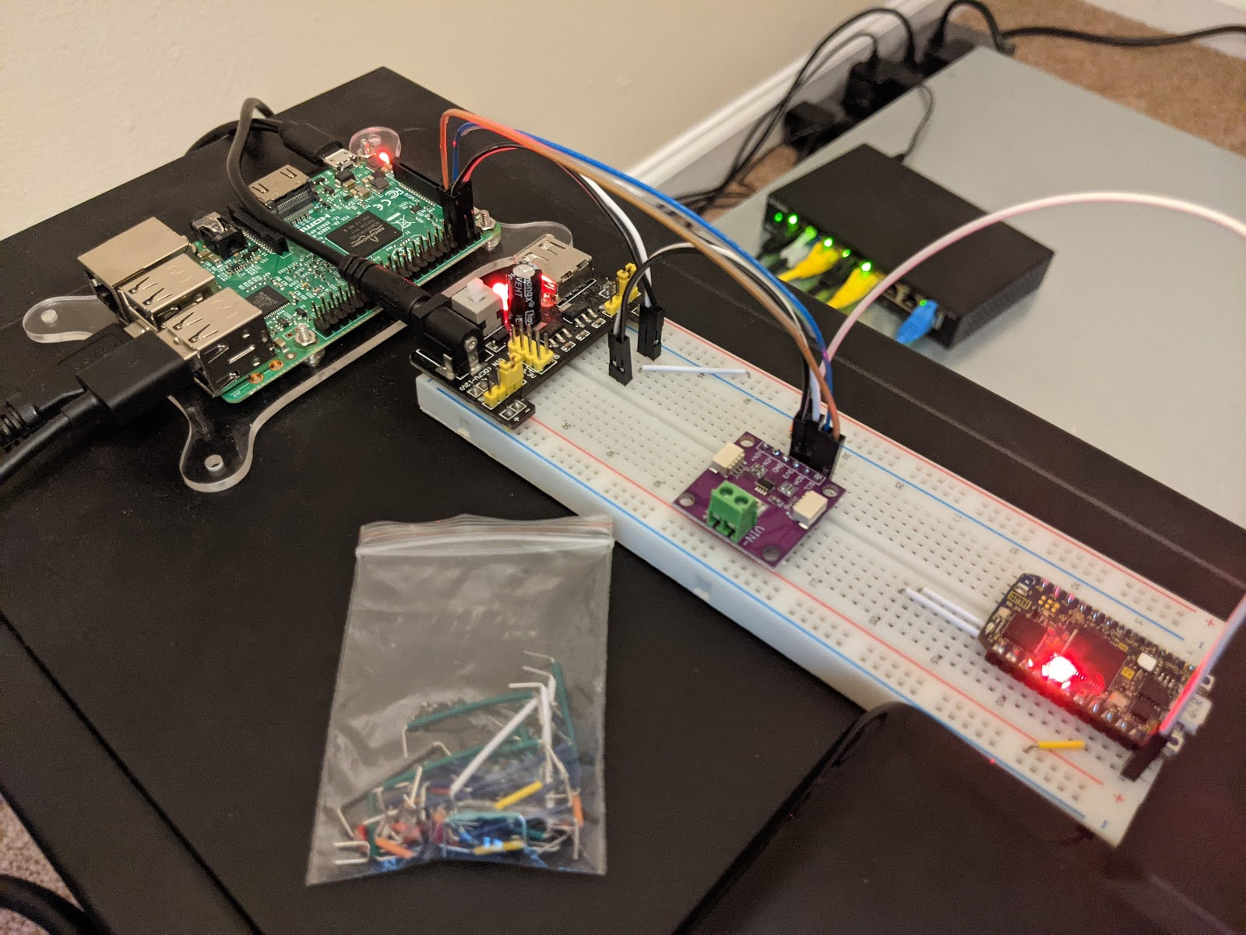
Will the updated device still work?
Risk: new combination of applications not harmonious on already deployed hardware
Testing architecture enables analyzing behavior of Tock platforms with new apps
Architecture three key components
Test monitor
Energy meters
Device under test
Device under test is any IoT device running the OS of interest
Software on the test monitor runs a workload on the IoT device
Test monitor: Raspberry PI (~$50)
Device under test has communication channels back to the test monitor
Examples: test energy and memory
Device under test
Test Monitor
Energy Meters
9

Slide 10
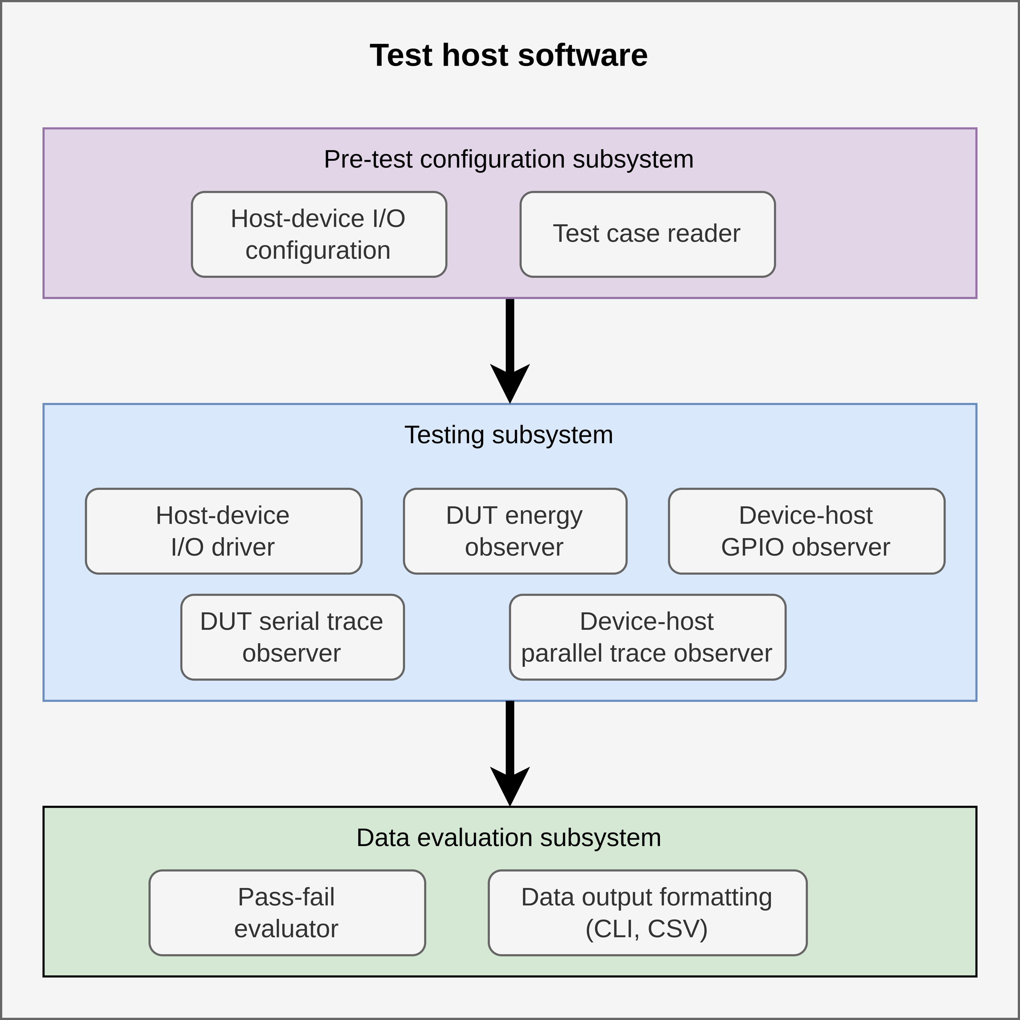
Testing software framework
Tests execute on the test monitor
Test framework:
Loads tests to run
Initializes the device under test
Parses inputs from device and monitors energy, events, and state
Compares observations to test requirements (pass/fail)
[software framework architecture diagram]
Tests are written in code, but compiled separately.

Slide 11
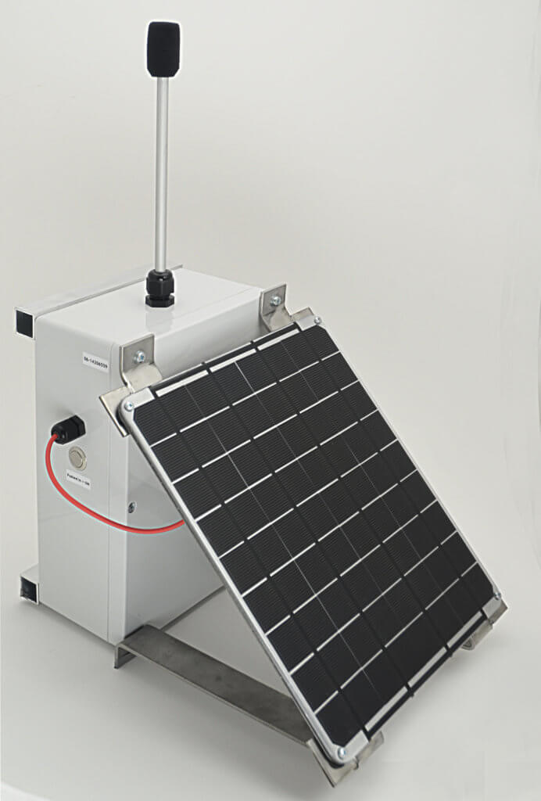
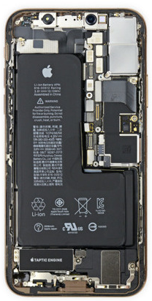
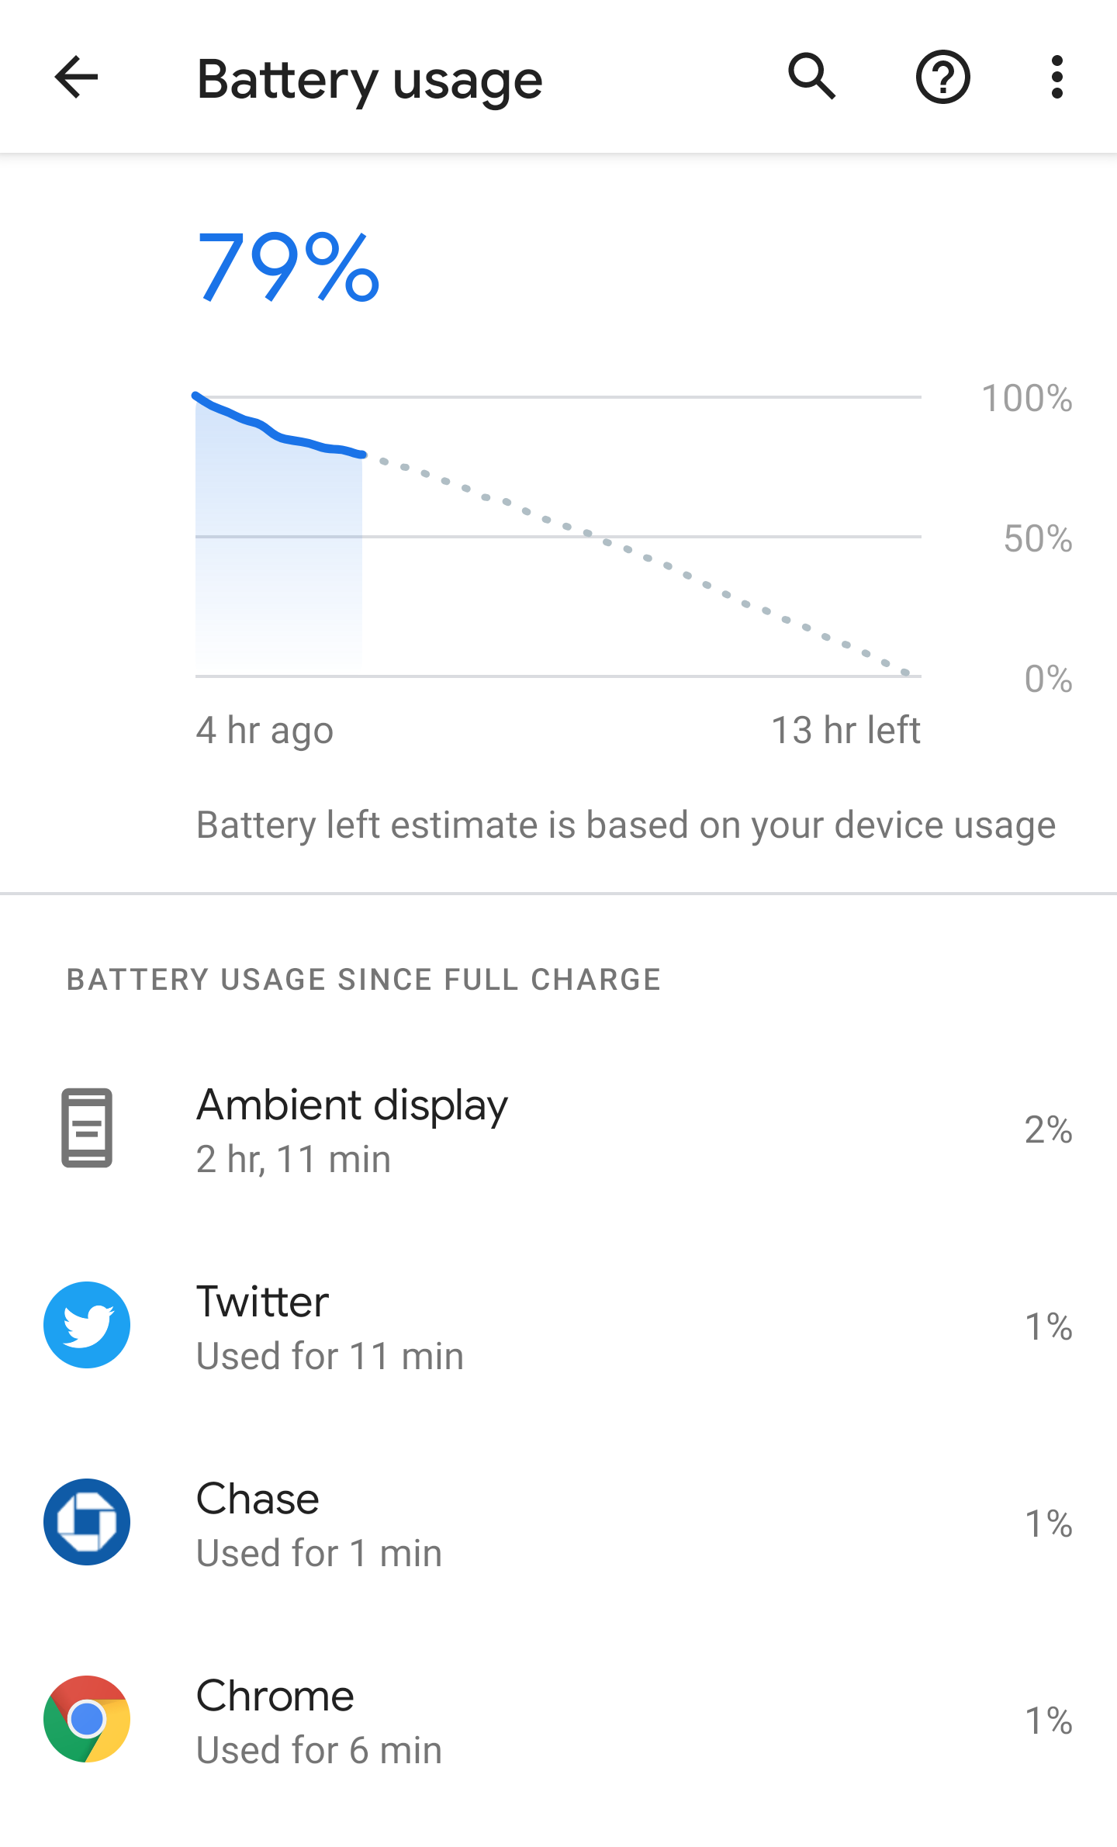

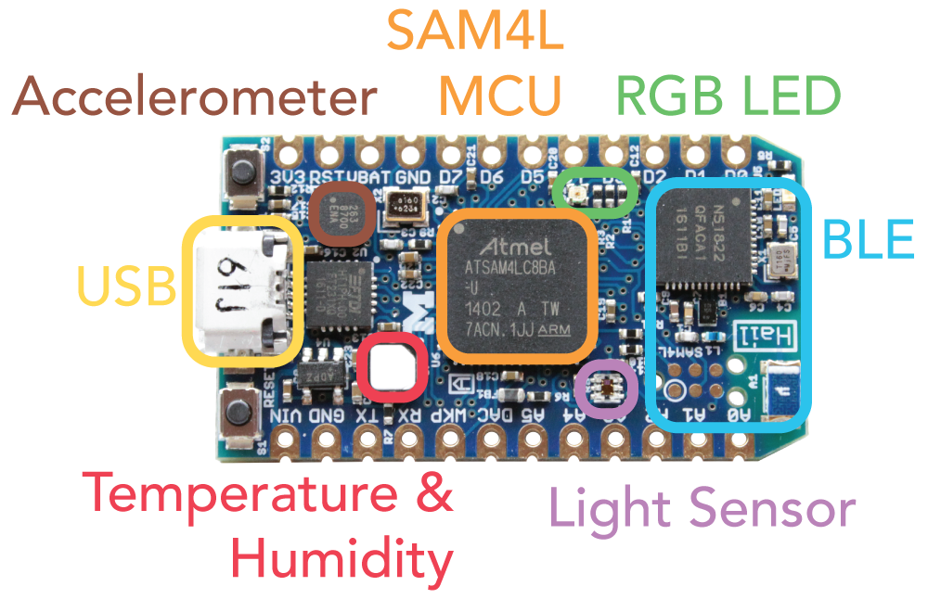
Issue #1: Energy
Energy is a critical challenge in IoT devices
Storing or collecting energy typically dominates the size
Less energy consumption: longer device lifetime, less maintenance, overall lower cost of operation
Smartphones, for example, include energy tracking
Typical IoT Device
Energy is consumed by each physical component on the device.
Light Sensor
MCU
Wireless Radio
Motion Sensor
LCD Screen
CO2 Sensor
Battery
Example questions:
My IoT device is drawing too much power, but why?
Will this change affect the power draw?
Which OS uses less power?
Notes:
Assuming no visibility

Slide 12
Running an energy test
Typical IoT Device
Test monitor observes the energy consumption of each hardware component
Opaque: no modification or insight into OS
Energy test:
Define the component to evaluate
Set allowed energy bounds
Run the device determine if conditions are met
Light Sensor
MCU
Wireless Radio
Motion Sensor
LCD Screen
CO2 Sensor
Battery
Energy Meters
Device under test
Test Monitor
EnergyTest::new( "radio-packet-tx", // test name "radio_send_app”, // test app
// test operations &[Operation::reset_device(), // reset Operation::idle_testbed(5000)], // wait 5s
&[Criterion::Energy(
EnergyCriterion::new(EnergyStat::Total) .with_max(350))] // max 350 mJ
)
Criterion (maximum limit)
Monitored trace
Notes:
Assuming no visibility

Slide 13
Testing radio energy consumption
Test monitor runs the test, monitors the hardware, and evaluates the pass/fail criterion
Criterion (maximum limit)
Monitored trace
radio-packet-tx Complete (in 3.000016813s) Platform specification: Energy metering: system-total (5441 samples)=== Criteria summary: - Energy: 'system-total' max consumption
min: -
max: 120.00 mW) (Pass) Message: 112.24mJ/s max

Slide 14
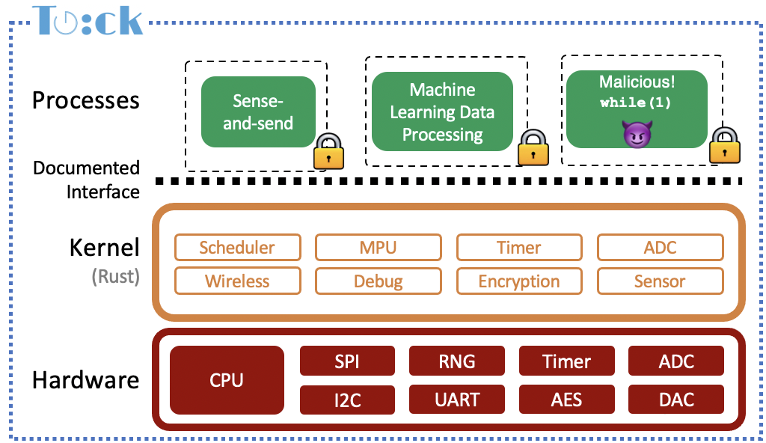
Issue #3: Memory
Embedded IoT devices have limited memory
Typical: ~64 kB of RAM
Comparison: Macbook Pro: 32 GB, Raspberry Pi: >2 GB
Memory is important!
Memory bugs lead to security vulnerabilities
SRAM is a major contributor to standby power draw
Memory is fixed when a device is manufactured
Re-engineering to reduce memory use is expensive
Large space to explore…
Focus on application memory requirements
Transparent: assume full access to modify Tock as needed

Slide 15
Primer: In Tock, processes have a fixed RAM memory region
All process-specific kernel state is stored in the process’s allocated memory (in the “grant” region).
That way, if a process requests too many resources only that process fails
Testing goal: enable testing process memory usage
Modify kernel
Unmodified processes
Process 1
Process 2
Grant section
Timer1 allocation
BLE allocation
Grant section
Timer1 allocation
Timer2 allocation
Timer3 allocation
Timer4 allocation
Timer5 allocation
Heap
Heap
Data
Data
Stack
Stack
Process RAM Allocation

Slide 16
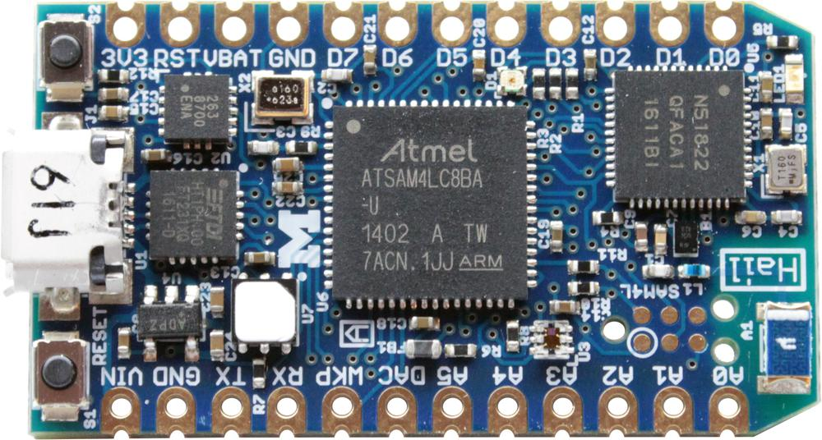
We modified Tock to create a counter table to account for all process memory
Counters track fine-grained process memory usage
Counters are updated every time memory usage changes
Device only streams updated counter values when they change
Reduces communication overhead
Test monitor tracks memory usage over time
In-kernel counters
Grant section
Timer1 allocation
BLE allocation
Metric | Size
Grant Header | 242 B
Grant Region | 1960 B
Stack Size | 116 B
Heap
Data
Stack
UART
Device under test
Test Monitor

Slide 17
Memory testing mechanism enables comparing versions of the operating system
August 2021: 2.0 release of Tock
Does 2.0 treat process memory differently?
Need to know how OS version updates will affect application operation.
Should we install the OS update now?
Tock version | process control block | upcall queue | grant pointer table | grant data | total
1.6 | 644B | 360B | 52B | 284B | 1340B
2.0 | 648B | 360B | 112B | 188B | 1308B

Slide 18
We can also observe what effects hardware platforms have on process memory
Run same process on multiple hardware boards
Compare memory use
Example of top-down testing approach
Results
2% memory overhead penalty based on per-hardware kernel configuration

Slide 19
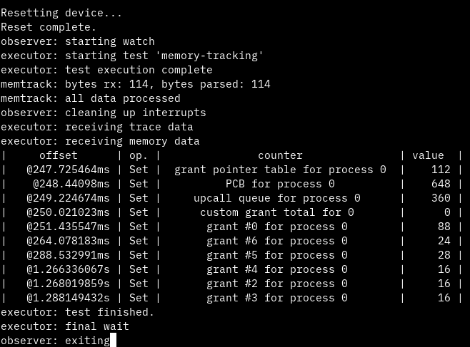
Memory test results
Test monitor tracks memory usage over time and evaluates conditions
Memory usage depends on application behavior over time

Slide 20
Repurposable devices
Dynamic app loading and updates
Testing/debugging app and system changes
Managing the inevitable relative decay of hardware

Slide 21
Simulate the future by downgrading the present
Consider in ten years…
Embedded microcontrollers include a decade of improvements
Software grows to fill hardware
2012: Hacking to fit TinyOS + 6LoWPAN + UDP + RPL + Deluge on msp430f1611
2022: Hacking to fit Tock on Ti50
Emulate future HW-SW divergence
./futurebuild -7y imix # compile imix for 7 year old hardware
Adjust RAM and flash sizes based on trends
Insert nops or adjust clock for slower/less performant HW
Disable ISA extensions

Slide 22
Upgrade the edge, not the devices
Future: ~1000:1 sensors to gateways
Easier to upgrade one gateway than one thousand IoT devices
Benefit from increased compute and new accelerators
Provision devices today to support app offload
Essential tasks (sensing, low latency) remain on-device
Computation shifts to gateways
Q: what abstractions needed for app developers?
Edge Offloading
App
App
Shadow App
App
App
…
Operating System
Edge Platform
Power Supply
IoT Device
Edge Gateways

Slide 23
Questions?
Brad Campbell
bradjc@virginia.edu

Slide 24


Processes
Sense-and-send
Machine Learning Data Processing
Malicious! while(1)
😈
Documented Interface
Kernel (Rust)
Scheduler
MPU
Timer
ADC
Wireless
Debug
Encryption
Sensor
Hardware
CPU
SPI
RNG
Timer
ADC
I2C
UART
AES
DAC
24
24

