Slide 1


Tock OS
Alexandru Radovici
Tockworld 6 - 2023

Slide 2
“
An embedded operating system designed for running multiple concurrent, mutually distrustful applications on low-memory and low-power microcontrollers.

Slide 3
TockOS
A pre-emptive embedded OS (runs on MCUs)
Cortex-M
RISC-V
Uses memory protection (MPU required)
Has separate kernel and user space
most embedded OS have the one piece software philosophy
Runs untrusted apps in user space
Kernel (and drivers) written in Rust
Apps written in C/C++ or Rust (any language that can be compiled)

Slide 4
Functional Components
Applications
user space processes
any language
independent executable
Capsules
hardware independent drivers
inside the kernel
safe rust
HAL
hardware dependent driver
unsafe rust
System calls (syscall)
Hardware Interface Layer (HIL)

Slide 5
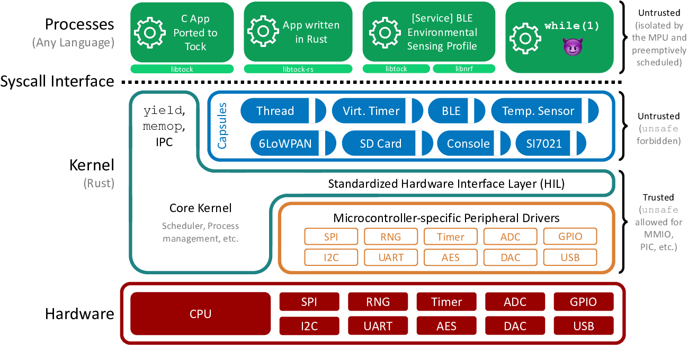
Architecture
Image from https://github.com/tock/tock/blob/master/doc/Overview.md

Slide 6
Kernel
Non pre-emptive
capsules (drivers) run to completion
async API
Does not allocate dynamic memory
only static buffers
no out of memory errors in kernel
Grants
memory for capsules in user processes
allocated at the start of a process (if possible)

Slide 7


Used by
Open-source implementation for security keys written in Rust that supports both FIDO U2F and FIDO2 standards.
Google Inc.
The first open source project building a transparent, high-quality reference design and integration guidelines for silicon root of trust (RoT) chips.
LowRISC, ETH Zurich, G+D Mobile Security,
Google, Nuvoton, Western Digital

Slide 8
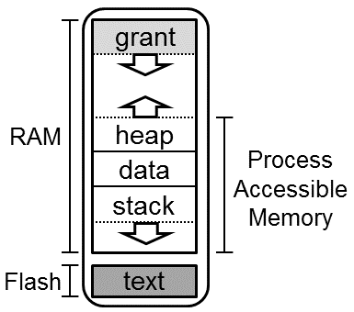
Application (Process)
Standalone executable
compiled without TockOS kernel
Memory Protection
MPU Regions
Can (seg)fault
Relocatable code
where the compiler allows it
IPC
service discovery

Slide 9
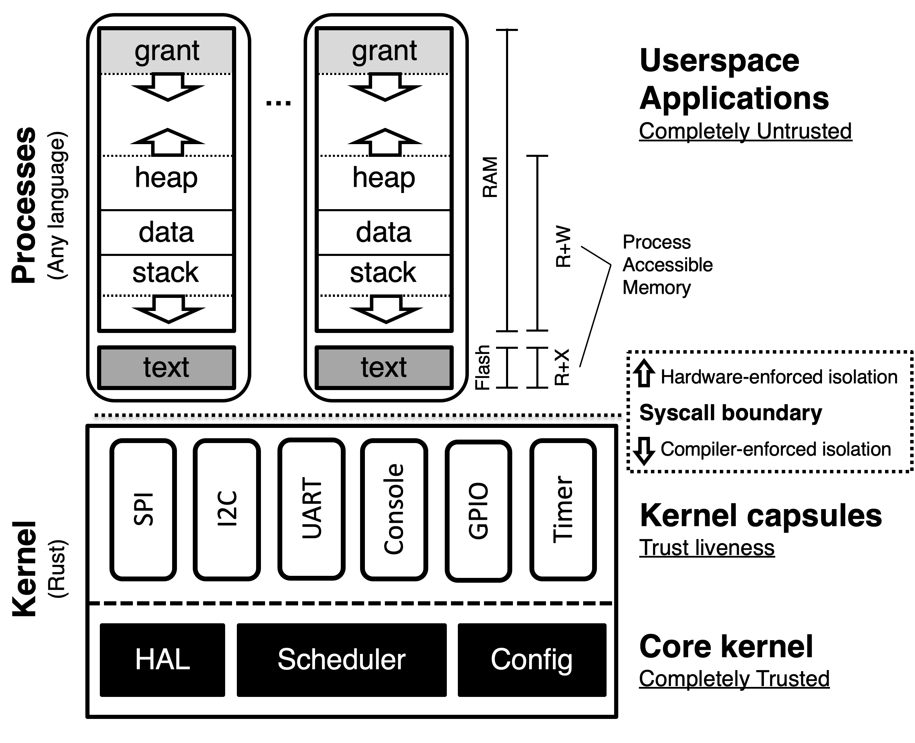
Memory
Image from https://github.com/tock/tock/blob/master/doc/Design.md

Slide 10
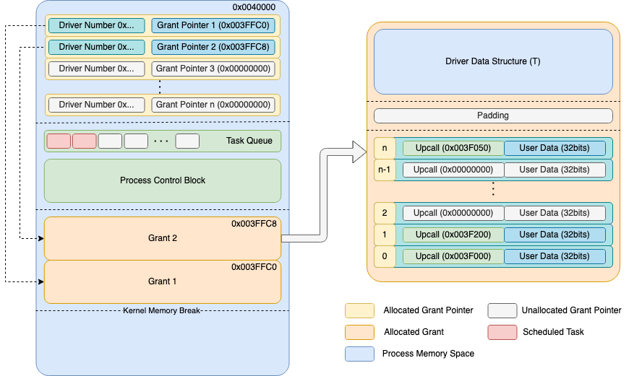
Grant

Slide 11
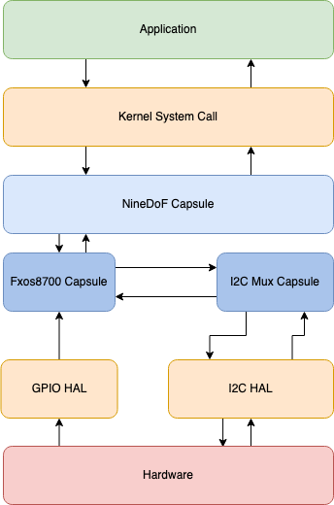
Only 7 Syscalls
0 – Yield
1 – Subscribe
2 – Command
3,4 – Allow
5 – Memop
6 – Exit

Slide 12
Yield
Processes have a callback queue
similar with an event loop system
Suspends the process until a callback is available
Callbacks are called only when the process is yielded
when main returns, libtock-c runs while (true) yield();

Slide 13
Subscribe
The process registers a callback function
Parameters
capsule_number – id of the driver
subscribe_number – a sub_command number, specific to the driver
callback – pointer to a function or NULL
user_data – any pointer

Slide 14
Command
The process sends a command to a driver
similar with ioctl from Linux
Parameters
capsule_number – id of the driver
command_number – a command_command number, specific to the driver
data1 – usize parameter
data2 – usize parameter

Slide 15
ReadWrite/ReadOnly Allow
The process shares a buffer with a driver
Parameters
capsule_number – id of the driver
allow_number – an allow_command number, specific to the driver
pointer – pointer to the buffer data
size – size of the buffer data

Slide 16
Memop
The process requests a memory action
similar with brk and sbrk from Linux
Parameters
op_type – action id
argument – usize parameter

Slide 17
Exit
Stop or restart the process
Parameters
restart – action id
completion_code – usize

Slide 18
Full system call

Slide 19
Userland libraries
LibTock-C
LibTock-RS
Stable (recommended)
newlib
libc
libm
libc+
Lua53
LittlevGL
RV32: issue with code relocation
not stable yet
core
active development
issue with relocation
Compiler problem

Slide 20
Tock Executable
Tock Binary Format
TBF
Tock header with memory and loading requirements
Process binary
Tock Application Bundle
TAB
several TBF files for several architectures
ARM M0, M3, M4, RV32-IMAC and RV32-IMC

Slide 21

Tockloader
Manage Tock OS Application
Uses TAB files
Written in Python
Needs implementation for several boards
Small App Store

Slide 22
Future Plans
In Progress
Ethernet for STM32
WiFi for Raspberry Pi Pico W
Tockloader Rust version

Slide 23
www.tockos.org
Thank you

