Slide 1

Installation of Python 3.6 & GDAL packages on Windows with Anaconda
Nesrin Salepci
Friedrich-Schiller-University Jena
Department for Earth Observation, Jena, Germany

Slide 2
The Tasks
The steps include
Download & install Anaconda with Python
Add Anaconda and Python into system paths
Download & install Pycharm
Install GDAL
Set the paths in Pycharm
Designed for:
64 bit Windows
Python 3.6
Gdal 2.2.2
Pycharm 2017.3.2

Slide 3
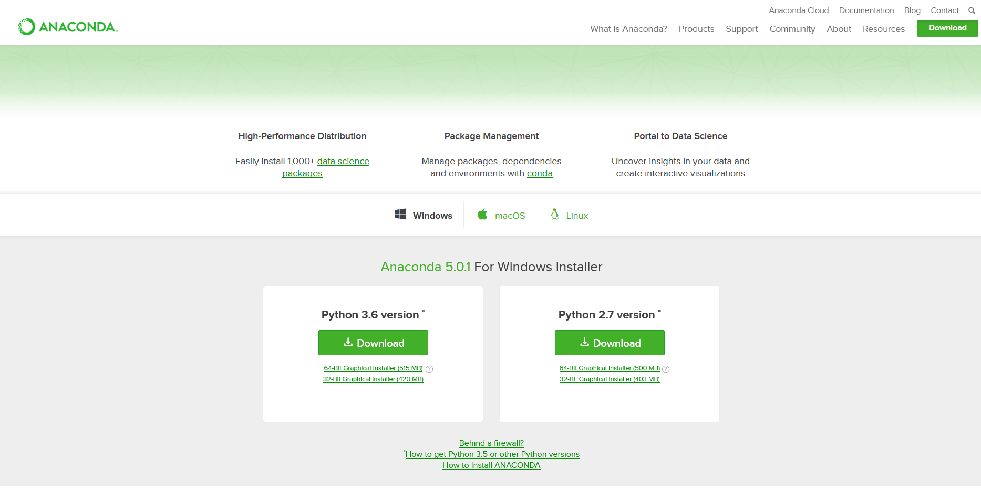
1. Download Anaconda
Visit below link for the download :
https://www.anaconda.com/download/#download
Pick the version Python 3.6
64 bit installer
(32 bit version can cause memory errors during processing)

Slide 4
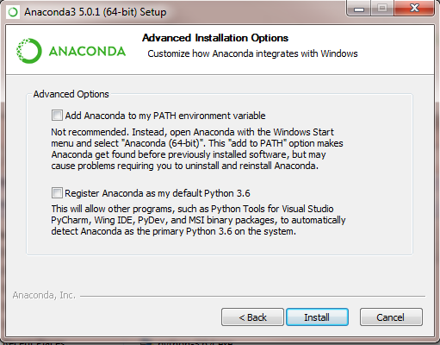
2. Installing Anaconda
Run the installation for Anaconda.
When the installation comes to the window with advanced options
do not check the box:
Anaconda to my path environment variable box
especially if you do not have an admin access in the computer you are working with

Slide 5
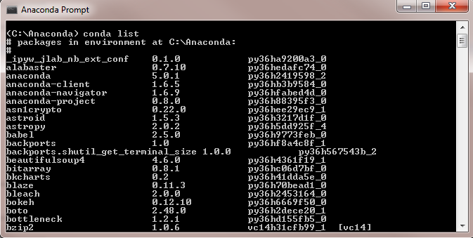
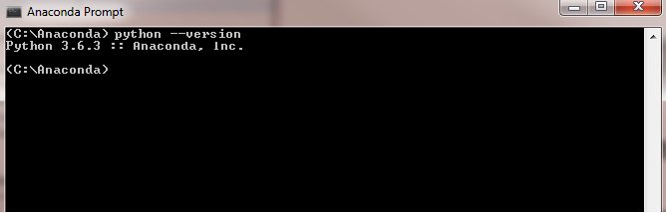
3. Test the installation
Open Anaconda Prompt
Write on the console : conda list
If there is a list coming, the installation looks good
You can check the python version by:
python --version

Slide 6
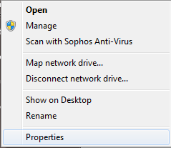

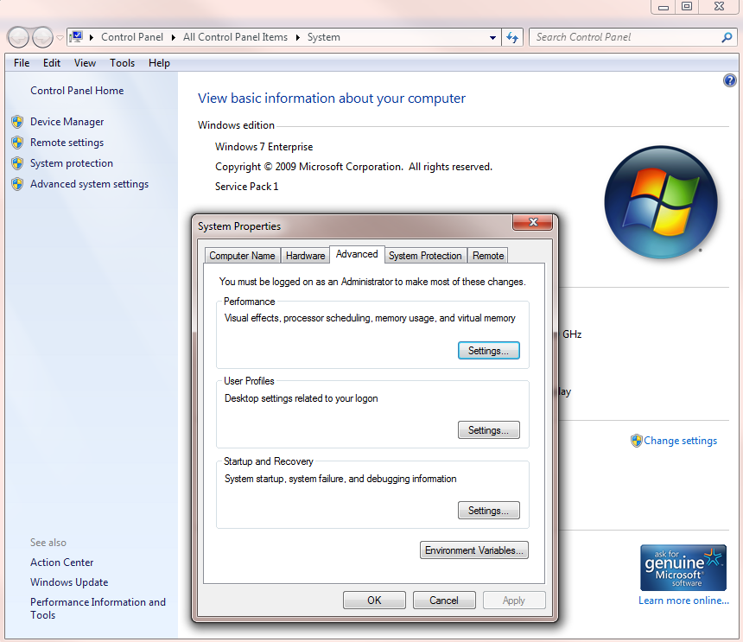
4. Add Anaconda and python to your path
Right click on computer, from the menu select properties
Click on the Advanced system settings
On the Advanced tab select click on the
Environment variable
right click

Slide 7
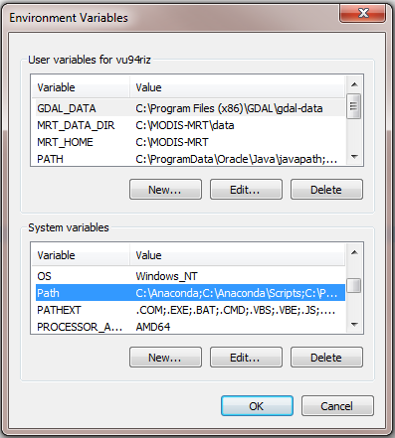
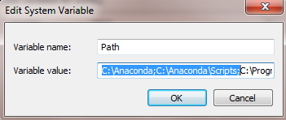
4. Add Anaconda and python to your path
Go to Path in the system variable list
Click edit
Add the path to Anaconda at the beginning of the variable value
If the path is C:\Anaconda, type:
C:\Anaconda;C:\Anaconda\Scripts;
Click OK

Slide 8
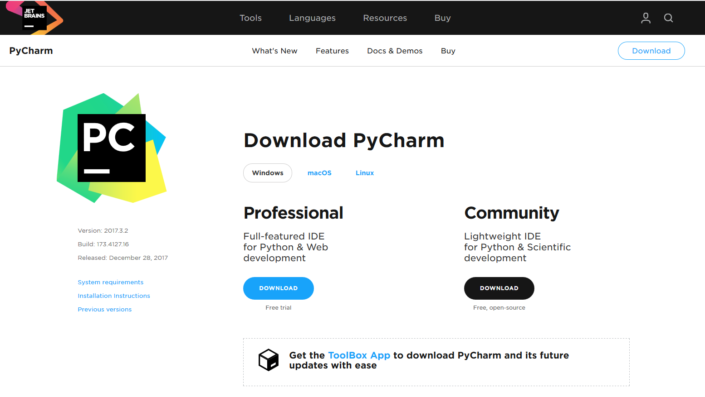
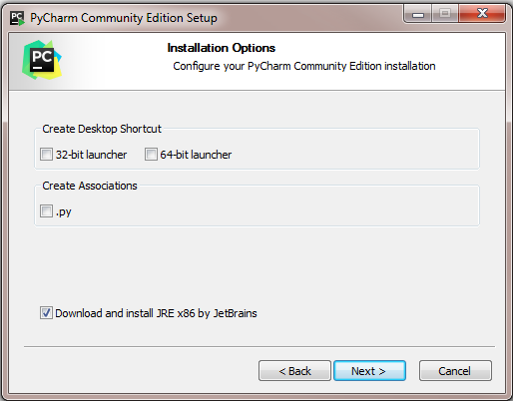
5. Download and install Pycharm
Download the community edition of Pycharm
https://www.jetbrains.com/pycharm/download/#section=windows
Run the installation till this window
Click on this box
Continue with installation (click on next)

Slide 9
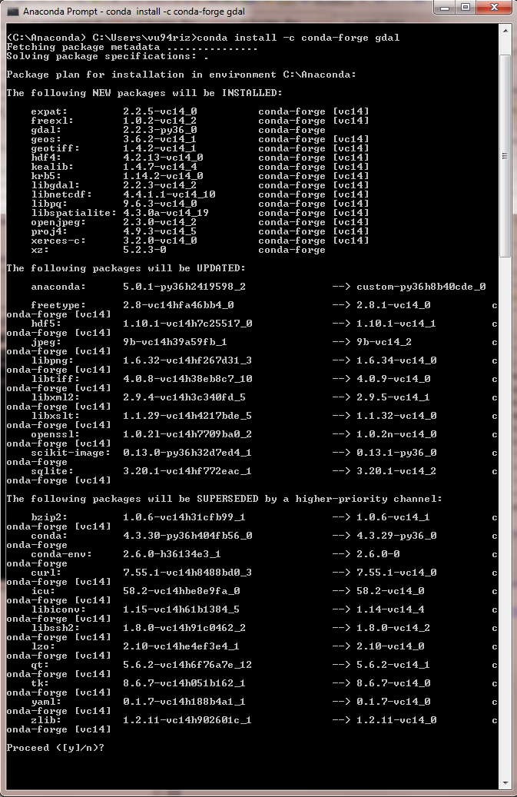

6. Install Gdal
Type on Anaconda or command promt:
conda install -c conda gdal
proceed?(y/n)
Enter y

Slide 10
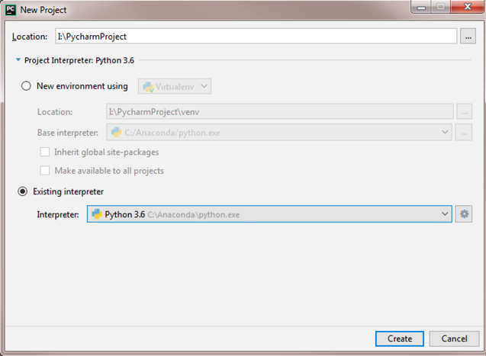
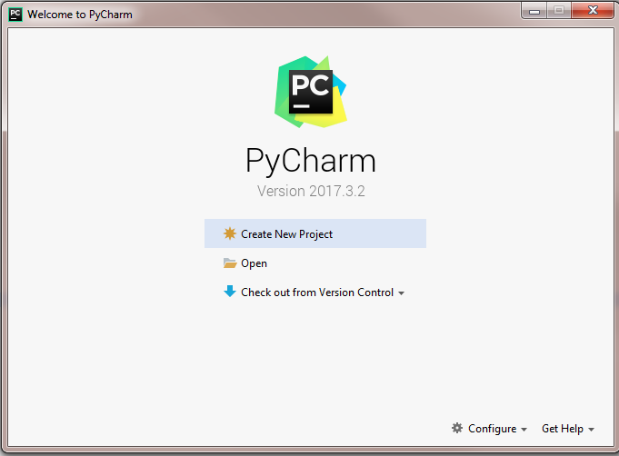
7. Setting Pycharm
run Pycharm and select the interpreter

Slide 11
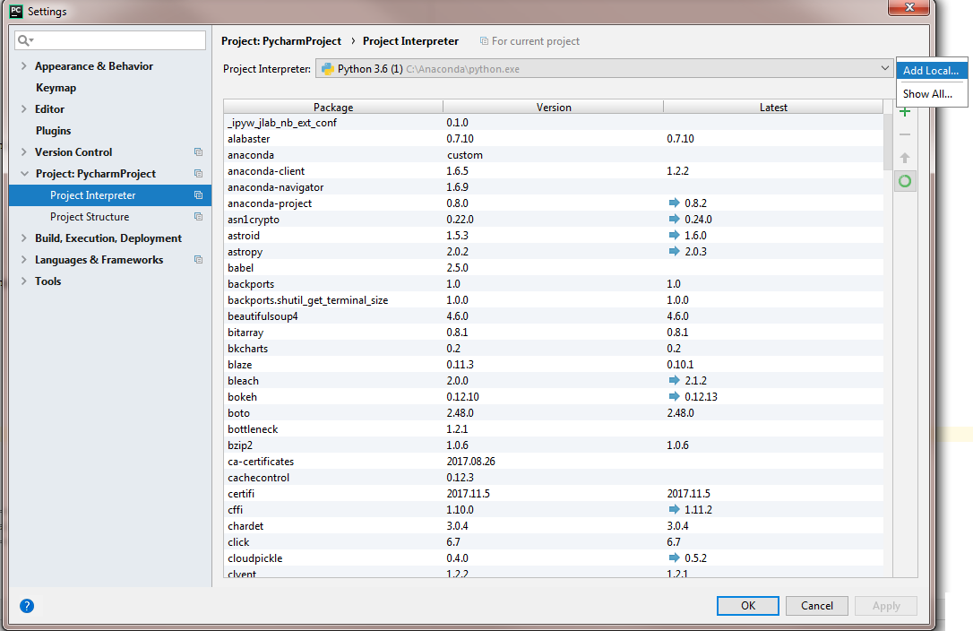
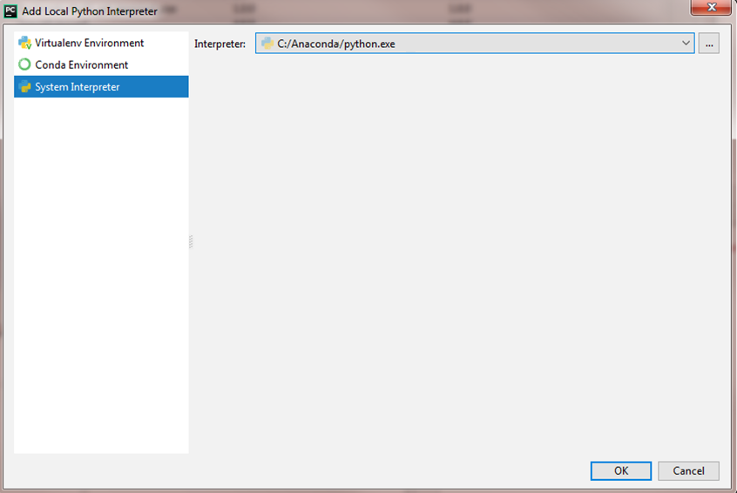
7. Setting Pycharm
Check if the project interpreter is correct:
On Pycharm
File > Settings > Project Interpreter
Click on the symbol, then
Add Local
Check if the path is correct

Slide 12
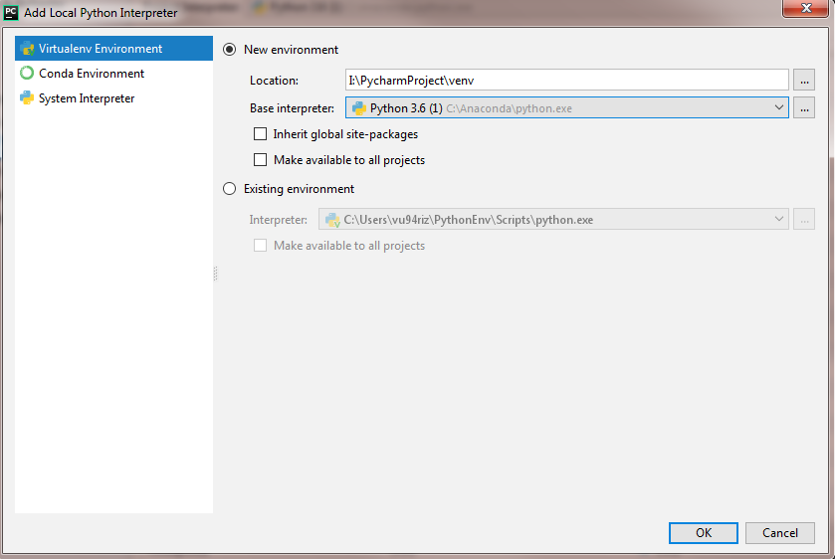
7. Setting Pycharm
In the Virtualenv Environment tab:
Select the Python under Anaconda

Slide 13
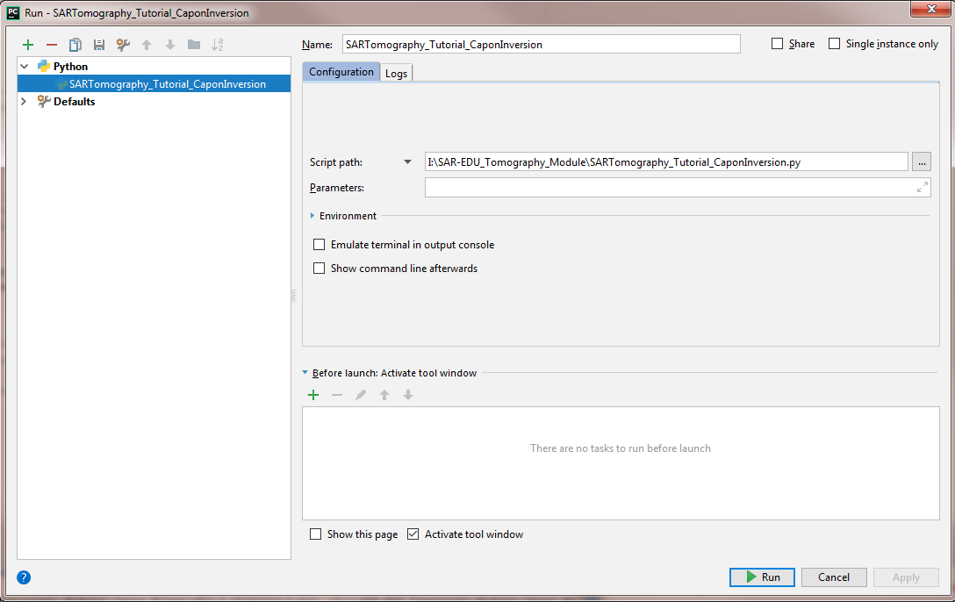
8. Run the Python Script
To run the script:
Click on Run in the main menu
Edit configurations
Check the script path

Slide 14
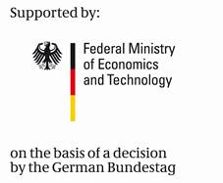

SAR-EDU
SAR Remote Sensing Education Initiative
https://eo-college.org
F-SAR data for the SAR Tomography Tutorial is provided by DLR (German Aerospace Center)

