Slide 1

SAR Tomography
TUTORIAL
Nesrin Salepci
Friedrich-Schiller-University Jena
Department for Earth Observation, Jena, Germany

Slide 2
The Task & Outline
The task of the tutorial is
to perform the tomographic SAR processing with Capon Beamforming approach
to plot the results!
The algorithm is written in Python.
OUTLINE
Dataset
Processing steps
Read input data, remove flat-earth and topographical phase, calculate covariance matrix, Inversion
Inversion algorithm
Calculate steering matrix, calculate the filter, reconstruction of the reflectivity profiles
Processing details
Python Script
Results

Slide 3
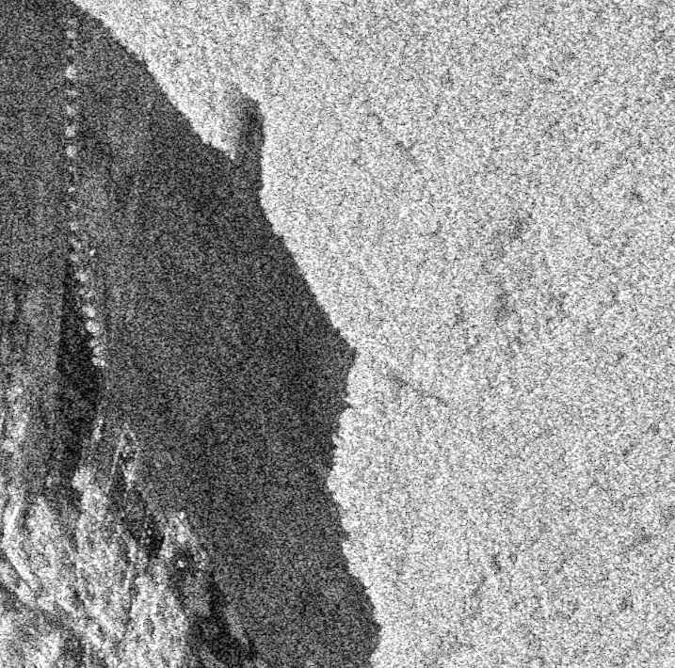


Dataset
Tomographic SAR dataset is acquired by DLR’s airborne SAR system: F-SAR
L-Band
HV Polarization
9 tracks
all the slave images are co-registered to the master image
the residual phase, e.g. due to atmosphere, is removed.
amplitude image of the master SLC
The input F-SAR data and related files provided by DLR are:
 | SLC | Flat-Earth & DEM Phase | Wavenumber
master | SLC_0_20151013_L_hv | - | -
slave 1 | SLC_1_20151013_L_hv | Pha_1_20151013_L_hv | Kz_1_20151013_L_hv
slave 2 | SLC_2_20151013_L_hv | Pha_2_20151013_L_hv | Kz_2_20151013_L_hv
slave 3 | SLC_3_20151013_L_hv | Pha_3_20151013_L_hv | Kz_3_20151013_L_hv
slave 4 | SLC_4_20151013_L_hv | Pha_4_20151013_L_hv | Kz_4_20151013_L_hv
slave 5 | SLC_5_20151013_L_hv | Pha_5_20151013_L_hv | Kz_5_20151013_L_hv
slave 6 | SLC_6_20151013_L_hv | Pha_6_20151013_L_hv | Kz_6_20151013_L_hv
slave 7 | SLC_7_20151013_L_hv | Pha_7_20151013_L_hv | Kz_7_20151013_L_hv
slave 8 | SLC_8_20151013_L_hv | Pha_8_20151013_L_hv | Kz_8_20151013_L_hv
©DLR
Phase file for slave 1
Kz file for slave 1

Slide 4
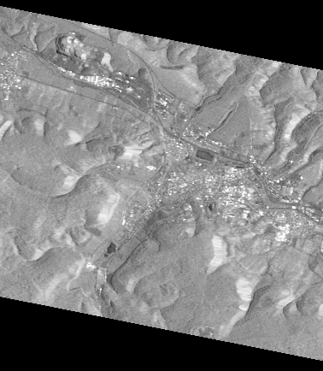




Processing Steps
input data
calculation of the covariance matrix
Estimation of the coherence
Coregistered
SLCs
Complex data vector
|ρ_{nm}|=$\frac{|E\left\{ynym∗\right\}|}{\sqrt{E\left\{|yn|2\right\}E\left\{|ym|2\right\}}}$
N
.
.
2
1
y_{o,1}
y_{o,2}
.
.
.
y_{o,N}
Read input data
y_{o,n} =
* : complex conjugate
$yn$ & $ym$ : SAR images
$E\left\{\right\}$ : represents the spatial average over defined window size
Remove flat-earth & topographical phase
Nx1
covariance for one pixel
Inversion
Calculate covariance matrix
removal of flat-earth and topographical phase
1 | ρ₁₂ | … | ρ_{1N}
ρ₂₁ | 1 |  | ρ_{2N}
ρ_{N1} | ρ_{N2} | … | 1
Subtract the flat-earth & DEM phase ($φtopo$) from the complex data vector
R =
Inversion
y₁
y₂
.
.
.
y_{N}
…
….
...
$${yn=yo,n .e}^{\left( −j ∗φtopo \right) }$$
y_{n} =
NxN
Nx1

Slide 5



Inversion– Capon Beamforming Inversion
Capon (adaptive beam forming) Inversion
steering matrix
A
$${A=e}^{\left( −j ∗Kz∗\text{z}\text{vec} \right) }$$
Inversion
Calculate the steering matrix
A
a₁₁ | a₁₂ | … | a_{1Z}
a₂₁ | a₂₂ | … | a_{2Z}
a_{N1} | a_{N2} | … | a_{NZ}
A =
filter
h_{ABF} = $\frac{R0−1A}{AH R0−1A}$
…
…
….
...
Calculate the filter
h_{ABF}
NxZ
Reconstruction of the backscattering profile
height vector
Z_{vec}
z_{vec} =
z_{min} … z_{max}
Capon Beamforming
Inversion
P_{ABF} =(h_{ABF})^{H} R₀ h_{ABF}
Reconstruction of the backscattering profiles
P_{ABF}
1xZ
vertical
wavenumber
Kz
$$kz, n=\frac{4πbn}{λr0sinθl}$$
k_{z},1=0 (for master it is zero)
N : number of tracks
Z : number of discreet steps between z_{min} - z_{max}

Slide 6

Processing Details
Read input data
Stack of
SAR SLCs
Stack of
Flat-earth & DEM phase files
Stack of
Kz files
range
master
range
range
Remove flat-earth & topographical phase
slave 1
number of tracks = N
N-1
N-1
slave 2
azimuth
slave 3
slave 4
azimuth
azimuth
Calculate covariance matrix
Inversion

Slide 7





Processing Details
Read input data
Stack of
SAR SLCs
Stack of
Flat-earth & DEM phase files
Stack of
Flattened & normalized files
range
master
master
Remove flat-earth & topographical phase
slave 1
slave 2
slave 1
azimuth
slave 3
slave 2
slave 4
slave 3
slave 4
Calculate covariance matrix
${ ∗e}^{\left( −j ∗ \right) }=$
Inversion
$$yo,n$$
$$φtopo$$
$${yn}^{ }$$
$${yn=yo,n .e}^{\left( −j ∗φtopo \right) }$$

Slide 8



Processing Details
coherence matrix
range
Read input data
N * N
covariance matrix
azimuth
N
range
1
ρ₁₂
…
…
ρ_{1N}
Remove flat-earth & topographical phase
ρ₂₁
1
…
ρ_{2N}
N
…
…
1
…
…
azimuth
…
…
…
1
…
ρ_{N1}
ρ_{N2}
…
…
1
Calculate covariance matrix
Inversion
|ρ_{nm}| = $\frac{|E\left\{ynym∗\right\}|}{\sqrt{E\left\{|yn|2\right\}E\left\{|ym|2\right\}}}$
$$|E\left\{ynym∗\right\}|$$
complex conjugate multiplication of the image combinations
$$E\left\{|yn|2\right\} \& E\left\{|ym|2\right\}$$
square of the pixel values then multi looking (smoothing of the images)
with a multi looking factor (window size for smoothing)

Slide 9
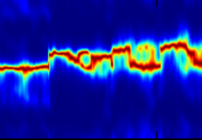







Processing Details
Read input data
Kz files
height vector
steering matrix
the filter
TomoSAR cube
range
range
m-m
m-s1
m-s2
m-s3
m-s4
azimuth
N-1
Remove flat-earth & topographical phase
azimuth
$$e^{\left( −j ∗ ∗ \right) =}$$
h
h
0 0 0 0 0 0 0 0 0 0
-4 -3 -2 -1 0 1 2 3 4 5
Calculate covariance matrix
h
Inversion
N
N
$$Kz$$
$$Zvec$$
$$A$$
$$hABF$$
$$PABF$$
$${A=e}^{\left( −j ∗Kz∗\text{z}\text{vec} \right) }$$
h_{ABF} = $\frac{R0−1A}{AH R0−1A}$
P_{ABF} =(h_{ABF})^{H} R₀ h_{ABF}

Slide 10

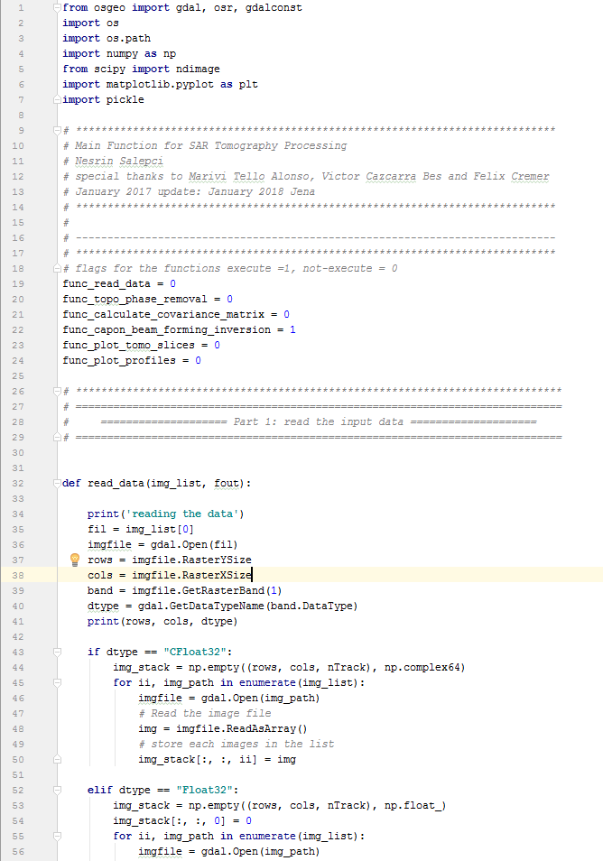
Python Script
Import python packages
In order to execute the functions,
assign 1!!
Define which functions to execute (function flags)
Definition of the functions
Define the input parameters
Call the functions

Slide 11
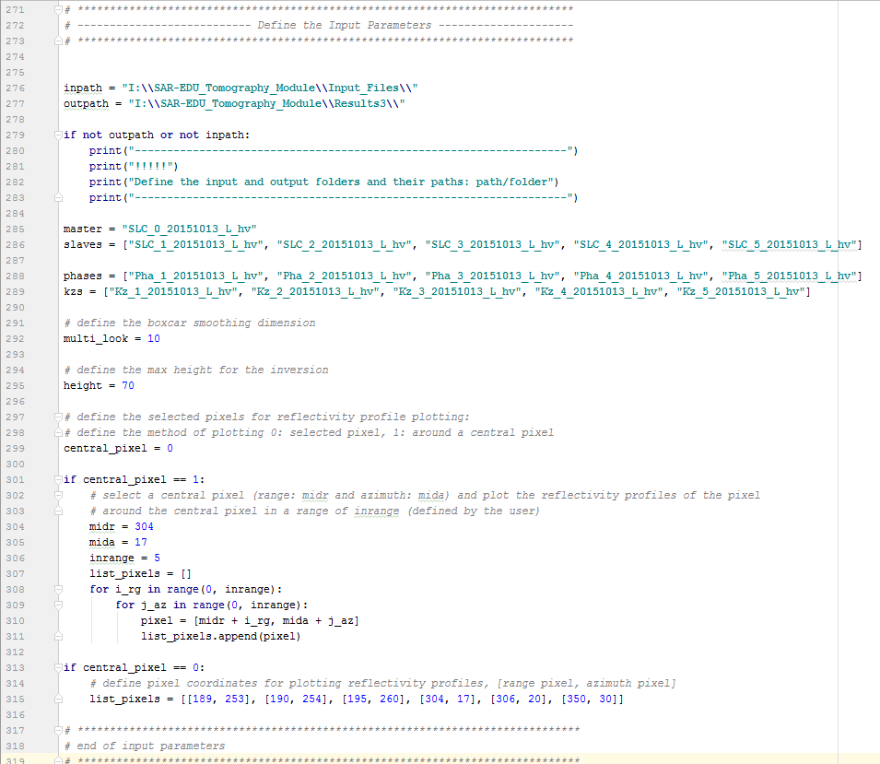
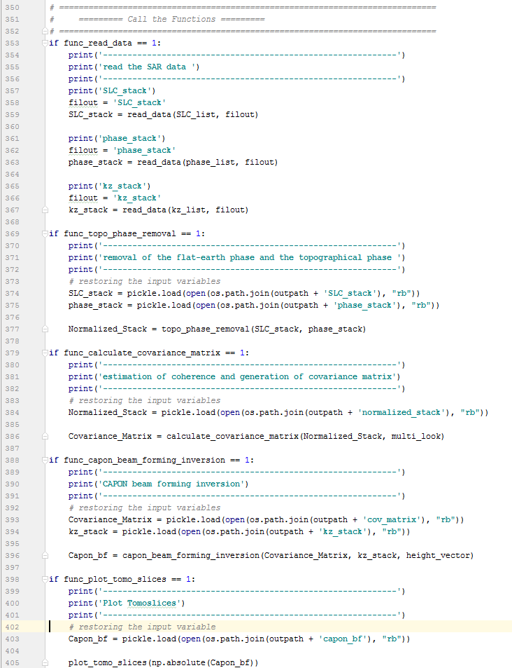
Python Script
In order to execute the script, define the variables inpath and outpath!!
Import python packages
Define which functions to execute (function flags)
define multi looking factor for the estimation of coherence
define height range for the inversion
Definition of the functions
Define the method for plotting
Define the input parameters
Define the central pixel in range and azimuth
Or select pixels to plot reflectivity profiles
Call the functions

Slide 12
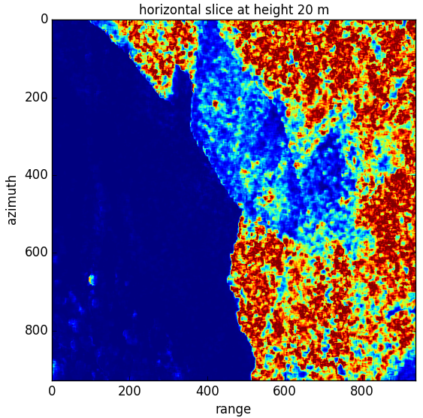
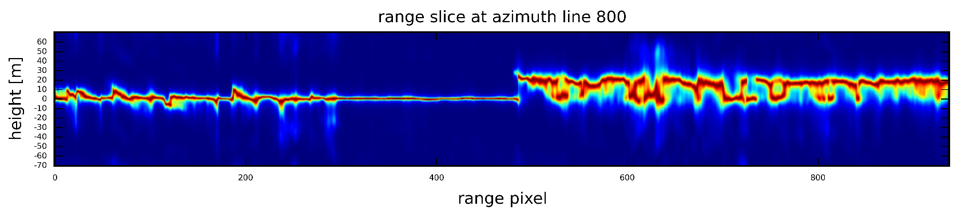
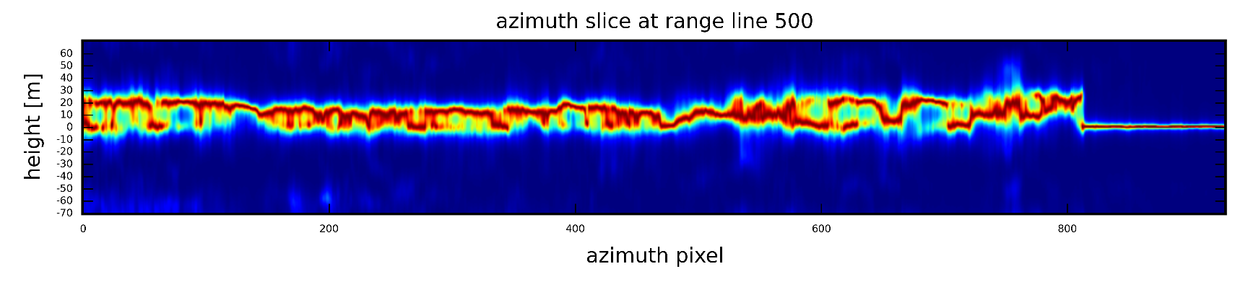
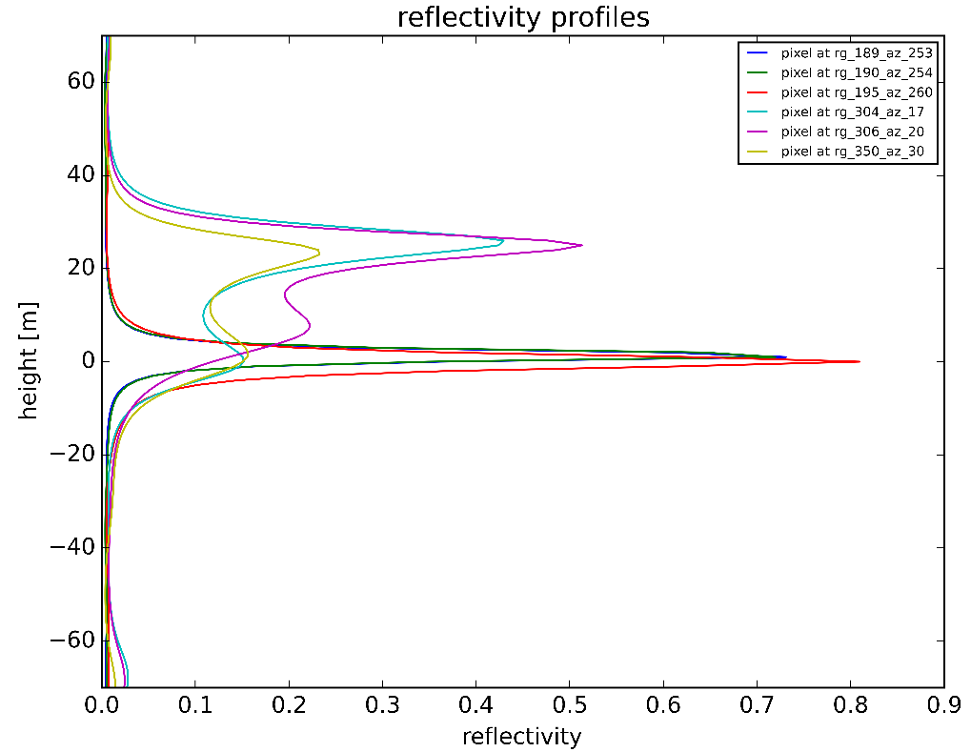
Results
settlements
ground
forest
forest
ground

Slide 13


SAR-EDU
SAR Remote Sensing Education Initiative
https://eo-college.org
F-SAR data for the SAR Tomography Tutorial is provided by DLR (German Aerospace Center)

