Slide 1
Cooperative bearings only tracking
Tracking an object with no knowledge of distance, only bearing
Object is tracked by many sensors
Information is shared between sensor robots
The problem is solved not by each robot but by the whole group

Slide 2

How it all began...
...with the Greeks, of course
Navigation at sea is a typical bearings only problem

Slide 3
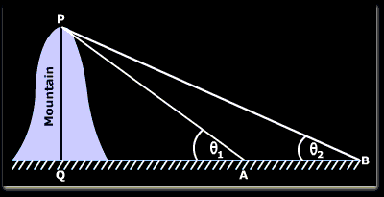
Finding the height of a mountain
Distance AB is known
The two angles are known
Then trigonometry makes finding PQ easy

Slide 4
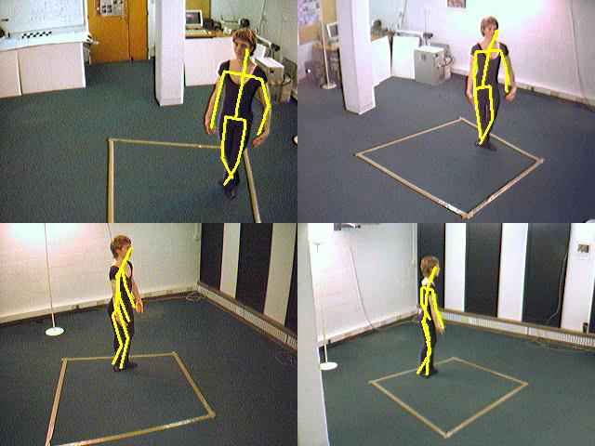
Modern applications
Tracking objects with a camera as a sensor

Slide 5
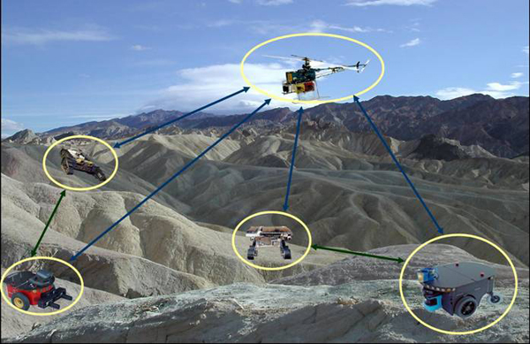
Sensor network
Data fusion
Different sensor techniques

Slide 6
Filtering
All signals have noise
The Kalman filter is an optimal filter with Gaussian noise
  The Kalman filter is linear
  Our problem is non-linear :(
Solutions
  Modified Kalman filters
  Monte Carlo methods

Slide 7
Flavours of kalman
Extended Kalman filter
  Linearises model
  Requires Jacobian
Iterated extended Kalman filter
  Re-linearises the model after each update
Unscented Kalman filter
  Needs carefully parameterised mean and covariance matrix
  More accurate for non-linear systems

Slide 8
More kalman?

Slide 9
Monte Carlo methods
Particle filters
Condensation algorithm
Survival of the fittest
Interacting particle approximation

Slide 10
Particle Filters
Recursive Monte Carlo method
Non-linear
Guesses the states of the tracked object
Tries to find the best approximation by testing if which hypothesis fits the data best

Slide 11
Networking
Share relevant information
Share information before it becomes obsolete
Prevent rumours spreading between nodes

