Slide 1
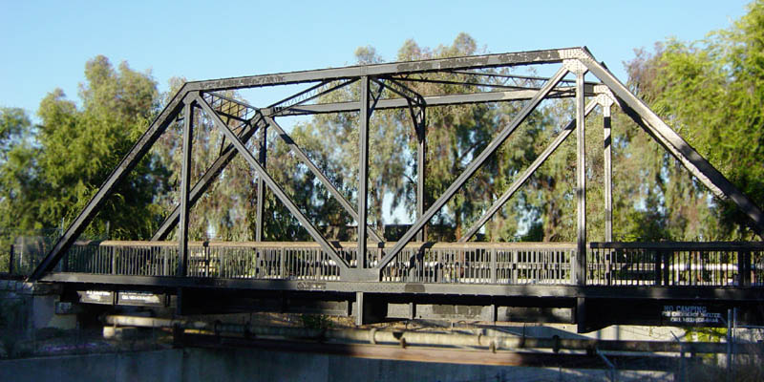
Lect. 3: Force Analysis of Truss Bridge
A truss is a structure composed of slender members joined together at their end points.
In particular, planar trusses lie in a single plane and are often used to support bridges.

Slide 2
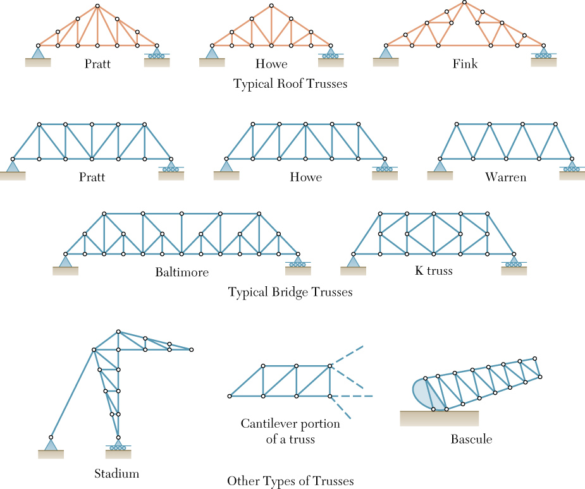
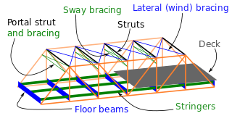
Different types of bridge truss
Notes:
https://www.youtube.com/watch?v=AoS0UvVfxRQ

Slide 3
Assumptions for Truss Bridge
All loads are applied at the joints.

Slide 4
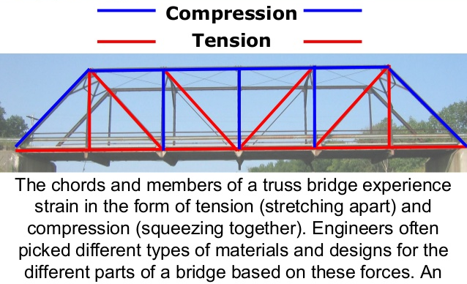
Force Analysis of Truss Bridge
Bridge design project:
force analysis (magnitude, C/T)→choose materials → construction

Slide 5
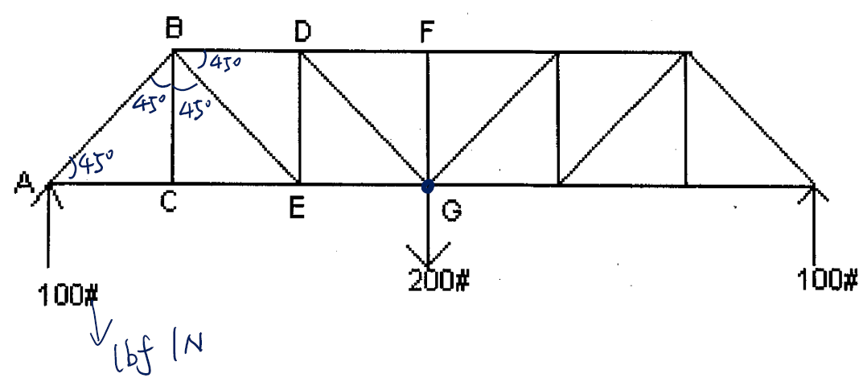
e.g. All angle members are 45°. Find forces in all members on left half of truss and in FG. List solutions on truss members. Note if Tension or Compression

Slide 6
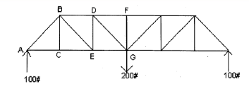
How to solve forces in a Bridge?
Step1: Assume ALL the unknown forces in truss members as in tension and sketch FBD for all the joints on left half (including the central member) of the bridge.
Step2: Make analysis of static equilibrium equation
∑Fx = 0, ∑ Fy = 0 for each joint based on the FBD in Step1.
–Start from the joint with one (or more) known force and maximum two unknown forces.
–Move on to the next joint with one (or more) known force and maximum two unknown forces until all the forces have been found.
Step3: Determine force magnitude and type (T/C) according to the calculated results in Step2
–If the result of force is ‘+’ →T.
–If the result of force is ‘-’ → C.

Slide 7
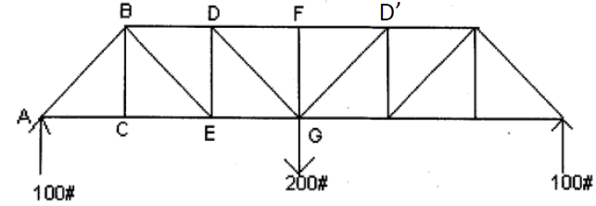
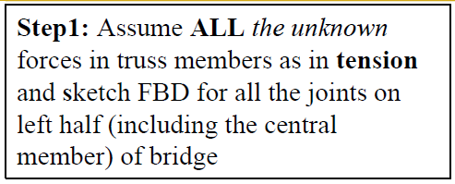
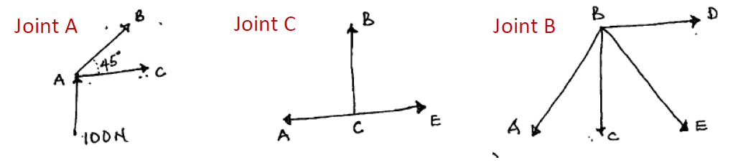
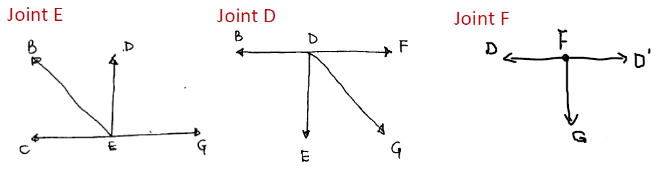

Slide 8
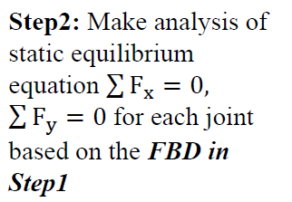
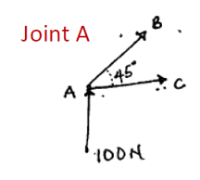

Slide 9
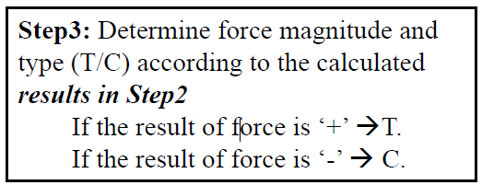
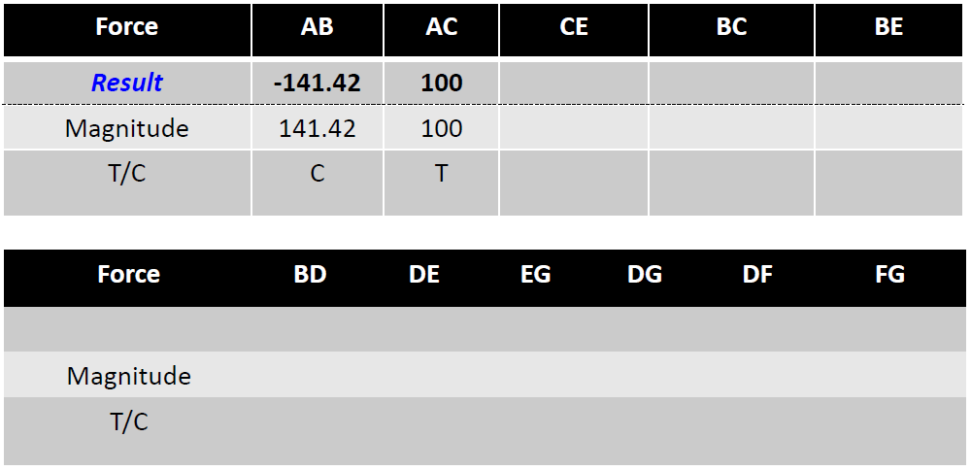

Slide 10
Move on to the next join with one (or more) known forces and maximum two unknown forces, and repeat steps 2 and 3 until all the forces have been found.
Remember!
- In the equilibrium equation: +/- are to say the direction of the component (left/right, up/down)
- In the results: +/- tell us the force type (“+” = Tension,
“-” = Compression)

Slide 11
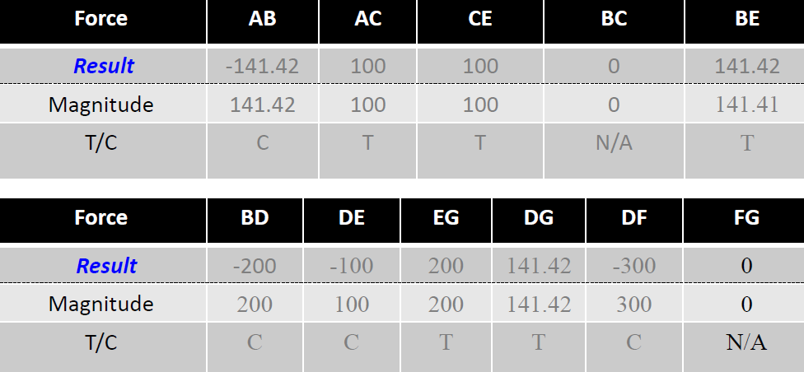
End Result

Slide 12
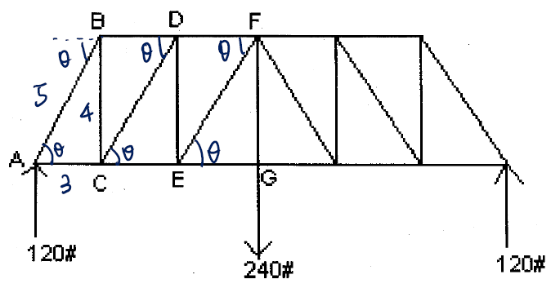
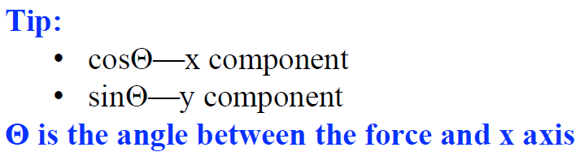
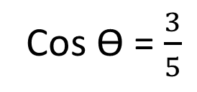
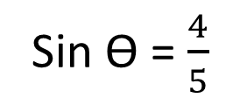
2. All panels are 3, 4, 5 proportion. Find forces in all members on left half of truss and in FG. List solutions on truss member and state whether Tension or Compression.
Cos ϴ = $\frac{3}{5}$
Sin ϴ = $\frac{4}{5}$

