Slide 1
ENGR19000 Elementary Engineering Design
Mechanical and Civil Engineering (MCE)
Kimia Mortezaei
Department of Mechanical and Civil Engineering
Purdue University Northwest

Slide 2
Mechanical and Civil Engineering (MCE)
Instructor: Dr. Kimia Mortezaei
Office: Powers 211K Phone: (219) 989-2123
Email: kmorteza@pnw.edu
Office hours: by appointment
Lab TA: Mervyn Earl John Medidi
Email: mmedidi@pnw.edu
Lecture: Potter 234, Monday 5:00pm - 5:50pm
Lab: Potter 308, Wednesday 17 – 19:50 pm, (ENGR 19000-018)

Slide 3
Instructor
Research Area: Geotechnical engineering, Geomechanics, Environmental Geomechanics.
Lecturer– University of South Alabama (2020-2021)
Post Doctoral Research Associate – CAVS, Mississippi State University (2017-2020)
Ph.D. – Mississippi State University (2014-2017)
MSc in Earthquake engineering– Semnan University (2010-2012)
BSc in Mechanical Engineering – Semnan University, Iran (2006-2010)
Notes:
Geomechanics is a scientific discipline that deals with the behavior of geological materials, such as rocks and soils, under the influence of various mechanical and environmental forces. It combines principles from geology, mechanics, and physics to understand how geological formations respond to stresses, pressures, and other external factors. The primary goal of geomechanics is to predict the mechanical behavior of Earth materials in different geological settings.

Slide 4
Brightspace
Course Materials - slides, manuals etc.
ENGR19000-017 LEC
Homework Submission from your lab session
ENGR19000-018 LAB

Slide 5
Course outline
Week | Lecture Date | Lecture Topic | Lab Topic
1 | 08/21 | Lect. 1: Introduction into engineering and design | HW1: vector, trig
2 | 08/28 | Lect. 2: Bridge types | -HW2
3 | 09/04 | Holiday | No lab
4 | 09/11 | Lect. 3: Materials selection and Failure | -Fatigue test HW, - Tensile Experiment
5 | 09/18 | Lect. 4: Manufacturing and 3D printing | - 3D Printing
6 | 09/25 | Lect. 5: - Bridge Construction | - Bridge Design + Construction
7 | 10/02 | Lect. 6: Sustainability | - Bridge Construction -Essay
8 | 10/09 | Final class (Q&A) | Bridge Testing

Slide 6
Introduction: What is Engineering?
Engineering according to Wikipedia is defined as the use of scientific principles to design and build machines, structures, and other items, including bridges, tunnels, roads, vehicles, and buildings.
The purpose of every engineer is to solve problems related with human activities in the most efficient, economical and environmentally friendly way possible.

Slide 7
Introduction: What is Engineering?
The term engineering is derived from the Latin ingenium, meaning “cleverness” and ingeniare, meaning “to contrive, devise”.

Slide 8
Introduction: Different field of engineering
Electrical Engineering
Computer Engineering
Mechanical Engineering
Civil Engineering
Materials Engineering
Industrial Engineering
Bioengineering
Chemical Engineering
https://www.youtube.com/watch?v=dwGNaixSKvI

Slide 9
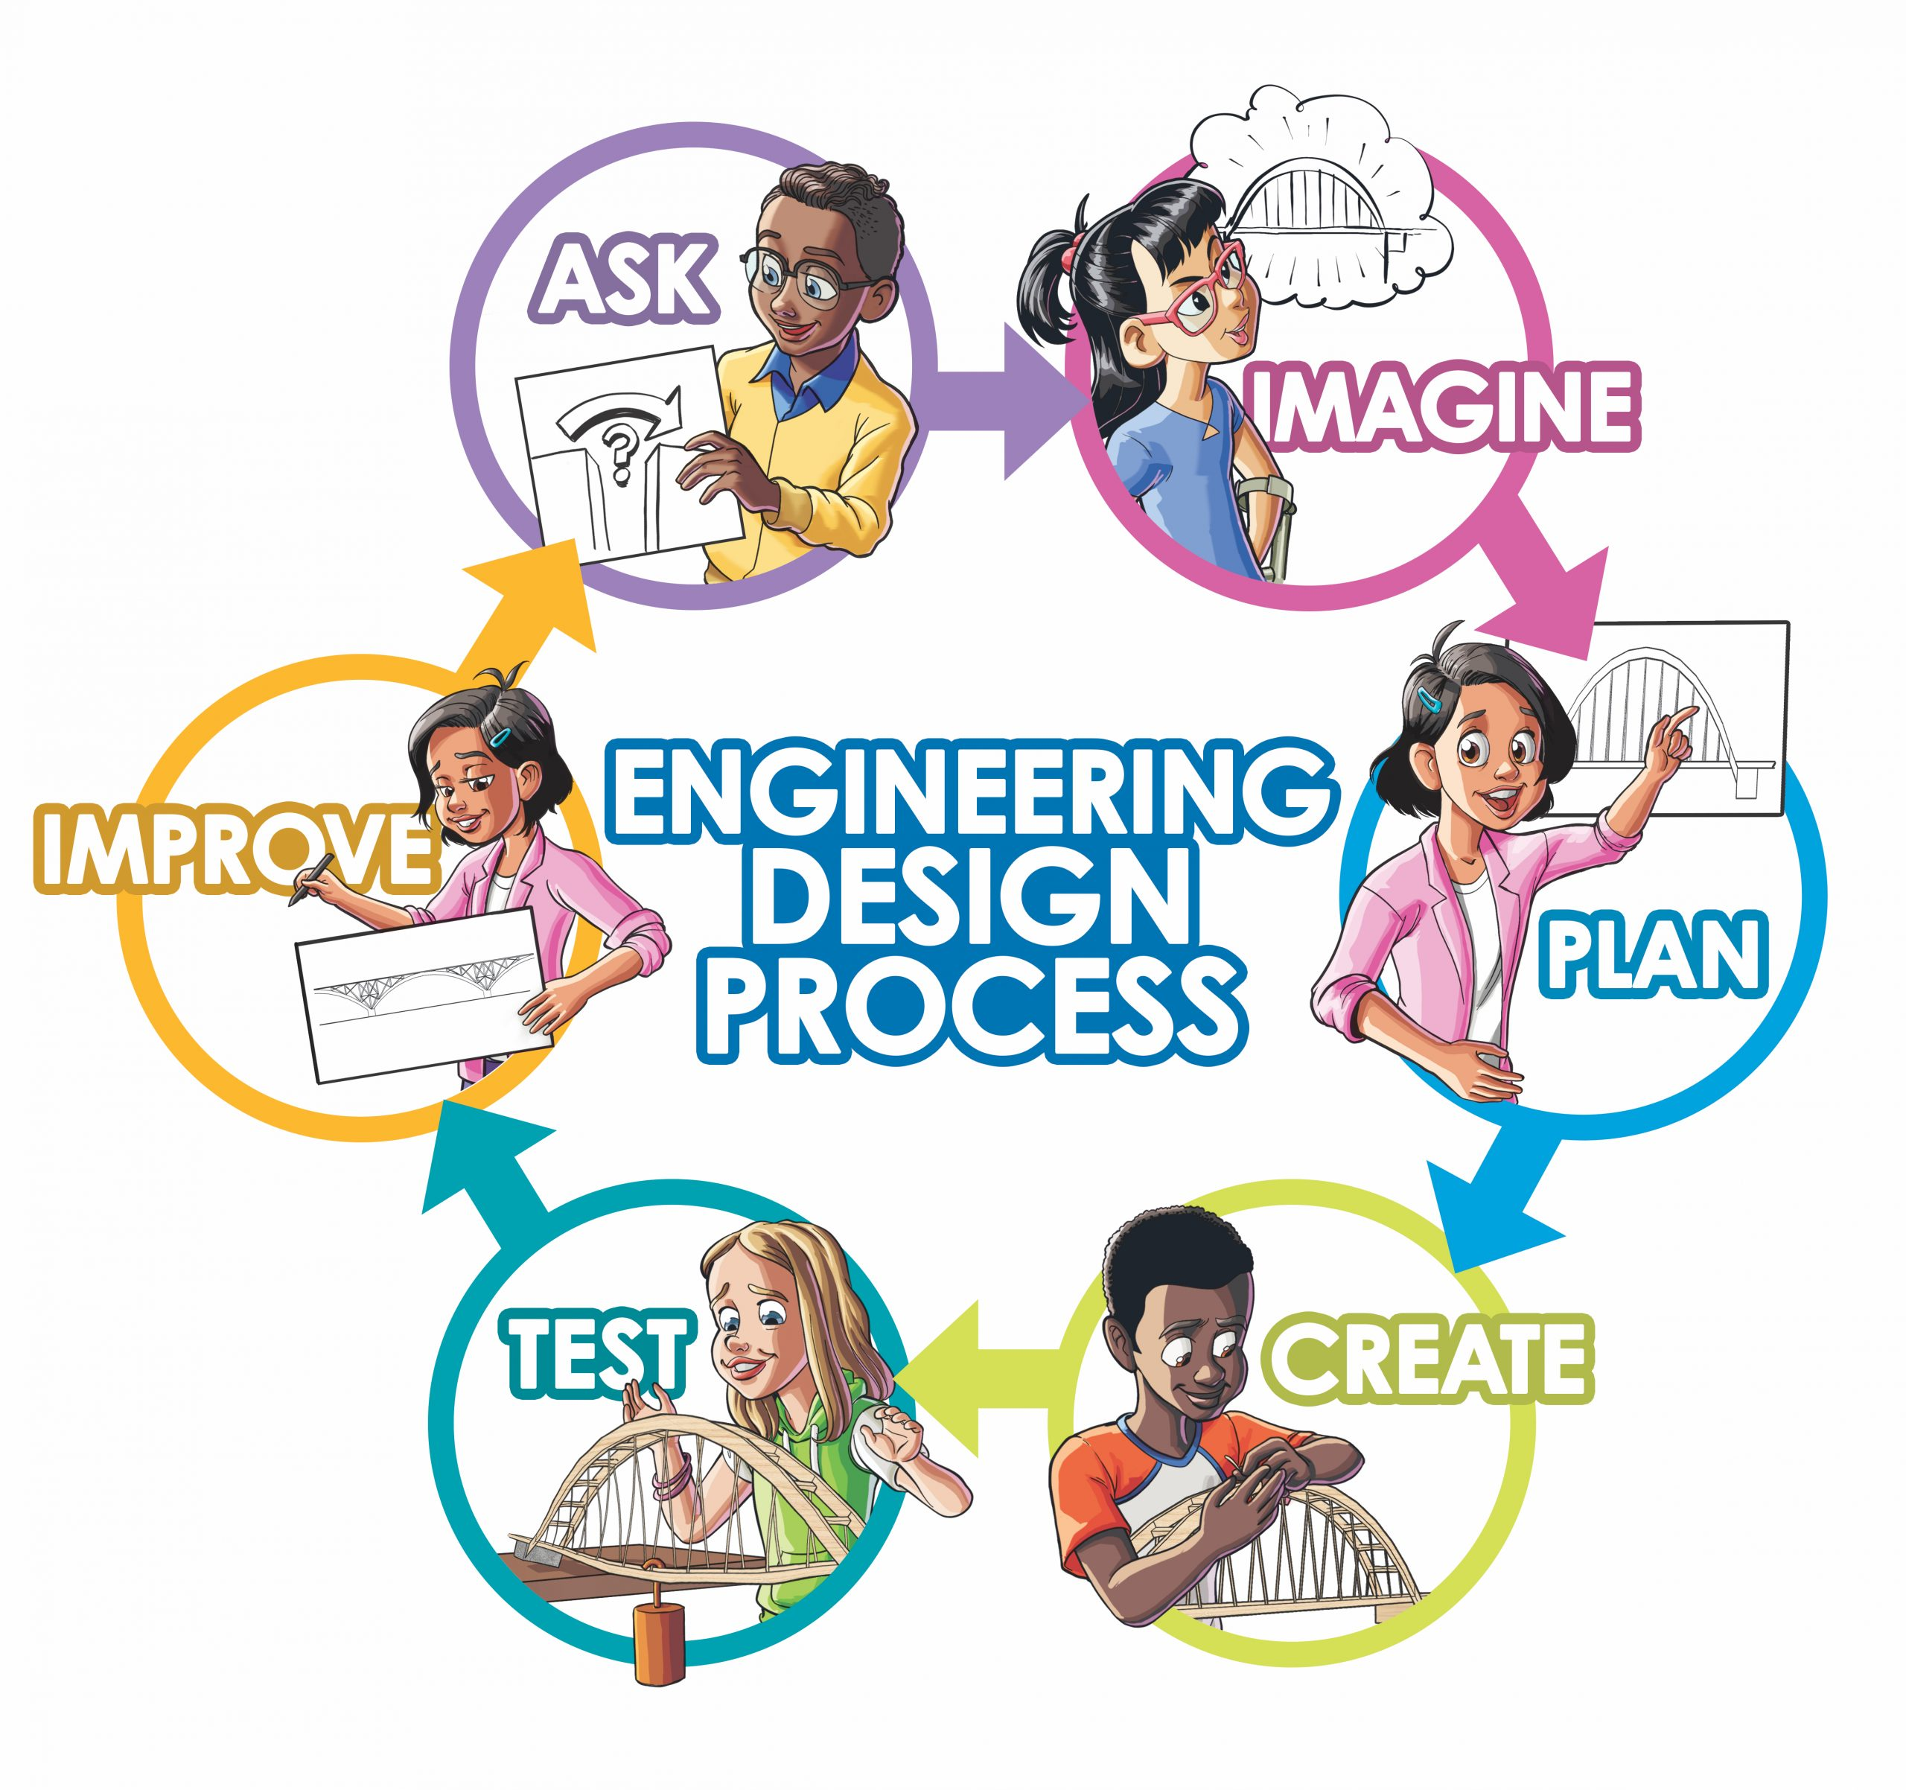
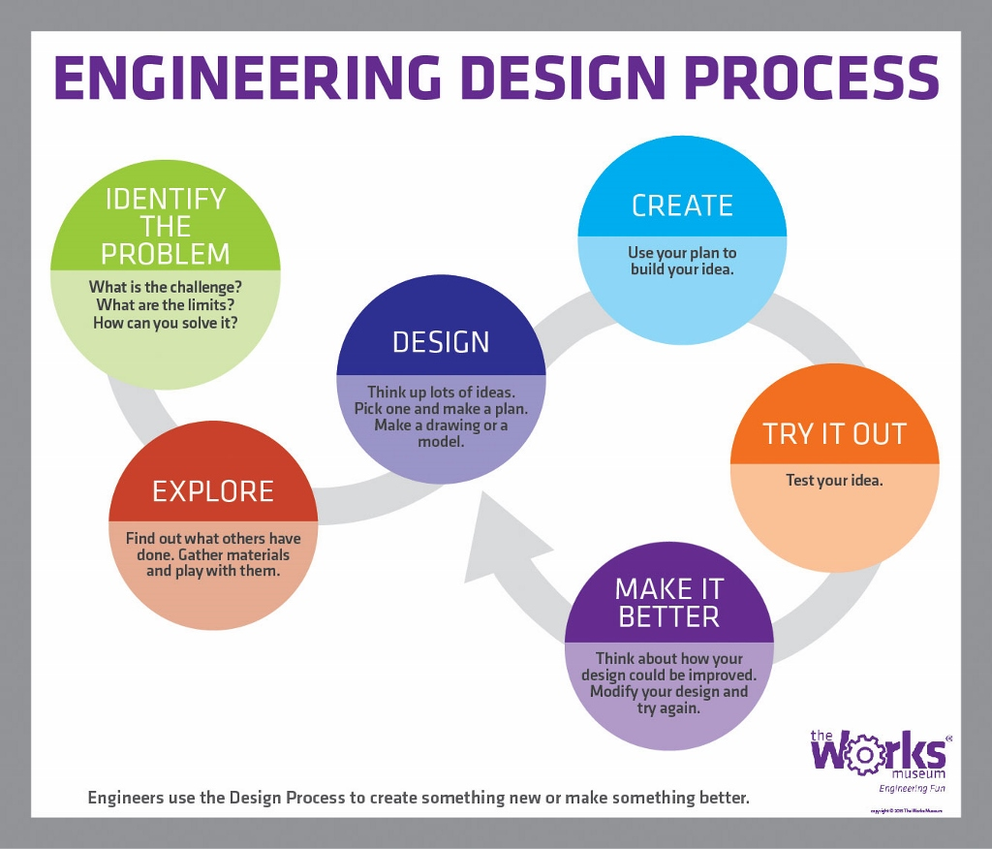
What do engineers do?
https://www.youtube.com/watch?v=owHF9iLyxic

Slide 10
Assignment!
Create a design challenge for middle school/elementary school students. Design simple, hands-on engineering projects. For instance, using common classroom materials like straws, tape, and paper to build a bridge or tower.
Students should use the engineering design process to
ask, ideate, plan, make, test and improve a design

Slide 11
Units of Measurement
Four fundamental physical quantities (or dimensions).
Length: Size or distance.
Mass: Quantity of matter.
Time: Succession of events. (Statics is time independent)
Force: “Push” or “pull” exerted in between bodies.

Slide 12
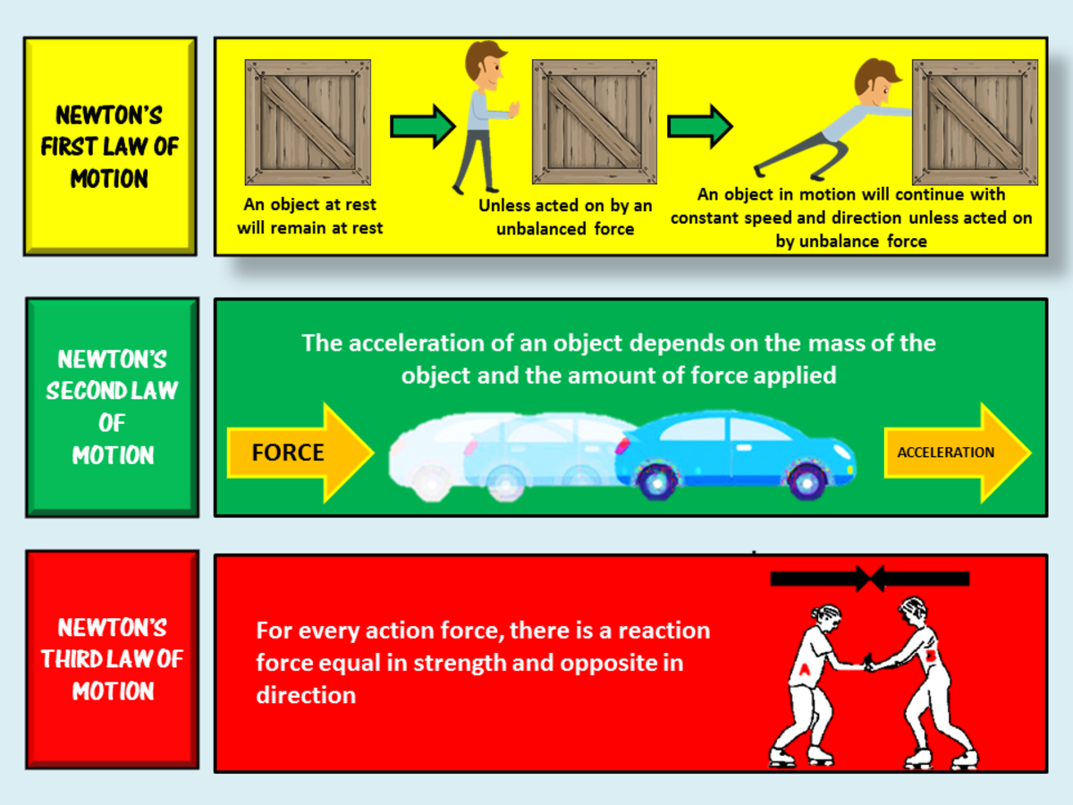
Unit Systems
Length, time, mass, and force are related by Newton’s 2nd law. Three of these are base units and the fourth unit is derived.
We will work with two unit systems in statics:
International System (S I)
U.S. Customary (U S C S)

Slide 13
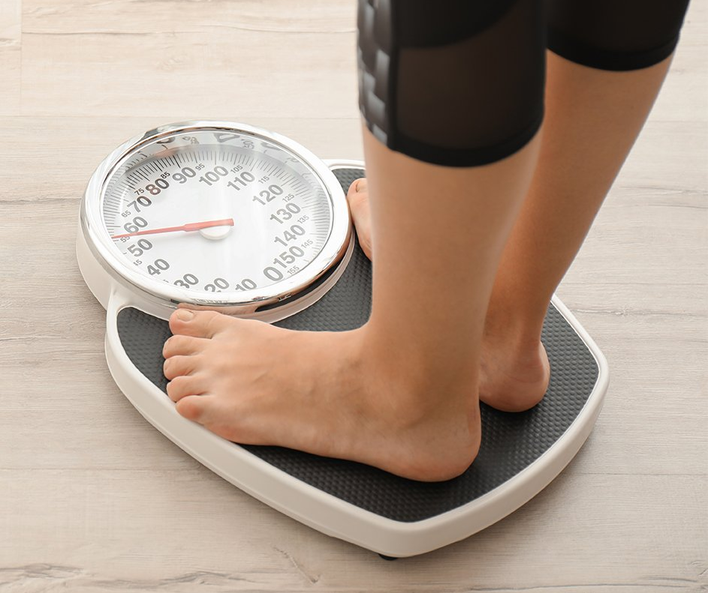
Systems of units
Name | Length | Time | Mass | Force
International System of Units S I | meter m | second s | kilogram kg | newton* N left parenthesis start fraction kilogram times meter over s squared end fraction right parenthesis
U.S. Customary F P S | foot ft | second s | slug* left paranthesis start fraction pound times s squared over feet end fraction right paranthesis | pound lb
*Derived unit.

Slide 14
Scalar and Vector
Scalar
Positive or negative physical quantity
Completely specified by magnitude
e.g. length. mass

Slide 15
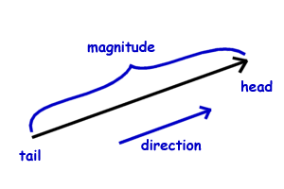

Scalar and Vector
Vector
Physical quantity that requires both a magnitude and a direction for its complete description
E.g. force
Length of arrow: magnitude of vector
Angle theta: direction of its line of action
Head of arrow: points to the direction of the vector
$$θ$$

Slide 16
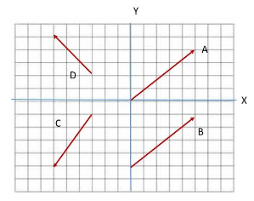
e.g., Find the magnitude , x-component, and y-component of each vector

Slide 17
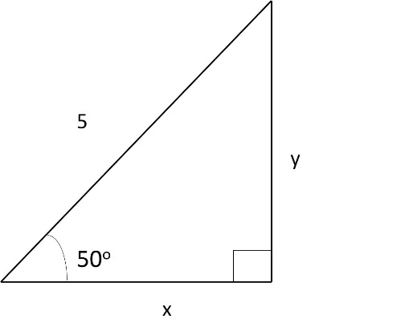

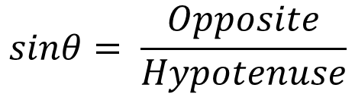

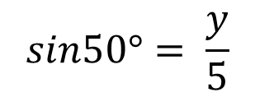
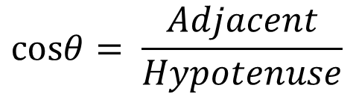
e.g. Find the values for x and y.
$$sinθ= \frac{Opposite}{Hypotenuse}$$
$$cosθ= \frac{Adjacent}{Hypotenuse}$$
$$sin50°= \frac{y}{5}$$
$$5 x sin50°=y$$
$$y=3.83$$

Slide 18
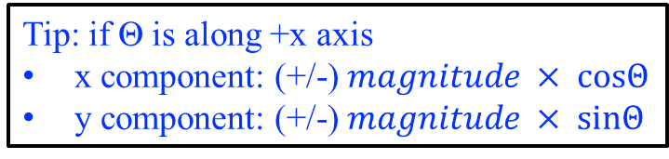
e.g. Find the x-component and y-component of each vector from the table and the figure.
Tip: if Θ is along +x axis
x component: (+/-) $magnitude × cosΘ$
y component: (+/-) $magnitude × sinΘ$
Vector | Magnitude | x-component | y-component
A | 5
B | 3
C | 4

Slide 19
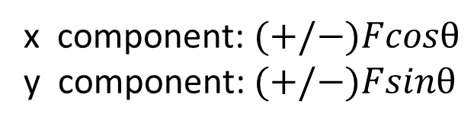

Finding the components of a force
When a force is resolved into two components along the x and y axes. The components are then called rectangular components.
y
$$F$$
Direction
Magnitude
x component: $(+/−)Fcosθ$
y component:$(+/−)Fsinθ$
Ө
x

