Slide 1
Nouns

Slide 2
Countable nouns
Things we can count using numbers. They have a singular and a plural form.
e.g “dog”
Use “a/an” and “how many”
Add “s” or “es” to make the noun plural
e.g:
I have a dog
I have two dogs
How many dogs do you have?

Slide 3
Uncountable nouns
Things that we cannot count with numbers. They may be the names for abstract ideas/qualities/objects that are too small to be counted (liquids, powders, gases, rice, sand, etc.). They usually do not have a plural form.
e.g “milk”
Use “some” and “how much”
Use “any” for the negative
e.g:
Do you want some milk?
How much milk do you want?
I don’t want any.

Slide 4
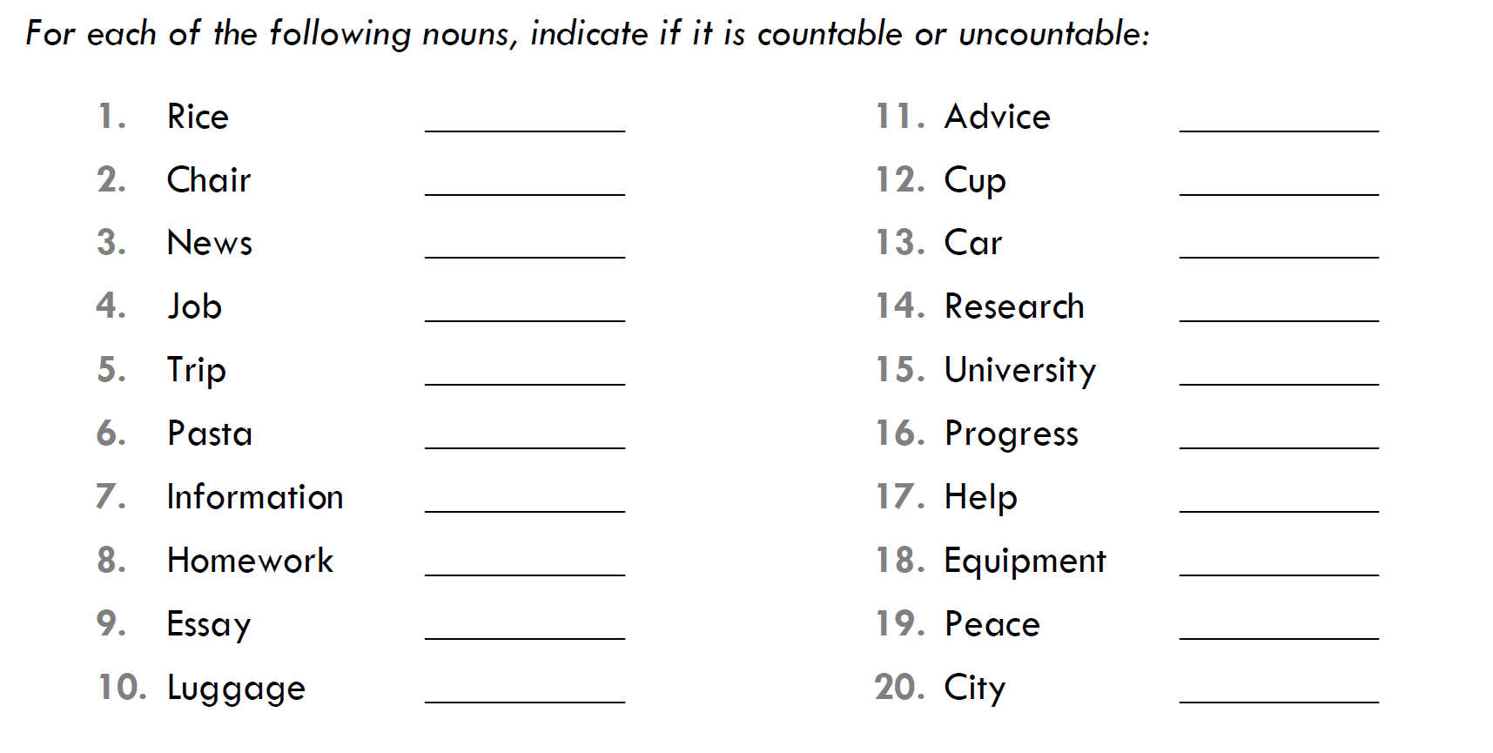
Practice

Slide 5
Exercise: Choose a/an/some/any to complete the sentence
I need ___________ information about the new client.
I always have ________ apple at lunch.
Can you help me? I need __________ advice.
Can you lend me _______ money? I don’t have ______.
Do you want ________ chips?
I really want ________ dog.
I need _______ help with my English homework.
I have ______ idea!
He is doing _______ research about cancer.
I am going to buy _____ plant tomorrow.

Slide 6
How many + countable noun
e.g: How many times have you been to Barcelona? (times=visits)
How many brothers do you have?
How much + uncountable noun
e.g: How much homework do you have tonight?
How much water do you want?

Slide 7
Use: how many, how much, or how long to complete each sentence
__________________ have you been a student at EFREI?
__________________ people live in your hometown?
_________________ cousins do you have?
_________________ time do you need to finish the report?
________________ is it to drive to Nantes from here?
________________ kids does Angelina Jolie have?
________________ money do I need to buy an apartment in Paris?

Slide 8
Write 6 questions using: how much, how many, and how long. Ask your partner.

Slide 9
On/At/In (Time)
On + day/date
e.g: I have to work on Saturday. The meeting is on June 7.
At + time of day
e.g: They arrived at 5 o’clock.
In + month/year/seasons
e.g: Class begins in September. I started teaching in 1988.

Slide 10
Practice: choose in/at/on
The movie starts _____ 7pm.
I always go to Florida _____ the summer.
______ Sunday I will be in Nantes.
I’ll see you ______ Friday.
Max got married ______ 2016.
I saw her ______ May.
We travelled to Paris and arrived ______ 6 o’clock _______ the morning.
Mozart was born in Salzburg _____ 1756.
I don’t like driving ______ night.

Slide 11
On/At/In (Place)

Slide 12
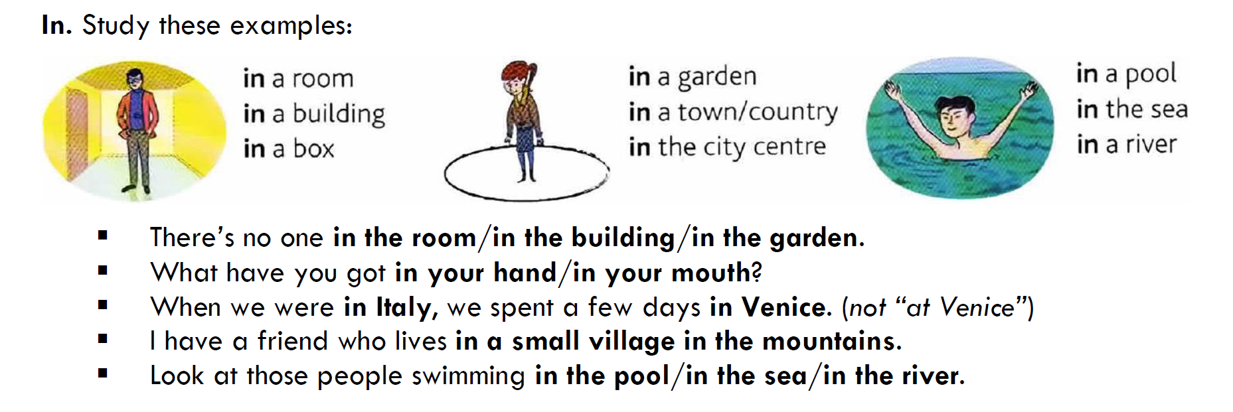
In

Slide 13
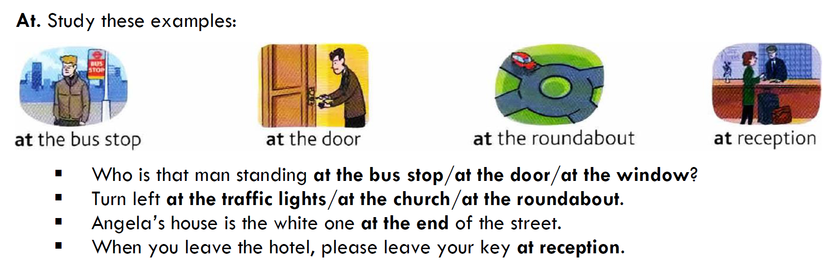
At

Slide 14
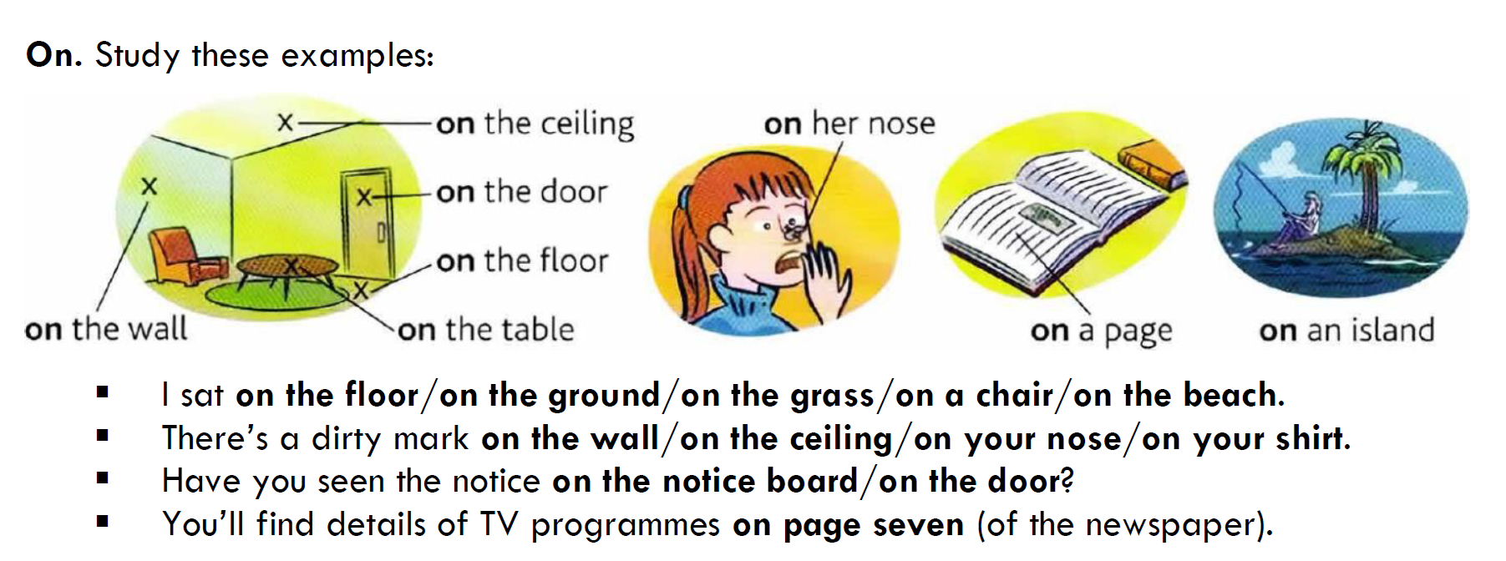
On

Slide 15
Complete the sentences with in, at or on.
Please write your name _______ the top of the page.
I like that picture hanging _____ the kitchen wall.
There was an accident _______ my street this morning.
I was _____ my apartment all morning.
All the answers are _____ the back page.
My sister lives _____ a small village _____ Peru.
I can’t imagine sitting ______ a desk all day.
The headquarters are _____ Paris.
Try to arrive ______ work _____ time, the boss doesn’t like it when people are late!
He has a tattoo _____ his arm.

