Slide 1

tagtag
An AR collecting game
for communities
Find your places. Collect your moments.
ETHGlobal Tokyo 2026
01
Notes:
0:00–0:15 · Slide 1 · tagtag
“What if your favourite places had something waiting for you? tagtag is an augmented reality collecting game that helps communities create discoveries worth sharing. Find your places. Collect your moments.”

Slide 2

Two inspirations
POAP
Pokémon GO
Memories worth keeping
Discovery worth
going out for
~7.6 million
badges minted
46,210+ issuers
Historical totals reported August 2026
02
Notes:
0:15–0:45 · Slide 2 · Two inspirations
“POAP showed how a digital collectible can carry the memory of being there. Reports put its lifetime reach at nearly 7.6 million badges, created by more than 46,000 issuers.
Pokémon GO showed the joy of taking a collecting game into the real world. It gave people a reason to explore and meet in shared places.
tagtag brings those ideas together: discovery with something personal to keep.”
Sources: https://poap.xyz/ and https://thecoinomist.com/news/poap-to-shut-down-after-minting-7-6m-event-badges/ (3 August 2026). 46,210 counts issuers, not distinct event designs. Pokémon GO: https://pokemongo.com/en. These products inspired tagtag; no affiliation is claimed.

Slide 3
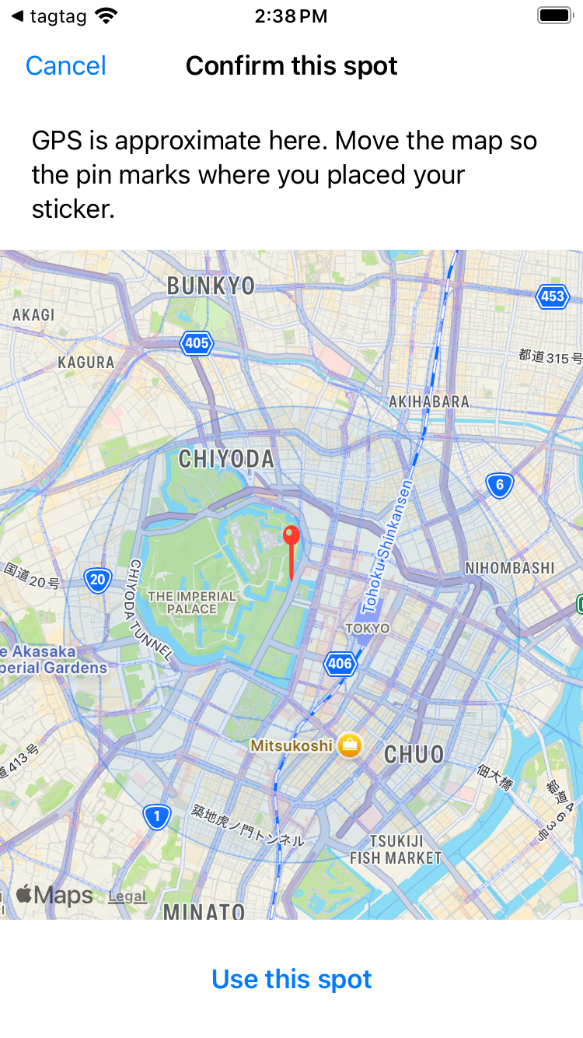
A place has
a story
Leave a little discovery
for the next person.
App preview from iOS Simulator
03
Notes:
0:45–1:05 · Slide 3 · A place has a story
“Think about a café you love, a corner of your campus, or a conversation at a hackathon. Each could hold a small discovery for the next person.
We want to give communities a playful way to share those places, with a keepsake that remembers the experience.”

Slide 4



The collecting loop
1. Leave a sticker
2. Find its place
3. Keep the memory
Art, a place, a private note.
Follow the clue into AR.
Collect a copy. Reveal the note.
04
Notes:
1:05–1:30 · Slide 4 · The collecting loop
“A creator chooses a sticker, places it on a real surface in AR, and leaves a clue and a note.
An explorer follows a nearby map pin and looks for the sticker at that spot. Collecting adds a copy to their sticker book and reveals the note. The original stays there for someone else to discover.”

Slide 5
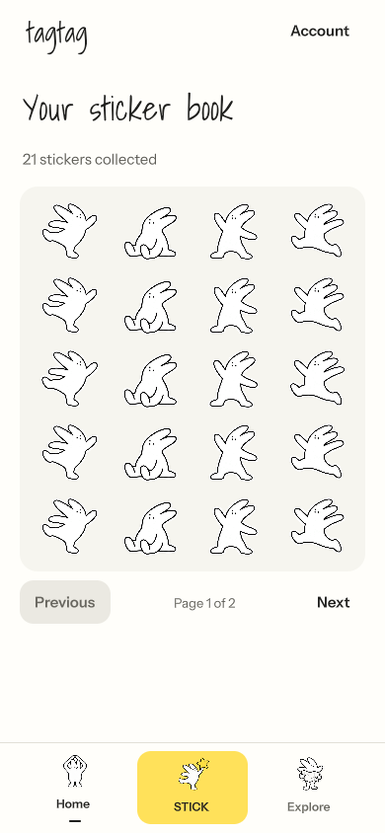
A game communities
can make their own
A conference’s gathering places
A neighbourhood’s art walk
Shared discoveries give people
a reason to meet and return.
Proposed uses
UI preview / sample data
05
Notes:
1:30–1:55 · Slide 5 · A game communities can make their own
“Imagine a conference where each community leaves a sticker at its gathering place. Or a neighbourhood walk curated by local artists.
The community supplies the stories and the places. Players explore, collect, and share what they found. Those shared discoveries give people a reason to meet and a reason to return. These are the experiences we want to test next.”

Slide 6

DEMO
A little discovery, in the real world
06
Notes:
1:55–3:10 · Slide 6 · DEMO
Switch to the mirrored iPhone at **1:55**. Keep this as one dedicated DEMO slide. Use a prepared location and a short note to avoid spending time typing.
| Time | Action | Spoken words |
| --- | --- | --- |
| 1:55–2:05 | Show the sticker book, then open STICK. | “Here’s tagtag. This is my sticker book, and I’m going to leave a little discovery.” |
| 2:05–2:25 | Choose artwork, scan a surface, and place it. | “I choose Taggi, find a surface, and place the sticker. I can move it, resize it, and rotate it so it belongs in this spot.” |
| 2:25–2:45 | Show the clue, note, and publishing flow. | “I add a clue for the explorer and a note to reveal after collection. The app saves the placement and a reference photo to help someone find the same spot.” |
| 2:45–3:00 | Open Explore and show the placement’s pin and teaser. | “Now the discovery has a place on the map. This is the invitation to come and look.” |
| 3:00–3:10 | If verified, show a second phone collecting. Otherwise show the collection UI and use the fallback below. | Verified: “On the finder’s phone, collecting adds a copy to the book and reveals the note. The original remains for the next visitor.” |
**Fallback for the final ten seconds:** “This is the collection interface. The complete journey between two phones is our next device test.” Do not present a simulated screen or a prepared book entry as a successful live collection.
If tracking or uploading takes too long, say “This step is still processing; I’ll show the saved placement,” and move to a known placement. Return to the deck at **3:10**. Do not accelerate the footage.

Slide 7

How it works
Unity + ARKit
Place and recover stickers in AR
MapKit
Nearby discovery on Apple’s maps
Optional Sepolia souvenirs
Firebase + Cloud Run
Implemented, disabled
pending verification
Stickers, collections and private notes
07
Notes:
3:10–3:35 · Slide 7 · How it works
“We built the iPhone experience in Unity with ARKit, and use Apple’s maps for nearby discovery. Firebase and our Cloud Run API store stickers, collections, and private notes.
We also built an optional Ethereum Sepolia souvenir path. It remains disabled while we verify minting and wallets. The collecting experience works without a blockchain transaction.”

Slide 8

The first
community pilot
A small trail of meaningful places.
Original stickers from the community.
Real people trying the full journey.
Learn: do people finish, and return?
08
Notes:
3:35–3:50 · Slide 8 · The first community pilot
“Next, we want to run a small community trail: a handful of meaningful places, a set of original stickers, and real people trying the full journey. We’ll learn whether they finish the trail and come back for another.”

Slide 9

Find your places.
Collect your moments.
Let’s create the first
community trail together.
tagtag
09
Notes:
3:50–4:00 · Slide 9 · Find your places. Collect your moments.
“tagtag turns places into invitations, and discoveries into keepsakes. We’re looking for a community to create the first trail with us. Thank you.”
## Recording notes
- Use your own voice, clear audio without music, and at least 720p. Keep the final export between 2:00 and 4:00. Aim to finish speech a few seconds before 4:00 so the final cut stays within the limit.
- Slide 6 reserves 75 seconds, including interaction and pauses. Keep the closing at 3:50 even if the demo runs slowly.
- The repository currently sets `nftEnabled` to `false`. Keep slide 7’s statement unless a newer build and live acceptance evidence establish otherwise.
- Community trails are a proposed pilot, not current customers, traction, or a finished campaign-management product.
- The app screenshots in the deck are simulator/UI fixture captures. Their counts are sample data, not user or usage metrics.
## Sources
- [POAP’s own description](https://poap.xyz/): collecting memories and connecting communities.
- [Reported POAP totals, 3 August 2026](https://thecoinomist.com/news/poap-to-shut-down-after-minting-7-6m-event-badges/): nearly 7.6 million badges and over 46,210 issuers. **Issuers** is the reported unit, not distinct badge designs. These are historical totals, not a live counter.
- [Pokémon GO](https://pokemongo.com/en): real-world collecting and exploration. No player-count claim appears in the deck.
- [Project description and evidence](../SUBMISSION.md), [feature readiness](../../FEATURE_READINESS.md), and [screenshot provenance](../SCREENSHOTS.md).

