Slide 1


Analysis of Social Buzz
MOHAMMED AMAN MOHIUDDIN

Slide 2


Today's agenda
Project recap
Problem
The Analytics team
Process
Insights
Summary

Slide 3

Social Buzz is a rapidly growing tech unicorn that needs to quickly adapt to its global scale. Accenture has initiated a 3-month proof of concept (POC) focused on the following tasks:
An audit of company's big data practice
Recommendations for a successful IPO
Analysis to find companies top 5 most popular categories of content
Project Recap

Slide 4

Problem
Managing and analyzing unstructured data generated
About 100000+ posts each day

Slide 5



Andrew Fleming
Chief Technical Architect
The Analytics team
Marcus Rompton
Senior Principle
Mohammed Aman Mohiuddin
Data Analyst

Slide 6
Process
1
Data Understanding
2
Data Cleaning
3
Data Modelling
4
Data Analysis
5
Uncover Insights

Slide 7

Insights
Top 5 categories contribute 65% of engagement
16
Categories
Animals
74,965

Slide 8
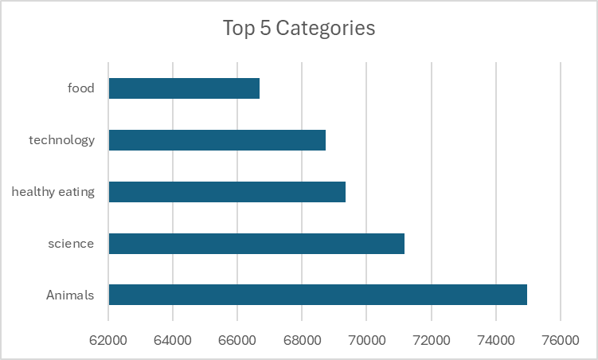

Slide 10

ANALYSIS
Animal and Science are the most popular categories, indicating that users prefer highly engaging and dynamic content formats.
INSIGHT
Highlighting an opportunity to focus on top categories to increase user interaction.
NEXT STEPS
While this analysis offers valuable insights, scaling it to real-time data will unlock deeper, actionable insights. We can help you implement real-time analytics for continuous optimization of your content strategy.
Summary

Slide 11
Thank you!
ANY QUESTIONS?

