Slide 1
Appetite for Infrastruction
Provisioning Resources in Amazon’s Cloud
{dixon.whitmire@pokitdok.com}, @nixonhughes

Slide 2
Who Am I ?
Software Engineer @ Pokitdok
Tasked with scaling out infrastructure
Developed custom provisioning process for AWS (Boto, Fabric, Cloud Formation)

Slide 3
What we’ll cover . . .
Amazon Web Services Overview (EC2, ESB, Regions, etc)
REALISTIC provisioning
Building a provisioning solution with Boto, Fabric, and Cloud Formation to deploy a MongoDB Replica Set

Slide 4
AWS Overview
Cloud Computing and Infrastructure as a Service (Iaas)
AWS Regions and Availability Zones
Amazon Machine Images (AMI)
Notes:
IaaS – use the cloud in an “elastic fashion”, resources on demand. Turn it off when you don’t need it!
Regions/availability zones – redundancy and availability. PD stack spread across multiple availability zones
Ami - “disk images” for your virtual machines (EC2 instances). Keep ‘em simple. We opt to

Slide 5
AWS Overview (continued)
Core Services
Elastic Compute (EC2)
Elastic Block Storage (EBS)
Elastic IP
Tagging
Security Groups
Accessing Instances
Notes:
As pertains to demo:
EC2 - mongo instances
EBS - root and data storage
Elastic IP – makes life easier with mongo rs starting and stopping and for failover
Importance of tagging – (Region Code)_(Environment)_(Tier) used as a selector
Security Groups – mongo: port 22, and 27017 internally
Accessing Instances – SSH

Slide 6
Realistic Provisioning
Base process off of configuration standards: directory layouts, users, etc.
Processes are repeatable (scripted) but may not be 100% automated
Iterate to improve automation %

Slide 7

the alternative . . .
Notes:
servers serving same function with different OS’s, software installation locations, ssh keys, etc

Slide 8
Boto – Python Interface for AWS
Hosted on github
Activate developer community on Google Groups
Supports additional services such as OpenStack, Eucalyptus, and Google Storage
Notes:
From the Zen of Python If the implementation is hard to explain, it’s a bad idea. If the implementation is easy to explain, it may be a good idea. Great API, easy to use and if used correctly trends towards “good lookin’” code

Slide 9
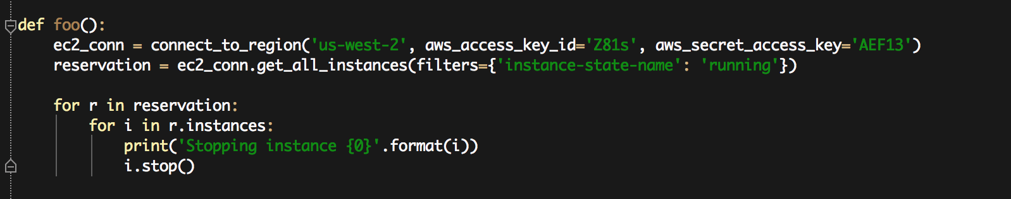
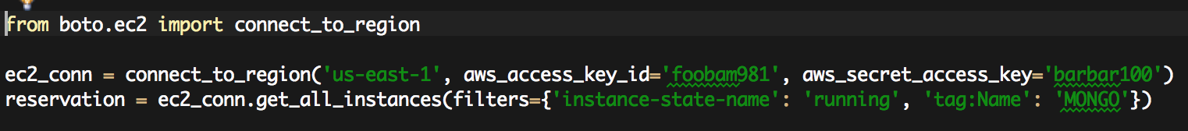
Boto Examples
Stop all instances in us-west-2
Get all running Mongo Instances
Notes:
- Note that connections are to REGIONS use of metadata as filters

Slide 10
Fabric – Python SSH Library
Hosted on github
Encapsulates common ssh/scp operations
Executable tasks are plain ‘ol Python functions decorated with @task
Notes:
Fabric is

Slide 11
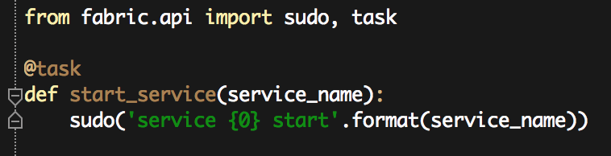
Fabric Examples
Start services
Command line task execution
Notes:
Tasks are run against specific environments. Can be a single or multiple environments. Also supports parallel execution.

Slide 12
AWS Cloud Formation
Declarative provisioning and deployment tool based on JSON templates
Supports composition/aggregation with template references
Templates are parameterized, may include scripts, and support updates
Notes:
The “bene” – you don’t write any code. Allows you to allocate AWS resources in a declarative fashion w/JSON.
Composition – have a template for Mongo Replica Set which references a Data Node template and Arbiter template. Reduces duplication and indirectly “consolidates” the configuration. Can do a lot with them package support (apt-get, yum, git)
Execute bash commands (whatever scripting environment is supported in the shell)

Slide 13
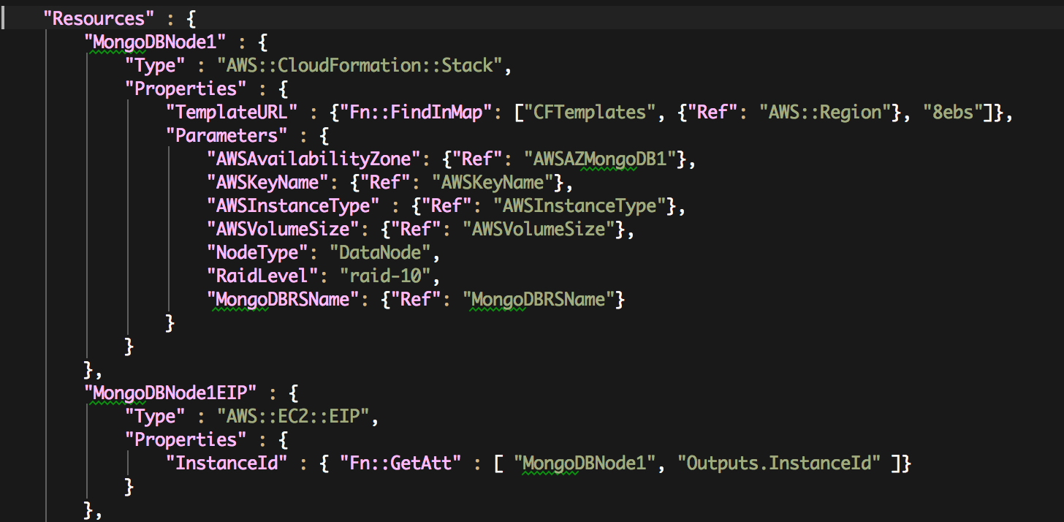
AWS Cloud Formation Snippet
Notes:
Verbose, but rather simple

Slide 14
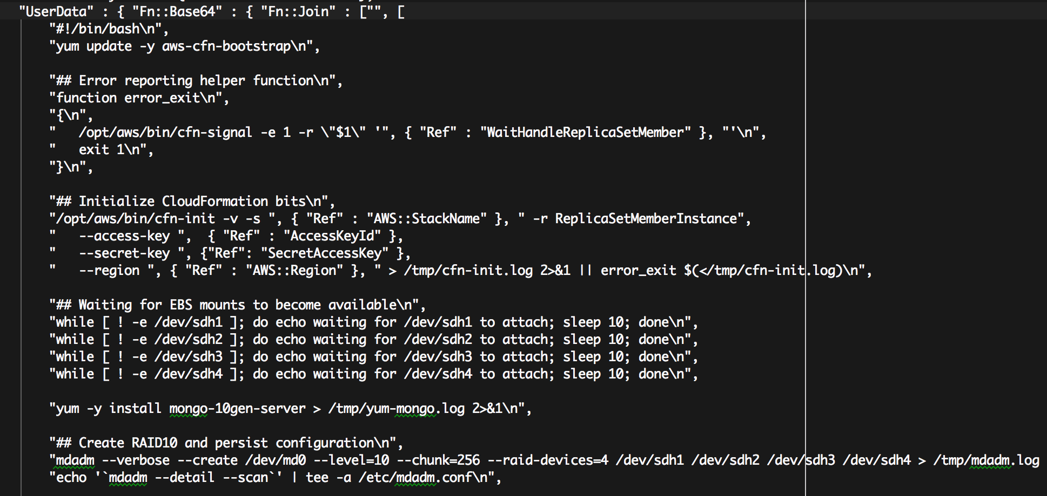
The Dark Side of Cloud Formation
User Data, BASH, and JSON
Notes:
All in one file . . .bash, package management in JSON strings
Region specific if you want to support multiple regions you’ll need to have copies of the template in each region. Also each template must be configured to work in any enviornment, unless you want to have separate copies of the template for each region (doesn’t scale)

Slide 15
The Design
Cloud Formation is used for provisioning not configuration
Boto creates AMIs and configures instances
Fabric as an execution framework

Slide 16
The Process
Create AMIs In the appropriate regions
Upload Cloud Formation templates to S3
Spin up instances using Cloud Formation
Configure instances with Fabric

Slide 17
Create AMIs
Use the command: fab create_ami
Supports saving AMI to multiple regions
Differentiates between general and specific functions using ami_type
Update CF Templates with AMI ID

Slide 18
Upload to CF Templates to S3
Publish templates using: fab push_cf_templates_to_s3
Templates are stored in S3 buckets per region
Publish for changes/updates to templates

Slide 19
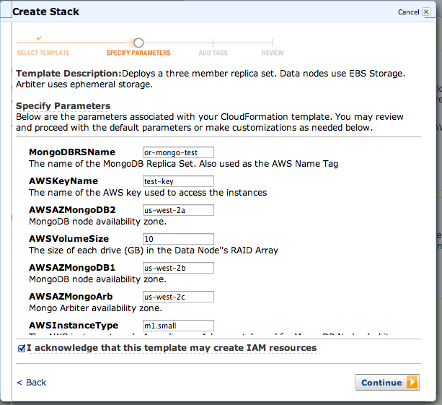
Cloud Formation
Notes:
AWS UI for CF template parameters

Slide 20
Wrap-Up
Does this scale?
Python/Boto ease of us vs Cloud Formation’s declarative verbosity
Next iteration – fabric toolchain wrapping boto APIs

Slide 21
FREE CODE !!!!!
No copyright
No terms of use
No strings attached
https://github.com/dixonwh/aws-provisioning

Slide 22

Questions?

