Slide 1
Appetite for Infrastruction
Provisioning Resources in Amazon’s Cloud
{dixon.whitmire@pokitdok.com}, @nixonhughes

Slide 2
Who Am I ?
Software Engineer @ Pokitdok
Developed custom provisioning process for AWS (Boto, Fabric, Cloud Formation)
Tasked with scaling out infrastructure as needed

Slide 3
What we’ll cover . . .
Amazon Web Services Overview (EC2, ESB, Regions, etc)
REALISTIC provisioning
Building a provisioning solution with Boto, Fabric, and Cloud Formation

Slide 4
AWS Overview
Cloud Computing and Infrastructure as a Service (Iaas)
AWS Regions and Availability Zones
Amazon Machine Images (AMI)

Slide 5
AWS Overview (continued)
Core Services
Elastic Compute (EC2)
Elastic Block Storage (EBS)
Elastic IP
Security Groups
Accessing Instances

Slide 6
Realistic Provisioning
Processes are repeatable (scripted) but may not be 100% automated
Iterate to improve automation %
Base process off of configuration standards

Slide 7

the alternative . . .

Slide 8
Boto – Python Interface for AWS
Hosted on github
Activate developer community on Google Groups
Supports additional services such as OpenStack, Eucalyptus, and Google Storage

Slide 9
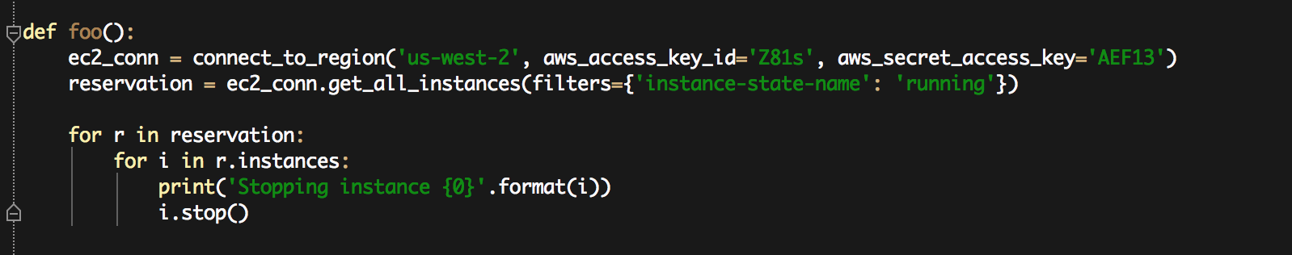
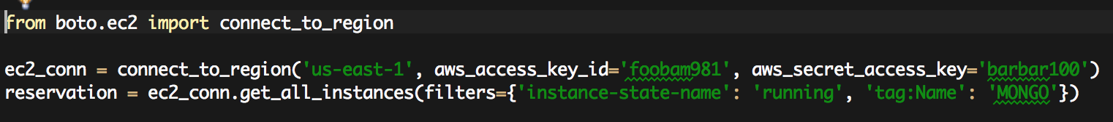
Boto Examples
Stop all instances in us-west-2
Get all running Mongo Instances

Slide 10
Fabric – Python SSH Library
Hosted on github
Provides “task” execution for local and remote environments
Executable tasks are plain ‘ol Python functions decorated with @task

Slide 11
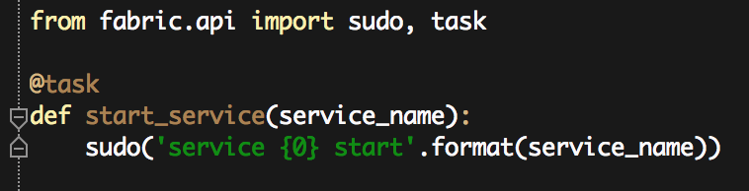
Fabric Examples
Start services
Command line task execution

Slide 12
AWS Cloud Formation
Declarative provisioning tool based on JSON templates
Supports composition/aggregation with template references
Templates are parameterized, may include scripts, and support updates

Slide 13
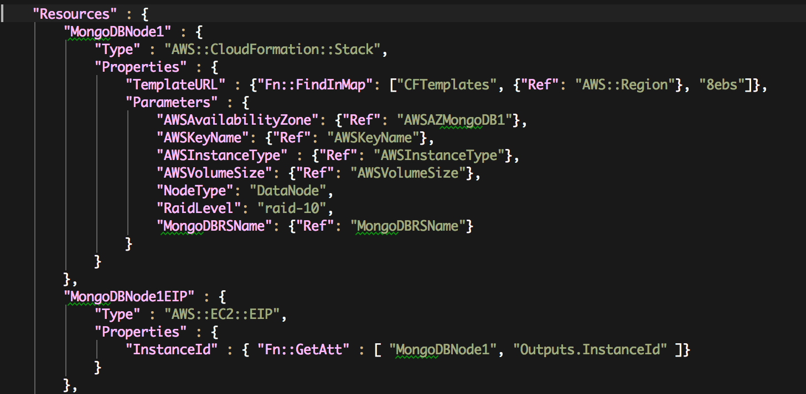
AWS Cloud Formation Snippet

Slide 14
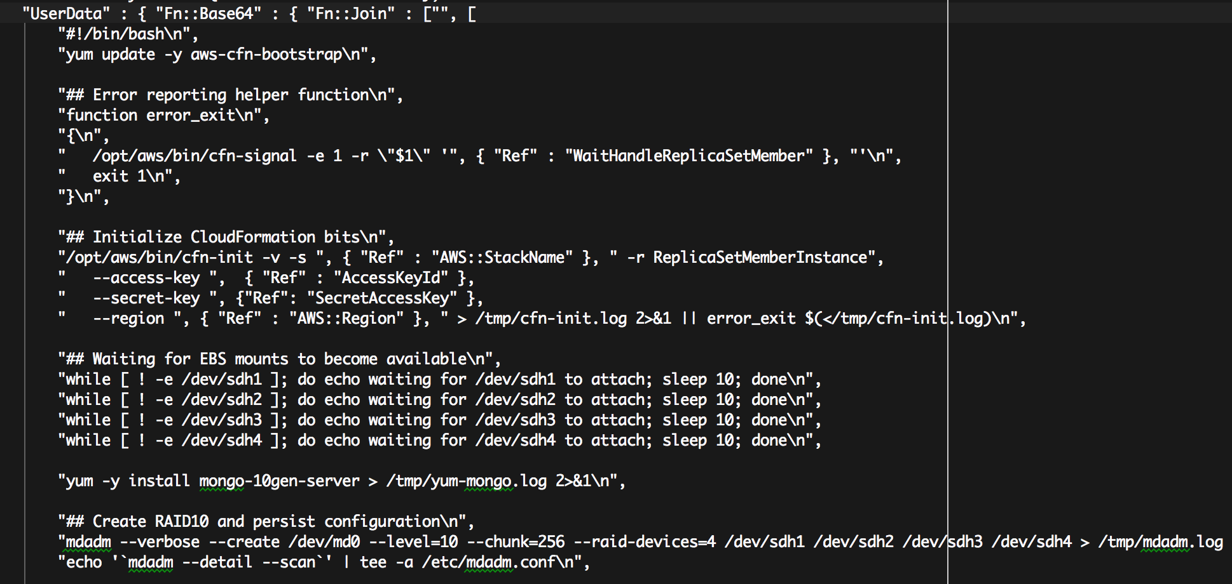
The Dark Side of Cloud Formation
User Data, BASH, and JSON

Slide 15
The Design
Cloud Formation is used for provisioning not configuration
Boto creates AMIs and configures instances
Fabric as an execution framework

Slide 16
Spinning Up Mongo
Create AMIs In the appropriate regions
Upload Cloud Formation templates to S3
Spin up instances using Cloud Formation
Configure instances with Fabric

Slide 17
Create AMIs
Use the command: fab create_ami
Supports saving AMI to multiple regions
Differentiates between general and specific functions using ami_type
Update CF Templates with AMI ID

Slide 18
Upload to CF Templates to S3
Publish templates using: fab push_cf_templates_to_s3
Templates are stored in S3 buckets per region
Publish for changes/updates to templates

Slide 19
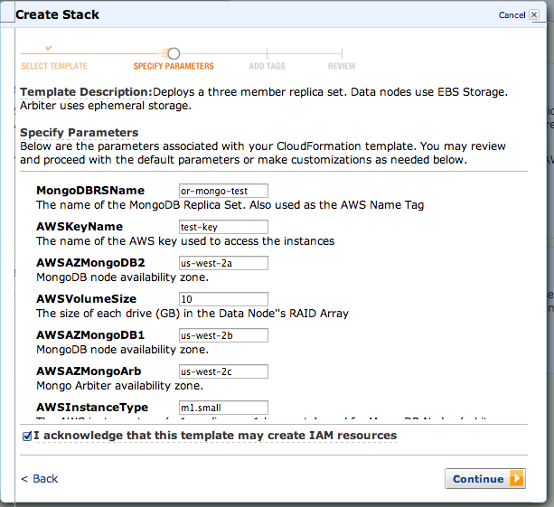
Cloud Formation

Slide 20
Wrap-Up/Questions
Boto vs Cloud Formation: programmatic provisioning vs declarative verboseness
Iterate to support scaling out and up
Metadata Management
Github: dixonwh

