Slide 1
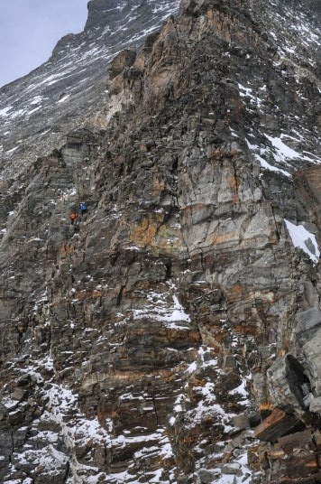


Team Aroma Luca, Tiziano, Emma, Lisa & Fran
Color Filter:
Movement Filter:

