Slide 1
Mountaineers Detection
Team Aroma Luca, Tiziano, Emma & Fran

Slide 2
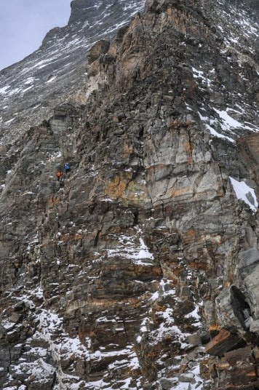


Detecting Mountaineers I: Colour Filter Approach
Original
Blue Filter
Red Filter
Mountaineers are often wearing colourful jackets
This fact can be used to detect them on images
Noise

Slide 3
Detecting Mountaineers II: Movement Approach
Mountaineers on pictures can be tracked due to their movements
Our approach: Taking the difference from two consecutive pictures

