Slide 1


1: Development Environment Diploma in Web Design
Transforming your laptop into a website production factory

Slide 2

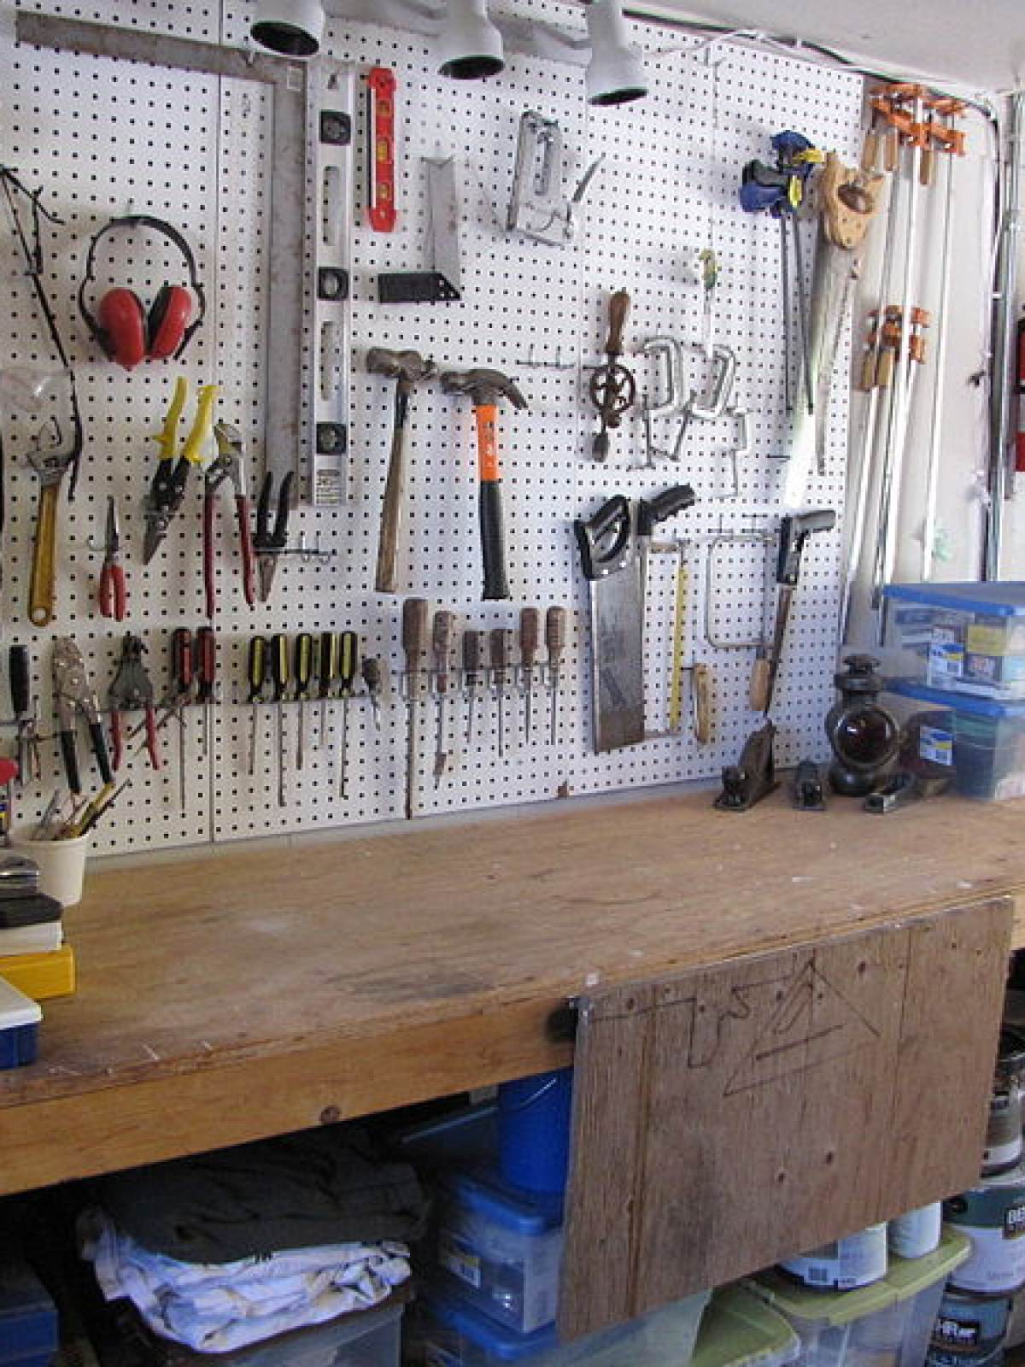
Organising your workspace
Kitchen
Workshop
Web Development
Set up local web server from Apache.
Install software tools:
Google Chrome
Mozilla Firefox Developer Edition
Emmet Re:view extension for Google Chrome
Sublime Text web editor

Slide 3
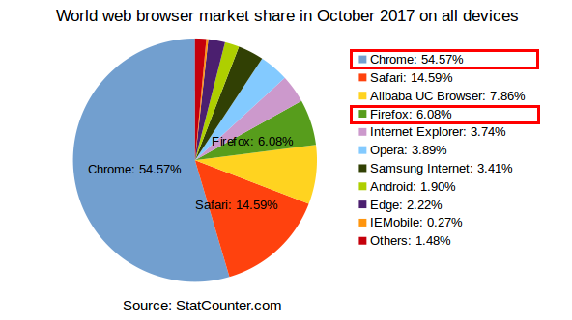
Web browsers: market share

Slide 4
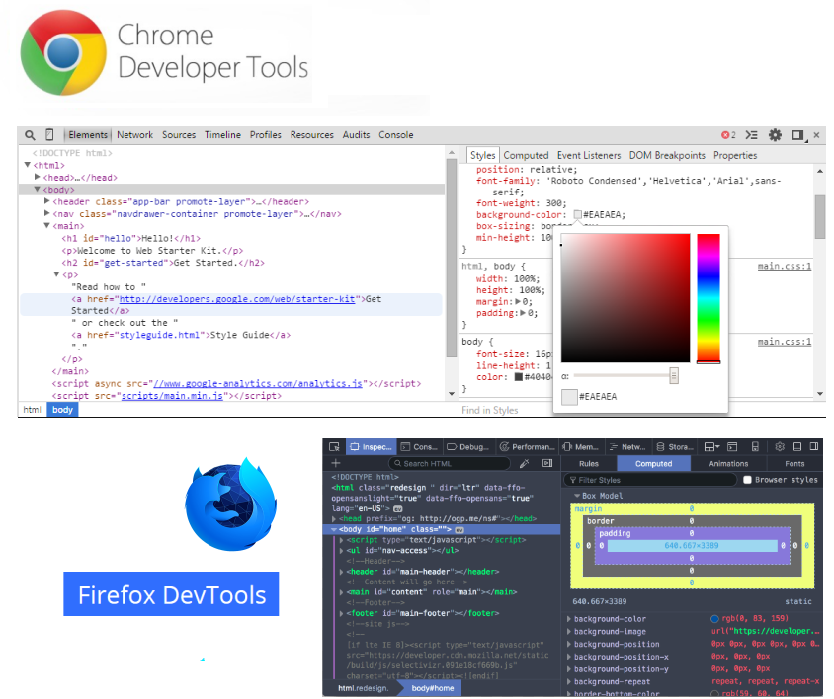
Browser Dev Tools
Both the Chrome (from Google) web browser and the Firefox Developer Edition web browser (from Mozilla) include Dev (developer) Tools.
These help you debug (find errors or performance issues) with your web pages.

Slide 5
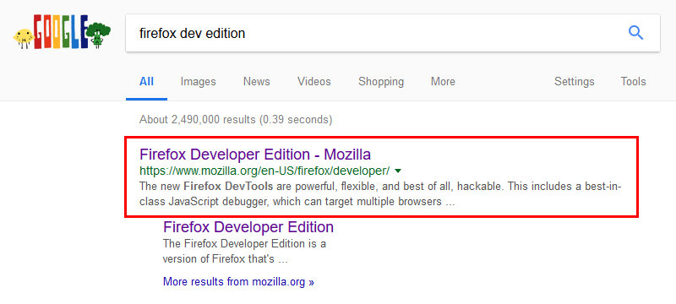
Mozilla Firefox Developer Edition

Slide 6
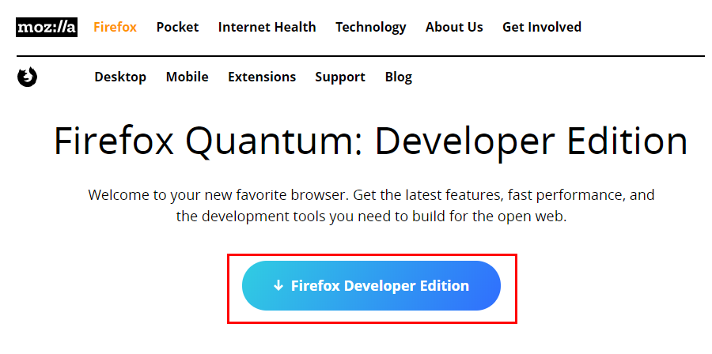
Download Firefox Developer Edition

Slide 7
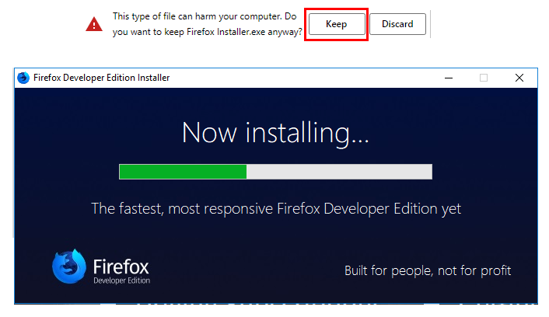
Install Firefox Developer Edition

Slide 8
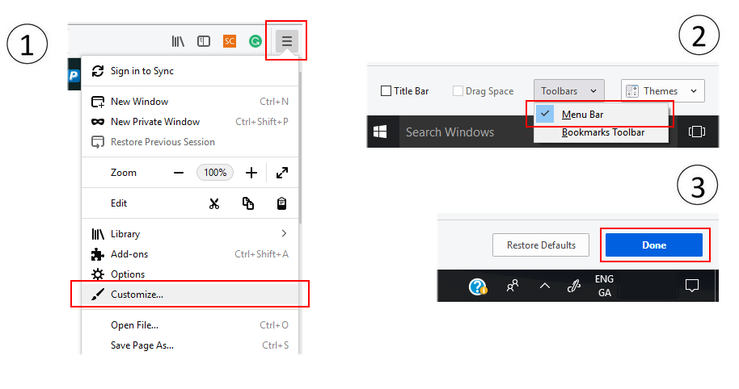
Customise Firefox Developer Edition

Slide 9
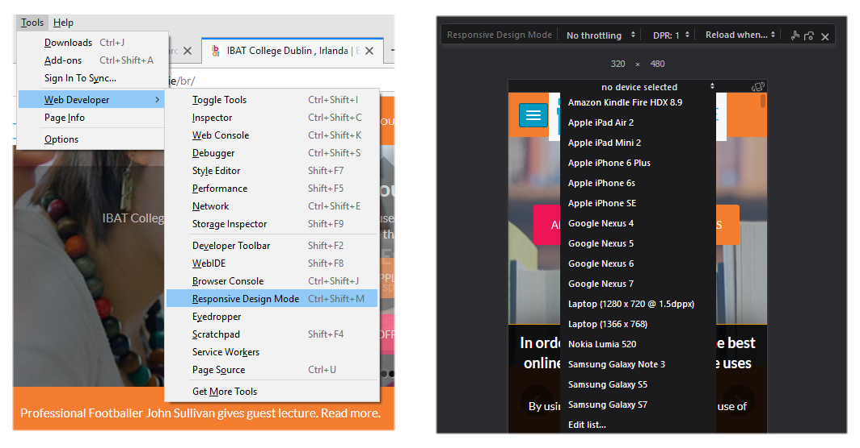
Firefox: Responsive Design Mode

Slide 10
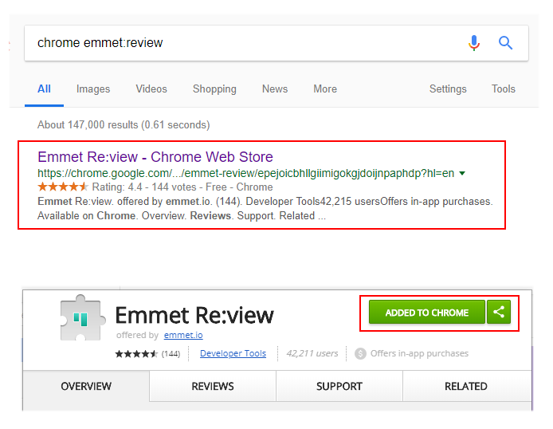
Emmet Re:view extension for Google Chrome
Displays multiple views of a web-page side-by-side
Enables you to inspect how a web page looks on different devices.

Slide 11
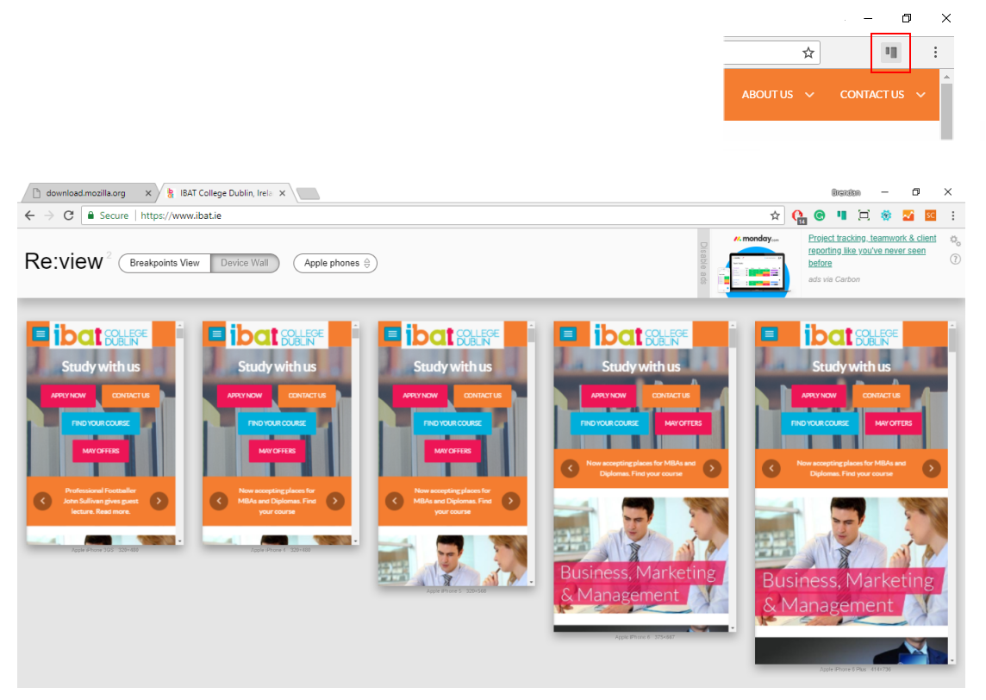
Emmet Re:view – Side-by-side views

Slide 12
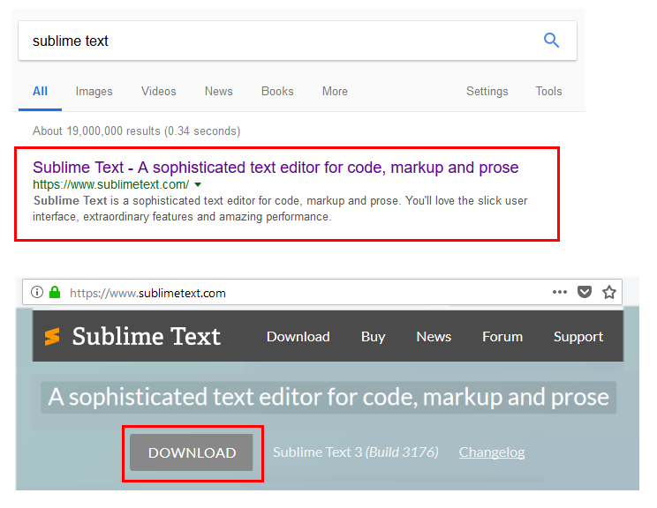
Sublime Text: HTML and CSS Editor
Cross-platform code editor
Extensible with free and paid plugins
Free-to-evaluate
Other code editor options:
VSCode
Atom
Brackets

Slide 13
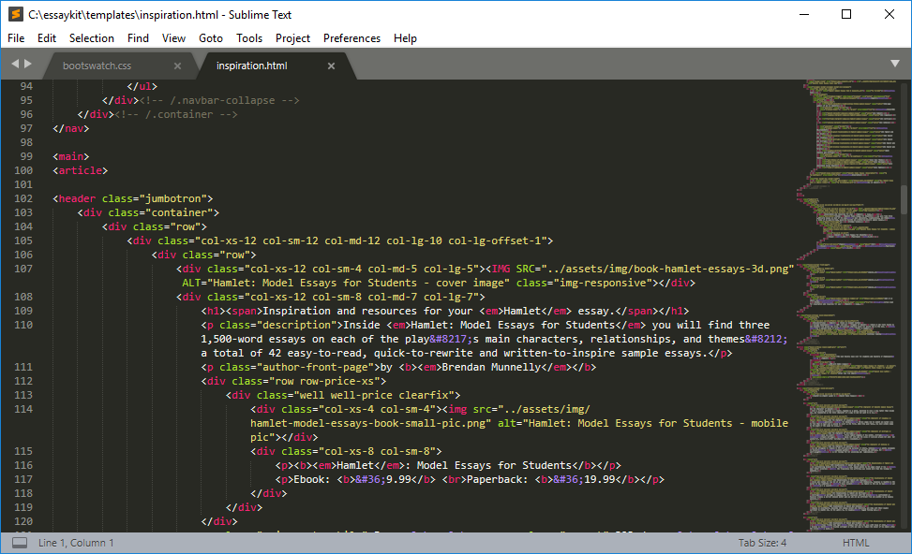
Sublime Text: Workspace

Slide 14
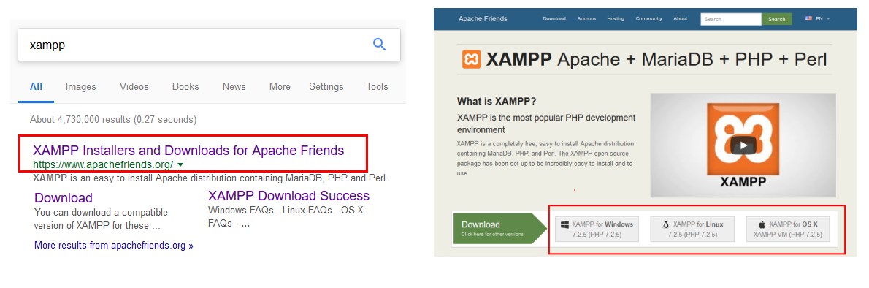
Apache Webserver (as part of XAMPP package)

Slide 15
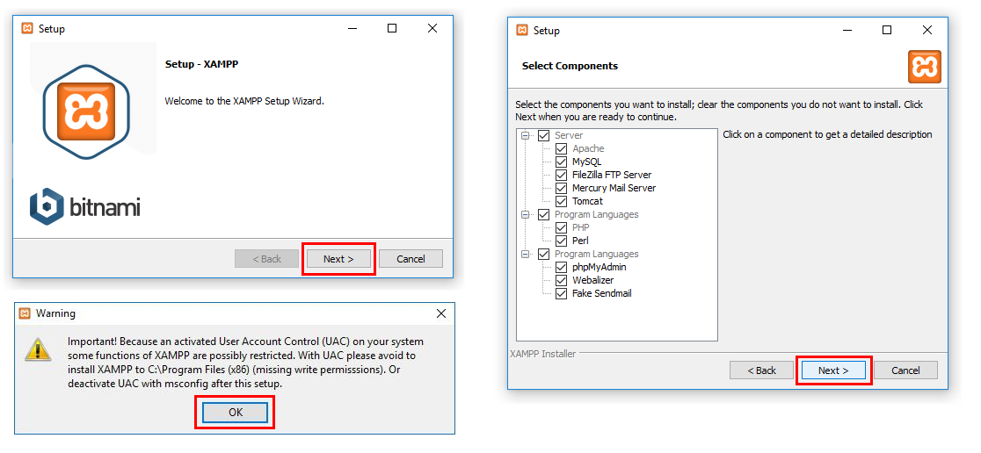
Installing XAMPP

Slide 16
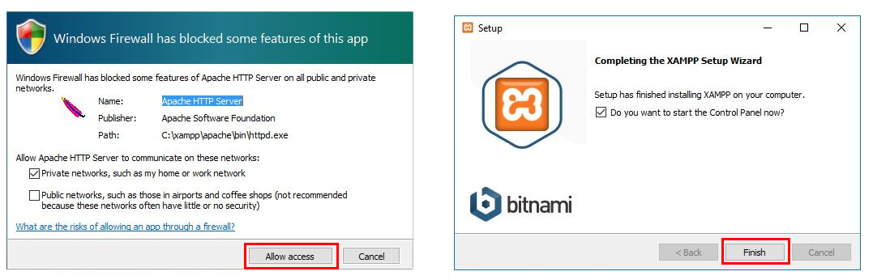
Installing XAMPP: continued

Slide 17
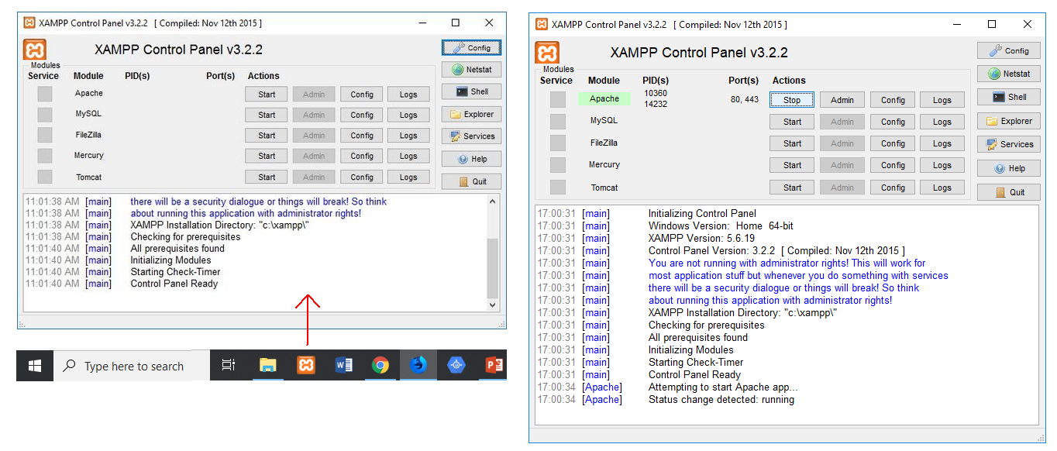
Running XAMPP

Slide 18
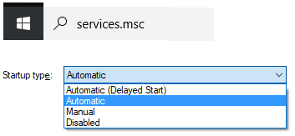
XAMPP Issues: Windows Services and Port 80
Apache needs access to port 80. But this maybe blocked by certain MS Windows 'services' that run automatically on start-up. These services are not needed for normal Windows functionality. You can safely disable them.
1: Start | services.msc
2: Locate the following services:
SQL Server Reporting Services (ReportServer)
Web Deployment Agent Service (MsDepSvc)
BranchCache (PeerDistSvc)
Sync Share Service (SyncShareSvc)
World Wide Web Publishing Service (W3SVC)
Internet Information Server (WAS, IISADMIN)
Double-click Service, and change Startup Type to Disabled.

Slide 19

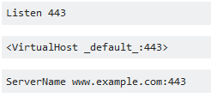


XAMPP: Change port number
From the XAMPP Control Panel, click Config for Apache.
Open httpd.conf file.
Ctrl+f to locate 80.
Replace 80 with 8080
Repeat procedure for httpd-ssl.conf file.
This time replace 443 with 4433.
To browse localhost web server, type:

