Slide 1
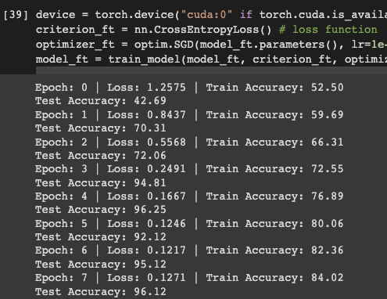
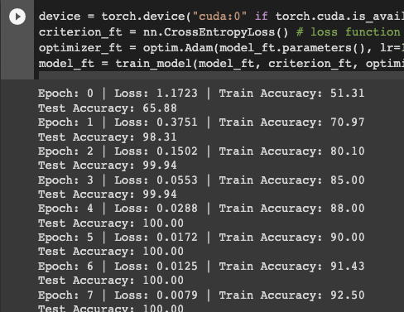
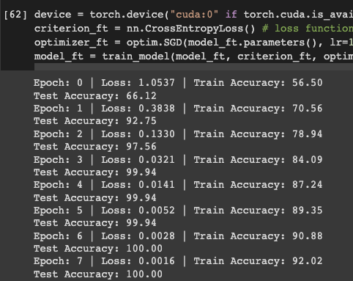
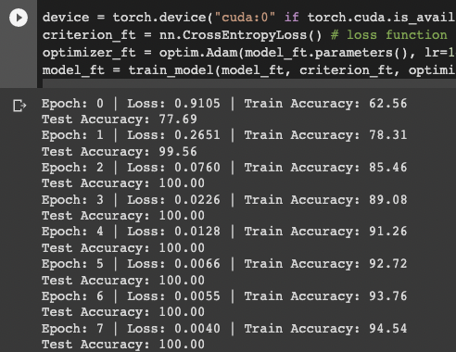
resnet18 : torch.Size([64, 3, 64, 64])
resnet18 : torch.Size([64, 3, 256,256])

Slide 2
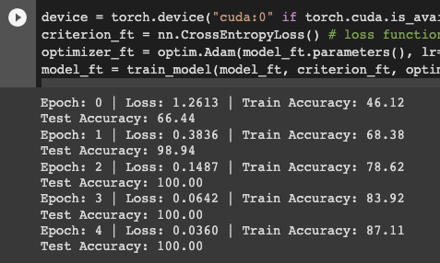
GoogLeNet : torch.Size([64, 3, 64, 64])
Notes:
Googlenet : torch.Size([64, 3, 64, 64])

