Slide 1
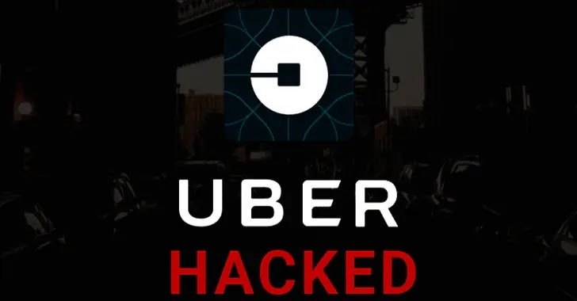
JOHN LEMUEL CUETO
ARIEL DE GUZMAN
WINONA GAILE DEONA
JOHN LOYD SALAZAR
STEVEN HERNANDEZ

Slide 2
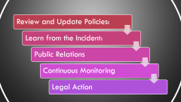
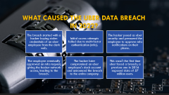
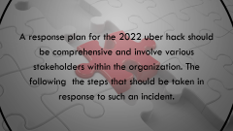
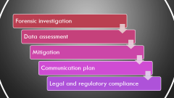
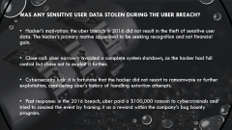
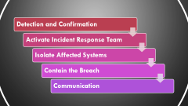

Slide 3

What Caused the Uber Data Breach in 2022?
The breach started with a hacker buying stolen credentials of an uber employee from the dark web.
Initial access attempts failed due to multi-factor authentication (mfa).
The hacker posed as uber security and pressured the employee to approve mfa notifications on their phone.
The employee eventually approved an mfa request, giving the hacker network access, leading to the breach.
The hacker later compromised an uber employee's slack account and announced the breach to the entire company.
This wasn't the first time uber faced a breach; a previous one in 2016 exposed data of 57 million users.

Slide 4

Was any Sensitive User Data Stolen During the Uber Breach?
Hacker's motivation: the uber breach in 2016 did not result in the theft of sensitive user data. The hacker's primary motive appeared to be seeking recognition and not financial gain.
Close call: uber narrowly avoided a complete system shutdown, as the hacker had full control but chose not to exploit it further.
Cybersecurity luck: it is fortunate that the hacker did not resort to ransomware or further exploitation, considering uber's history of handling extortion attempts.
Past response: in the 2016 breach, uber paid a $100,000 ransom to cybercriminals and tried to conceal the event by framing it as a reward within the company's bug bounty program.

Slide 5

A response plan for the 2022 uber hack should be comprehensive and involve various stakeholders within the organization. The following the steps that should be taken in response to such an incident.

Slide 6
Detection and Confirmation
Activate Incident Response Team
Isolate Affected Systems
Contain the Breach
Communication

Slide 7
Forensic investigation
Data assessment
Mitigation
Communication plan
Legal and regulatory compliance

Slide 8
Review and Update Policies:
Learn from the Incident:
Public Relations
Continuous Monitoring
Legal Action
Notes:
2. Review and Update Policies: Review and update cybersecurity policies and procedures to prevent future breaches. Conduct employee training on security awareness.
13. Learn from the Incident: Conduct a post-incident review to understand what went wrong and how the incident response can be improved. Use lessons learned to enhance overall cybersecurity resilience.
14. Public Relations: Maintain open and honest communication with the public to rebuild trust. Continuously update stakeholders on the progress of the response.
15. Continuous Monitoring: Implement continuous monitoring and threat detection to identify any signs of further breaches.
16. Legal Action: Consider pursuing legal action against the attackers if possible. 17. Prevent Recurrence: Continuously assess and improve security practices to prevent a recurrence of the breach.

Slide 9
THANK YOU

